Slide 1
CampusFix
Campus maintenance and IT support
DevOps capstone · Shreeya Reddy · Session 21
Notes:
Recording guide, 10–15 seconds: introduce CampusFix as a campus issue reporting and tracking application. Say the project name is CampusFix because the capstone rubric asks for the student's own application domain; TaskBoard is the reference starter, not the required product name.

Slide 2
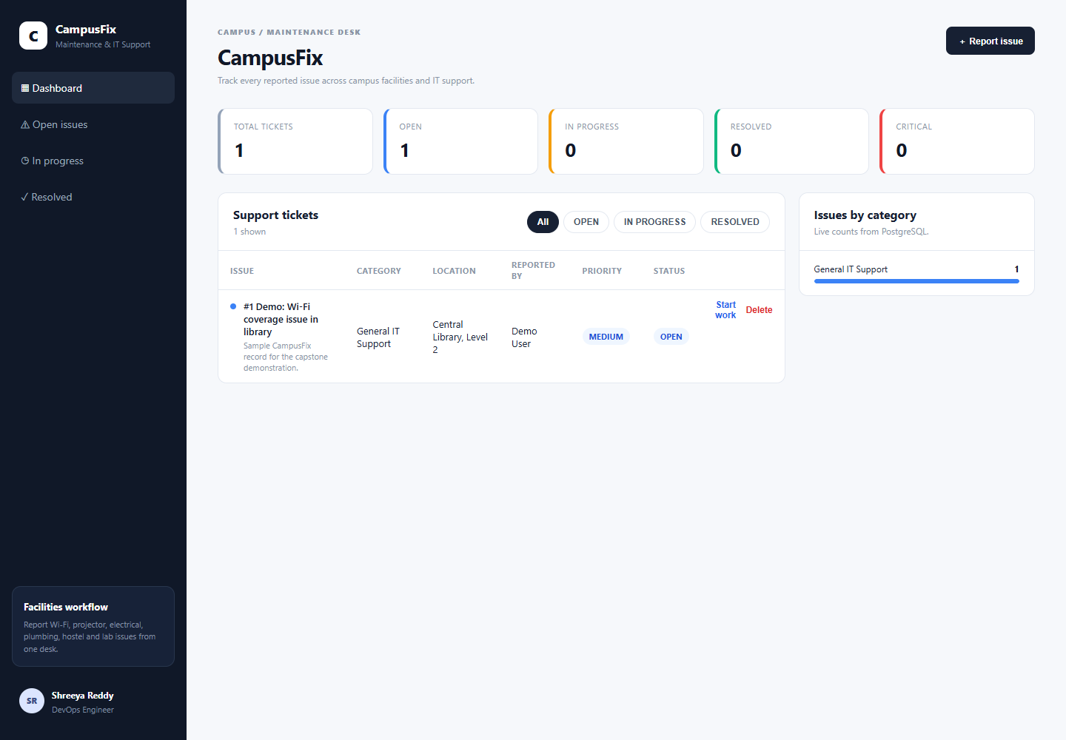
CampusFix turns campus issues into trackable tickets
Students and staff can report maintenance and IT problems, then follow each ticket through resolution.
Examples include Wi-Fi outages, classroom AV faults, plumbing, electrical issues, and lab equipment. The backend validates status changes: OPEN → IN_PROGRESS → RESOLVED.
Notes:
Recording guide, about 30 seconds: show the current Compose app in the browser. Explain the custom campus domain, then create one safe demo ticket if a live demonstration is required. The current image is evidence from the running Compose stack; screenshots 09 and 10 are older captures.

Slide 3
CampusFix service architecture
A browser request reaches the React frontend, passes through the API, and is stored in PostgreSQL.
Browser
React + Nginx
:3000
FastAPI
:8000
PostgreSQL 16
:5432
FastAPI /metrics → Prometheus → Grafana
Alembic manages the database schema; Docker Compose and Helm run the same application images.
Notes:
Recording guide, about 25 seconds: trace one ticket request from the browser to the API and PostgreSQL. Then explain that the /metrics endpoint is scraped by Prometheus and visualized in Grafana. Mention that Compose runs this locally and Helm deploys it to Kubernetes.

Slide 4
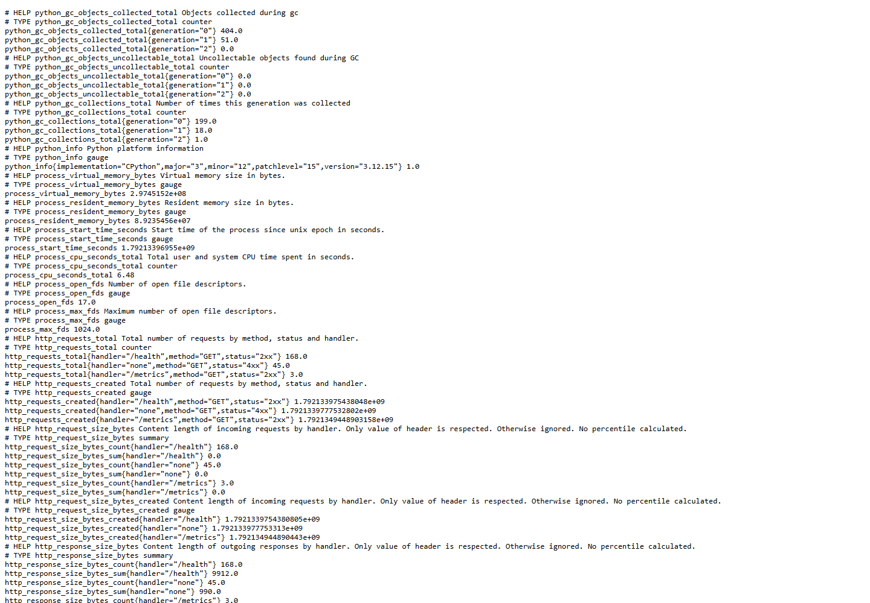
Application and test evidence
25 tests passed
FastAPI provides ticket create, list, read, update, and delete routes. PostgreSQL stores runtime data; tests use an isolated temporary database. The backend exposes Prometheus metrics at /metrics.
Capture a terminal view of pytest -v for the submission evidence.
Notes:
Recording guide, about 30 seconds: show the metrics endpoint screenshot, then switch to a real terminal and run `python -m pytest -v backend` from the repository root or the documented equivalent inside the backend container. The last local run passed 25 tests with two third-party deprecation warnings. Capture that terminal output separately; this deck image is not a terminal screenshot.

Slide 5
Linux and Docker run locally under WSL 2
Ubuntu 24.04 in WSL 2 hosts Docker Engine, Compose, and Minikube.
Docker Compose builds and runs three services: frontend, FastAPI backend, and PostgreSQL. Health checks hold the startup order so the API migrates only after the database is ready. Both application images run as non-root users.
The stack was rebuilt and validated from the Linux environment. The Windows Docker Desktop pipe was not used in this run.
Browser evidence: screenshot 14
Terminal capture of `docker compose up --build` is still required.
Notes:
Recording guide, about 25 seconds: explain that the Windows laptop runs Ubuntu through WSL 2 and Docker Engine inside that Linux environment. Show `docker compose ps` with the three healthy services, then the browser at localhost:3000. Capture `docker compose up --build` output separately for M4.

Slide 6
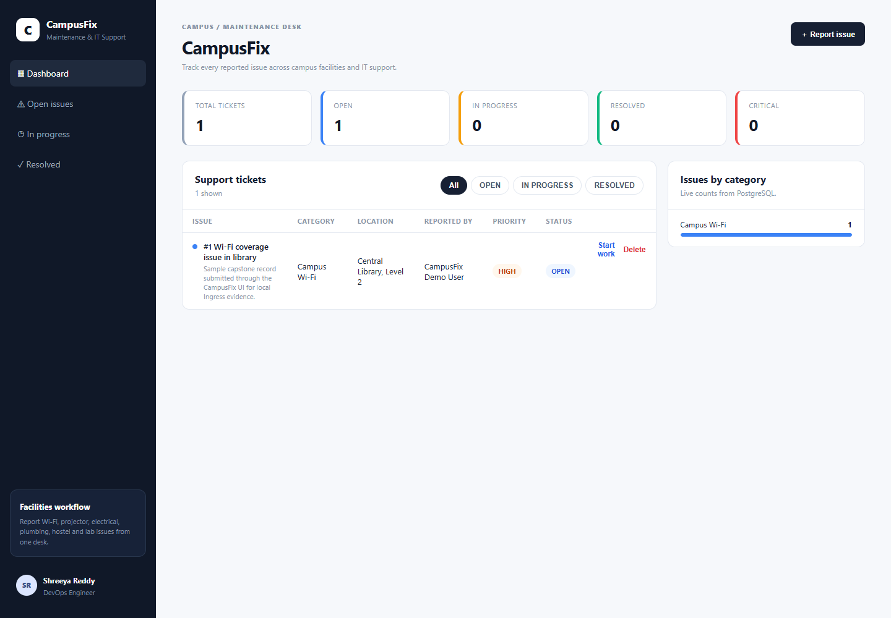
Kubernetes deployment with Helm
The CampusFix Helm release runs on local Minikube.
Two backend replicas
Two frontend replicas
One PostgreSQL pod
Ingress routes the browser and API traffic
Current capture: app reached through Ingress at localhost:8081. Terminal screenshots of pods, services, and Helm release are still required.
Notes:
Recording guide, about 35 seconds: show the application from the Minikube Ingress, then switch to the Linux terminal and show `kubectl get pods -n campusfix`, `kubectl get svc -n campusfix`, and `helm list -n campusfix`. The current local namespace has five app/database pods running. Capture all three terminal commands as separate rubric evidence.

Slide 7
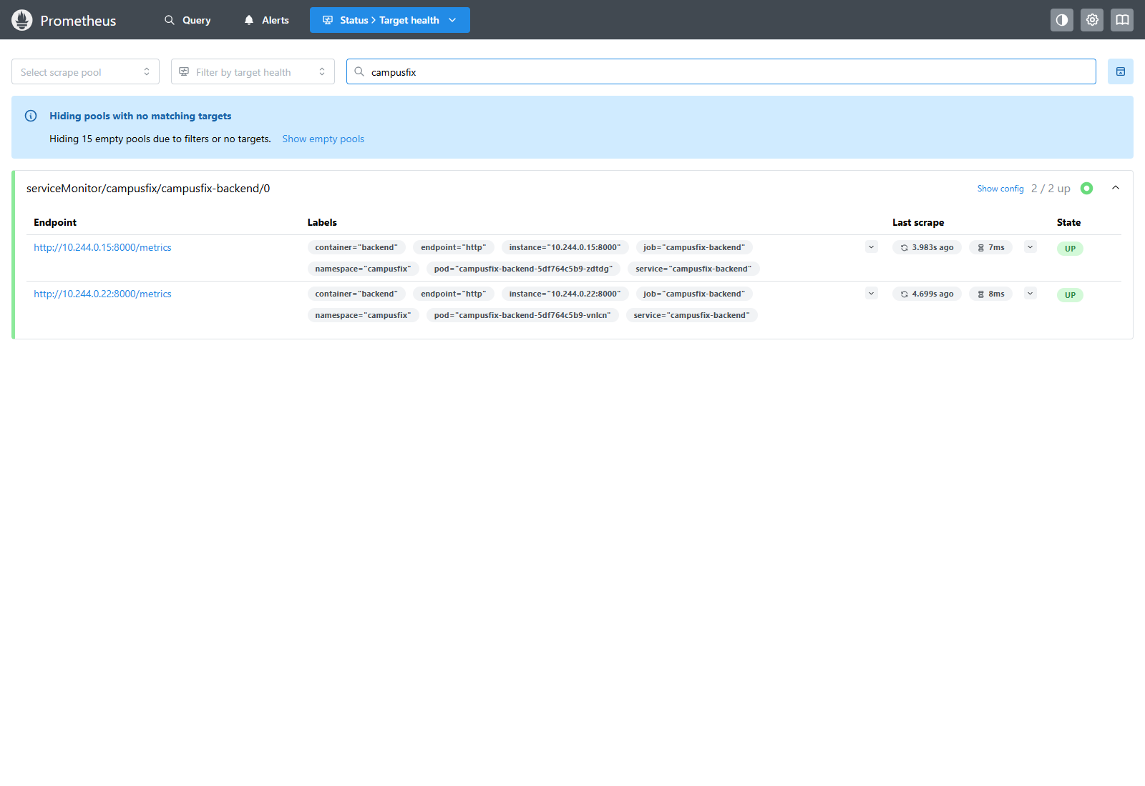
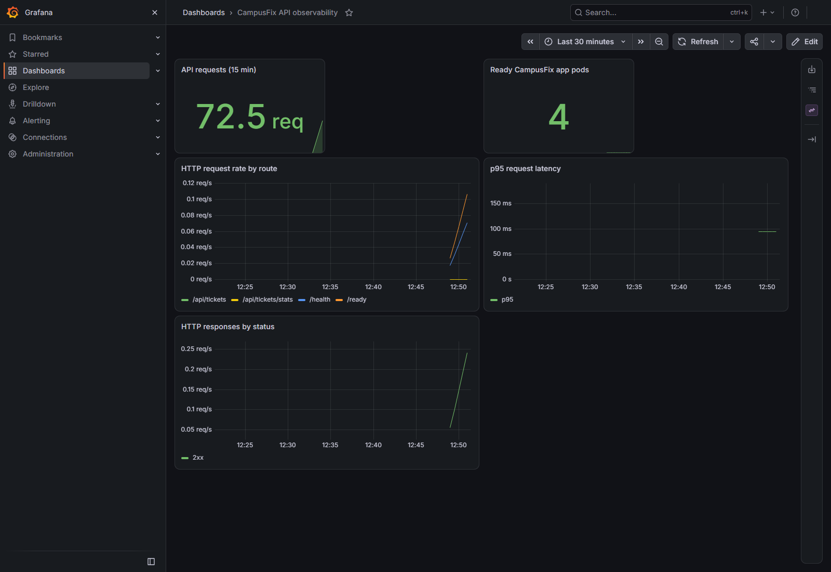
Prometheus and Grafana show live metrics
Prometheus: 2 / 2 backend targets UP. Grafana: five populated panels for request count, ready pods, route rate, p95 latency, and response status.
Notes:
Recording guide, about 35 seconds: show the Prometheus Targets page and point out both CampusFix backend targets are UP. Open the CampusFix Grafana dashboard and briefly explain the request, pod, route-rate, latency, and response-status panels. The `/metrics` page is on slide 4; for the rubric also capture the required `curl` output in the terminal.

Slide 8
CI and security status
Workflow stages
pytest → frontend build → backend + frontend images → Trivy gate → GHCR SHA tags → optional Helm deploy
No GitHub push or Actions run was made. GHCR publication and CI Trivy output are not yet verified; the workflow file is present and configured.
Local Trivy 0.76.0 scans found zero HIGH or CRITICAL vulnerabilities in either rebuilt image when unfixed findings were ignored.
Local Git history contains 64 commits. The live pipeline-and-deployment demo still needs a pushed change and reachable cluster credentials.
Notes:
Recording guide, about 40 seconds: describe the pipeline stages from the workflow file. Explain that local Trivy scans are clean for HIGH and CRITICAL findings, but distinguish those local results from the required Actions run output. Do not claim GHCR publication or a live pipeline run; no push was made. The M10 live demo remains outstanding until a change is pushed and deployment credentials are available.

Slide 9
Cloud deployment remains pending
Terraform configuration is present and `fmt`, `init`, and `validate` passed. There is no AWS account configured, so no plan, apply, EKS deployment, or destroy was performed.
For the recorded walkthrough: show the working app, Compose services, tests, Minikube Ingress, Prometheus, and Grafana. State clearly that the GitHub Actions run and AWS deployment are still pending.
CampusFix is a custom campus support application, not a TaskBoard clone.
Notes:
Recording guide, about 25 seconds: close by stating exactly what is done and what remains. Terraform configuration is validated, but the AWS account and infrastructure have not been set up. Do not say AWS or the GitHub pipeline is complete. The instructor expects the M10 demo to show a pushed change, pipeline run, and deployment update once those are available. End by inviting questions.

