Slide 1

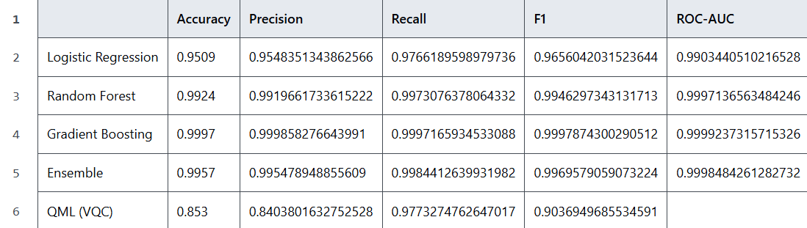
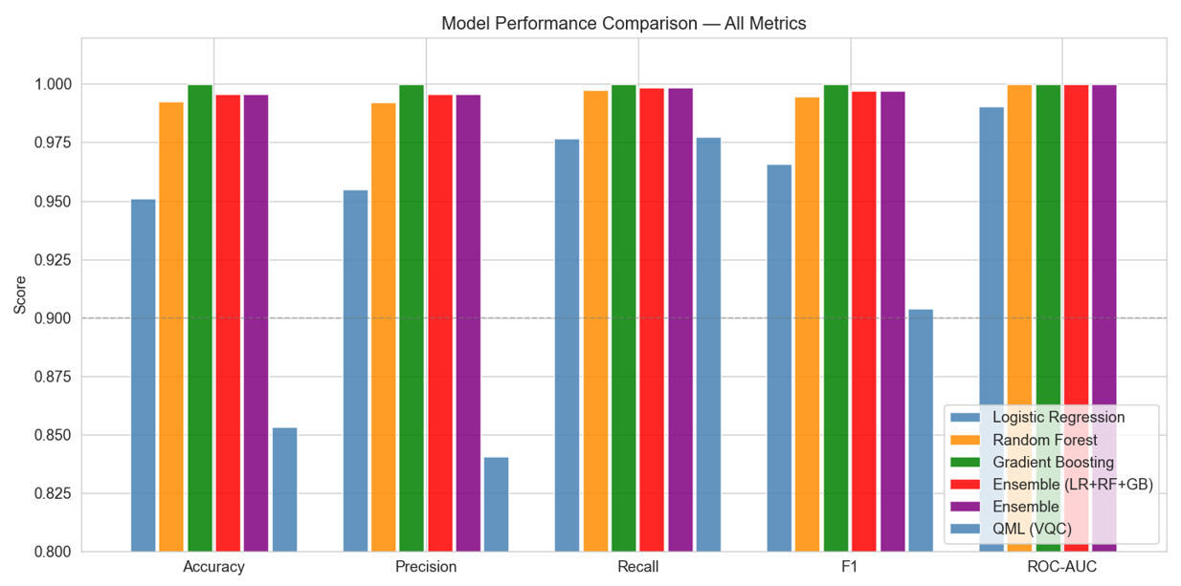
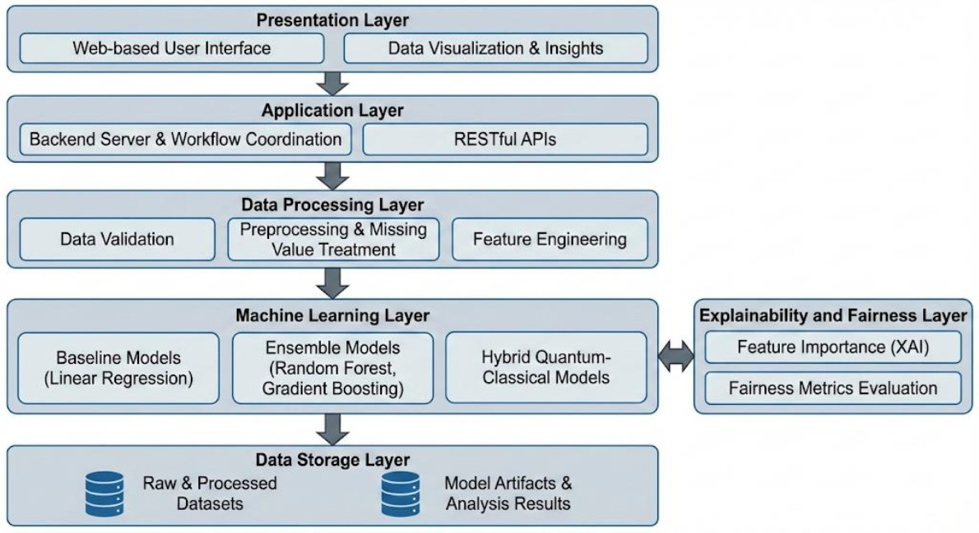

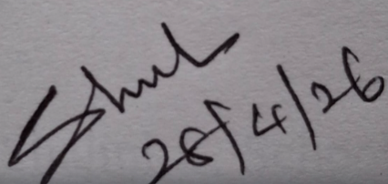
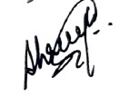
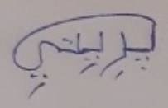
AI-Driven Detection of Wage Inefficiencies in Indian Industries
School of Computer Science and Engineering – Winter Semester 2025 - 26
Introduction
Results
Indian labour sectors face wage disparities due to weak enforcement and inefficient manual audits, creating a need for scalable, data-driven solutions. Existing work uses ML and legal NLP to analyse wage patterns but faces challenges in interpretability and data limitations. Key gaps include lack of end-to-end violation detection, enforcement factors and reliable policy diagnostics.
The developed system successfully identified underpaid workers by comparing actual wages with predicted fair wages. Classical ML models achieved strong baseline performance, while the Quantum ML model captured more complex feature interactions. The QML model showed comparable or slightly improved predictive accuracy in specific scenarios. Key factors influencing wage disparities included experience, skill level, industry type and region. The system provided interpretable insights into why workers were underpaid, supporting better decision-making. Overall, the results demonstrate the feasibility of using AII and QML for scalable and data-driven wage gap analysis.
Model Performance Comparison
Model Comparison Metrics
Motivation
Motivated by the need for a transparent and scalable system to detect wage inefficiencies beyond manual audits. Aims to improve trust and fairness by combining explainable AI with Quantum ML for better wage analysis.
Scope of the Project
The project focuses on developing an AI-driven system to analyse wage data and detect compensation gaps across Indian industries. It uses classical, ensemble and hybrid quantum-classical models to predict fair wages and compare performance. The system emphasizes fairness evaluation and model explainability. It is deployed as a web-based tool to support data-driven wage policy decisions without replacing legal processes.
Methodology
The system is structured into modular components covering data collection, preprocessing and exploratory analysis to prepare and understand wage datasets. Baseline and ensemble ML models are implemented to predict fair wages and analyse performance improvements. Wages were computed as:
Base Wage = Education-based wage + (Experience * 300),
with a 15% penalty applied for female workers to reflect observed labour survey trends.
A fairness evaluation module ensures bias detection, while an explainability module interprets model decisions. A Quantum Machine Learning module explores hybrid quantum-classical approaches for advanced prediction capabilities. Finally, reporting and visualisation modules present insights, wage gap detection results and recommendations through user-friendly dashboards.
System Architecture
The proposed system follows a layered architecture designed to support efficient wage analysis and prediction across Indian industries. At the top level, the presentation layer provides a web-based interface through which users can input worker details and visualize results. The application layer manages user requests and coordinates communication between the frontend and backend components through API calls.
The data processing layer prepares input data by handling missing values, encoding categorical variables, and normalizing features to ensure consistency. The processed data is then passed to the model layer, which includes baseline machine learning models, ensemble methods such as Random Forest and Gradient Boosting, and an exploratory hybrid quantum-classical model for advanced pattern recognition.
To improve transparency, an explainability component is integrated to identify key factors influencing wage predictions and highlight contributors to wage disparities. Finally, the output is presented through a visualization module that displays wage predictions, underpayment detection, and analytical insights. This architecture ensures scalability, interpretability, and effective decision support for labor policy analysis.
System Architecture Diagram
Discussions
The analysis shows that major labour law violations, particularly under the Minimum Wages Act, 1948 and Payment of Wages Act, 1936, impact the largest number of workers and lead to significant economic losses, while moderate issues persist in gender-related laws like the Equal Remuneration Act, 1976. most workers were found to violate multiple laws simultaneously (typically 2-3), indicating systemic non-compliance rather than isolated cases. Ensemble models effectively captured these patterns, with quantum models showing potential for deeper insights. Overall, the results confirm that wage inefficiencies are closely linked to legal non-compliance, highlighting the need for scalable, AI-driven monitoring systems.
Future Scope
The project can be extended by integrating real-time data, improving model accuracy with larger datasets and enhancing fairness through bias reduction . Future work may also include advanced quantum models, stronger legal NLP and scaling the system into a multilingual, real-time policy support tool for better labour law enforcement.
Conclusion
The project demonstrates that AI-based models can effectively identify wage inefficiencies by analysing labour data with quantum ML model capturing complex relationships beyond classical approaches. The results support the hypothesis that integrating QML enhances prediction depth and fairness in wage analysis. Key insights highlight the role of multiple socio-economic factors influencing wage disparities. Future work can focus on larger datasets, real-time deployment and improved quantum models for scalable and accurate wage monitoring.
References
[1]. Acemoglu, D., & Autor, D. (2011). Skills, tasks and technologies: Implications for employment and earnings. Handbook of Labor Economics, 4, 1043-1171.
[2]. Ahsan, A., & Pagés, C. (2009).
Demo Video Link:
Student Reg. No, Name: (22BCE0984) Preeti Ambwani, (22BKT0100) Shreeya Srivastava
Guide Name: Dr. Shalini L.

