Slide 1
THAMIZHI
Applicant Name : SHREEYAA SENTHILNATHAN
Domain : TAMIL WIKIPEDIA
Project Model : CHATBOT
Project Title : MUTHTHAMIZH

Slide 2
Problem Statement
Diverse Words and Language Elements
To overcome the difficulty of unknown old and pure tamil words, give accurate meanings, and chatbot builds an easier and efficient pathway.
To build knowledge on Thirukkural with accurate meanings.
To improvise the tamil literary knowledge and history.

Slide 3
Existing Solution
Existing solutions for Literal translation and literary analysis often struggle with contextual understanding, leading to inaccuracies, especially in idiomatic expressions and literary texts.
Chatbots doesn’t have all services in a single platform.
Tamil literature websites offer limited interactivity and user experience, requiring users to navigate multiple pages for information
The proposed "MUTHTHAMIZH" chatbot aims to fill these gaps by integrating translation, literary analysis, summarization, and document search functionalities, all tailored to the rich context of Tamil literature.

Slide 4
Proposed Solution
The “MUTHTHAMIZH” is a Chatbot which does the following services namely translates the English words to Tamil words and vice-versa, answers to the Questions related to the ancient Literatures, Epics, Stories, Poetries, Thirukkural and translates the Tamil words in those Literatures and provides its equivalent meanings. The Chatbot also does the Tamil Text Summarisation and Word Search in a Tamil Document is given to the Chatbot. The User Interface of the Chatbot has the document uploading option, microphone and output voice over feature which is enhanced with the elements and designs related to Tamil Literature.
The Technical Domains involved in this project includes NLP, AI, ML, Web Development.

Slide 5
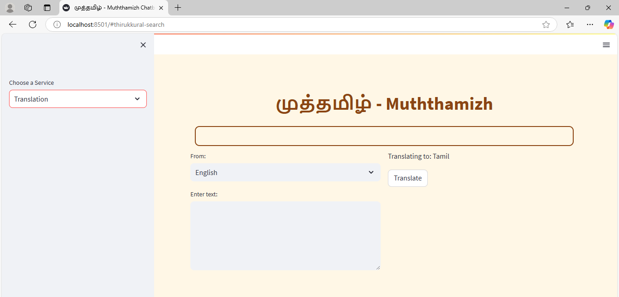
Prototype / Demo

Slide 6
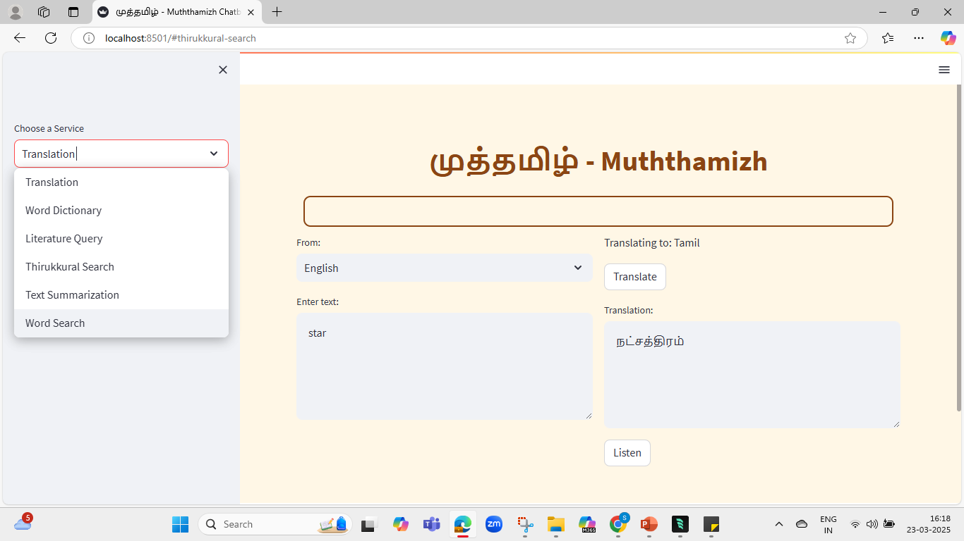
Prototype / Demo

Slide 7
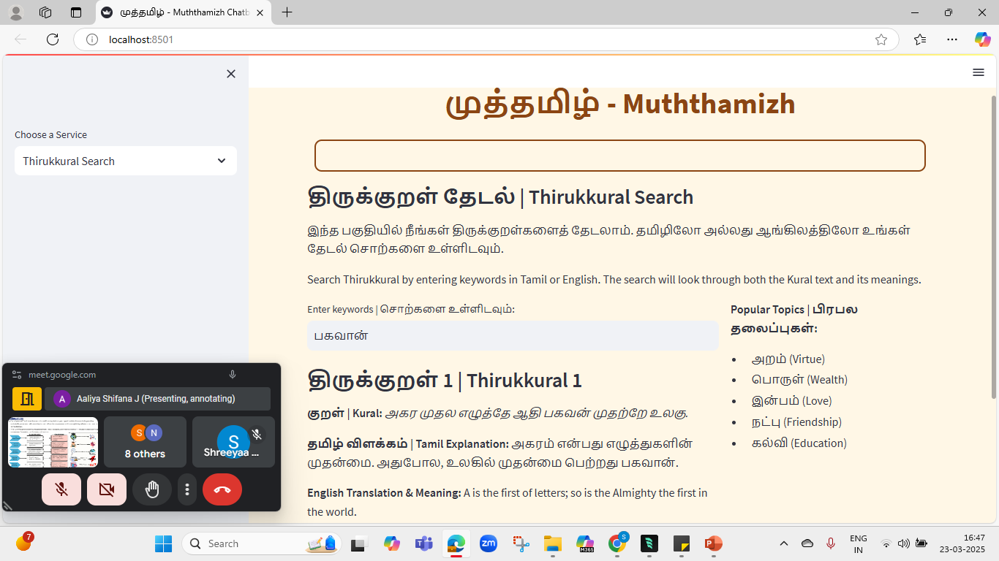
Prototype / Demo

Slide 8
Technical Aspects
Programming Language:
Python 3.x
Web Framework:
Streamlit (for web interface and UI components)
Key Libraries:
googletrans: For online translation services
gTTS (Google Text-to-Speech): For text-to-speech conversion
PyPDF2: For PDF file processing
NLTK: For natural language processing and text tokenization
deep-translator: For additional translation capabilities
sounddevice & soundfile: For audio processing
PIL (Python Imaging Library): For image handling
Data Storage:
JSON files for structured data storage:
thirukkural_data.json: Thirukkural verses and meanings
tamil_translations.json: Translation mappings
Features & APIs:
Text-to-Speech API (Google TTS)
Translation APIs (Google Translate)
Local dictionary implementation
PDF text extraction
Bilingual search functionality
UI Components:
Streamlit components:
Text inputs
Text areas
Buttons
Sidebars
Markdown rendering
Custom CSS for Tamil-themed styling
Data Processing:
Regular expressions for text processing
NLTK for sentence tokenization
JSON parsing and manipulation
Unicode support for Tamil text
Key Features:
Bilingual support (Tamil & English)
Real-time translation
Text-to-speech conversion
Thirukkural search engine
Literature query system
Word dictionary
Development Tools:
VS Code/Windsurf IDE
Git for version control
Python virtual environment

Slide 9
Done By
Applicant Name : SHREEYAA SENTHILNATHAN
Domain : TAMIL WIKIPEDIA
Project Model : CHATBOT
Project Title : MUTHTHAMIZH

Slide 10
பகவான்
கற்றல் அறிவு
அன்பு
குடியிருப்பு
வினை

