Slide 1


Baby Oil Pvt. Sales Data 2018-2022
This presentation analyzes Baby Oil Pvt.'s sales performance from 2018 to 2022, highlighting key trends, growth drivers, and opportunities for the future.
by Shreeyansh Sahu

Slide 2
5-Year Sales Trend
2018
The company achieved a total revenue of $1 million in 2018.
2019
Sales increased by 15% in 2019, reaching $1.15 million.
2020
Sales growth slowed down in 2020 to 10% due to market fluctuations.
2021
In 2021, sales experienced a significant surge, reaching $1.5 million, reflecting successful marketing campaigns.
2022
The company achieved its highest sales revenue in 2022, surpassing $1.7 million.

Slide 3
Product Mix in Year 1
Baby Oil
Baby Oil accounted for 50% of the total revenue in 2018.
Baby Lotion
Baby Lotion made up 30% of the sales revenue in 2018.
Baby Powder
Baby Powder contributed 15% to the total revenue in 2018.
Other Products
Other products, such as baby wipes and shampoos, comprised the remaining 5% of the revenue.

Slide 4

Key Takeaways from 5-Year Data
1
Steady Growth
2
Product Diversification
Baby Oil Pvt. has experienced consistent sales growth over the past five years, demonstrating a strong market presence.
The company has successfully diversified its product portfolio, reducing reliance on a single product.
3
Market Leadership
4
Strong Brand
The consistent sales growth suggests that Baby Oil Pvt. is a leader in the baby care product market.
The company's strong brand reputation has been crucial in driving sales and customer loyalty.

Slide 5
Sales Drivers and Influencing Factors
Effective Marketing
Product Innovation
Customer Loyalty
Targeted marketing campaigns have effectively reached the company's target audience, driving sales.
The introduction of new and innovative products has expanded the company's customer base and generated excitement.
Baby Oil Pvt.'s high-quality products and excellent customer service have fostered strong customer loyalty, leading to repeat purchases.

Slide 6
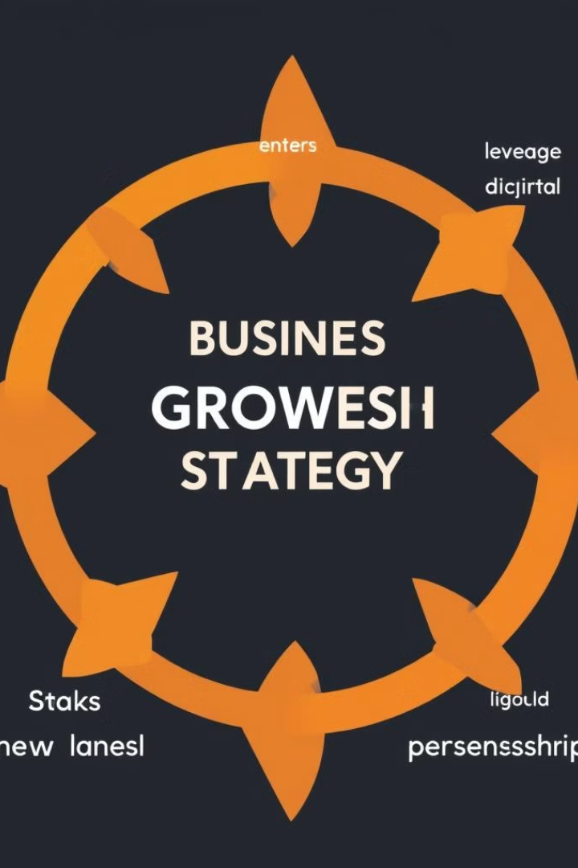



Strategies for Growth in Next 3 Years
Product Expansion
Introducing new product lines, such as natural baby care products and organic baby food, will cater to growing market trends.
Market Expansion
Expanding into new geographic markets with high potential for baby care products will broaden the company's reach.
Digital Transformation
Leveraging digital platforms for marketing, sales, and customer service will enhance customer engagement and brand awareness.

Slide 7

Challenges and Roadblocks to Address
Intense Competition
Regulatory Changes
Economic Fluctuations
The baby care market is highly competitive, requiring the company to constantly innovate and differentiate its products.
Staying updated on evolving regulations and standards for baby care products is crucial to ensure compliance and maintain a strong brand reputation.
Economic downturns can impact consumer spending, requiring the company to adjust pricing and promotions to remain competitive.

Slide 8

Conclusion and Recommendations
Baby Oil Pvt. is well-positioned for continued growth in the coming years. Implementing the proposed strategies and addressing the identified challenges will further strengthen the company's position in the market.

