Slide 1

CYBERSECURITY

Slide 2

TABLE OF CONTENTS
01
Introduction
04
Types of Security tools
02
Categories of Cyber crime
05
Advantage of Cybersecurity
03
Types of Cyber crime
06
Safety tips to Cyber crime

Slide 3

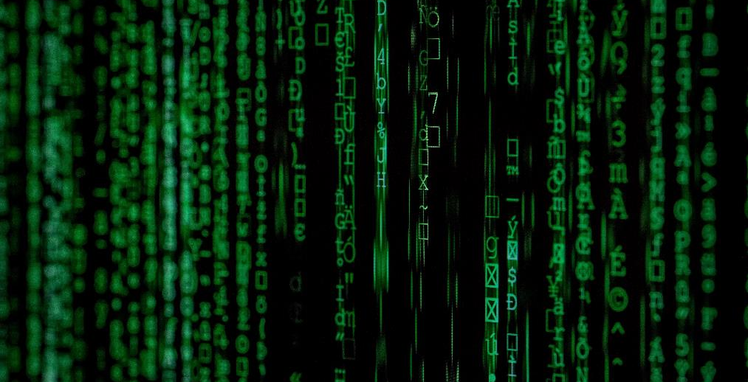
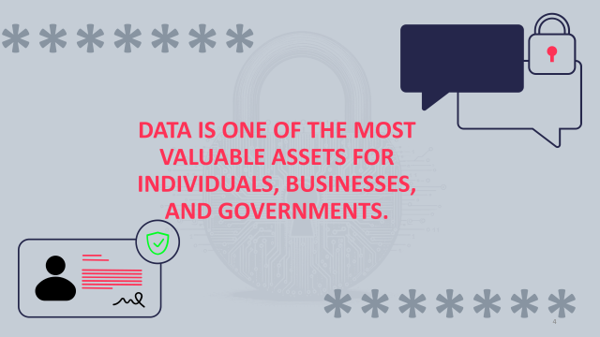
Introduction
The term cyber security is used to refer to the security offered through on-line services to protect your online information.
With an increasing amount of people getting connected to Internet, the security threats that cause massive harm are increasing also.

Slide 4
*******
DATA IS ONE OF THE MOST VALUABLE ASSETS FOR INDIVIDUALS, BUSINESSES, AND GOVERNMENTS.
*******

Slide 5

BEST PRACTICES TO AVOID THESE THREATS
01
Anti-virus software detects certain types of malware and can destroy it before any damage is done.
Make a big impact with professional slides, charts, infographics and more.
02
Install and maintain anti-virus and anti-spyware software.
Make a big impact with professional slides, charts, infographics and more.
03
Be sure to keep anti-virus software updated.
Make a big impact with professional slides, charts, infographics and more.

Slide 6

01
* * * *
No security measure is 100% reliable.
02
Even the best hardware fails.
Backup Important Information
03
What information is important to you?
04
Is your backup:
Recent?
Off-site & Secure?
Process Documented?
Encrypted?
Tested?

Slide 7
A STRONG CYBERSECURITY POSTURE FOSTERS TRUST AND CONFIDENCE

Slide 8
Avoid Hacker Tricks
Pop-up blockers do not always block ALL pop-ups so always close a pop-up window using the ‘X’ in the upper corner.
Be sure to have a good firewall or pop-up blocker installed.
Never click “yes,” “accept” or even “cancel.”
Infected USB drives are often left unattended by hackers in public places.

Slide 9
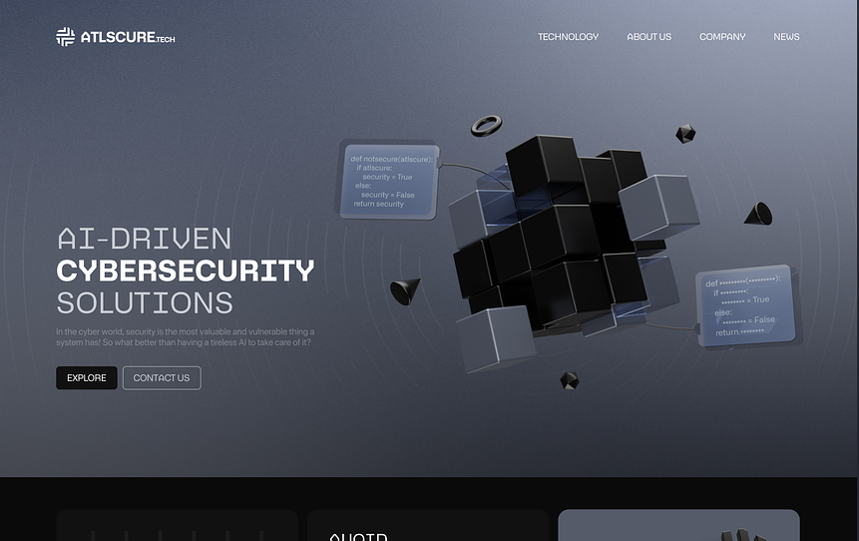
“Data privacy is a human right, and it belongs to you. Lock it down, protect it up, and block the hackers.” - A straightforward emphasis on individual data ownership and protection.

Slide 10

THANK YOU

