Slide 1
Competitive Landscape: non-small cell lung cancer (EU, 2023)
Report date: 2023-06-22 | Prepared by: Greta Lindholm

Slide 2
Market Overview
In the EU non-small cell lung cancer market, 4 brands compete for second-line+ patients as of Q4 2023. The segment is shaped by guideline updates, reimbursement decisions and real-world evidence.
The number of branded options in non-small cell lung cancer has grown since 2021, increasing pressure on standard of care positioning.
Notes:
Speaker note: market shares for 4 brands in EU.

Slide 3
Positioning: Keytrava
In the EU non-small cell lung cancer market, Keytrava maintains a 24% market share as of Q4 2023, with the strongest uptake among oncologists.
Sentiment index for Keytrava in EU: 0.38 (scale 0 to 1, 2023). Clinicians view the brand negatively; cost and formulary access remain barriers.

Slide 4
Positioning: Opdivra
In the EU non-small cell lung cancer market, Opdivra maintains a 32% market share as of Q1 2023, with the strongest uptake among oncologists.
Sentiment index for Opdivra in EU: 0.35 (scale 0 to 1, 2023). Clinicians view the brand negatively; payer prior-authorisation requirements slow initiation.

Slide 5
Positioning: Tagrisa
In the EU non-small cell lung cancer market, Tagrisa maintains a 31% market share as of Q3 2023, with the strongest uptake among oncologists.
Sentiment index for Tagrisa in EU: 0.79 (scale 0 to 1, 2023). Clinicians view the brand strongly positively; long-term safety data are still limited.

Slide 6
Positioning: Lumakro
In the EU non-small cell lung cancer market, Lumakro maintains a 14% market share as of Q2 2023, with the strongest uptake among oncologists.
Sentiment index for Lumakro in EU: 0.52 (scale 0 to 1, 2023). Clinicians view the brand moderately positively; cost and formulary access remain barriers.

Slide 7
Competitive Dynamics
Lumakro has been gaining ground since its 2020 approval for non-small cell lung cancer, pressuring Keytrava in first-line use.
Price competition, biosimilar entry and head-to-head evidence are expected to reshape formulary position over the next 24 months.
Clinical guidelines in United Kingdom recommend refractory disease use of agents in this class, and recent updates have broadened eligibility based on biomarker status and comorbidity profile.
Sequencing after progression remains an open question; oncologists in United Kingdom reported using a different mechanism of action after Keytrava fails.
Education needs include biomarker testing, management of adverse events and counselling patients on the expected benefit-risk.

Slide 8
Outlook
We expect continued consolidation in non-small cell lung cancer. Differentiation will depend on tolerability, dosing convenience and evidence of overall survival or clinical benefit.
Treatment burden, including monitoring visits and monitoring requirements, was described as a key factor in long-term adherence and persistence.
Peer-to-peer education and congress data were cited as the most trusted sources when oncologists evaluate new evidence on PD-1 inhibitor agents.
Patient advocacy groups are pushing for earlier access, and shared decision-making tools are being piloted to explain benefit, risk and treatment burden.

Slide 9
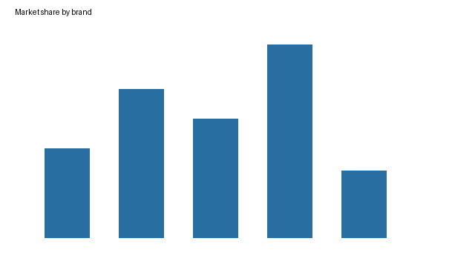

Slide 10
Disclaimer
Synthetic document generated for the Watson prototype. All brand names and figures are fictional.

