Slide 1
Therapy Area Landscape: Oncology (GLOBAL, 2024)
Report date: 2024-05-23 | Prepared by: Priya Venkat

Slide 2
Pipeline Overview
The oncology pipeline shows 9 late-stage assets targeting PD-1 and KRAS G12C pathways, creating significant competitive pressure on established biologics.

Slide 3
Marketed Landscape
Marketed brands include Keytrava, Opdivra, Tagrisa, Lumakro, Enhertra, Trodelvia, spanning EGFR-mutant NSCLC, HER2-positive breast cancer, KRAS G12C-mutant NSCLC, melanoma.

Slide 4
Key Takeaways
First-line positioning is contested in GLOBAL. Payer scrutiny and biosimilar competition continue to rise.
Mechanism of action differentiation and dosing convenience will drive prescribing.

Slide 5
Implications
Brand teams in Oncology should prioritise evidence for EGFR-mutant NSCLC and monitor phase 3 readouts through 2025.

Slide 6
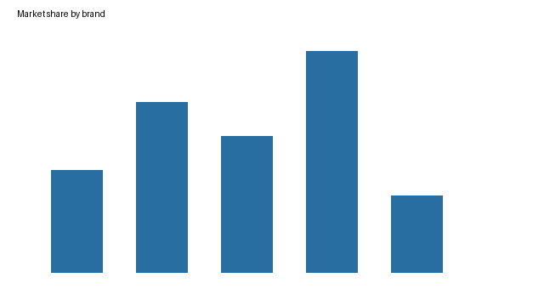

Slide 7
Disclaimer
Synthetic document generated for the Watson prototype. All brand names and figures are fictional.

