Slide 1


 | Nitte Meenakshi Institute of Technology (AN AUTONOMOUS INSTITUTION AFFILIATED TO VISVESVARAYA TECHNOLOGICAL UNIVERSITY, BELGAUM) PB No. 6429, Yelahanka, Bangalore 560-064, Karnataka Telephone: 080- 22167800, 22167860, Fax: 080 - 22167805
Department of Computer Science and Engineering
MOVIE RECOMMENDATION USING KNN ALGORITHM
Presentation By:
Shreeyut Shrestha (1NT18CS206)
Tej Narayan Chauhan (1NT18CS209)
Anish Pokhrel (1NT18CS191)

Slide 2
TABLE OF CONTENTS
 | Nitte Meenakshi Institute of Technology (AN AUTONOMOUS INSTITUTION AFFILIATED TO VISVESVARAYA TECHNOLOGICAL UNIVERSITY, BELGAUM) PB No. 6429, Yelahanka, Bangalore 560-064, Karnataka Telephone: 080- 22167800, 22167860, Fax: 080 - 22167805
Department of Computer Science and Engineering
Abstract
Introduction
Motivation
Problem statement
Aims and objectives
Data Set
Data pre processing
KNN algorithm
Output Screenshots
Conclusion
References

Slide 3
Abstract
 | Nitte Meenakshi Institute of Technology (AN AUTONOMOUS INSTITUTION AFFILIATED TO VISVESVARAYA TECHNOLOGICAL UNIVERSITY, BELGAUM) PB No. 6429, Yelahanka, Bangalore 560-064, Karnataka Telephone: 080- 22167800, 22167860, Fax: 080 - 22167805
Department of Computer Science and Engineering
This learning activity will entail designing a machine learning algorithm that uses the basic K Nearest Neighbors algorithm to find the most suitable movie recommendation for a particular individual based on their prior preferences.
We will be looking at the various identifiers in our library to identify key traits in those movies and also look at the features of the movies that the user has previously watched and liked to give them new movie choices that they have not viewed before.

Slide 4
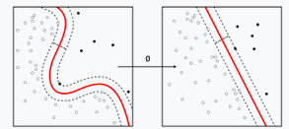
Introduction
 | Nitte Meenakshi Institute of Technology (AN AUTONOMOUS INSTITUTION AFFILIATED TO VISVESVARAYA TECHNOLOGICAL UNIVERSITY, BELGAUM) PB No. 6429, Yelahanka, Bangalore 560-064, Karnataka Telephone: 080- 22167800, 22167860, Fax: 080 - 22167805
Department of Computer Science and Engineering
Machine learning is the study of specific computer algorithm that can improve through either the efforts of random chance or with specific inputs of the programmer with the data that was provided to it.
It can be taken as a sub-genre of artificial intelligence as they are not essentially hard coded code but instead as this fluid entity that seeks to complete an objective with the closest output vector.

Slide 5
Introduction
 | Nitte Meenakshi Institute of Technology (AN AUTONOMOUS INSTITUTION AFFILIATED TO VISVESVARAYA TECHNOLOGICAL UNIVERSITY, BELGAUM) PB No. 6429, Yelahanka, Bangalore 560-064, Karnataka Telephone: 080- 22167800, 22167860, Fax: 080 - 22167805
Department of Computer Science and Engineering
Machine learning is closely related to computational statistics as we are trying to produce the model with the best fit to the data that we possess with trying to avoid issues such as over-fitting and under-fitting so that our algorithm can be used in almost all general use case topics that might come into the algorithms field.
Predictions are made using computers with mathematical optimization delivery methods. There are many algorithms that fit the bill to achieve this task. For our project we will be looking at K Nearest Neighbors algorithm to achieve our goals.

Slide 6
Problem Statement
 | Nitte Meenakshi Institute of Technology (AN AUTONOMOUS INSTITUTION AFFILIATED TO VISVESVARAYA TECHNOLOGICAL UNIVERSITY, BELGAUM) PB No. 6429, Yelahanka, Bangalore 560-064, Karnataka Telephone: 080- 22167800, 22167860, Fax: 080 - 22167805
Department of Computer Science and Engineering
Scope:
Create an object detection model specifically on human detection from drone footage.
The model needs to run on an NVidia Jetson TX2, and with minimum latency.
Objectives:
Find a model that is good at fine-grained object detection.
Fine tune the model on humans in drone footage.
Convert it to a format that can run efficiently on the specified machine.

Slide 7
Motivation
 | Nitte Meenakshi Institute of Technology (AN AUTONOMOUS INSTITUTION AFFILIATED TO VISVESVARAYA TECHNOLOGICAL UNIVERSITY, BELGAUM) PB No. 6429, Yelahanka, Bangalore 560-064, Karnataka Telephone: 080- 22167800, 22167860, Fax: 080 - 22167805
Department of Computer Science and Engineering
Our generation is the century of innovation and with that innovation comes a huge influx into each market that can use these new technologies.
Even with the current pandemic people have been producing high volumes of video format entertainment services that include movies, videos, streams etc.
With this newfound volume in the content that we can consume also comes the problem of endless choices to make in what we choose to entertain ourselves with.
To produce a simple solution to the problem we wish to classify each movie to their raw traits on their genre, topic, actors etc. so that we can correlate that data to what any particular user finds entertaining to produce a short list of incredibly likable movies for the user.

Slide 8
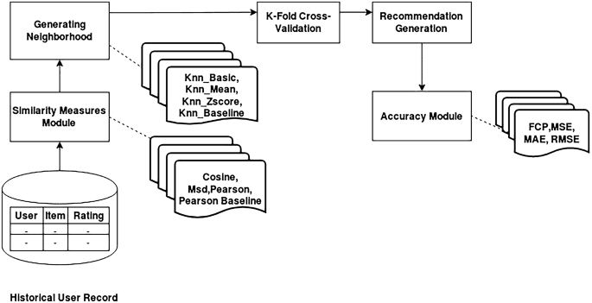
Design
 | Nitte Meenakshi Institute of Technology (AN AUTONOMOUS INSTITUTION AFFILIATED TO VISVESVARAYA TECHNOLOGICAL UNIVERSITY, BELGAUM) PB No. 6429, Yelahanka, Bangalore 560-064, Karnataka Telephone: 080- 22167800, 22167860, Fax: 080 - 22167805
Department of Computer Science and Engineering

Slide 9
Problem statement
 | Nitte Meenakshi Institute of Technology (AN AUTONOMOUS INSTITUTION AFFILIATED TO VISVESVARAYA TECHNOLOGICAL UNIVERSITY, BELGAUM) PB No. 6429, Yelahanka, Bangalore 560-064, Karnataka Telephone: 080- 22167800, 22167860, Fax: 080 - 22167805
Department of Computer Science and Engineering
We have the name and various features of a high selection of movies.
The task requires the data to be sifted through to find similar movies based on their genre, cast and other factors.
This information then must be cross referenced with the data on the movie that the user has chosen as movies they liked using the K nearest neighbors’ algorithm to find the closest movies in our raw data set.

Slide 10
Aims and objectives
 | Nitte Meenakshi Institute of Technology (AN AUTONOMOUS INSTITUTION AFFILIATED TO VISVESVARAYA TECHNOLOGICAL UNIVERSITY, BELGAUM) PB No. 6429, Yelahanka, Bangalore 560-064, Karnataka Telephone: 080- 22167800, 22167860, Fax: 080 - 22167805
Department of Computer Science and Engineering
Classify the movies in the data set according to their key attributes.
Make a model to find the best fit neighbor to the movies that the user has watched.
Figure out the key attributes in movies that the user finds entertaining i.e., what they prefer to watch
Process the raw data into movie, cast, ratings, tags, genre and others.

Slide 11
Data set
 | Nitte Meenakshi Institute of Technology (AN AUTONOMOUS INSTITUTION AFFILIATED TO VISVESVARAYA TECHNOLOGICAL UNIVERSITY, BELGAUM) PB No. 6429, Yelahanka, Bangalore 560-064, Karnataka Telephone: 080- 22167800, 22167860, Fax: 080 - 22167805
Department of Computer Science and Engineering
We will use the dataset from the Donate-a-cry campaign. The dataset is obtained from the following link ----------------------------------- https://grouplens.org/datasets/movielens/latest/
This dataset (ml-latest-small) describes 5-star rating and free-text tagging activity from Movie lens, a movie recommendation service. It contains 100836 ratings and 3683 tag applications across 9742 movies. These data were created by 610 users between March 29, 1996 and September 24, 2018. This dataset was generated on September 26, 2018.
The content in the file are as follows
UserID
MovieID
Ratings Data File Structure
Movie Data File Structure
Links Data File Structure

Slide 12

Data preprocessing steps
 | Nitte Meenakshi Institute of Technology (AN AUTONOMOUS INSTITUTION AFFILIATED TO VISVESVARAYA TECHNOLOGICAL UNIVERSITY, BELGAUM) PB No. 6429, Yelahanka, Bangalore 560-064, Karnataka Telephone: 080- 22167800, 22167860, Fax: 080 - 22167805
Department of Computer Science and Engineering
The following steps will be performed in data pre-processing in our project:
Getting the data: We will be getting our data from the aforementioned site group lens and we will be using the movie lens data that they have collected in the form of csv files.
Import libraries: Then we will proceed by importing the necessary libraries to process our information which will be
Pandas: The last library is the Pandas library, which is one of the most famous Python libraries and used for importing and managing the datasets. It is an open-source data manipulation and analysis library. It will be imported as below:

Slide 13

Data preprocessing steps
 | Nitte Meenakshi Institute of Technology (AN AUTONOMOUS INSTITUTION AFFILIATED TO VISVESVARAYA TECHNOLOGICAL UNIVERSITY, BELGAUM) PB No. 6429, Yelahanka, Bangalore 560-064, Karnataka Telephone: 080- 22167800, 22167860, Fax: 080 - 22167805
Department of Computer Science and Engineering
The following steps will be performed in data pre-processing in our project:
Import the dataset: Now we need to import the datasets which we have collected for our machine learning project. Now to import the dataset, we will use read_csv() function of pandas library, which is used to read a csv file and performs various operations on it. Using this function, we can read a csv file locally as well as through an URL.
We can use read_csv function as below:

Slide 14
Data preprocessing steps
 | Nitte Meenakshi Institute of Technology (AN AUTONOMOUS INSTITUTION AFFILIATED TO VISVESVARAYA TECHNOLOGICAL UNIVERSITY, BELGAUM) PB No. 6429, Yelahanka, Bangalore 560-064, Karnataka Telephone: 080- 22167800, 22167860, Fax: 080 - 22167805
Department of Computer Science and Engineering
The following steps will be performed in data pre-processing in our project:
Handle missing data: Then we can handle missing data so when we are creating our model it doesn’t run into any problems. The main ways to handle missing data are as follows:
Deleting the particular row: If a row contains some missing information, then we can just delete the entire row and carry on with our modelling.
By calculating the mean: If the missing value of the row is a non-discrete, continuous value then we can assign the missing value of the row as the mean of the entire column as it wont interfere with our calculations.
Encode the categorical data: The KNN machine learning algorithm works on the basis of mathematical approximation it would be suitable to encode the categorical data such as genre and tags as numerical representation for easy and quick computation.

Slide 15
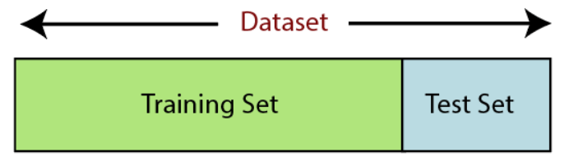
Data preprocessing steps
 | Nitte Meenakshi Institute of Technology (AN AUTONOMOUS INSTITUTION AFFILIATED TO VISVESVARAYA TECHNOLOGICAL UNIVERSITY, BELGAUM) PB No. 6429, Yelahanka, Bangalore 560-064, Karnataka Telephone: 080- 22167800, 22167860, Fax: 080 - 22167805
Department of Computer Science and Engineering
The following steps will be performed in data pre-processing in our project:
Split the data into training and test set: After all that we will have to decide what data from the data set will be used for the purpose of training the model and what portion will be used for testing the data set. For our purpose as we want to be as unbiased as possible, we will be using an arbitrary random selection of the data.

Slide 16
Data preprocessing steps
 | Nitte Meenakshi Institute of Technology (AN AUTONOMOUS INSTITUTION AFFILIATED TO VISVESVARAYA TECHNOLOGICAL UNIVERSITY, BELGAUM) PB No. 6429, Yelahanka, Bangalore 560-064, Karnataka Telephone: 080- 22167800, 22167860, Fax: 080 - 22167805
Department of Computer Science and Engineering
The following steps will be performed in data pre-processing in our project:
Feature scaling: For the purpose in the mathematical computation in the KNN algorithm we will be using the non-Euclidean distance between the values to generate the model to find the closest neighbor. Here we will standardize the independent variables in the data table to a specific range. This is performed so that no variable will dominate the other variable.

Slide 17
KNN Algorithm
 | Nitte Meenakshi Institute of Technology (AN AUTONOMOUS INSTITUTION AFFILIATED TO VISVESVARAYA TECHNOLOGICAL UNIVERSITY, BELGAUM) PB No. 6429, Yelahanka, Bangalore 560-064, Karnataka Telephone: 080- 22167800, 22167860, Fax: 080 - 22167805
Department of Computer Science and Engineering
In our project we will only be using one machine learning method that is K Nearest Neighbors algorithm. KNN algorithm is a non-parametric classification method that was first developed by Evelyn Fix and Joseph Hodges in 1951. It is an algorithm based around classification and regression. It takes the input that is the k closest to the training example from the data set.
The training examples are vectors in a multidimensional feature space, each with a class label. The training phase of the algorithm consists only of storing the feature vectors and class labels of the training samples.
In the classification phase, k is a user-defined constant, and an unlabeled vector (a query or test point) is classified by assigning the label which is most frequent among the k training samples nearest to that query point.

Slide 18
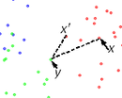
KNN Algorithm
 | Nitte Meenakshi Institute of Technology (AN AUTONOMOUS INSTITUTION AFFILIATED TO VISVESVARAYA TECHNOLOGICAL UNIVERSITY, BELGAUM) PB No. 6429, Yelahanka, Bangalore 560-064, Karnataka Telephone: 080- 22167800, 22167860, Fax: 080 - 22167805
Department of Computer Science and Engineering
A commonly used distance metric for continuous variables is Euclidean distance. For discrete variables, such as for text classification, another metric can be used, such as the overlap metric (or Hamming distance). In the context of gene expression microarray data, for example, k-NN has been employed with correlation coefficients, such as Pearson and Spearman, as a metric. Often, the classification accuracy of k-NN can be improved significantly if the distance metric is learned with specialized algorithms such as Large Margin Nearest Neighbor or Neighborhood components analysis.

Slide 19
KNN Algorithm
 | Nitte Meenakshi Institute of Technology (AN AUTONOMOUS INSTITUTION AFFILIATED TO VISVESVARAYA TECHNOLOGICAL UNIVERSITY, BELGAUM) PB No. 6429, Yelahanka, Bangalore 560-064, Karnataka Telephone: 080- 22167800, 22167860, Fax: 080 - 22167805
Department of Computer Science and Engineering
The best choice of k depends upon the data; generally, larger values of k reduce effect of the noise on the classification,[8] but make boundaries between classes less distinct. A good k can be selected by various heuristic techniques. The special case where the class is predicted to be the class of the closest training sample (i.e. when k = 1) is called the nearest neighbor algorithm.
The accuracy of the k-NN algorithm can be severely degraded by the presence of noisy or irrelevant features, or if the feature scales are not consistent with their importance. Much research effort has been put into selecting or scaling features to improve classification. A particularly popular approach is the use of evolutionary algorithms to optimize feature scaling.[9] Another popular approach is to scale features by the mutual information of the training data with the training classes.

Slide 20
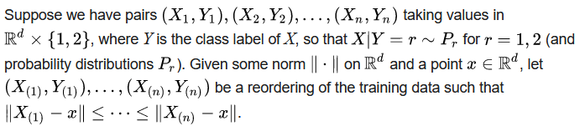
KNN Algorithm
 | Nitte Meenakshi Institute of Technology (AN AUTONOMOUS INSTITUTION AFFILIATED TO VISVESVARAYA TECHNOLOGICAL UNIVERSITY, BELGAUM) PB No. 6429, Yelahanka, Bangalore 560-064, Karnataka Telephone: 080- 22167800, 22167860, Fax: 080 - 22167805
Department of Computer Science and Engineering

Slide 21
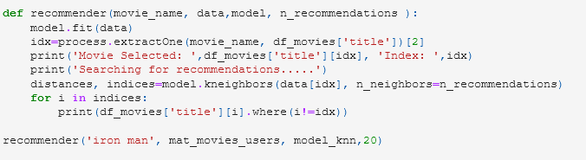
Output Screenshot
 | Nitte Meenakshi Institute of Technology (AN AUTONOMOUS INSTITUTION AFFILIATED TO VISVESVARAYA TECHNOLOGICAL UNIVERSITY, BELGAUM) PB No. 6429, Yelahanka, Bangalore 560-064, Karnataka Telephone: 080- 22167800, 22167860, Fax: 080 - 22167805
Department of Computer Science and Engineering
Here the model was generated and we got an accurate movie recommendation related to the movie liked by the exemplary user.

Slide 22
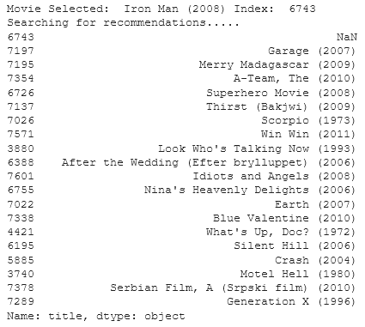
Output Screenshot
 | Nitte Meenakshi Institute of Technology (AN AUTONOMOUS INSTITUTION AFFILIATED TO VISVESVARAYA TECHNOLOGICAL UNIVERSITY, BELGAUM) PB No. 6429, Yelahanka, Bangalore 560-064, Karnataka Telephone: 080- 22167800, 22167860, Fax: 080 - 22167805
Department of Computer Science and Engineering
Iron man was taken as the movie of choice and the algorithm correctly identified its genre as action, adventure with some other tags such as superhero and other movies of similar time period as shown below.

Slide 23
Conclusion
 | Nitte Meenakshi Institute of Technology (AN AUTONOMOUS INSTITUTION AFFILIATED TO VISVESVARAYA TECHNOLOGICAL UNIVERSITY, BELGAUM) PB No. 6429, Yelahanka, Bangalore 560-064, Karnataka Telephone: 080- 22167800, 22167860, Fax: 080 - 22167805
Department of Computer Science and Engineering
Thus, the model that was generated was fairly accurate through our tests. It successfully identified key attributes in each of the movie in both the training sets and the movies that we chose to test it with to find exciting new movie recommendations for movies that weren’t just a carbon copy of the first movie. Instead, it recommended movies that had unique similarities to the given movie such as time period and others.
Our group learnt valuable new skills on the proper procedure for creating a machine learning algorithm. We especially found the proper way to handle the pre processing of data very important as it is the building block of the entire project and so has to be done absolutely by the book to make sure the algorithm is made without any underlying error from the data being bad.

Slide 24
References
 | Nitte Meenakshi Institute of Technology (AN AUTONOMOUS INSTITUTION AFFILIATED TO VISVESVARAYA TECHNOLOGICAL UNIVERSITY, BELGAUM) PB No. 6429, Yelahanka, Bangalore 560-064, Karnataka Telephone: 080- 22167800, 22167860, Fax: 080 - 22167805
Department of Computer Science and Engineering
Mitchell, Tom (1997). Machine Learning. New York: McGraw Hill. ISBN 0-07-042807-7. OCLC 36417892.A
The definition "without being explicitly programmed" is often attributed to Arthur Samuel, who coined the term "machine learning" in 1959, but the phrase is not found verbatim in this publication, and may be a paraphrase that appeared later. Confer "Paraphrasing Arthur Samuel (1959), the question is: How can computers learn to solve problems without being explicitly programmed?" in Koza, John R.; Bennett, Forrest H.; Andre, David; Keane, Martin A. (1996). Automated Design of Both the Topology and Sizing of Analog Electrical Circuits Using Genetic Programming. Artificial Intelligence in Design '96. Springer, Dordrecht. pp. 151–170. doi:10.1007/978-94-009-0279-4_9.www.javatpoint.com. 2022. Data Preprocessing in Machine learning - Javatpoint. [online] Available at: <https://www.javatpoint.com/data-preprocessing-machine-learning> [Accessed 17 January 2022].F. Maxwell Harper and Joseph A. Konstan. 2015. The MovieLens Datasets: History and Context. ACM Transactions on Interactive Intelligent Systems (TiiS) 5, 4: 19:1–19:19. https://doi.org/10.1145/2827872
Hu, J.; Niu, H.; Carrasco, J.; Lennox, B.; Arvin, F., "Voronoi-Based Multi-Robot Autonomous Exploration in Unknown Environments via Deep Reinforcement Learning" IEEE Transactions on Vehicular Technology, 2020.Jaskowiak, Pablo A.; Campello, Ricardo J. G. B. "Comparing Correlation Coefficients as Dissimilarity Measures for Cancer Classification in Gene Expression Data". Brazilian Symposium on Bioinformatics (BSB 2011): 1–8. CiteSeerX 10.1.1.208.993.A
Coomans, Danny; Massart, Desire L. (1982). "Alternative k-nearest neighbour rules in supervised pattern recognition : Part 1. k-Nearest neighbour classification by using alternative voting rules". Analytica Chimica Acta. 136: 15–27.

Slide 25
References
 | Nitte Meenakshi Institute of Technology (AN AUTONOMOUS INSTITUTION AFFILIATED TO VISVESVARAYA TECHNOLOGICAL UNIVERSITY, BELGAUM) PB No. 6429, Yelahanka, Bangalore 560-064, Karnataka Telephone: 080- 22167800, 22167860, Fax: 080 - 22167805
Department of Computer Science and Engineering
5. Zhou, Victor (2019-12-20). "Machine Learning for Beginners: An Introduction to Neural Networks". Medium. Retrieved 2021-08-15. Domingos 2015, Chapter 6, Chapter 7.
6. Jaskowiak, Pablo A.; Campello, Ricardo J. G. B. "Comparing Correlation Coefficients as Dissimilarity Measures for Cancer Classification in Gene Expression Data". Brazilian Symposium on Bioinformatics (BSB 2011): 1–8. CiteSeerX 10.1.1.208.993.
7. Coomans, Danny; Massart, Desire L. (1982). "Alternative k-nearest neighbour rules in supervised pattern recognition : Part 1. k-Nearest neighbour classification by using alternative voting rules". Analytica Chimica Acta. 136: 15–27.
Everitt, Brian S.; Landau, Sabine; Leese, Morven; and Stahl, Daniel (2011) "Miscellaneous Clustering Methods", in Cluster Analysis, 5th Edition, John Wiley & Sons, Ltd., Chichester, UK
Nigsch, Florian; Bender, Andreas; van Buuren, Bernd; Tissen, Jos; Nigsch, Eduard; Mitchell, John B. O. (2006). "Melting point prediction employing k-nearest neighbor algorithms and genetic parameter optimization". Journal of Chemical Information and Modeling. 46 (6): 2412–2422. doi:10.1021/ci060149f.
Hall, Peter; Park, Byeong U.; Samworth, Richard J. (2008). "Choice of neighbor order in nearest- neighbor classification". Annals of Statistics. 36 (5): 2135–2152. arXiv:0810.5276. Bibcode:2008arXiv0810.5276H. doi:10.1214/07-AOS537. S2CID 14059866.

