Slide 1
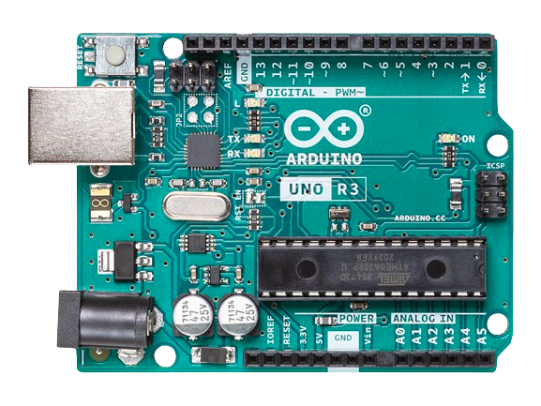
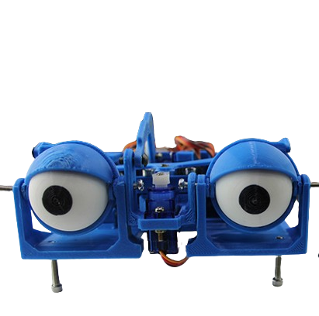
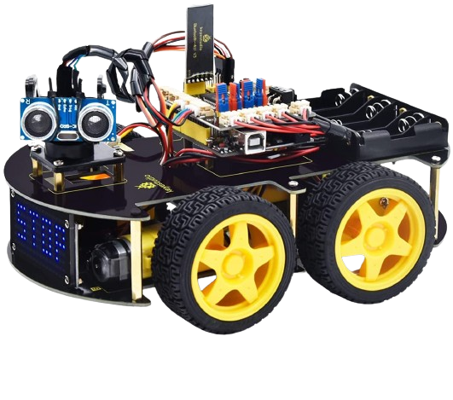
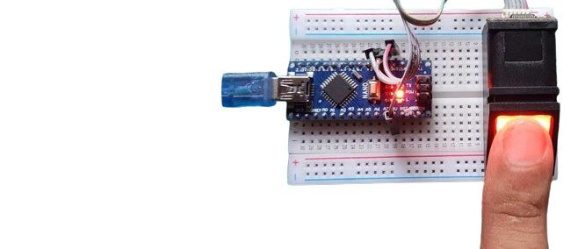
Welcome to Arduino Course 101

Slide 2
- what is an embedded sytem
- what is arduino, capabilites, and types
- UNO board layout overview - Arduino IDE layout (what is compilation / flashing)
- Basic programming (variables, function, loops, conditional statements, datatypes, operators)
- Binary systems
- pulse width modulation in general (implementation and disadvntages)
- arduino functions: digital/analog read/write, pinmode, delays, delaymicroseconds,>
- LED, resistors, ohms low, PULLUP/PULLDOWN resistors, button, button as toggle, breadboard.
- sensors ultrasonic, ir, light, humidity, temperature, buzzers, sound, color sensor ...)
- potentiometer
- motors: dc motors and motor drivers, servo motors and libraries.
- serial communication, serial monitor and serial plotter
- possibly LCD screen
- possible light dependent resistor LDR (sun tracking project)

Slide 3
Introducing
RISE

Slide 4
Course overview(1)
Objectives:
Learn to use Arduino board
- Layout
- Programming
- common sensors.
- common actuators.
Learn by building, some electronic concepts and circuits.
Gain searching skills for new topics and applying them.

Slide 5
Course overview(2)
Content:
- what is an embedded systems
- what is arduino, capabilites, and types
- UNO board layout overview - Arduino IDE layout (what is compilation / flashing)
- Basic programming (variables, function, loops, conditional statements, datatypes, operators)
- Binary systems
- Pulse Width Modulation (software and hardware.)
- Arduino functions: digital/analog read/write, pinmode, delays,...
- LED, resistors, ohms low, PULLUP/PULLDOWN resistors, button, button as toggle, breadboard.
- sensors: ultrasonic, ir receiver/transmitter, light, humidity, temperature, buzzers, sound, color sensor ...)
- potentiometer
- motors: dc motors and motor drivers, servo motors and libraries.
- serial communication, serial monitor and serial plotter
- possibly LCD screen
- possible light dependent resistor LDR (sun tracking project)

Slide 6
Session 1 breakdown
Embedded systems and why to learn it.
What is Arduino board? types and capabilities.
Arduino IDE.
Using digital pin and blinking on board LED.
Electronics basics (LED, resistor, Breadboard, Jumper wires, Caps and Trans).
Blinking external LED.
Traffic Light.
Software PWM.
Modes to power Arduino.

Slide 7
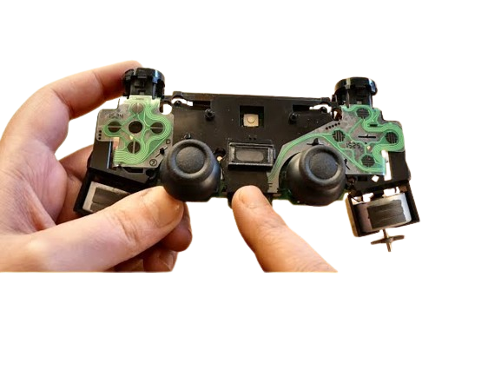
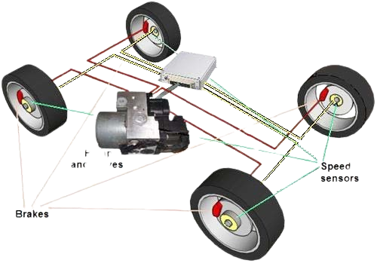
What is meant by embedded systems?
An embedded system is a combination of hardware and software integrated as a part of a bigger systems or standalone systems, and can execute a specific function.

Slide 8
Why Learn Arduino (embedded programming)
Introduction to programming and electrical engineering.
An easy solution for complex tasks and projects.
An interesting and creative hobby

