Slide 1
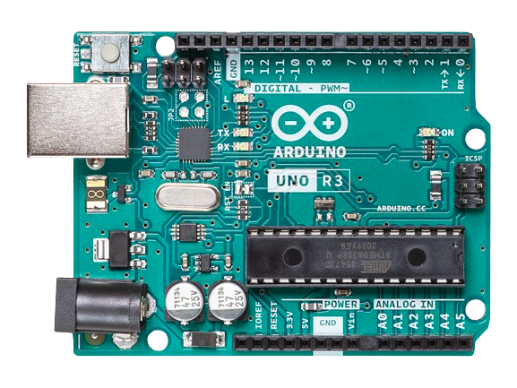
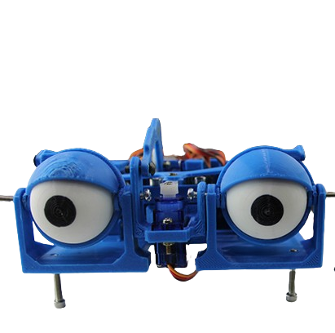
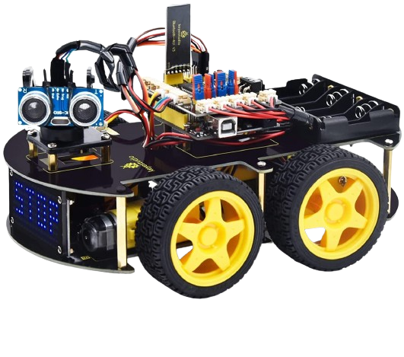
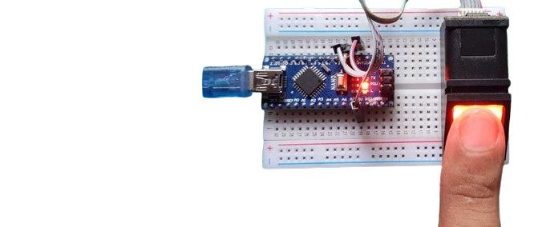
Welcome to Arduino Course 101

Slide 2
Course overview (1)
Course breakdown:
topic
topic
topic
topic
topic
topic
topic
topic
topic

Slide 3
Course overview (2)
Projects
project
project
project
project
project

Slide 4
What is meant by embedded systems?
An embedded system is a combination of hardware and software integrated as a part of a bigger systems or standalone systems, and can execute a specific function.

