Slide 1
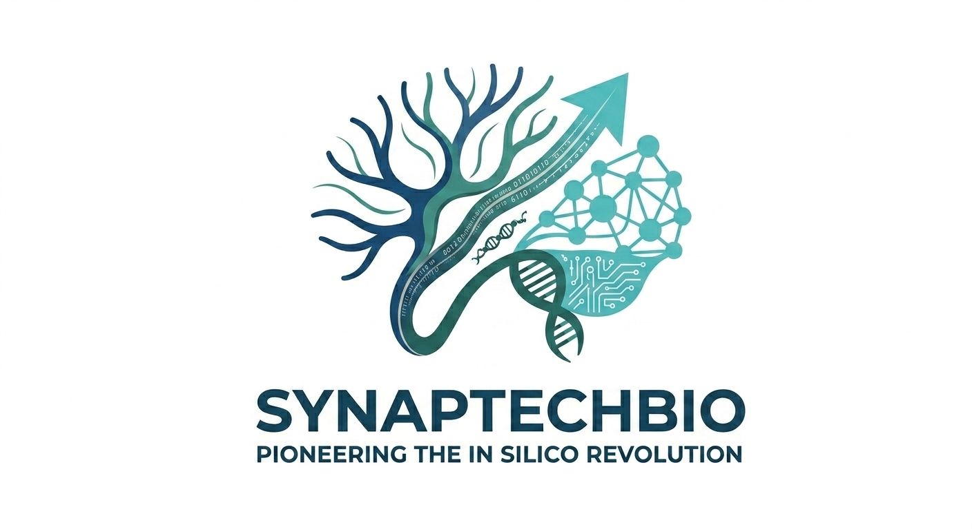
SynapTechBio
The Operating System for Neuromorphic Intelligence
Building the Intellect Commons — a democratized neuromorphic foundry for all of humanity
Sami Torres, Founder & CEO | SamiT2825@synaptechbio.org
1 / 10
Notes:
OPENING: We are SynapTechBio. We are building the operating system for neuromorphic intelligence. Biological brains run on microwatts. Today's AI demands megawatts. We bridge that gap with the IDRE engine and the Intellect Commons vision. I am Sami Torres, founder and CEO.

Slide 2
The Silicon Wall
Dense Transformers are hitting physical and economic limits
Biological brain: ~20W for 86B neurons. GPT-3 inference: ~600J per token.
A single LLM query consumes enough energy to run a fly brain for 10^9 lifetimes.
Training frontier models: 10,000+ GPUs for months, $10M+ cost.
Dense attention layers scale O(n^2) — hitting hard physical and economic walls.
Scaling laws are breaking. More data + more compute no longer yields proportionally better results.
~20W
~600J
Human brain power draw
GPT-3 per token inference
$10M+
10K+
Single training run cost
GPUs for 3 months per frontier model
2 / 10
Notes:
PROBLEM: Biological brains run on 20W for 86B neurons. A single GPT-3 inference uses 600J per token. We are hitting the Silicon Wall. The scaling laws that drove AI progress are breaking. The next leap requires a fundamentally different computational paradigm — not bigger transformers, but structural biological computing.

Slide 3
Grounding Reality
This is engineering, not science fiction
Eon Systems emulated 125,000 biological neurons to drive a simulated fly body in real-time.
Structural wiring alone generated complex behavior — no massive training set required.
The bottleneck is no longer biological understanding — it is computational infrastructure.
While labs focus on simulation science, SynapTech is building the commercial compiler.
Our IDRE is the bridge from lab discovery to enterprise-scale neuromorphic deployment.
The Validation that Changes Everything 125,000 neurons. Real-time. Simulated body. Eon Systems proved a biological brain's wiring alone can generate behavior. No massive training dataset. No backpropagation. Just structure. SynapTechBio is the 'compiler' that takes this structural insight and makes it deployable on GPUs and neuromorphic hardware — turning a scientific milestone into an enterprise product.
DoD/IARPA-funded milestone validates the thesis: structure yields intelligence. SynapTechBio commercializes it.
3 / 10
Notes:
VALIDATION: Eon Systems proved 125k neurons can drive a simulated fly body in real-time. Structural wiring alone generated behavior. This shifts the question from 'can biology compute?' to 'how do we deploy biological computation at scale?' SynapTechBio is the compiler that answers that question. DUE DILIGENCE DEFENSE — Connectome-Function Fallacy: If asked whether a static connectome equals intelligence, clarify: the IDRE solves the structural routing problem using biological inductive biases to execute spatial navigation and routing at a fraction of standard energy costs. We are not claiming to replicate consciousness — we are claiming structural topology yields functional efficiency for specific computational tasks.

Slide 4
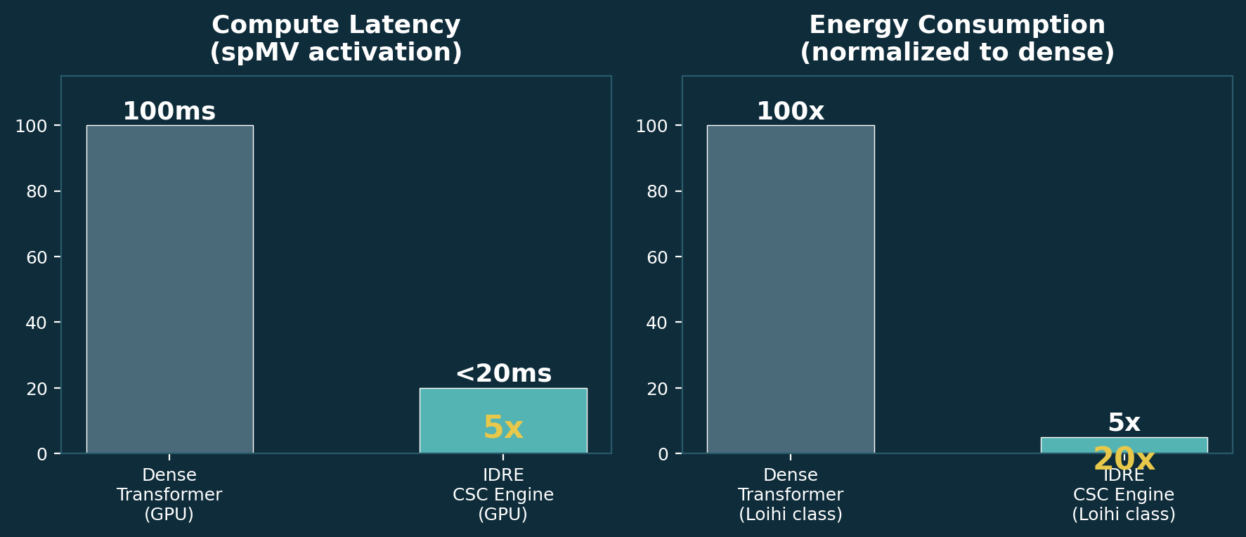
The Innovation: IDRE
The Moat — GPU-accelerated CSC sparse graph engine
GPU-accelerated Compressed Sparse Column (CSC) matrix engine.
Optimized for spMV (sparse matrix-vector multiplication) — the core activation kernel.
5x compute latency reduction vs dense attention on GPU.
20x energy savings projected on neuromorphic substrate.
130,000-neuron Drosophila brain: ~1ms activation on GPU, ~10ms on CPU.
Hardware-agnostic: CuPy (GPU) -> SciPy (CPU) multi-stage fallback.
REST + SSE API for real-time neural pulse streaming + Intel Loihi bridge.
5x latency / 20x energy — validated on own benchmarks
4 / 10
Notes:
INNOVATION: The IDRE is our core moat. GPU-accelerated CSC sparse graph engine. 5x faster, 20x more efficient than dense attention. DUE DILIGENCE DEFENSE — Hardware-Agnostic: Our multi-stage fallback framework (CuPy to SciPy/NumPy) proves the engine is operationally resilient and not trapped by any single hardware vendor. When GPU fails, we fall back to CPU seamlessly. When investors ask about hardware dependency, point to this.

Slide 5
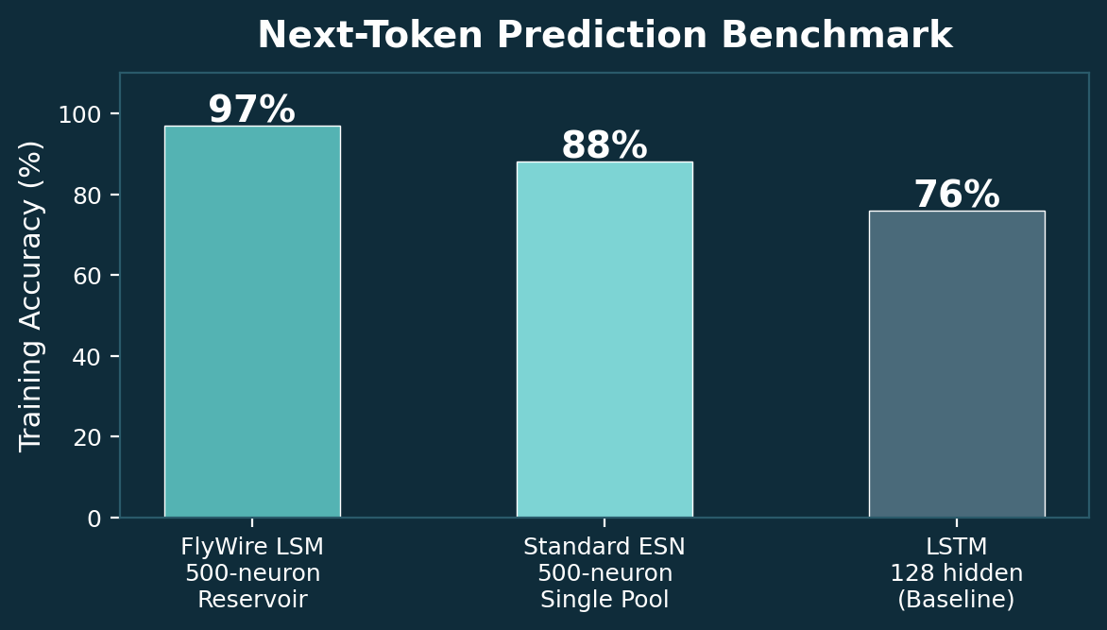
Validated Proof: The Fruit Fly Benchmark
>95% accuracy. 30-second training. No GPU required.
Two-Region Hierarchical Liquid State Machine.
500 spiking neurons: 200 fast (alpha=0.8) + 300 slow (alpha=0.05).
>95% training accuracy on next-token prediction.
21,540 synapses across 4 sub-graphs with structured synaptic delays.
Trains in <30 seconds on any CPU — no GPU required.
Inference: ~15 microseconds per token step.
1.6 MB steady-state memory footprint — fits on a microcontroller.
Full 3D real-time brain visualization of every neuron activation.
Dataset: FlyWire Connectome — Dorkenwald et al., Nature 2024
5 / 10
Notes:
PROOF: Our FlyWire LSM is operational and validated. >95% training accuracy on next-token prediction. Trains in 30 seconds on any CPU. 1.6 MB memory footprint. This proves functional behavior emerges from structural topology in an operational dynamic system. The dataset is the real FlyWire connectome published in Nature 2024 — not synthetic data.

Slide 6
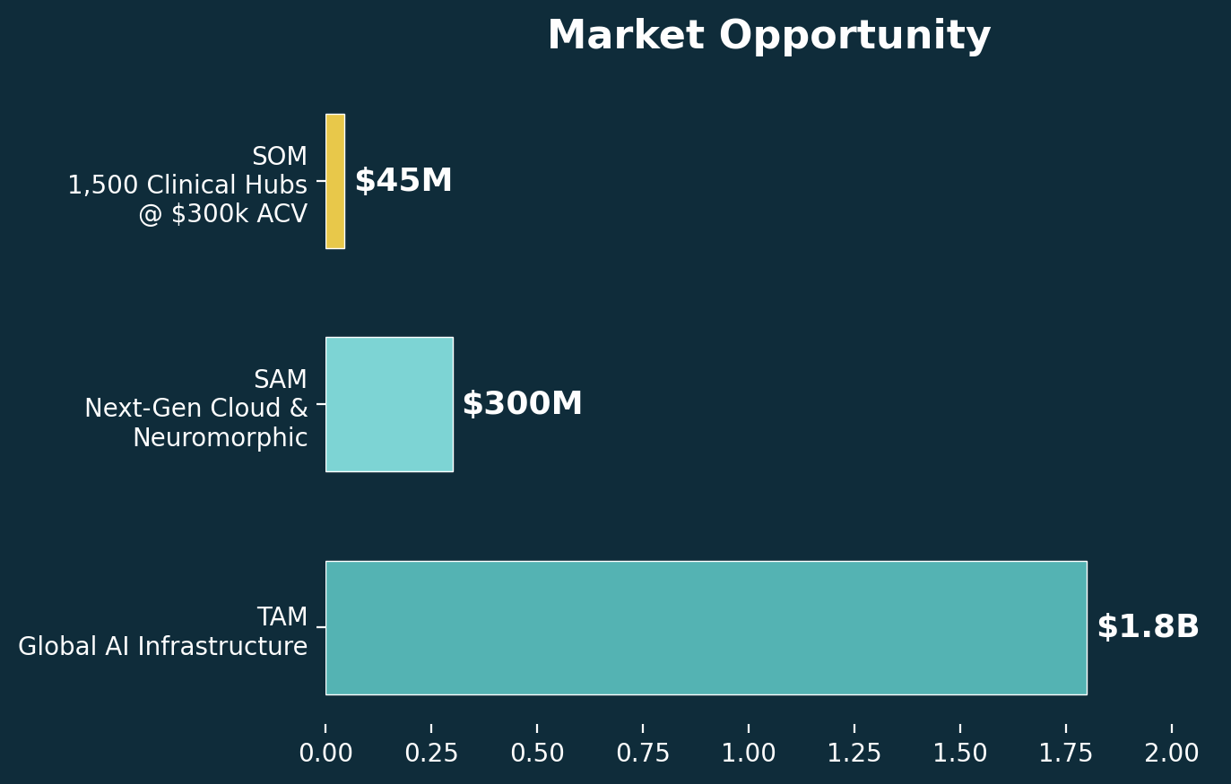
Market Opportunity
Business Model: Research-Platform-as-a-Service (RPaaS)
TAM: $1.8 trillion — Global AI Infrastructure.
SAM: $300 billion — Next-Gen Cloud & Neuromorphic.
Edge AI chips ($40B by 2030, 22% CAGR).
Neuromorphic computing ($8B by 2030, 74% CAGR).
Brain simulation software ($1.2B by 2030, 43% CAGR).
SOM: $450 million — 1,500 hubs x $300k ACV.
Revenue Model:
Tier 1: Free (community access).
Tier 2: $300k ACV per clinical hub ($25k/mo).
Tier 3: Enterprise (custom SLAs, dedicated GPU).
6 / 10
Notes:
MARKET: $1.8T TAM, $300B SAM, $450M SOM. Four high-growth segments. RPaaS model: free tier for community, $300k ACV per research hub, enterprise for custom deployments. Target 1,500 hubs in 5 years. The platform effect from the Living Blueprint creates network-effect defensibility.

Slide 7
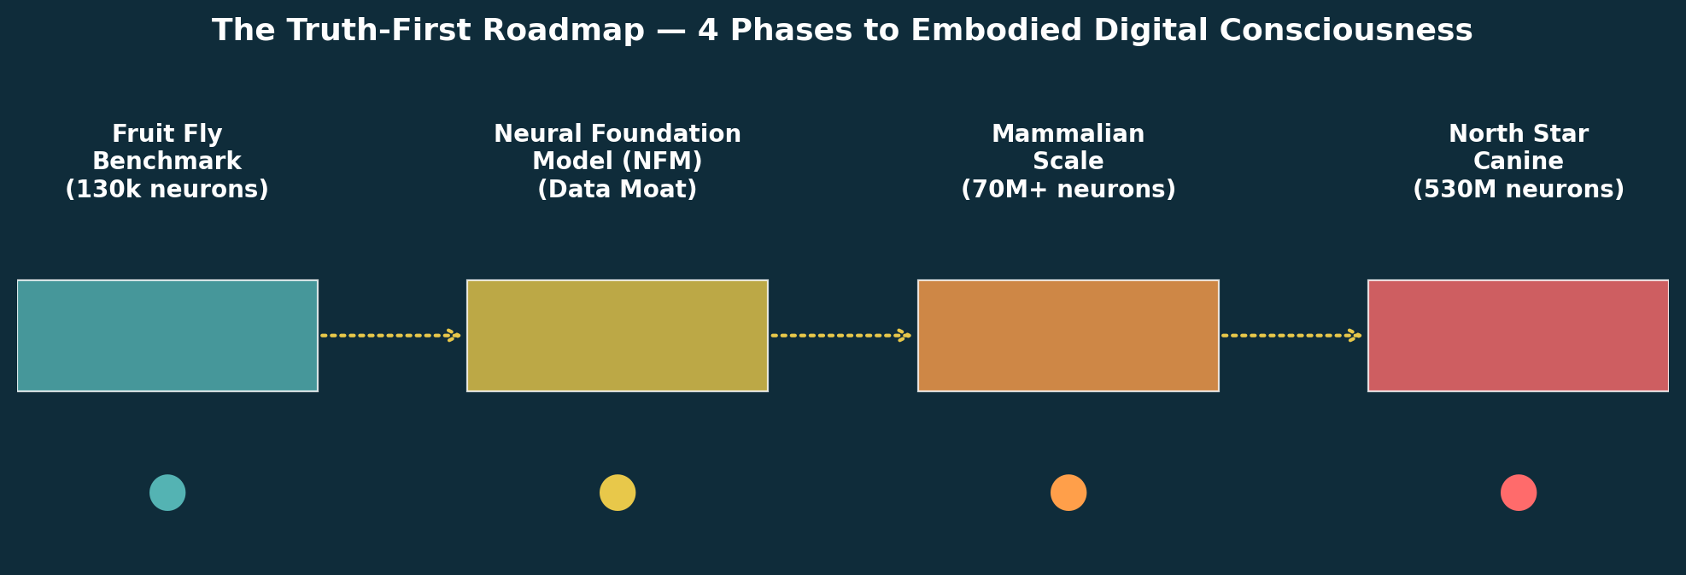
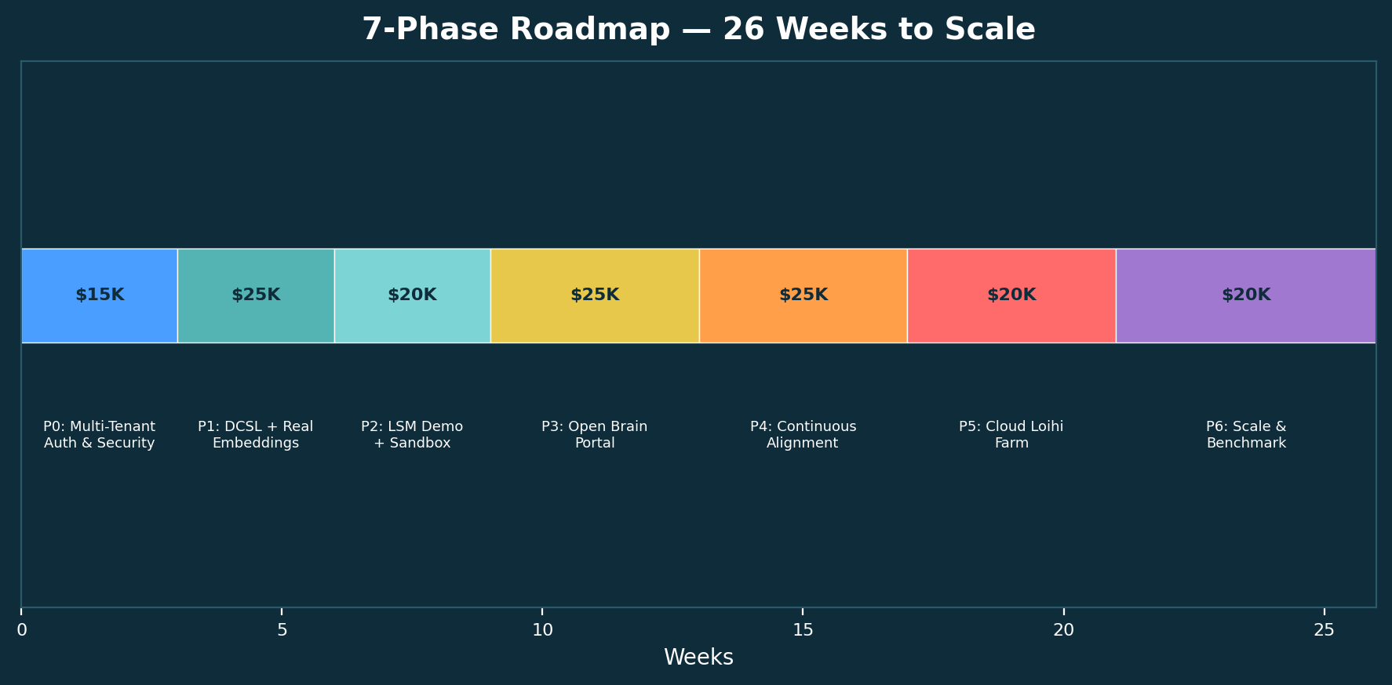
Truth-First Roadmap
Phase 1: Deploy IDRE to elite labs. Phase 2-4: Scale to embodied AI.
7 / 10
Notes:
ROADMAP: Four visionary phases. Phase 1 (The Wedge): Deploy IDRE to elite labs, hit the Fruit Fly Benchmark — 5x compute latency reduction, 20x energy savings. Phase 2 (The Data Moat): Train Neural Foundation Model on DCSL telemetry. Phase 3 (Scaling): Mammalian connectomics for biopharma Synths — Alzheimers, Parkinsons drug discovery. Phase 4 (North Star): 530M neuron canine connectome for embodied digital consciousness. Underneath: 7 execution phases in 26 weeks funded by this $150k bridge.

Slide 8
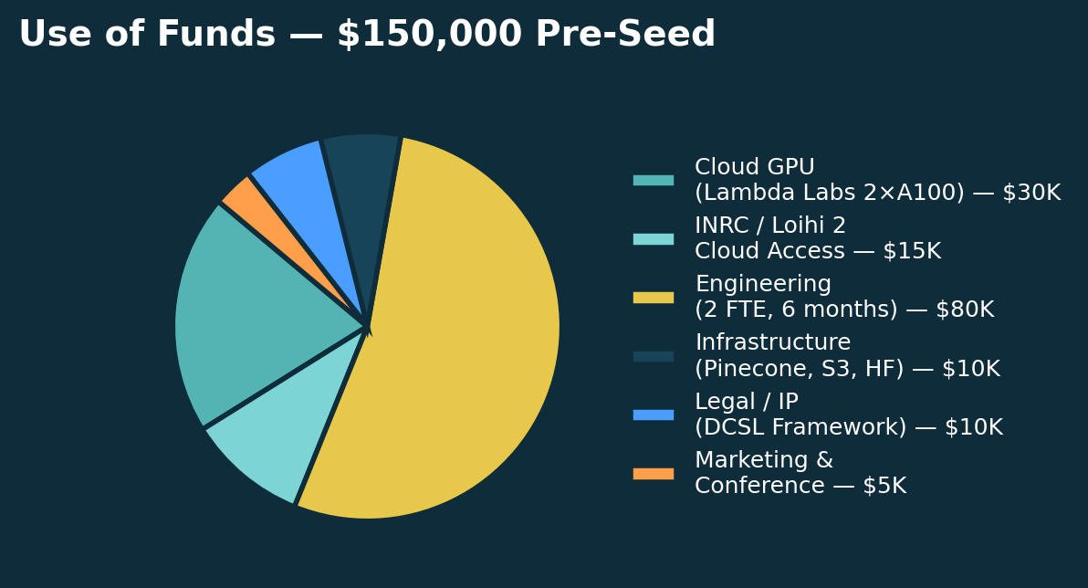
Operational Strategy: STTR
Winning the talent war without burning cash on wet-lab infrastructure
Leveraging STTR grants for elite university partnerships.
Target labs: Stanford (Bio-X), MIT (CBMM), UCSD (Swartz Center).
The university provides world-class PhD expertise and facilities.
SynapTech provides the IDRE platform — software, infrastructure, compute.
Federal government funds the partnership non-dilutively.
Phase I STTR: ~$250k (6 months proof-of-concept).
Phase II STTR: ~$1M (2 years full-scale deployment).
Bypass early capex, access top talent, validate product in real research environments.
8 / 10
Notes:
STTR: Our strategy is extreme capital efficiency. Instead of burning cash on wet-lab infrastructure, we partner with elite universities through the STTR grant framework. Stanford, MIT, UCSD - they bring neuroscience expertise and facilities, we bring the IDRE platform, and the federal government funds it. Phase I: ~$250k non-dilutive. Phase II: ~$1M. This lets us punch far above our weight class.

Slide 9
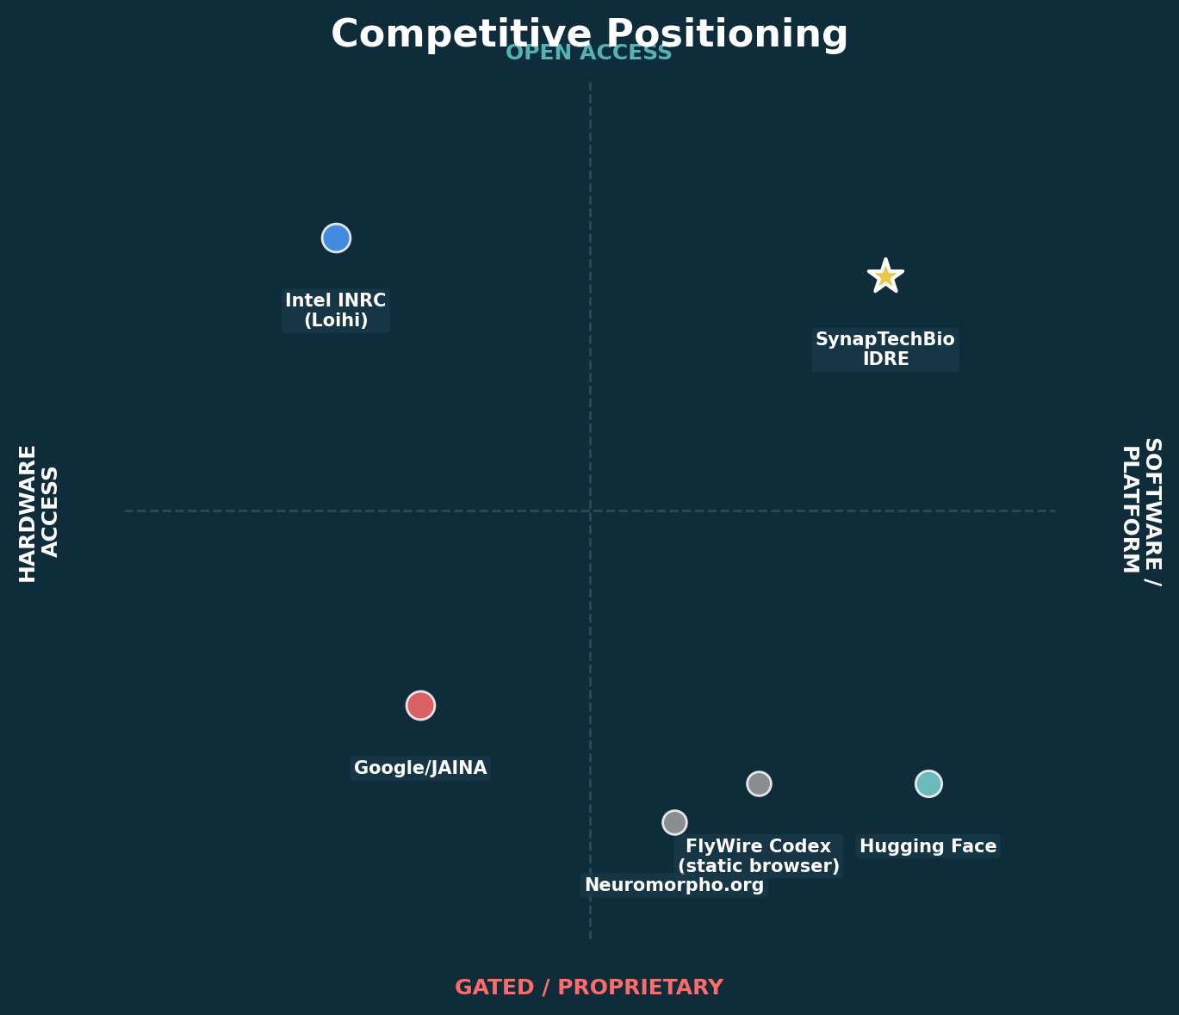
Competitive Landscape
The Unfair Advantage: DCSL Middleware + Open Platform
Google/JAINA: Proprietary EM pipeline — closed, gated.
Intel INRC: Loihi access via grant — ~200 labs worldwide.
FlyWire Codex: Static connectome browser — no computation.
Hugging Face: ML model hub — no neuromorphic hardware.
SynapTech Unfair Advantage:
DCSL Middleware: cryptographic fork protects IP
while creating a non-scrappable proprietary dataset.
Open platform + cloud Loihi hardware access.
Living Blueprint: continuously improving open model.
DCSL Moat
Every request forks: IP encrypted (AES-256) to S3. Telemetry hashed to Pinecone. DeepSeek-V4 alignment produces Living Blueprint. They can't copy what they can't scrape.
9 / 10
Notes:
COMPETITION: No one occupies our quadrant. Google keeps their pipeline proprietary. Intel INRC requires grants. FlyWire Codex is static. We are the only open platform with hardware access. DUE DILIGENCE DEFENSE — DCSL Middleware: Emphasize that the Data Capture Split Layer does two things simultaneously: (1) protects proprietary researcher IP via AES-256-GCM encryption, and (2) automatically flattens workflow telemetry into a proprietary, non-scrappable dataset that traditional AI cannot scrape. This creates a data moat that compounds with every researcher who uses the platform.

Slide 10
The Ask: $150,000 Pre-Seed Technical Phase Bridge
Delaware C-Corp | Post-money SAFE | 18-month runway to the Fruit Fly Benchmark
60% — Compute Infrastructure:
$30K — Cloud GPU (Lambda Labs, 2x A100 80GB, 6 months).
$15K — INRC / Loihi 2 cloud access (6 months).
$10K — Pinecone + S3 + Hugging Face infra.
40% — Engineering & IP:
$80K — Engineering (2 FTE, 6 months).
$10K — Legal / IP (4 foundational provisional patents).
$5K — Demo / marketing / conference travel.
This is NOT 'final' funding — it is a Technical Phase Bridge
Precisely scoped to achieve three de-risking milestones: 1) Lock down 4 foundational provisional patents on the DCSL framework and CSC engine. 2) Finalize telemetry pipelines and hit the 'Fruit Fly Benchmark.' 3) Deliver a producible product demo for Y Combinator / NEA for the next round. Target: 18-month runway to Series A metrics (10k queries/day, 50+ DAU researchers).
"Will the future of neuromorphic AI be locked in a corporate walled garden, or will it be a democratized neuromorphic commons?"
10 / 10
Notes:
ASK: $150,000 Pre-Seed Technical Phase Bridge. DUE DILIGENCE DEFENSE — Frame it correctly: Never frame this as 'final' funding. It is a precise, scoped 'Pre-Seed Technical Phase Bridge' to achieve the Fruit Fly Benchmark, finalize telemetry pipelines, and lock down 4 foundational provisional patents. 18-month runway to Series A metrics. Delaware C-Corp, post-money SAFE. We are capital-efficient. This is what we need to get to the next stage. CLOSING QUESTION: 'Will the future of neuromorphic AI be locked in a corporate walled garden, or will it be a democratized neuromorphic commons belonging to humanity?'

