Slide 1
Actiondex
A database system to reference past actions

Slide 2


Overview
Decision maker
Actiondex
Proposed action
Retrieve historical actions similar to the proposed action
lessons
Take action
taken action + result
Insert historical action

Slide 3


Define similar action? Break down a clinical trial procedure
New lesson
Type through
Actiondex interface
Store into Actiondex
Trial on adolescents in spring was delayed
Drug
Type
Price
Patients
Occupation
Age
Disease
Demography
Location
Temperature
Duration
Time
Background
Phase
Sub-phases
Result
Lesson
Patients:
Occupation: students
Age: 16
Time: spring
Result: delayed
Lesson: consider school schedule
Patients:
Disease: dementia
Result: success
Lesson: need to help them with transportation
Partnered with Lyft to help dementia come to the trial sites

Slide 4
Next time we conduct a clinical trial…
Proposed action
Type through
Actiondex interface
Actiondex
Drug
Type XX
Price
Patients
Occupation students
Age 15
Disease
Demography
Location
Temperature
Duration
Time winter
Background
Phase
Sub-phases
Result
Lesson
Patients:
Occupation: students
Age: 16
Time: spring
Result: delayed
Lesson: consider school schedule
Trial on drug XX with young patients in winter
Query
similar
actions
Drug:
Type: XX
Result: success
Lesson: consider valid period for XX
More cases…

Slide 5
Want it general? Break down a general procedure
Who
Title
Subteam
Phase
Sub-phases
Material
Cost
…
result
Procedure table
Person table
fields
fields
Phase table
fields
fields
fields
fields
fields

Slide 6
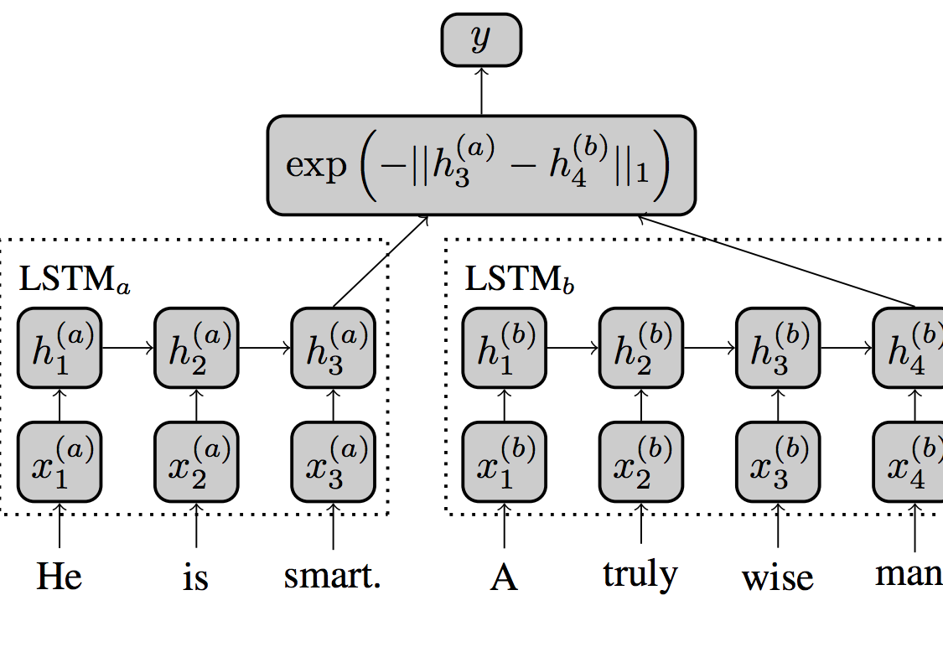
Want it fancier? Siamese Recurrent Architectures
#text-similarity @ github
Siamese neural network is a class of neural network architectures that contain two or more identical subnetworks.
Siamese NNs are popular among tasks that involve finding similarity or relationship between 2 comparable things

