Slide 1

Building a Smart System for Autonomous Lunar Probe Landing
By Shresht Sanjay Prasad
Shreshtsanjay.prasad@ue-Germany.de
47021111

Slide 2

Problem Statement
Challenges in Autonomous Lunar Landing:
Human control not feasible due to delay and uncertainty
Harsh terrain, unpredictable gravity, and fuel limits
Need for real-time, adaptive, low-latency control systems
Traditional controllers (PID etc.) fail under these constraints
Goal: Train a neural-based agent to land autonomously in a simulated lunar environment.

Slide 3
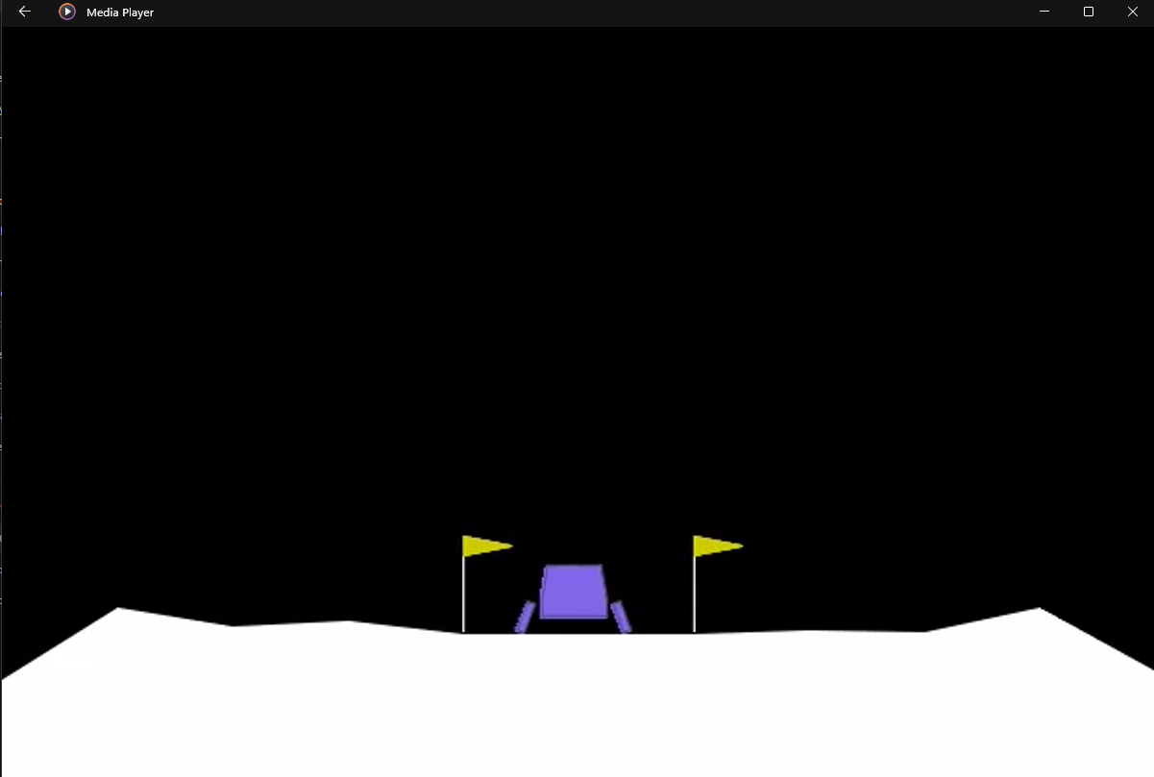
Our Contributions
Designed and trained a DQN agent in the LunarLander-v3 environment
Investigated impact of network architectures and training parameters
Achieved >93% success with optimized configuration
Delivered a lightweight and deployable RL system Validated performance via success-time tradeoff across agent types
Best Agent:
Wide (128–128)
LR: 0.0005 | γ: 0.99 | τ: 0.01
93/100 success in 291s of training(average)

Slide 4
Architecture
The Deep Q-Network (DQN) agent uses a feedforward neural network with two hidden layers of 128 neurons each, forming a wide architecture. ReLU activation functions are applied at each hidden layer. The network takes an 8-dimensional state input representing the lander’s position, velocity, angle, and leg contact, and outputs Q-values for 4 possible actions (do nothing, fire left, fire main, fire right).
Two networks are maintained:
Local Q-Network: Actively trained and used for selecting actions.
Target Q-Network: Slowly updated to stabilize learning.
An epsilon-greedy policy balances exploration and exploitation during training, while a replay buffer stores experiences for batch learning. A soft update mechanism ensures stable target updates using a small factor τ.
This architecture was chosen after comparative testing and consistently achieved the best trade-off between training speed and landing success.
HL1
HL2
Output
Layer
Input
Layer
8
4
128
128
Selected Action
Relu
Relu
• Input: 8 features (position, velocity, angle, leg contact)
• Hidden Layers: 128 – 128 with ReLU
• Output: 4 Q-values for each action

Slide 5
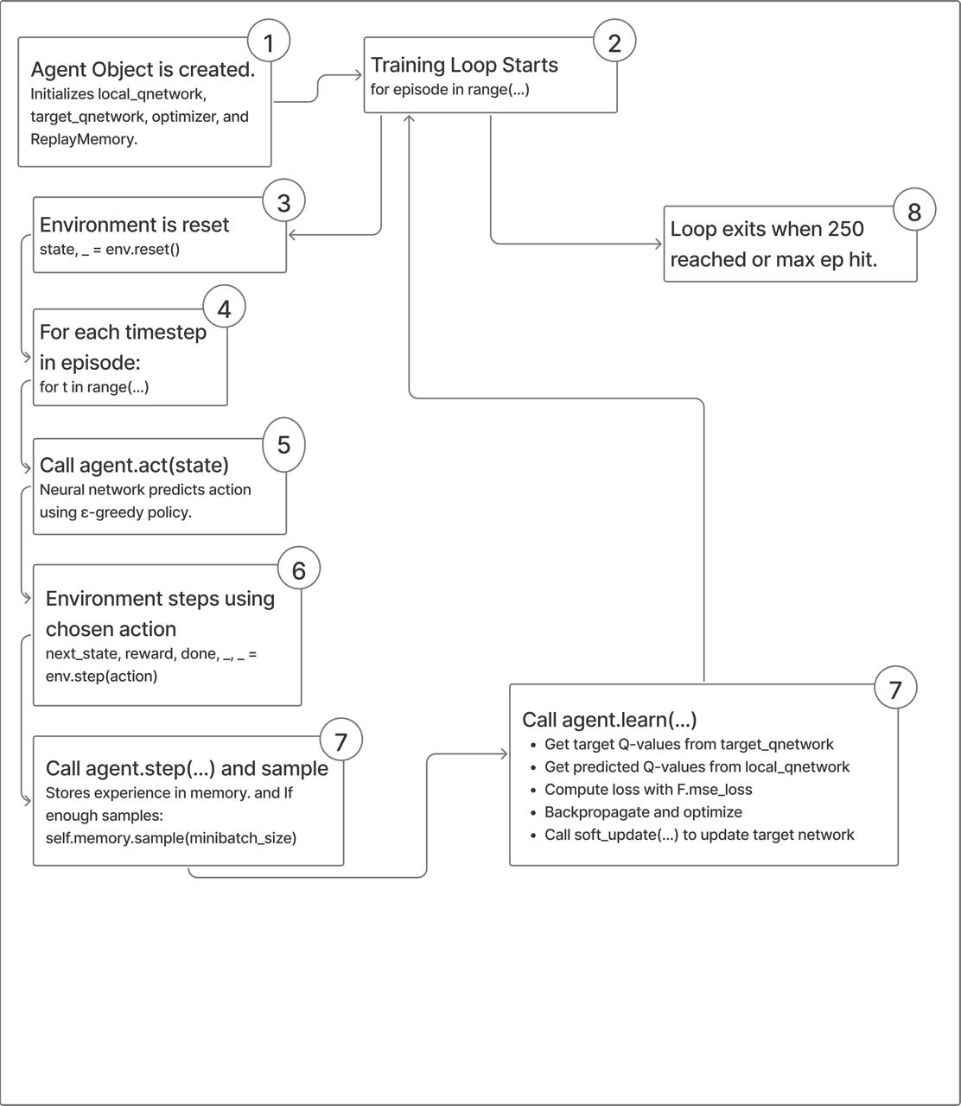
Workflow
Overview
A Deep Q-Network (DQN) agent learns to land autonomously by interacting with the LunarLander-v3 environment through trial-and-error and refining its policy via backpropagation.
Core Components
Local Q-Network: Estimates action values for decision-making
Target Q-Network: Stabilizes learning with fixed targets
Replay Buffer: Stores past experiences for training
Optimizer: Minimizes TD error using MSE loss
Training Workflow
Initialize agent and environment
For each episode: • Reset environment • For each timestep: – Select action via $\varepsilon$-greedy policy – Receive reward, next state, done flag – Store experience in buffer – If enough data: • Sample batch, train network • Soft update target network
Stop when target score or max episodes reached
Techniques Used
MSE loss for Q-value updates
Soft updates for stable target network adjustment
Epsilon decay for exploration–exploitation balance

Slide 6
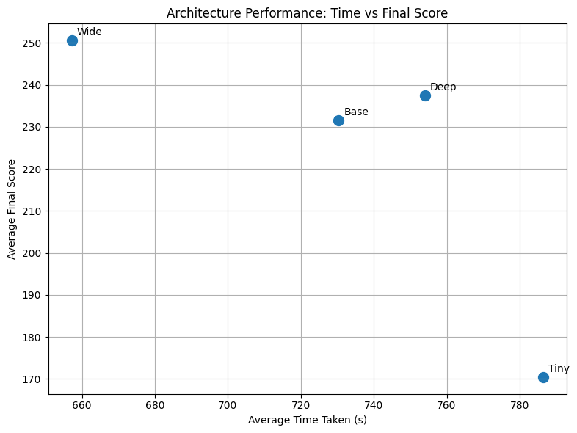
Research Question 1 : How do different neural network architectures affect performance?
Results
Tested 4 models: Tiny (32–32), Base (64–64), Wide (128–128), Deep (256–128–64)
Wide architecture scored ~250 with lowest training time (~658s)
Tiny model underperformed and trained slowest (~785s)
Base and Deep were moderate but inferior to Wide
Discussion
Wider networks (more neurons) generalize better than deeper or smaller ones
Shallow, narrow networks struggle with the complexity of landing tasks
Wide model hits the balance between capacity and efficiency
Choosing the right architecture is crucial for performance and resource use

Slide 7
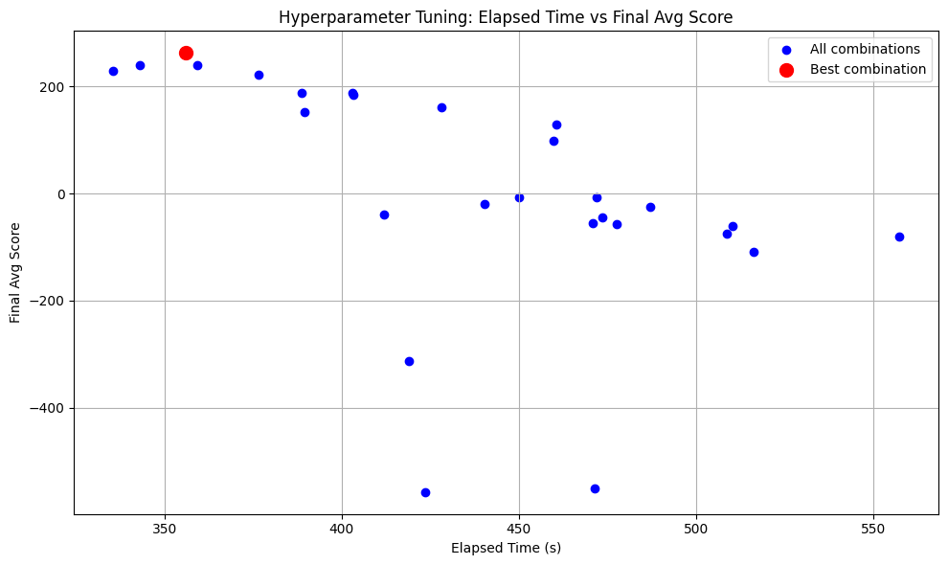
Research Question 2 : How do hyperparameters affect learning and success rate?
Results
27 combinations tested: learning rate, gamma (discount), tau (soft update)
Best config: LR = 0.0005, gamma = 0.99, tau = 0.01
Achieved score ~262.89 in just 355s
Several combinations led to negative scores or failed convergence
Discussion
Slight changes in hyperparameters have huge impact on learning
Too low learning rate or update rate → slow/no learning
Too aggressive → unstable updates and low final scores
Tuning is essential for stable, high-speed learning in resource-constrained settings

Slide 8
Research Question 3 : How much training is needed before reliable landing?
Results
Agent250: 99/100 success in ~291s
Agent200: 81/100 success in ~282s
Agent300: 84/100 success but required ~895s
Best success-to-time ratio achieved at training threshold of 250
Discussion
Training to 250 is optimal — high accuracy with moderate time
300 adds time but no meaningful gain
200 is faster but less consistent
Diminishing returns beyond 250 — critical for real-world efficiency
Agent | Training Time - Second | Success | Success:Time
agent250 | 291.016522 | 99 | 0.340187
agent200 | 282.133176 | 81 | 0.287098
agent300 | 895.274564 | 84 | 0.093826

Slide 9
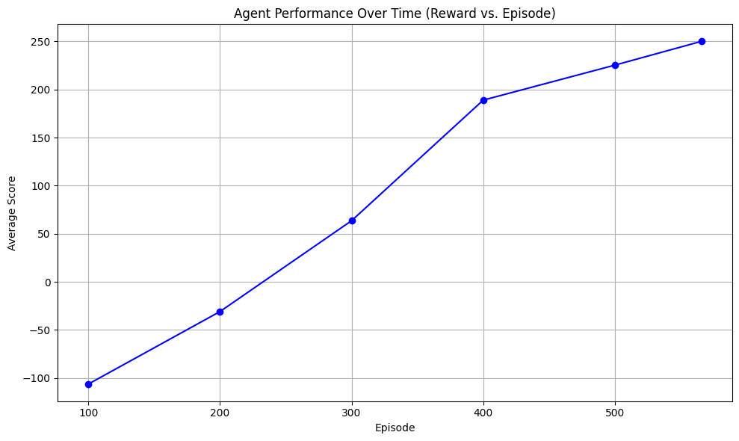
Research Question 4 : Can the trained RL system generalize and perform consistently on unseen episodes?
Results
Final model tested on 100 unseen episodes
Achieved 99 successful landings (score > 200)
Over 5 test runs: average success rate = 93%
Consistent performance without retraining or exploration
Discussion
Model shows strong generalization to new situations
High success rate confirms reliable policy learning
No signs of overfitting or instability
Proves readiness for deployment in simulation or real-world conditions
Parameter Value
Network Architecture Wide 3-layer feedforward
Hidden Layers 2 layers, each with 128 units
Learning Rate (α) 0.0005
Discount Factor (γ) 0.99
Soft Update Rate (τ) 0.01
Mini-Batch Size 256
Replay Buffer Size 100,000
Testing Episodes 100
Success Training Threshold 250
Test Success Rate 93%

Slide 10
References
@inproceedings{shen2024comparison, title={Comparison of Three Deep Reinforcement Learning Algorithms for Solving the Lunar Lander Problem}, author={Shen, Dingli}, booktitle={2023 International Conference on Data Science, Advanced Algorithm and Intelligent Computing (DAI 2023)}, pages={187--199}, year={2024}, organization={Atlantis Press}}
@inproceedings{choi2025uncertainty, title={Uncertainty-Aware Autonomous Mars Landing Guidance With Curriculum Reinforcement Learning}, author={Choi, Jimin and Ahn, Jaemyung}, booktitle={AIAA SCITECH 2025 Forum}, pages={1933}, year={2025}}
@inproceedings{khunmaturod2024development, title={Development of a Lunar Rover Simulator with an Interface for Reinforcement Learning}, author={Khunmaturod, Assawayut and Chang, Dong Eui}, booktitle={2024 9th International Conference on Automation, Control and Robotics Engineering (CACRE)}, pages={117--123}, year={2024}, organization={IEEE}}
@article{del2024comparative, title={Comparative Analysis of A3C and PPO Algorithms in Reinforcement Learning: A Survey on General Environments}, author={Del Rio, Alberto and Jimenez, David and Serrano, Javier}, journal={IEEE Access}, year={2024}, publisher={IEEE}}
@inproceedings{mali2023lunar, title={Lunar Lander Using Reinforcement Learning Algorithm}, author={Mali, Rohan and Kande, Nikhil and Mandwade, Sangam and Nagre, Vishal and Sable, Nilesh P}, booktitle={2023 7th International Conference On Computing, Communication, Control And Automation (ICCUBEA)}, pages={1--5}, year={2023}, organization={IEEE}}
@inproceedings{shah2023deep, title={Deep Reinforcement Learning for Unpredictability-Induced Rewards to Handle Spacecraft Landing}, author={Shah, Salman and Yao, Nianmin}, booktitle={2023 13th International Conference on Information Science and Technology (ICIST)}, pages={73--79}, year={2023}, organization={IEEE}}
@inproceedings{ciabatti2022deep, title={Deep Reinforcement Learning for Pin-Point Autonomous Lunar Landing: Trajectory Recalculation for Obstacle Avoidance}, author={Ciabatti, Giulia and Spiller, Dario and Daftry, Shreyansh and Capobianco, Roberto and Curti, Fabio}, booktitle={International Conference on Applied Intelligence and Informatics}, pages={101--115}, year={2022}, organization={Springer}}
@inproceedings{lu2023comparison, title={Comparison and Hyperparameter Analysis of Four Reinforcement Learning Algorithms in the Lunar Lander Environment}, author={Lu, Yuyang}, booktitle={International Conference on Artificial Intelligence, Robotics, and Communication}, pages={257--266}, year={2023}, organization={Springer}}
9

Slide 11
Thank you

