Slide 1
LearnSphere
Generative AI-Powered Machine Learning System
Team: MetaMinds
Ashwitha. Y
Shreshta. J
Sonu. V
Srujana. K

Slide 2
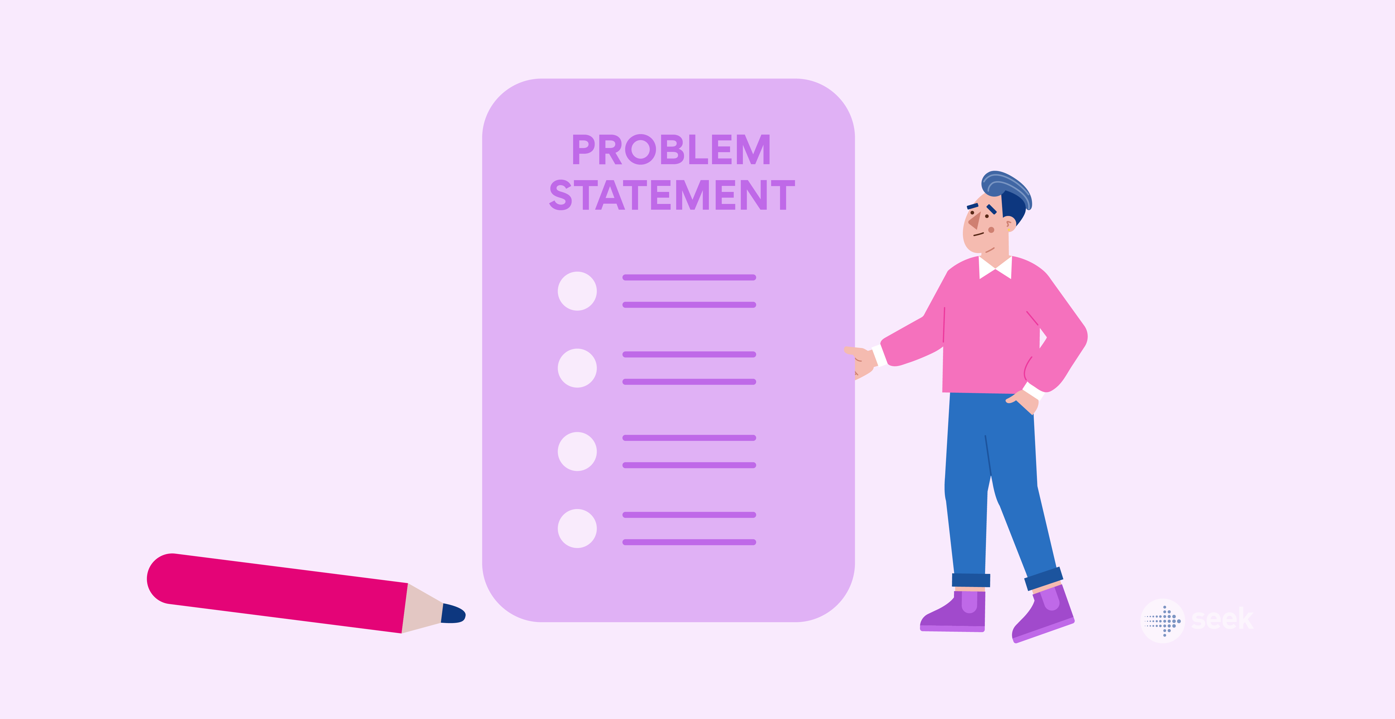
Problem Statement
AI-driven learning platform delivers personalized ML education through text, code, audio, and visual explanations. It adapts content to user learning styles, making complex ML concepts easier to understand.

Slide 3
Proposed System
Uses Generative AI for dynamic concept explanations
Generates real-time code examples for better understanding
Adapts content difficulty based on user performance
Provides multi-modal learning (text, code, visual,audioexplanations)
Bridges the gap between theory and practical implementation

Slide 4
Technologies and Tools
Backend:
Flask
Python
Gemini, AI APIs
Frontend:
HTML, CSS, JavaScript

Slide 5
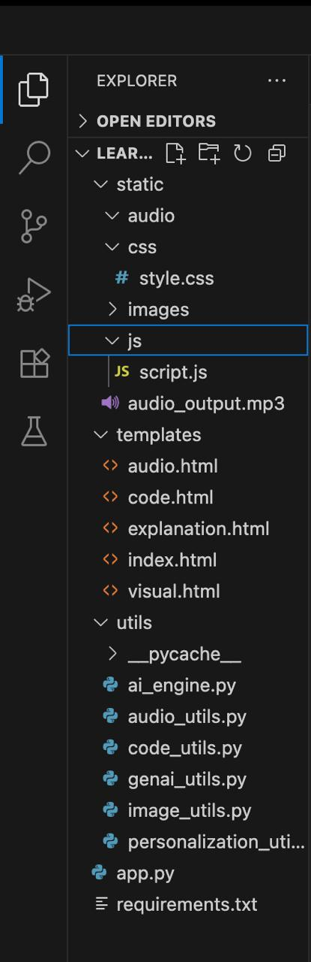
Implementation

Slide 6
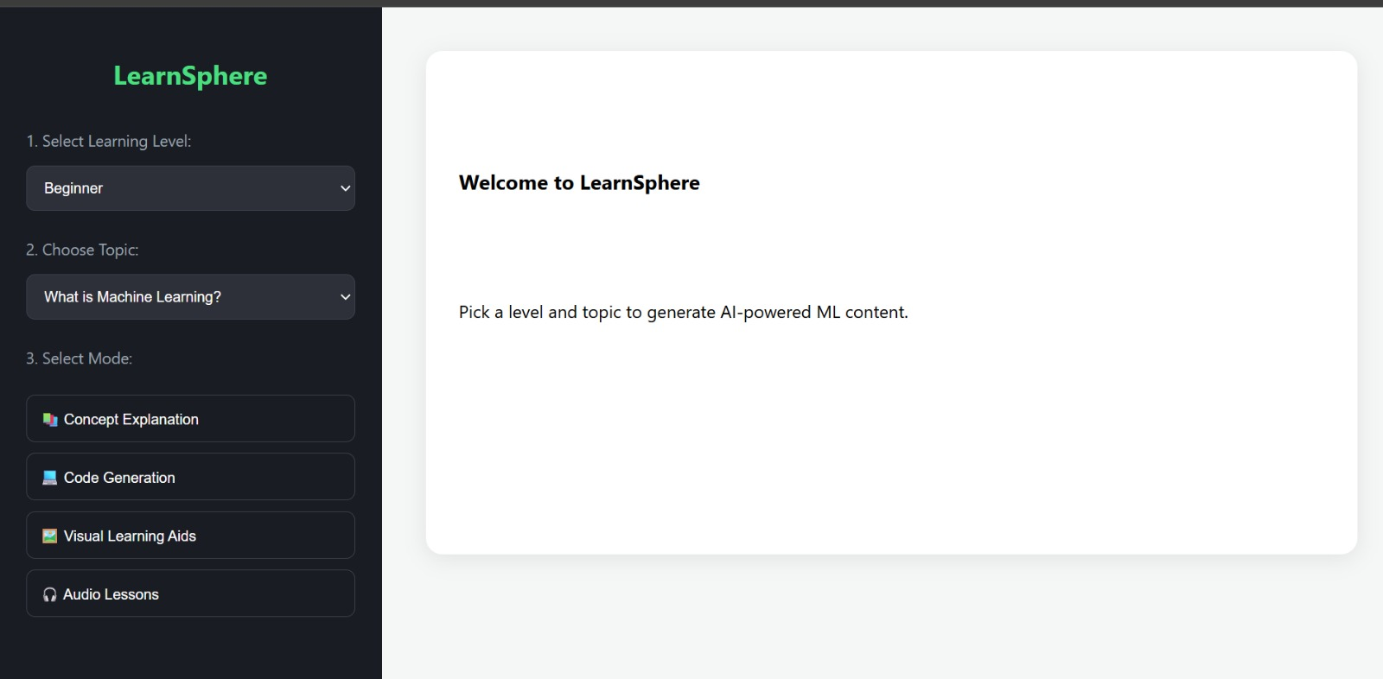
Results

Slide 7
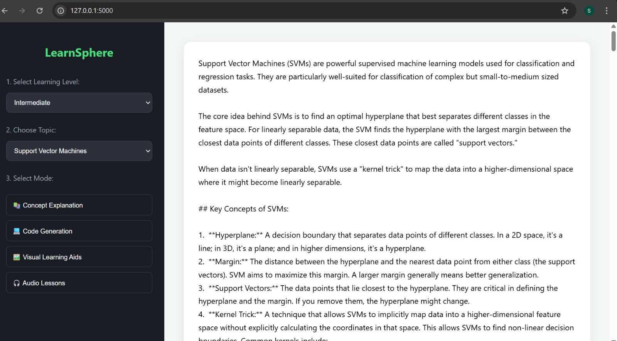

Slide 8
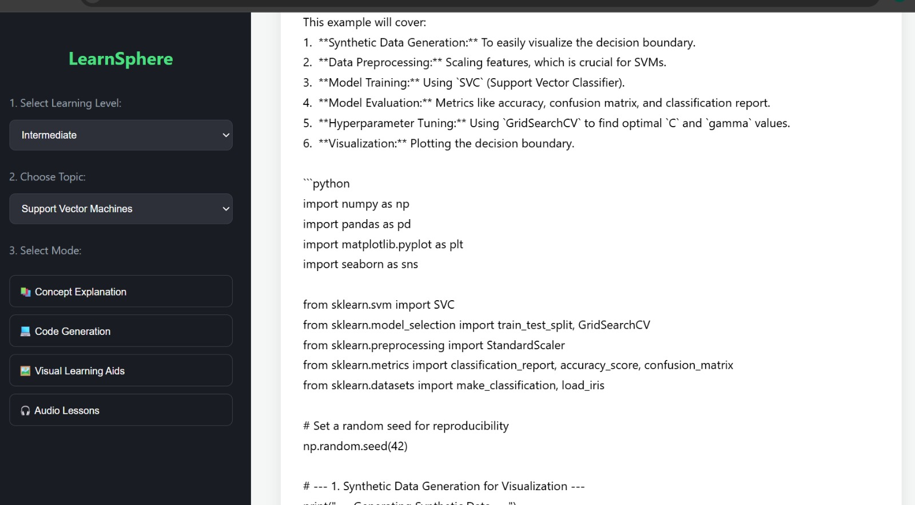

Slide 9
