Slide 1
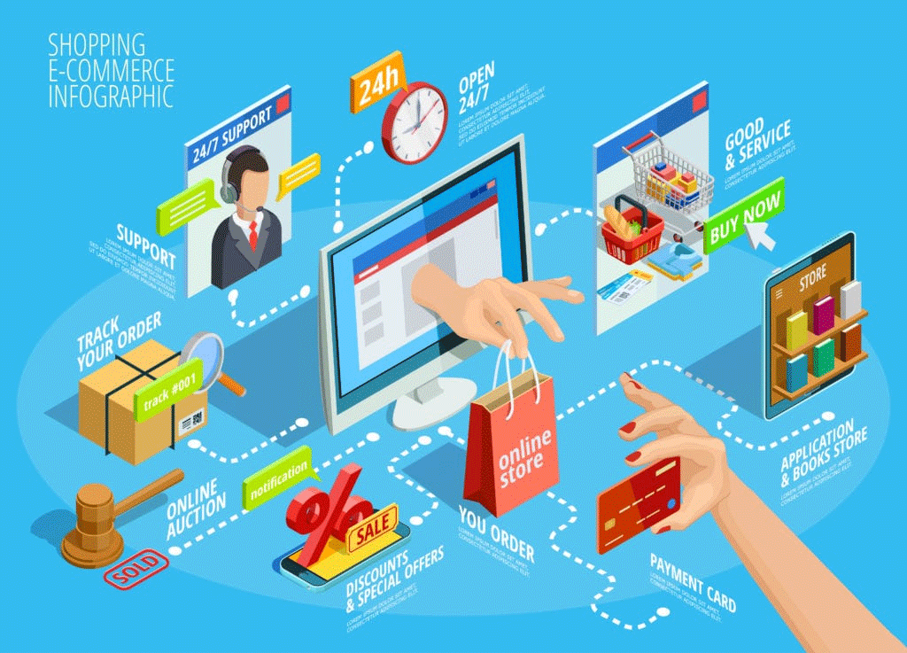

POWER BI PROJECT
E-commerce Customer
Analytics
A Power BI dashboard project E-Commerce Customer Analytics using the Brazilian E-commerce dataset.
Developed by –
Shreshta Saha
Shreyasree Mete
Centre of Excellence for AI | E-commerce Customer Analytics

Slide 2












BEFORE & AFTER
The Impact of Data Analytics
Shop Without Data Analysis
Shop With Data Analysis
Runs on memory, guesswork and manual records
Runs on a live dashboard, not guesswork
Manual sales tracking in registers or notebooks
Real-time KPI cards for revenue & orders
Guesswork on best-selling products
Clear view of best-selling products
Delayed, end-of-month reporting
Instant, always-up-to-date reporting
No visibility into customer trends
Full visibility into customer & sales trends
Reactive, gut-feel decision-making
Confident, evidence-based decisions
Centre of Excellence for AI | E-commerce Customer Analytics

Slide 3

Project Objective
This project analyzes the Brazilian E-commerce (Olist) dataset to build an interactive Power BI dashboard that tracks revenue, orders, and customer behavior. It helps stakeholders monitor sales trends, payment performance, and delivery efficiency in one place. The goal is to convert raw transactional data into clear, actionable business insights. Ultimately, the dashboard supports faster, data-driven decision-making across the customer journey.
Goal-Driven
Dashboard
132.10K
501
263.67
69
Turning raw e-commerce data
into business insight
Total Revenue
Total Orders
Avg Order Value
New Customers
Centre of Excellence for AI | E-commerce Customer Analytics

Slide 4





Tools & Technologies Used
Power BI Desktop
Power Query
Data Modeling
Core platform used to build the interactive dashboard and reports.
Cleaned, transformed and merged the Sales, Payments & Delivery tables.
Built relationships across tables for accurate cross-filtering.
DAX Measures
Interactive Slicers
Excel Data Source
Custom formulas for revenue, AOV, on-time delivery % and more.
Segment, state, order status and payment-type filters.
Raw Olist dataset imported and refreshed from .xlsx files.
Centre of Excellence for AI | E-commerce Customer Analytics

Slide 5

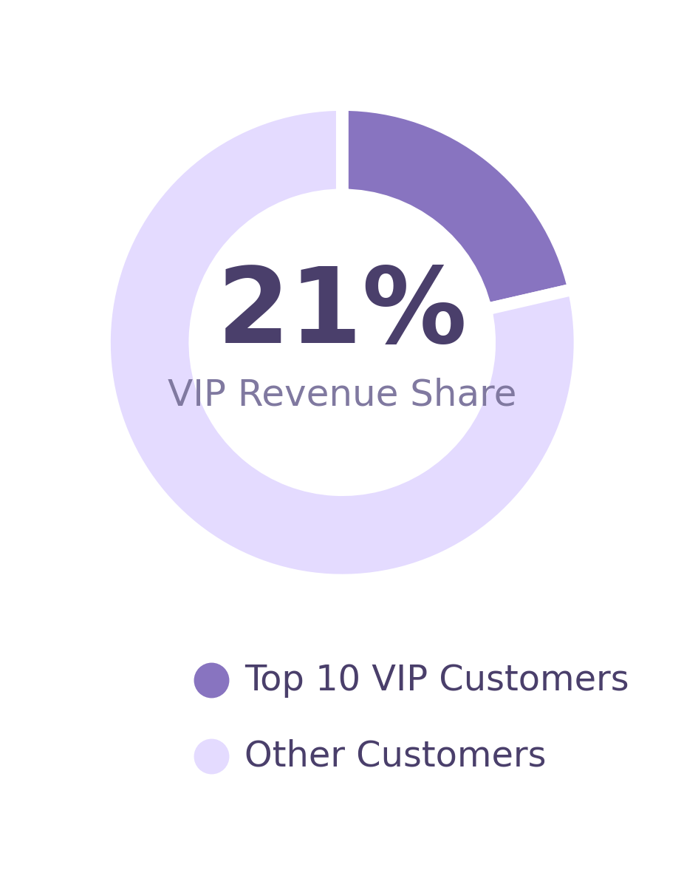

STEP 05
Customer Analysis
69 new customers acquired this period, growing the active base
3.66 / 5 average review score across delivered orders
Top 10 VIP customers contribute 21% of total revenue
Customer Rank by Revenue highlights high-value repeat buyers
Is Top 10 Customer flag pinpoints VIP accounts instantly
Segment & state slicers isolate any customer group in one click
Centre of Excellence for AI | E-commerce Customer Analytics

Slide 6

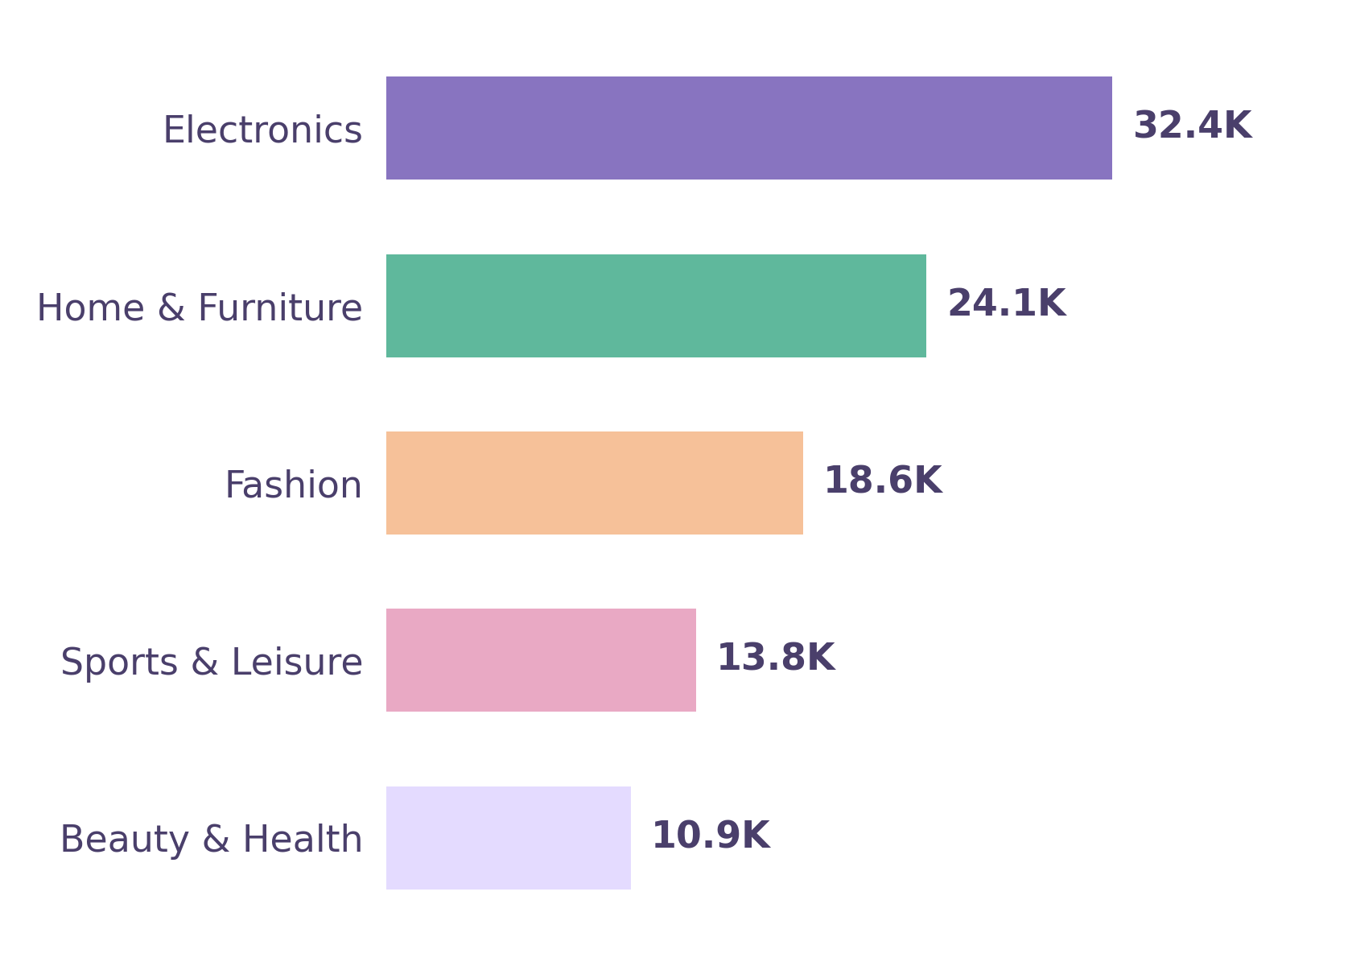



STEP 06
Sales Analysis
132.10K total revenue generated across 501 orders
263.67 average order value (AOV) per transaction
Electronics leads all categories with 32.4K in revenue
8.45K total discount given against 123.65K net revenue
Monthly trend view tracks revenue momentum order by order
Total Quantity sold reveals demand beyond order count alone
Centre of Excellence for AI | E-commerce Customer Analytics

Slide 7

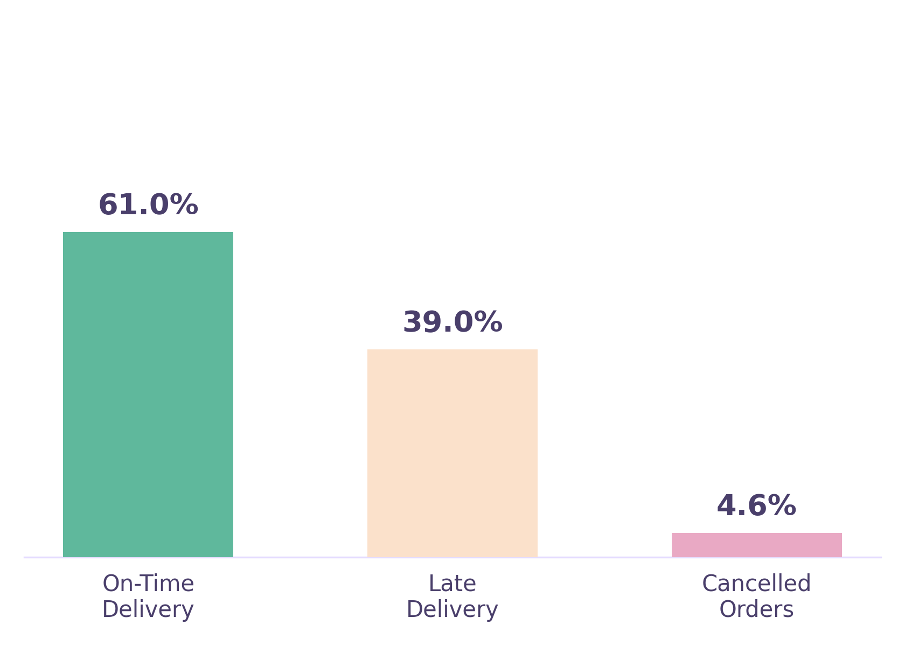
STEP 07
Delivery Analysis
61% of orders delivered on or before the estimated date
39% of deliveries arrive later than the promised date
4.6% cancelled order rate flags at-risk fulfillment
13.88K in payment value failed or refunded, tracked for recovery
Avg Review Score sits at 3.66 / 5, dipping whenever delivery runs late
Status & state slicers isolate delivery issues by region instantly
Centre of Excellence for AI | E-commerce Customer Analytics

Slide 8
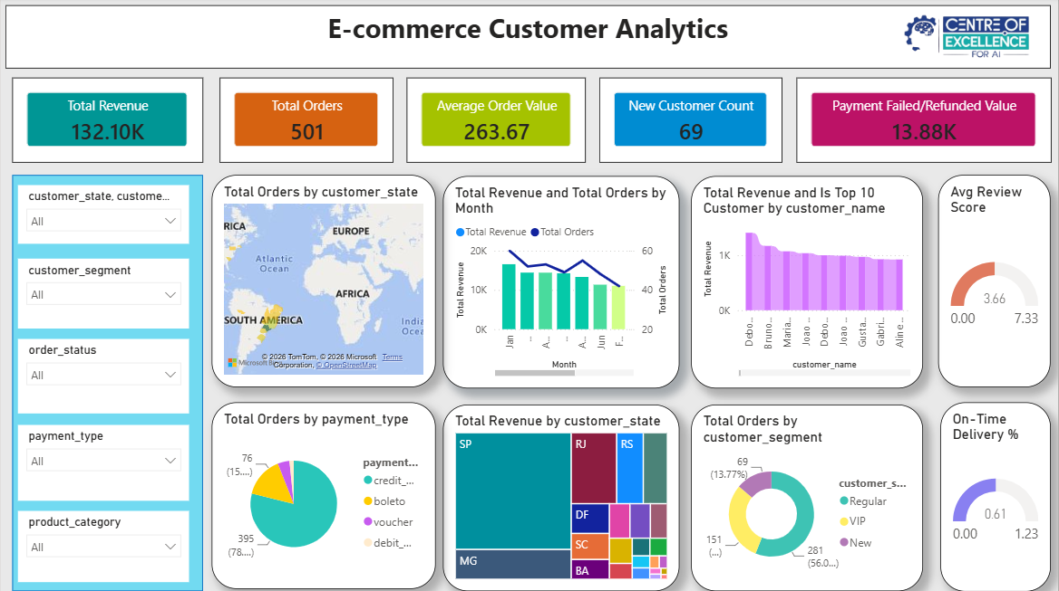

Key Features
5 KPI cards — revenue, orders, AOV, new customers, refunds
Geographic view of orders by customer state
Monthly revenue & order trend analysis
Top-10 customer ranking & average review score
Payment type and delivery performance breakdown
Dynamic slicers for state, segment, status & category
Centre of Excellence for AI | E-commerce Customer Analytics

Slide 9



Learning Outcome
DAX & Measures
Data Modeling
Data Cleaning
Wrote DAX formulas for KPIs like AOV and on-time delivery %.
Built relationships across multiple related tables.
Used Power Query to shape and merge raw Excel data.
Dashboard UX
Data Storytelling
Problem Solving
Designed clear, filterable, decision-ready dashboard layouts.
Translated numbers into insights stakeholders can act on.
Worked through real-world, messy e-commerce data challenges.
Centre of Excellence for AI | E-commerce Customer Analytics

Slide 10
Conclusion
The E-commerce Customer Analytics dashboard turns raw Olist transaction data into a single, interactive view of revenue, orders, customer segments and delivery performance. Business users can filter by state, segment, payment type and order status to answer questions in seconds rather than hours. The project demonstrates a complete, practical Power BI workflow — from messy multi-table data to a polished, decision-ready dashboard.
Orders analyzed
69 new customers tracked
Delivery performance monitored
Key Takeaway: A fully self-serve BI dashboard that shortens the path from raw e-commerce data to confident business decisions.
Centre of Excellence for AI | E-commerce Customer Analytics

