Slide 1
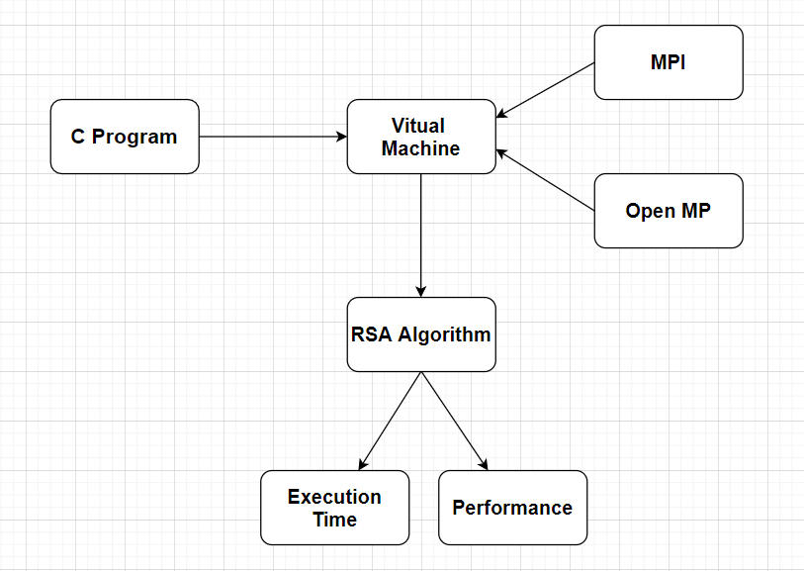
Architecture diagram

Slide 2
RSA algorithm
STEP 1 : START
STEP 2 : Choose two large random prime integer numbers x and y (with bit size of 512 or more).
STEP 3 : Calculate z as z = x*y referred to as modulus
STEP 4 : Calculate f(n) as f(n)=(x-1) *(y-1)
STEP 5 : Choose an integer w, 1 < w < f(n) such that: GCD (w,f(n)) = 1 (where GCD is greatest common denominator)
STEP 6 : Calculate a, 1 < a < f(n) such that: a.w ≡ 1 (mod f(n))
STEP 7 : STOP

Slide 3
Rsa algorithm using parallelisation concepts
Procedure Divisors (n1, n2, r) // where r= maximum (sqrt (n1), sqrt
(n2))
Begin
#pragma omp parallel
for omp_num_threads (n) // spawning for loop
over n threads
// nowait clause allows the threads to execute two if conditions
simultaneously
#pragma omp nowait

Slide 4
Rsa algorithm using parallelisation concepts
for i=1 to r do
if (n1 mod i)
store result of n1 mod i in vector1.
If (n2 mod i)
store result of n2 mod i in
vector2.
end for
end for
End

Slide 5
Tools used
Jupyter Notebook – for coding and execution of unaltered RSA algorithm in Python.
Oracle VM Virtual Box – to create an environment for parallel computing of the algorithms

Slide 6
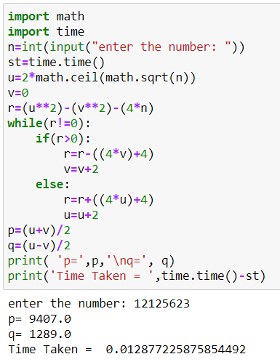
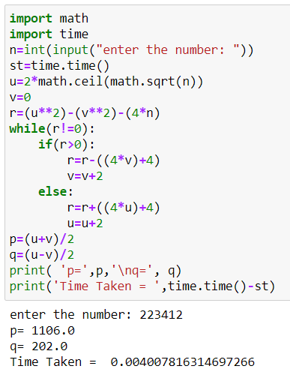
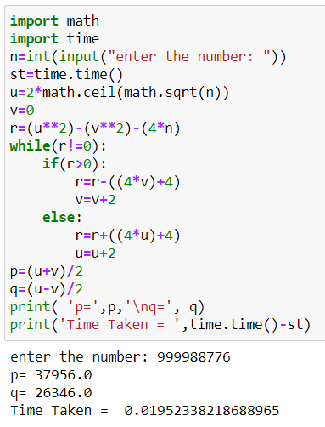
Screenshots (of serial implementation)

Slide 7
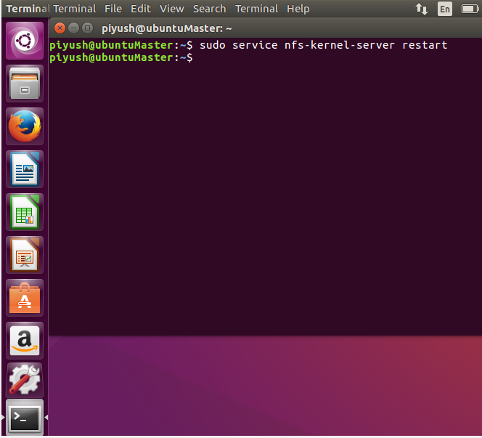
Screenshots (of environment setup)
Login into Master Node (Piyush) with password 123456
Open terminal and run : sudo nfs-kernel-server restart
This command restarts nfs servers

Slide 8
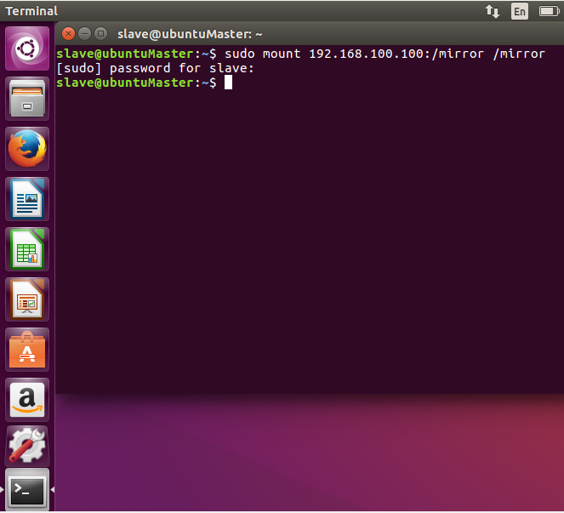
Screenshots (of environment setup)
Login into Slave node (Slave) with password 123456
Open terminal and run commond: sudo mount 192.168.100.100:/mirror /mirror
This command mounts directory /mirror in master node ip 192.168.100.100 over directory /mirror in slave node

Slide 9
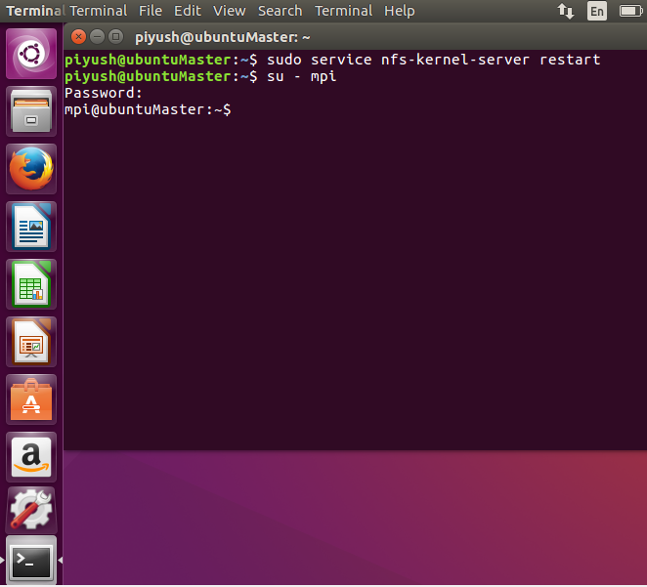
Screenshots (of environment setup)
In Master node (Piyush) use command su – mpi
This command switches to user mpi whose password is 123

Slide 10
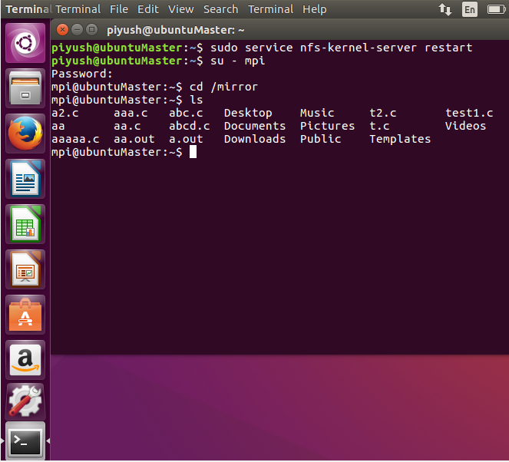
Screenshots (of environment setup)
In master node use command : cd /mirror
Then to view all files present use command: ls

