Slide 1
Minor Project
M.Sc. Computer Science
Semester III
2018-19
By Surajit Das(41) and Shreshth Saxena(38)

Slide 2
Overview
Our project covers the learning and application of Convolution Neural Networks in the field of Deep Learning.
We studied the working and creation of Neural Networks, particularly Convolution Neural Networks and applying this knowledge to build a CNN based lung cancer prediction model.
The report demonstrates our learnings about Neural Network models and the development of the cancer prediction CNN.

Slide 3
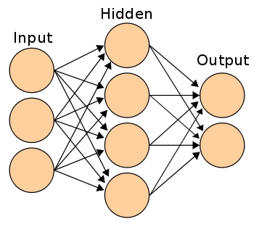
Background
An artificial neural network is an interconnected group of nodes, similar to the vast network of neurons in a brain. Here, each circular node represents an artificial neuron and an arrow represents a connection from the output of one artificial neuron to the input of another.
Artificial Neural Networks (ANN) have many different coefficients, which it can optimize. Hence, it can handle much more variability as compared to traditional models.

Slide 4
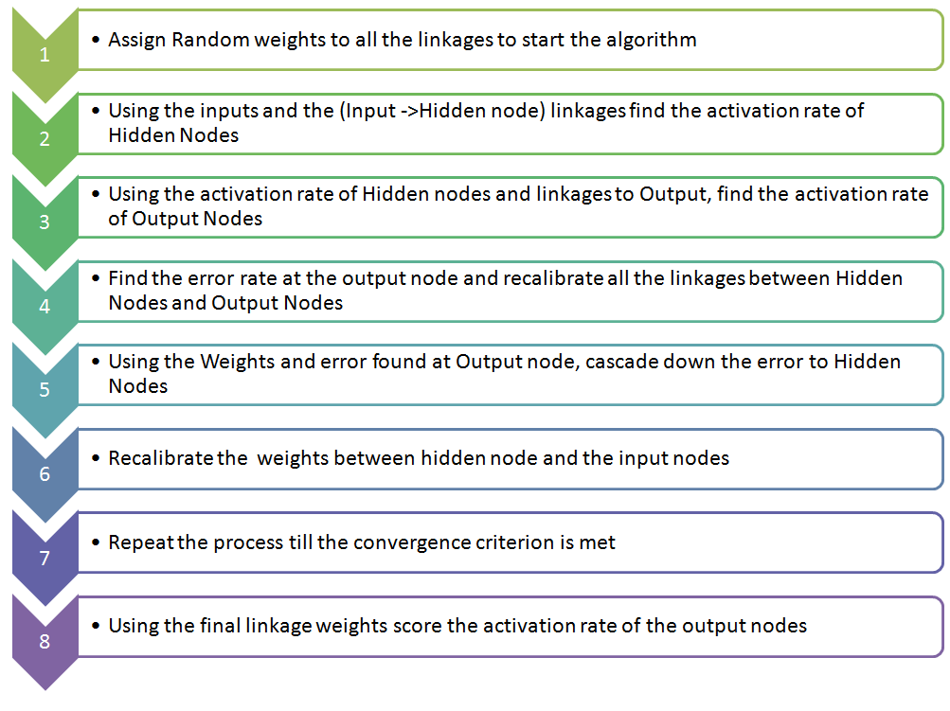

Slide 5
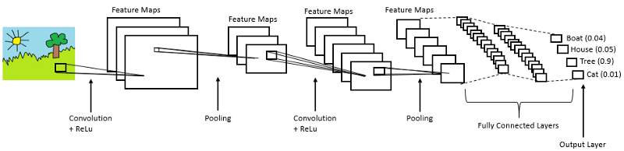
Convolution Neural Networks
Convolutional Neural Networks are very similar to ordinary Neural Networks. ConvNet architectures make the explicit assumption that the inputs are images, which allows us to encode certain properties into the architecture. These then make the forward function more efficient to implement and vastly reduce the amount of parameters in the network.

Slide 6
Dog-Cat Classifier
CONV2D
MAX POOL
CONV2D
MAX POOL
CONV2D
FLATTEN
FC LAYERS
32 (3X3) kernels
ReLU activation
32 (3X3) kernels
ReLU activation
64 (3X3) kernels
ReLU activation
FULLY CONNECTED LAYERS
The model inputs images of dimensions 150 x 150, using 2000 images for training and 800 images for validation. The number of images is further increased by making use of the Image Processing class in Keras called ImageDataGenerator which generates batches of tensor image data with real-time data augmentations such as zooming, flipping, scaling etc. The model was compared on categorical crossentropy and binary crossentropy loss functions and RMSprop optimizer and adagrad optimizers.

Slide 7
Cancer Prediction model

Slide 8
Dataset
Total 2948 images are used.
The data includes three datasets:
● Training Data: Contains total 2064 grayscale images
● Validation data: Contains 442 grayscale images
● Testing data: Contains 442 grayscale images
Image size 40*40 pixels
Images are result of total 888 CT scans

Slide 9
Model
The model is implemented using the Sequential API in Keras. It consists of three
Convolution-2D layers with 16, 32 and 64 kernels of size (3,3), (5,5) and (7,7) respectively each followed by a Maxpooling-2D layer of size (2,2) pooling with a stride of 2. Maxpooling layers reduce the dimensionality of data thereby reducing the number of parameters, leading to a reduction in training time and tackling overfitting. Pooling layers downsample each feature map independently

Slide 10
Model contd..
We need the Flattening layers since the output of both convolution and pooling layers are 3D volumes, but a fully connected layer expects a 1D vector of numbers. The Flattening operation simply involves arranging the 3D volume of numbers into a 1D vector. The flatten output becomes an input to the fully connected layers. We then implement grid search to find the best values for hyperparameters optimizer, epochs and batch size.

Slide 11
Visualization of the model

Slide 12
Experiments and results
Parameter vs Hyperparameter
Parameter - weights and biases
Hyperparameter - number of hidden layers and nodes, activation functions, number of filters kernel size, stride, pooling, learning rate

Slide 13
Hyperparameter Tuning
The model was trained on different combinations of hyperparameters and the performance in each case was recorded as below:
1.
epochs = [ 10,25]
batches = [50,100,104]
optimizers = ['SGD', 'adam']
Cross validation = 10
Best parameter combination
{'batch_size': 104, 'epochs': 25, 'optimizer': 'adam'}
Accuracy on test data: 97.05%

Slide 14
2.
epochs = [25,35]
batches = [50,104,150]
optimizers = ['adam']
Cross validation = 10
Best parameter combination
{'batch_size': 150, 'epochs': 25, 'optimizer': 'adam'}
Accuracy on test data: 97.29%

Slide 15
3.
epochs = [20,25,40]
batches = [200,150]
optimizers = ['adam']
Cross validation = 10
Best parameter combination
{'batch_size': 200, 'epochs': 40, 'optimizer': 'adam'}
Accuracy on test data: 96.38%

Slide 16
4.
epochs = [20,25,40]
batches = [200,150]
optimizers = ['adam']
Cross validation = 3
Best parameter combination
{'batch_size': 200, 'epochs': 40, 'optimizer': 'adam'}
Accuracy on test data: 97.51%

Slide 17
5.
epochs = [40,45]
batches = [200,250]
optimizers = ['adam']
Cross validation = 3
Best parameter combination
{'batch_size': 250, 'epochs': 40, 'optimizer': 'adam'}
Accuracy on test data: 96.83%

Slide 18
6.
epochs = [40,45]
batches = [150,250,300]
optimizers = ['adam']
Cross validation = 3
Best parameter combination
{'batch_size': 150, 'epochs': 45, 'optimizer': 'adam'}
Accuracy on test data: 97.29%

Slide 19
7.
epochs = [40,45]
batches = [150,250,300]
optimizers = ['adam']
Cross validation = 3
Best parameter combination
{'batch_size': 300, 'epochs': 45, 'optimizer': 'adam'}
Accuracy on test data: 97.51%

Slide 20
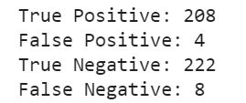
We further calculated confusion matrix

Slide 21
Acknowledgement
We would like to express our special thanks of gratitude to our professor Mr Naveen Kumar who gave us the golden opportunity to do this wonderful project, which also helped me in doing a lot of Research and i came to know about so many new things I am really thankful to them. We’d also like to thank Mrs. Sheetal Taneja for her guidance and assistance throughout the project.

Slide 22
References
1. https://apollack11.github.io/machine-learning.html
2. https://keras.io/
3. https://www.tensorflow.org/
4. https://www.healthline.com/health/lung-cancer#stages
5.https://towardsdatascience.com/building-a-convolutional-neural-network-cnn-in-keras-329fbbadc5f5
6. https://machinelearningmastery.com/tutorial-first-neural-network-python-keras/

Slide 23
THANK YOU

