Slide 1
IMAGE PROCESSING & COMPUTER VISION · COURSE PROJECT
Low-Light Image Enhancement using Spatial and Intensity-Based Techniques
Department of Computer Science & Engineering, MNNIT Allahabad
Notes:
Introduce the team and the topic: making dark photos look like they were taken in good light, comparing classical image processing with a deep learning model.

Slide 2
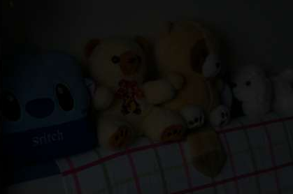
The problem with low-light images
1
Poor visibility
Objects and regions are hard to see
2
Low contrast
Intensities squeezed into a narrow dark range
3
Lost detail
Edges and textures buried in shadow and noise
4
Wrong colours
Weak, shifted colour information
This hurts object detection, segmentation, surveillance and image analysis. Goal: turn a dark image into a bright, clear, natural one.
Notes:
Explain why low-light images are a problem, using the sample image from the LOL dataset.

Slide 3
Project objectives
1
2
3
4
Implement
Train
Evaluate
Compare
five traditional enhancement techniques: Gamma, HE, CLAHE, SSR, MSR
a U-Net on paired low-light / normal-light images (LOL-v1)
every method with PSNR and SSIM on the same 15 test pairs
traditional techniques against the deep learning approach
Notes:
Four objectives: implement, train, evaluate, compare.

Slide 4
Approach overview
A · Traditional (no training)
Gamma Correction · Histogram Equalization · CLAHE · Single-Scale Retinex · Multi-Scale Retinex
Low-light image
(LOL-v1)
Evaluation
PSNR · SSIM
B · Deep learning (supervised)
Preprocessing → U-Net → L1 + SSIM loss → 50 epochs on Colab T4
Both branches are scored on the same 15 test images, so the comparison is like-for-like.
Notes:
Two branches from one input, both evaluated the same way.

Slide 5
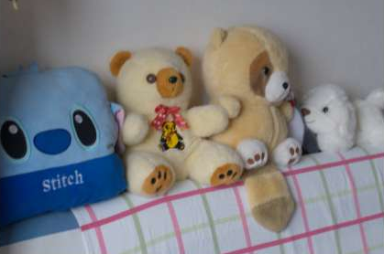
Dataset: LOL-v1 (LOw-Light)
500
paired images
485
training pairs (our485)
15
test pairs (eval15)
400×600
resolution
Low-light input
Well-lit reference
Folder structure
our485/low · our485/high → training
eval15/low · eval15/high → testing
Low and high images are paired by filename
Same scene captured under low and normal light
Real camera noise; mostly indoor scenes
Wei et al., Deep Retinex Decomposition, BMVC 2018
Notes:
The LOL dataset gives paired images, which makes supervised training and PSNR/SSIM evaluation possible.

Slide 6
Environment and data setup
1
Platform Google Colab with an NVIDIA Tesla T4 GPU; code falls back to CPU if no GPU is found
Tools & libraries
Python
PyTorch
OpenCV
NumPy · Pillow
Matplotlib
scikit-image (PSNR, SSIM)
Pandas
2
Download LOL zip (331 MB) fetched from Hugging Face directly into Colab and extracted
3
Verify Image count checked in every folder so low and high sets match
4
Clean Hidden system files (e.g. .DS_Store) filtered out so each low image pairs with exactly one high image
Notes:
Setup steps in the notebook before any processing.

Slide 7
1 · Gamma correction
I_out = I_in ^ γ , γ = 0.6
Non-linear point operation on normalised intensities [0, 1]
γ < 1 lifts dark values much more than bright ones
Simple and very fast
Cannot recover detail in extremely dark regions
On LOL test set (eval15)
PSNR 10.62 dB · SSIM 0.4726
Notes:
Gamma raises every pixel to the power 0.6. The amber curve sits above the identity line, so every pixel gets brighter, dark ones the most.

Slide 8
2 · Histogram equalization
Redistributes intensities to use the full 0–255 range
Applied only to the Y (luminance) channel in YCrCb
Cr and Cb (colour) channels are kept unchanged
Global: can look unnatural and amplify noise
Schematic histograms, for illustration
Each intensity is mapped through the cumulative distribution (CDF) of the histogram, so frequent dark levels get stretched across the range.
On LOL test set (eval15)
PSNR 14.24 dB · SSIM 0.4252
Notes:
HE uses the cumulative histogram as the mapping. The histograms here are schematic, not measured.

Slide 9
3 · CLAHE
Contrast Limited Adaptive Histogram Equalization
Divides the image into small tiles and equalizes each one locally
Clip limit 2.0 caps how much contrast is amplified
Tile grid 8 × 8, applied to the luminance channel
Interpolation hides the borders between tiles
On LOL test set (eval15)
PSNR 9.63 dB · SSIM 0.3995
8 × 8 tiles: each (e.g. the highlighted one) gets its own clipped histogram equalization
Notes:
CLAHE fixes HE's global problem by working tile by tile. It scored lowest here because it improves local contrast but barely raises overall brightness, so it stays far from the bright reference.

Slide 10
4 · Single-Scale Retinex (SSR)
R(x,y) = log I(x,y) − log [ G(x,y) * I(x,y) ]
Image = illumination × reflectance
Gaussian blur estimates the illumination
Subtracting it in log space keeps the reflectance (detail)
Gaussian scale σ = 30
One scale can't treat fine and large details equally well
Input I
Gaussian blur
σ = 30
Log difference
Reflectance R
G = Gaussian surround function, * = convolution
On LOL test set (eval15)
PSNR 13.79 dB · SSIM 0.5875
Notes:
Retinex theory: what we see is illumination times reflectance. Blur estimates illumination; removing it leaves detail.

Slide 11
5 · Multi-Scale Retinex (MSR)
Runs Retinex at three Gaussian scales and averages them
Small σ → fine detail; large σ → overall illumination
More balanced than SSR
Best traditional method by PSNR
May still show colour shifts or noise
σ = 15
fine detail
Average
→ R_MSR
σ = 80
mid-scale
σ = 250
global light
On LOL test set (eval15)
PSNR 14.87 dB · SSIM 0.5840
Notes:
MSR combines three SSR outputs, so it handles both small details and broad lighting.

Slide 12
Preprocessing for the U-Net
Load
RGB image pairs
Normalise
pixels / 255 → [0, 1]
Random crop
same 256 × 256 window on input and target
Random flip
horizontal, p = 0.5, applied to both
Tensor
channel-first C × H × W, batch of 8
Crop and flip are spatial augmentations: each epoch sees different regions of the same images
Identical transform on input and target keeps every pixel aligned with its ground truth
Augmentation only during training; test images are used at full size
Notes:
Highlighted boxes are the spatial augmentations. Applying the same crop and flip to both images is essential, otherwise the target no longer matches the input.

Slide 13
U-Net architecture
Encoder ↓ (max-pool)
Decoder ↑ (transposed conv)
32
32
skip connections
64
64
128
128
256
256
512
Bottleneck
7.76 M
trainable parameters
2 × (3×3 conv + ReLU)
in every block
1×1 conv + sigmoid
RGB output in [0, 1]
Notes:
Encoder halves resolution at each level while doubling channels. Decoder upsamples back. Skip connections copy fine detail across, which is why U-Net keeps edges sharp. Exact parameter count is 7,760,163.

Slide 14
Loss function
L_total = L1 + 0.5 × (1 − SSIM)
L1 loss
Average absolute pixel difference between prediction and ground truth
Gets brightness and colour right
SSIM term
Compares local mean, variance and covariance in 11 × 11 windows
Keeps edges, texture and structure
Combined
L1 alone tends to blur; SSIM alone can drift in colour
Pixel accuracy + structural quality
Notes:
SSIM is implemented with average pooling over 11x11 windows, constants c1 = 0.01 squared and c2 = 0.03 squared.

Slide 15
Training configuration
Epochs | 50
Optimizer | Adam
Learning rate | 0.001
LR schedule | Cosine annealing
Batch size | 8
Crop size | 256 × 256
Hardware | Tesla T4 (Colab)
Time per epoch | ≈ 14.5 s
0.1840
lowest training loss (epoch 44)
0.1872
training loss at epoch 50
Best checkpoint saved by lowest training loss. Training loss shows learning progress; test quality is measured separately with PSNR and SSIM.
Notes:
Cosine annealing smoothly lowers the learning rate over the 50 epochs. Be clear that 0.1840 is a training loss, not a test score.

Slide 16
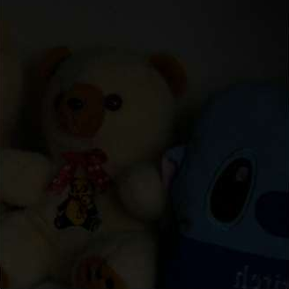
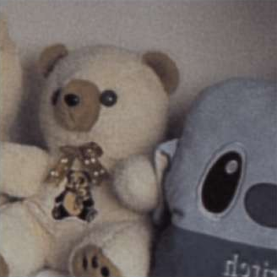
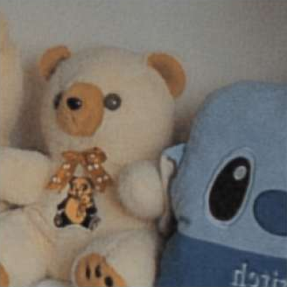


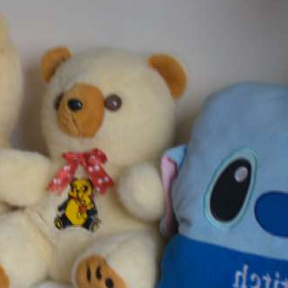
Watching the network learn
Input
Epoch 1
Epoch 5
Epoch 10
Epoch 18
Ground truth
Epoch 1
Brightness learned almost immediately, but colours washed out (loss 0.2528)
Epochs 5–10
Colour starts returning: blue body, orange ears
Epoch 18
Close to ground truth; bow and badge colours still muted (loss 0.2282)
Fixed 256 × 256 preview crop from the training set, shown after each epoch in the notebook.
Notes:
These are real notebook outputs. The preview is a training crop, so it shows learning progress, not test performance.

Slide 17
Results: U-Net outperforms every traditional method
+3.4 dB PSNR and +0.19 SSIM over the best traditional method. Evaluated on all 15 LOL test pairs with scikit-image.
Notes:
Full numbers: U-Net 18.3099 / 0.7797; MSR 14.8663 / 0.5840; HE 14.2356 / 0.4252; SSR 13.7931 / 0.5875; Gamma 10.6168 / 0.4726; CLAHE 9.6272 / 0.3995.

Slide 18
Results at a glance
Method | PSNR (dB) | SSIM
U-Net (ours) | 18.3099 | 0.7797
Multi-Scale Retinex | 14.8663 | 0.5840
Histogram Equalization | 14.2356 | 0.4252
Single-Scale Retinex | 13.7931 | 0.5875
Gamma Correction | 10.6168 | 0.4726
CLAHE | 9.6272 | 0.3995
MSR best traditional method by PSNR
SSR slightly higher SSIM than MSR (0.5875 vs 0.5840)
HE good PSNR but low SSIM: more contrast ≠ preserved structure
CLAHE boosts local contrast but barely brightens, so it stays far from the reference
Notes:
Point out that the ranking depends on the metric: SSR beats MSR on SSIM, HE beats SSR on PSNR but not SSIM.

Slide 19
Discussion and limitations
What the results show
Limitations
U-Net learns the mapping from data, so it handles brightness, colour and noise together
Traditional methods need no training and run instantly, but depend on hand-tuned parameters
PSNR and SSIM don't fully capture naturalness, noise or colour accuracy; visual inspection matters too
Small test set (15 images): small differences between methods may not be significant
LOL is mostly indoor scenes; results on outdoor or night photos may differ
Best checkpoint chosen by training loss, not a separate validation set
Notes:
Raising limitations yourself shows you understand the evaluation.

Slide 20
Conclusion
18.31 dB
U-Net PSNR
0.7797
U-Net SSIM
6
methods compared
Compared five traditional techniques with a U-Net on LOL-v1; the U-Net is best on both metrics
Among traditional methods, Retinex-based approaches are strongest
Future work: more diverse training data, more datasets (e.g. LOL-v2), extra quality measures, faster inference for real-time use
Notes:
Summarise in one breath: learned beats hand-crafted on this benchmark, Retinex is the best classical family, then future work.

Slide 21
Thank you
Questions?
Shreshtha Ojha · Singireddy Amulya Reddy · Swati · Sweta Sachan

