Slide 1

Student AI Assistant
School of Computer Science and Engineering
Department of Computer Science and Engineering
Submitted By:
Shresth Panigrahi: - 23F10CSE00669
Raaj Shekhar: - 23FE10CSE00791
Supervised By:
Dr. Jay S. Sharma

Slide 2
Outline
Introduction
Literature Review
Problem Statement
Proposed Solution
Objectives

Slide 3
Introduction
Student AI Assisstant
Real-time Speech-to-Text Transcription System for live lectures and educational content
AI-powered learning companion designed specifically for students
Intelligent Q&A capabilities to help understand lecture content better
Automated lecture analysis with summarization and key concept extraction
What It Does?
Live Transcription: Converts spoken lectures into text in real-time
Smart Q&A: Answer questions about ongoing or previous lectures instantly
Lecture Summarization: Generate comprehensive summaries of educational content
Terminology Extraction: Automatically identify and explain technical terms
Session Management: Save and revisit previous lecture transcriptions

Slide 4
System Architecture
Core Components
Main Application Controller - Central orchestration and state management
Audio Processing Layer - Real-time capture with VAD and buffering
Speech Recognition Engine - WhisperLive integration for transcription
AI Processing Pipeline - QA agent and lecture summarizer
User Interface - CustomTkinter-based modern GUI
Key Technologies
WhisperLive (claudev4.py) - Real-time speech-to-text transcription
LangGraph & Ollama - Local AI processing with Gemma 2B model
FAISS Vector Store - Efficient similarity search for Q&A
Multi-threaded Architecture - Background processing and UI responsiveness
Data Flow
Audio Input → VAD Processing → Transcription → AI Analysis → UI Display
Thread-safe communication between all components
JSON-based persistence for chat history and sessions
Design Principles
Modular Structure - Separate files for each functionality
Local Processing - Privacy-focused with no cloud dependencies
Real-time Performance - Concurrent processing with intelligent buffering

Slide 5
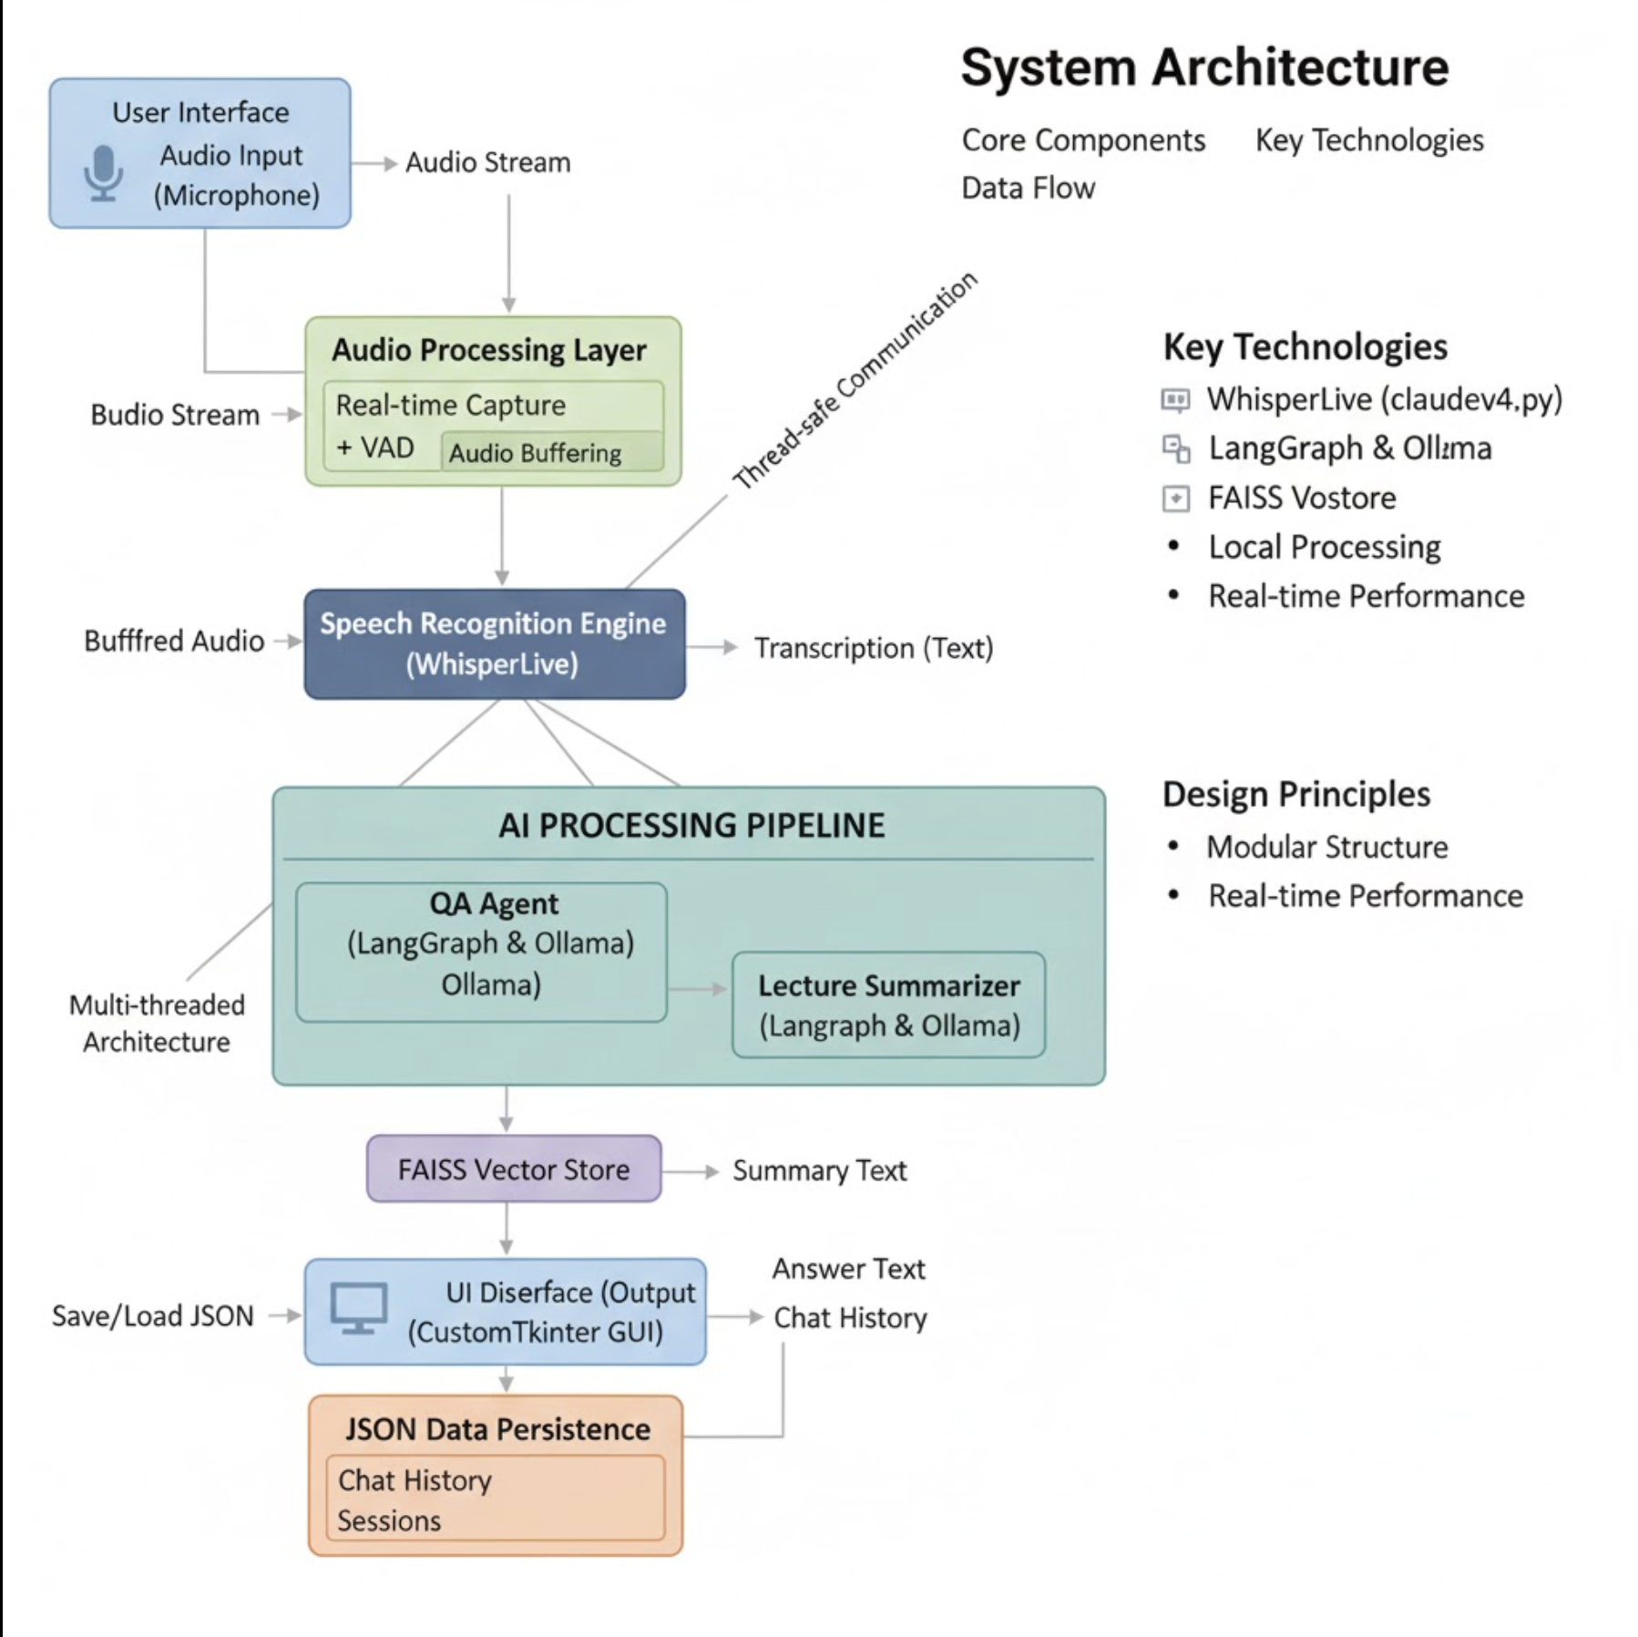

Slide 6
Literature Review
Core Technologies Implemented
WhisperLive - Real-Time Transcription
Colabora's WhisperLive implementation for nearly-live speech-to-text conversion​
Faster-Whisper backend using OpenAI's Whisper model for accurate transcription​
Intelligent buffering with sentence-level segmentation and redundancy removal​
Performance optimization with Real-Time Factor (RTF) monitoring for low-latency processing​
Voice Activity Detection (VAD)
WebRTC VAD with configurable aggressiveness levels (0-3) for speech detection​
Frame-based processing at 30ms intervals with padding for smoother transitions​
Threshold tuning for voiced (0.8) and unvoiced (0.95) speech classification​
AI Processing Technologies
LangGraph & LangChain Framework
State-based workflows for building complex AI agent pipelines​
Message handling with HumanMessage and AIMessage for conversation management​
Memory management using ChatMessageHistory for context-aware responses​
Multi-stage processing with chunking, terminology extraction, and summarization​
Vector Storage & Semantic Search
FAISS indexing with 1024-dimensional embeddings for similarity search​
Ollama mxbai-embed-large model for generating semantic embeddings​
Cosine similarity with threshold 0.35 for context retrieval​
Efficient retrieval for question answering with relevant transcript segments

Slide 7
Advanced Features
Local LLM Integration
Ollama framework for running local language models without cloud dependencies​
Gemma 2B model for conversational AI and question answering​
Temperature control (0) for consistent, deterministic responses​
Tavily search integration for terminology definitions and external knowledge​
Transcript Processing Pipeline
Multi-threaded architecture with separate threads for recording and transcription​
Queue-based audio streaming for non-blocking real-time processing​
Post-processing refinement for grammar correction and formatting​
Confidence scoring for filtering low-quality transcription segments​
Enhanced Lecture Summarization
Text chunking with RecursiveCharacterTextSplitter for manageable processing​
LLM-based terminology extraction with regex filtering for technical terms​
Structured output generation with key concepts and comprehensive summaries​
Performance metrics tracking including processing time and memory usage

Slide 8
Problem Statement
Transforming the Learning Ecology: Designing a Proactive AI Assistant for Maximizing Engagement and Knowledge Retention in Live Instructional Settings.

Slide 9
Objectives
Primary Goal:
Develop an on-device AI Student Assistant for real-time lecture transcription, intelligent Q&A, and automated summarization.
Key Features:
Real-Time Transcription: - WhisperLive-based low-latency speech-to-text with VAD, multi-language (English only) support.
Intelligent Q&A: - Contextual question answering using LangGraph agents, FAISS semantic search, and local Gemma 2B-LLM.
Lecture Analysis: - Auto-summarization, key term extraction, and concept categorization with integrated definitions.
User Experience: - Modern CustomTkinter UI, session management, privacy-focused local processing, and optimized performance.
Expected Impact:
Boosts learning efficiency & retention
Enables self-paced, accessible, AI-assisted study experiences

Slide 10
Proposed Methodology
System Workflow
Step 1: Audio Capture & Processing
Audio input: 16kHz sampling rate with mono channel configuration​
VAD implementation: WebRTC VAD (aggressiveness level 3) for speech detection​
Queue-based streaming: Thread-safe audio transfer for real-time processing​
Step 2: Speech-to-Text Transcription
WhisperLive integration: Colabora's real-time transcription engine
Sentence buffering: Intelligent segmentation with redundancy removal
Quality filtering: Confidence threshold (0.6) for accurate transcripts
Transcript refinement: Post-processing with grammar correction using Ollama

Slide 11
Step 3: AI-Powered Question Answering
Vector embeddings: Ollama mxbai-embed-large for 1024-dimensional vectors​
FAISS indexing: Similarity search with 0.35 threshold for context retrieval​
LangGraph workflow: State-based agent with Gemma 2B for responses​
Memory management: ChatMessageHistory for conversation continuity​
Step 4: Lecture Analysis
Text chunking: 2000-character chunks with 200-character overlap​
LLM-based extraction: Terminology identification and definition generation​
Multi-stage summarization: Chunk summaries followed by final synthesis​
Tavily integration: External knowledge retrieval for comprehensive definitions​
Step 5: User Interface & Integration
CustomTkinter GUI: Three-view architecture (dashboard, recording, history)​
Multi-threaded design: Separate threads for audio, transcription, and UI​
JSON storage: Persistent session management with chat history​
Event-driven updates: Real-time display with callback-based communication​

Slide 12
Result
Component | Technology | Function
WhisperModelWrapper | OpenAI Whisper | Real-time speech transcription
QA_Agent | LangChain + LangGraph | Context-aware question answering
AudioProcessor | PyAudio + WebRTC VAD | Audio capture and processing
EnhancedLectureTranscriptSummarizer | Ollama LLM | Advanced text analysis
AppUI | AppUI | Modern user interface

Slide 13
Key Features Implemented
Audio processing at 16 kHz sampling rate
Low-latency transcription with intelligent buffering
Vector similarity search with 1024-dimensional embeddings
Multi-threaded architecture ensuring responsive user experience

Slide 14
References
Radford, A., et al. "Robust Speech Recognition via Large-Scale Weak Supervision." ICML 2023.
2. Chase, H. "LangChain: Building applications with LLMs through composability." 2022.
3. Johnson, J., Douze, M., & Jégou, H. "Billion-scale similarity search with GPUs." IEEE Transactions on Big Data, 2019.

Slide 15
Thank You

