Slide 1
NATURAL LANGUAGE PROCESSING · PROJECT
Sentiment
Analysis
TEAM MEMBERS
Siddharth Kumar Purbey
Divy Agrawal
Shresth Rastogi
Mukund AnilKumar
of IMDB Movie Reviews
FACULTY
using TF-IDF and Logistic Regression
Dr. Nabanita Choudhury
B.B.A (AI) 2026-27 · SAII, Pune
+
–

Slide 2
PROBLEM STATEMENT
The problem and our objective
PROBLEM
OBJECTIVE
Millions of movie reviews exist and nobody can read them all. Given the text of one review, can a computer decide if the writer felt positive or negative? Input: an English review. Output: one of two labels.
Build a complete, easy-to-explain baseline pipeline: clean the text, turn it into numbers, train a classifier, test it honestly, and understand why it predicts what it does.
“Brilliant movie, great acting!” → Positive
“Boring plot, a waste of time.” → Negative
Clear steps over a black box.

Slide 3
DATA PREPROCESSING
Cleaning pipeline, step by step
1
Remove duplicates
2
Lowercase + tokenise
3
Remove HTML tags
418 copied reviews dropped: 50,000 → 49,582.
“Great” = “great”. Regex [a-z']+ splits into words.
Strip leftovers like <br /> using the pattern <.*?>.
4
Letters only
5
Stop-word filter
6
Length filter
Digits and punctuation become spaces: “you'll” → you, ll.
Keep not, no, nor, never, cannot so meaning is safe.
Drop 1-letter tokens left from apostrophe splits.
BEFORE One of the other reviewers has mentioned that after watching just 1 Oz episode you'll be hooked…
AFTER reviewers mentioned watching just oz episode ll hooked right exactly happened…

Slide 4
DATASET DESCRIPTION
IMDB Large Movie Review Dataset
Dataset | IMDB Large Movie Review Dataset
Source | Kaggle · Stanford, Maas et al. (2011)
Size | 50,000 reviews, 2 columns
Columns | review (text), sentiment (label)
Language | English, informal web text
Classes | 25,000 positive · 25,000 negative
Missing | 0 missing values
Duplicates | 418 removed → 49,582 unique
58.4%
56.0%
contain HTML tags
contain digits
9.3%
~170
non-ASCII characters
median words per review
Perfectly balanced classes, so accuracy is a fair score.

Slide 5
NLP MODEL PIPELINE
From raw review to prediction
›
›
1
Load & explore
2
Clean text
3
Split data
Read the 50,000-review CSV. Check balance, duplicates and length.
Lowercase, remove HTML and symbols, drop stop-words but keep “not”.
80/20 stratified split: 39,665 train, 9,917 test. Done before any fitting.
›
›
4
TF-IDF features
5
Train model
6
Evaluate & predict
Top 5,000 words and word-pairs, learned from training text only.
Logistic Regression learns one weight for every feature.
Score the unseen test set, then predict brand-new reviews.

Slide 6
NLP MODELS & TECHNIQUES
The tools we used
1
Tokenisation
Logistic Regression
Splits text into words with a regex
Multiply each word score by its weight
Add everything up
Sigmoid turns the total into a probability
Above 0.5 = Positive, else Negative
2
Stop-word handling
Removes filler, keeps “not” and “never”
3
N-grams (1 and 2)
Catches pairs like “not good”
L2 regularisation · C = 1.0 · 1000 iterations. Fast, simple, and we can read its weights.
4
TF-IDF
Rare, meaningful words score higher

Slide 7
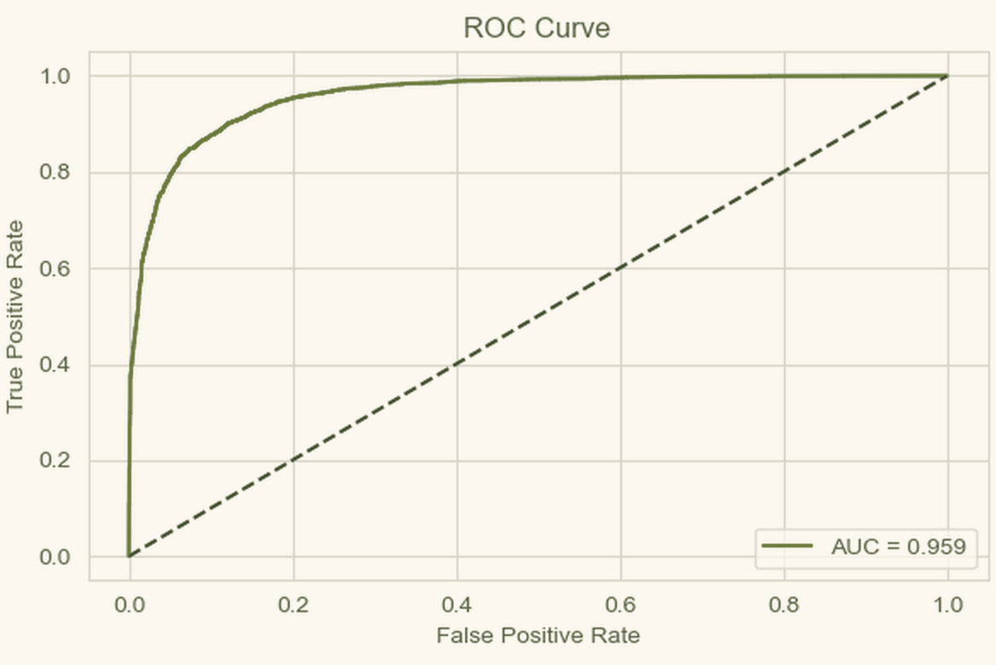
EVALUATION
How well does it work?
88.9%
0.959
Accuracy
ROC-AUC
0.89
0.89
F1-score (avg)
Recall (avg)
Class | Precision | Recall | F1
Negative | 0.90 | 0.87 | 0.89
Positive | 0.88 | 0.90 | 0.89
AUC-ROC: the curve hugs the top-left corner. Dashed line = random guessing.
Tested on 9,917 unseen reviews

Slide 8
LIMITATIONS
Where the model struggles
Only two labels
Sarcasm & long negation
Old, single domain
Neutral or mixed reviews are forced into positive or negative.
Happy-looking words can hide anger; only short pairs are caught.
Trained on 2011 film reviews. New text needs retraining.
Unsure zone
Misuse risk
EXAMPLE
“It was okay, not great but not bad either.”
Model: NEGATIVE. Human: neutral.
Predictions between 0.3 and 0.7 are right only about half the time.
Must never be used to score or rank people.

Slide 9
FUTURE SCOPE
What we can do next
1
Try transformers
Fine-tune DistilBERT to handle sarcasm and long negation.
2
Add a neutral class
Use 3 classes or star ratings for mixed opinions.
3
Trust the confidence
Calibrate probabilities; send unsure reviews to a human.
4
Test other domains
Check product and app reviews without retraining.
5
Build a web app
Paste a review, see the label and the words behind it.
Thank you! Any questions?

