Slide 1



VIRTUAL THERAPY CHATBOT
Bridging the Gap in Mental Health Support
Team 10:
Shrestha Bhandari
Harika Suravarapu
Shruti Bandula

Slide 2
OVERVIEW
Introduction
Result
Objective
Conclusion
Approaches
Reference
Evaluation

Slide 3
INTRODUCTION
Problem Statement:
Access to mental health support is frequently hindered by high costs, societal stigma, and limited availability.
There is a growing need for a compassionate, affordable, and easily accessible solution to address these barriers.
Solution Statement:
Develop a virtual therapy chatbot that offers 24/7 accessible, empathetic, and personalized mental health support, overcoming barriers like cost, stigma, and availability.
Provide a compassionate, low-cost alternative to traditional therapy, ensuring users can seek help without the fear of judgment or financial strain.

Slide 4
OBJECTIVE
Build a chatbot capable of empathetic and supportive conversations.
Maintain conversational context over multi-turn dialogues.
Evaluate the chatbot's effectiveness

Slide 5
APPROACHES
Approach 1 : Data Ingestion and Document Retrieval
Document Loading and Preprocessing:
Load documents (e.g., PDFs) using DirectoryLoader and PyPDFLoader.
Preprocess the content using RecursiveCharacterTextSplitter to break documents into chunks for easier processing.
Vector Database Creation:
Convert text chunks into semantic vector embeddings using Hugging Face's all-MiniLM-L6-v2 model.
Store these vectors in a FAISS vector store for efficient retrieval based on user queries.

Slide 6
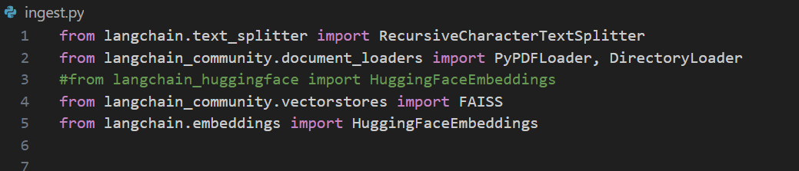
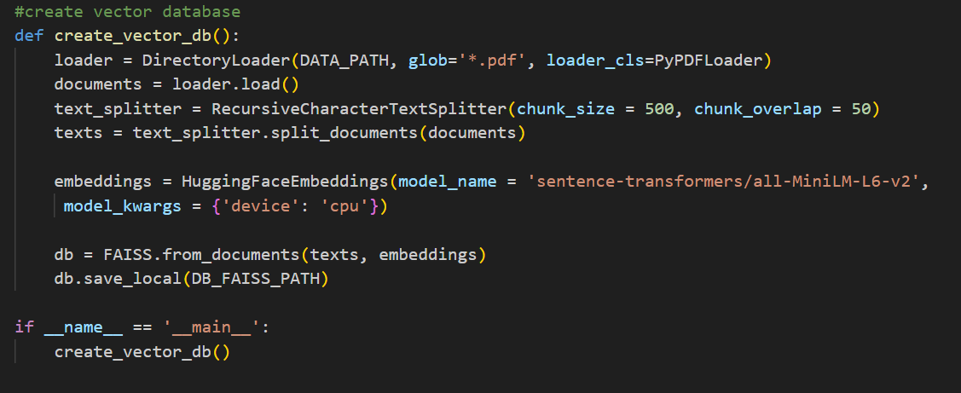
Code Snippet For Approach 1

Slide 7
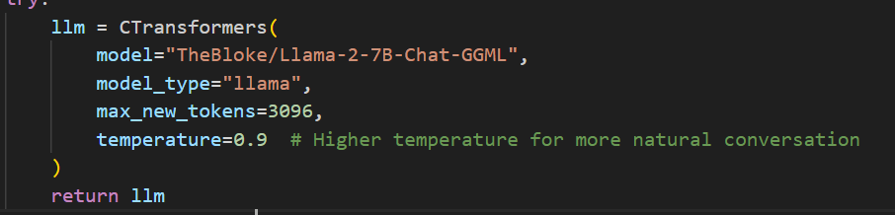
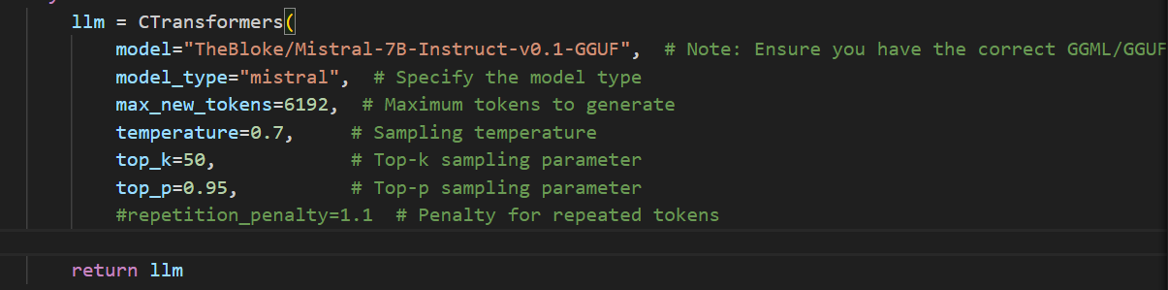
The two models we have used in this project are:

Slide 8
Approach 2 : Conversational Agent with Empathy and Contextual
Understanding
Empathetic Prompt Design:
Use a custom prompt template to generate warm, compassionate, and context-aware responses.
Contextual Response Generation:
Integrate the CTransformers LLaMA 2 and Mistral model to generate responses.
Incorporate conversation history and retrieved documents for personalized responses.
Greeting Handling:
Separate logic to recognize and respond to user greetings with friendly, supportive messages.

Slide 9
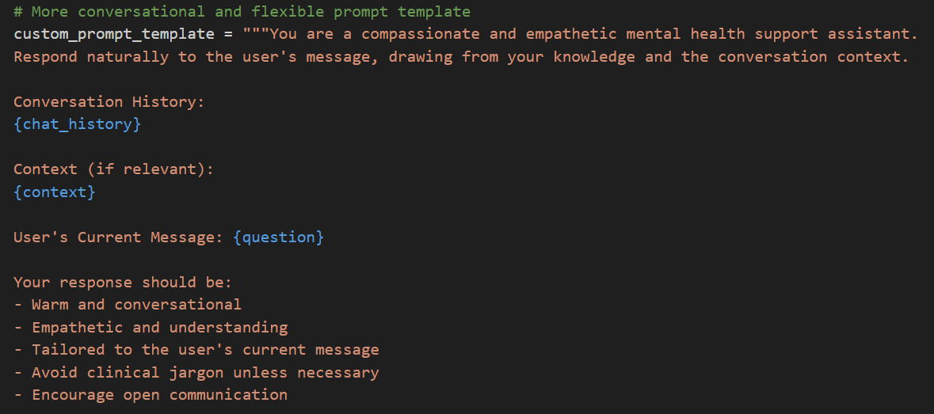
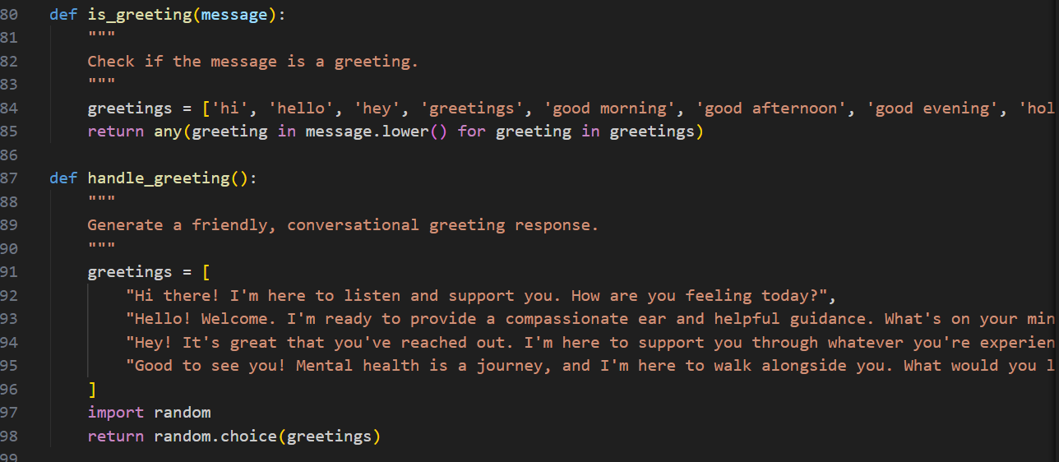
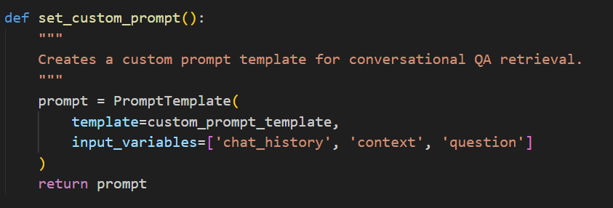
Code Snippet For Approach 2

Slide 10
Approach 3 : Integration and Session Management
User Input Handling:
Detect greetings and provide a personalized response.
For other queries, retrieve relevant documents and generate appropriate responses using the LLaMA 2 and Mistral model.
Session Management:
Maintain conversation history and context throughout the interaction.
Store session components in the user session for continuity over multi-turn dialogues.

Slide 11
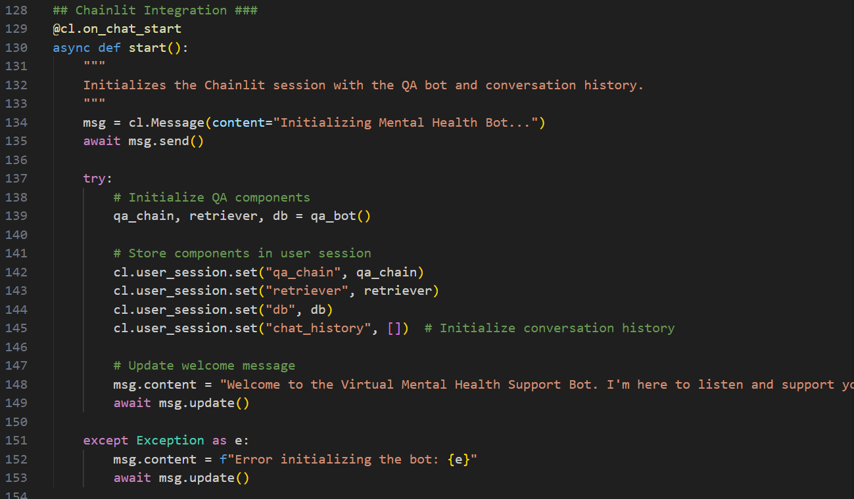
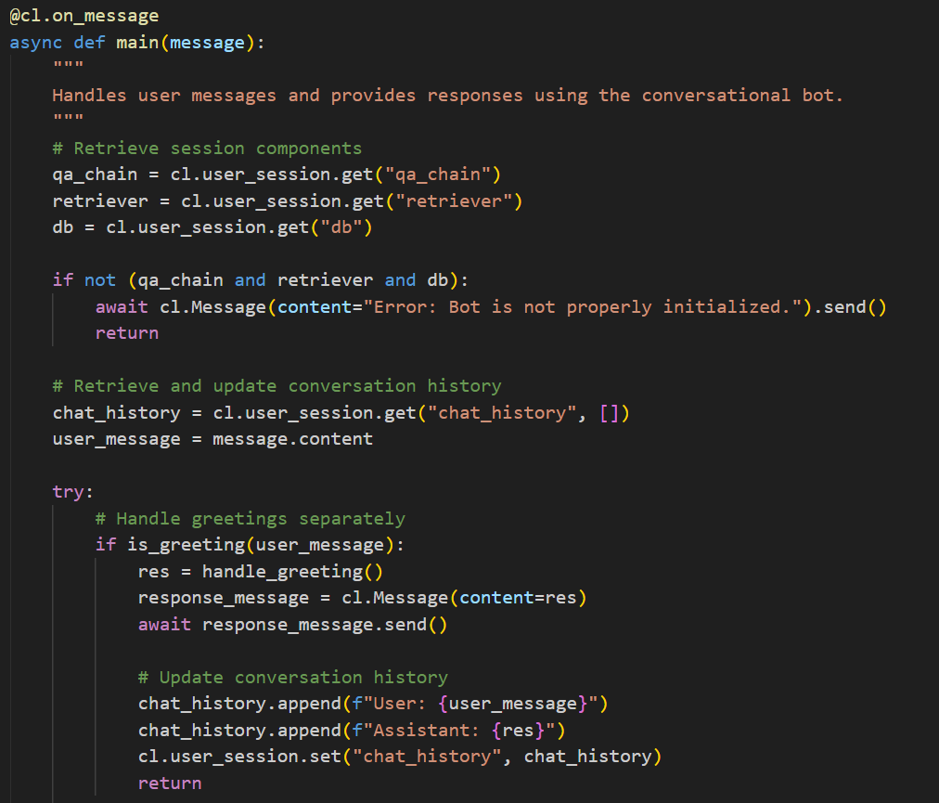
Code Snippet For Approach 3

Slide 12
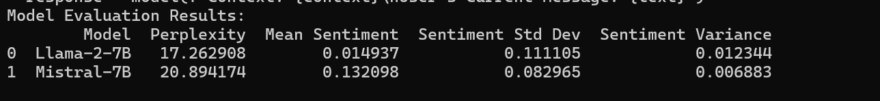
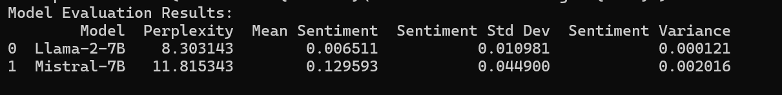
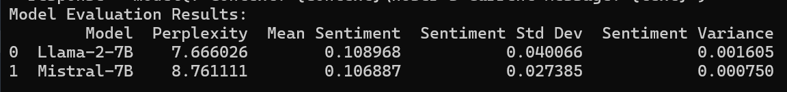
EVALUATION

Slide 13
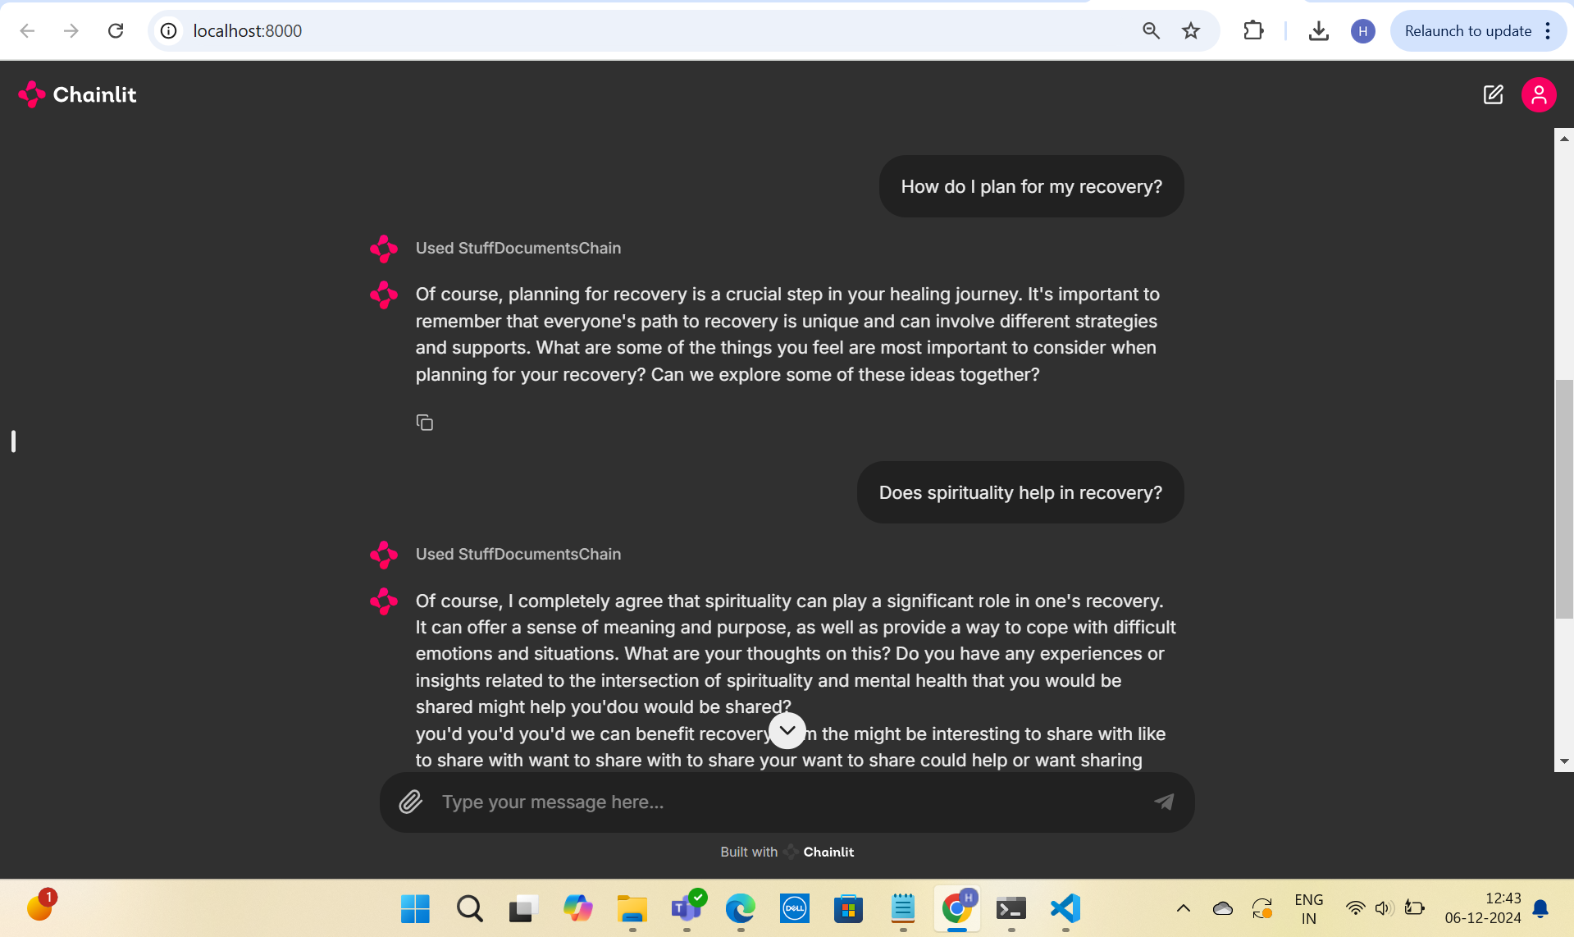

RESULT

Slide 14
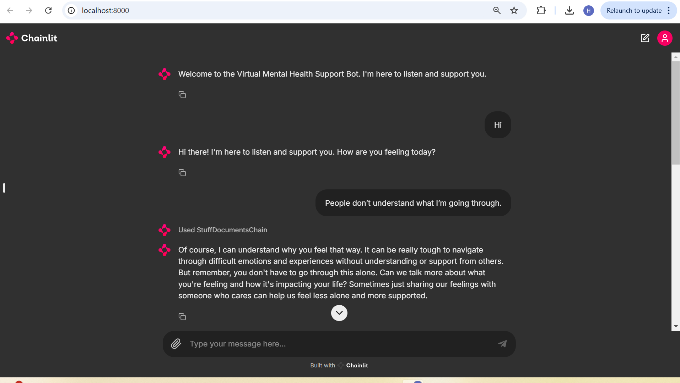
RESULT

Slide 15
CONCLUSION
Performance Comparison:
Perplexity: Llama-2-7B consistently achieved lower scores, demonstrating better coherence and contextual relevance.
Mean Sentiment: Mistral-7B exhibited higher sentiment values, maintaining a more positive tone in conversations.
Sentiment Variability:
Llama-2-7B: Lower standard deviation and variance in later evaluations, ensuring more stable and consistent tone.
Mistral-7B: Higher variability initially, reflecting greater adaptability but less stability.
Model Strengths:
Llama-2-7B: Ideal for scenarios requiring reliable, contextually accurate responses.
Mistral-7B: Suited for applications prioritizing emotional upliftment and adaptability.

Slide 16
Thank You

