Slide 1


50
YEARS
H
ESTD. 1975
HANUMAN PRASAD PODDAR CANCER HOSPITAL & RESEARCH INSTITUTE
CITY-WIDE CANCER
AWARENESS DRIVE
Know. Check. Act. Don't Delay.
A community-led digital & social awareness initiative for early cancer detection
Organised by
Hanuman Prasad Poddar Cancer Hospital & Research Institute, Gorakhpur
Celebrating 50 Years • Estd. 1975

Slide 2
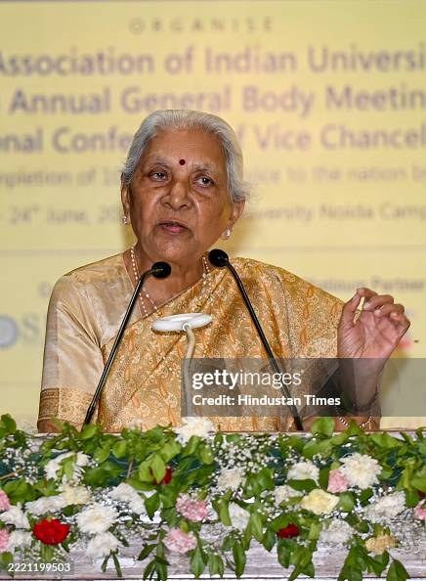
H
HANUMAN PRASAD PODDAR CANCER HOSPITAL & RESEARCH INSTITUTE
MESSAGE OF SUPPORT
A Message from the Hon'ble Governor
“
AP
मुझे यह जानकर अत्यंत हर्ष हो रहा है कि पूर्वांचल के युवाओं, विशेषकर गोरखपुर में, दीनदयाल उपाध्याय गोरखपुर विश्वविद्यालय, हनुमान प्रसाद पोद्दार कैंसर अस्पताल एवं शोध संस्थान, एम्स-गोरखपुर, बी.आर.डी. मेडिकल कॉलेज, श्री गोरक्षनाथ मेडिकल कॉलेज, स्वास्थ्य विभाग समेत अनेक संस्थाओं द्वारा संयुक्त रूप से कैंसर जागरूकता अभियान संचालित किया जा रहा है, और एक लघु पुस्तिका ‘युवा संचार’ का प्रकाशन किया जा रहा है।
Anandiben Patel
Governor, Uttar Pradesh
— आनंदीबेन पटेल, राज्यपाल, उत्तर प्रदेश
The most effective way to fight a serious disease like cancer is timely diagnosis, awareness and appropriate treatment. This collective effort will help establish Gorakhpur as a model city in cancer prevention and treatment.
Cancer-Related Information & Assistance — Toll-Free: 1800 890 7526

Slide 3
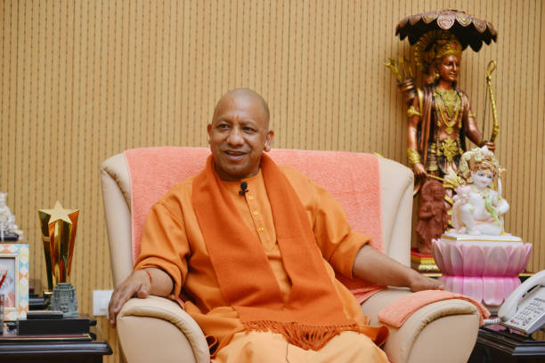
H
HANUMAN PRASAD PODDAR CANCER HOSPITAL & RESEARCH INSTITUTE
MESSAGE OF SUPPORT
A Message from the Hon'ble Chief Minister
“
मुझे यह जानकर अत्यंत प्रसन्नता की अनुभूति हो रही है कि हनुमान प्रसाद पोद्दार कैंसर अस्पताल एवं शोध संस्थान, गीता वाटिका, गोरखपुर की स्थापना के 50 वर्ष पूर्ण होने के अवसर पर ‘कैंसर जागरूकता अभियान’ संचालित किया जा रहा है। कैंसर जैसी गंभीर बीमारी के निदान के लिए उचित मार्गदर्शन और समय से उपचार अति आवश्यक है। जागरूकता के माध्यम से लोगों को कैंसर से बचाव और इसके प्रारम्भिक लक्षणों की पहचान की जानकारी सकारात्मक परिणाम दे सकती है।
Yogi Adityanath
Chief Minister, Uttar Pradesh
— योगी आदित्यनाथ, मुख्यमंत्री, उत्तर प्रदेश
“Nar Seva–Narayan Seva” was the guiding motto of Bhaiji Shri Hanuman Prasad Poddar. In his memory, the hospital continues this commendable work of service to society, and the Cancer Awareness Campaign in its Golden Jubilee year is highly commendable.
Cancer-Related Information & Assistance — Toll-Free: 1800 890 7526

Slide 4
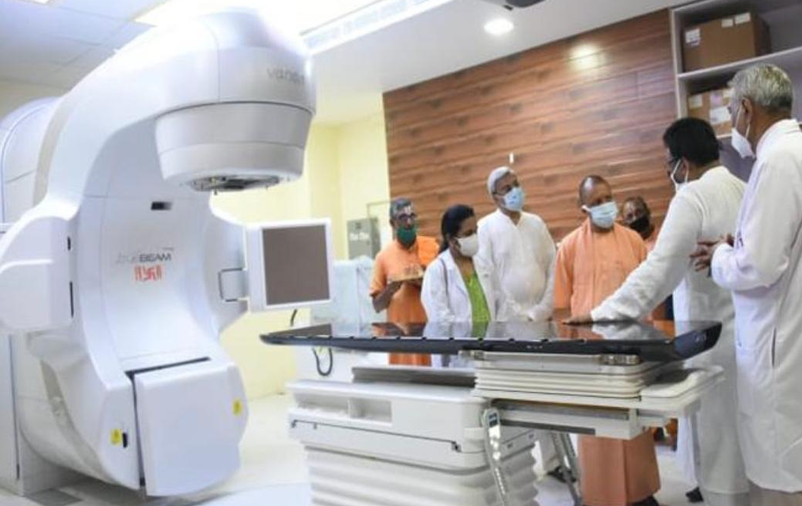
H
HANUMAN PRASAD PODDAR CANCER HOSPITAL & RESEARCH INSTITUTE
ABOUT HPPCHRI
Who We Are
Hanuman Prasad Poddar Cancer Hospital & Research Institute, Gorakhpur
Our Roots
Our Facilities
Founded in 1982 at Gita Vatika, Gorakhpur, serving 13 districts
of eastern UP, Bihar & Nepal.
With a strong legacy of service and compassion, the hospital aims to make quality cancer care accessible across Eastern Uttar Pradesh and adjoining regions.
Major services include Radiation,
Medical & Surgical Oncology,
Diagnostics, Palliative Care and Rehabilitation.
The hospital is equipped with
advanced facilities including
TrueBeam, Linear Accelerators, Cobalt Teletherapy, HDR Brachytherapy, CT, Mammography and Pathology.
Growing Reach
New patient volumes grew from 4,060 (2022) to 5,036 (2024); NABH-accredited
& HBCR-reporting since 2022.
Our Motto
“Seva of Artnarayan” — compassionate cancer care for all, regardless of means.
Cancer-Related Information & Assistance — Toll-Free: 1800 890 7526

Slide 5

H
HANUMAN PRASAD PODDAR CANCER HOSPITAL & RESEARCH INSTITUTE
CAMPAIGN INTRODUCTION
Why This Campaign?
50 Years of Saving Lives — Now, Let’s Help People Come Earlier.
1
For 50 years, HPPCHRI has stood beside cancer patients and their families, offering treatment, hope and care through some of their most difficult moments.
Cancer awareness saves lives — not by promising cures, but by moving people from silence to timely action.
2
The challenge is not only treating cancer — it is helping people recognise it before it is too late. A warning sign noticed today, a check-up taken today, can change the course of a life tomorrow.
We want every person to know the signs, seek timely medical advice, and reach a hospital early — because the earlier we find cancer, the more chances we have to save a life.
3
Cancer-Related Information & Assistance — Toll-Free: 1800 890 7526

Slide 6
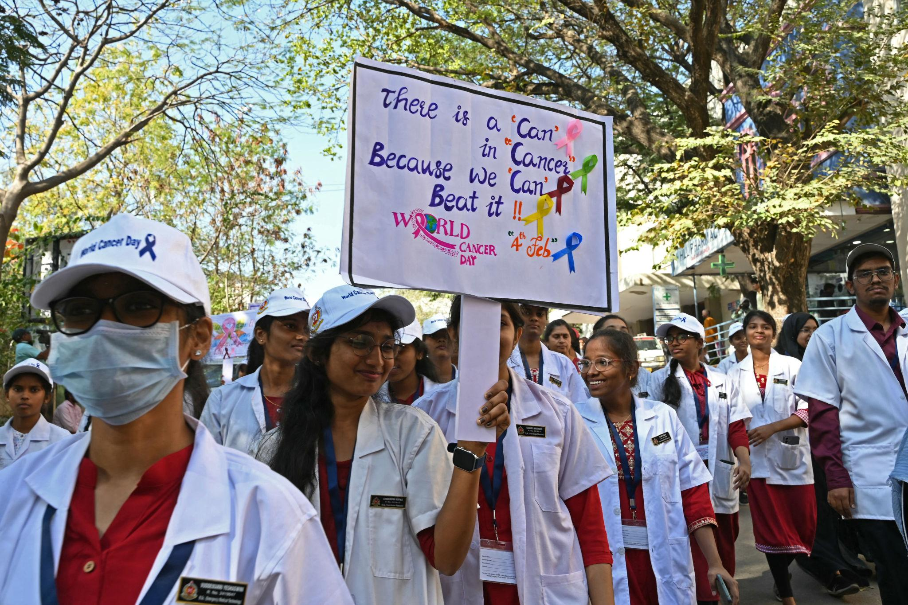
H
HANUMAN PRASAD PODDAR CANCER HOSPITAL & RESEARCH INSTITUTE
A REAL-WORLD EXAMPLE
Hyderabad: Community Awareness in Action
A city-wide cancer screening & awareness drive — hospitals, students, doctors and community organisations working together.
~30%
improvement in
early detection
Earlier detection helped people reach treatment sooner.
Cancer-Related Information & Assistance — Toll-Free: 1800 890 7526

Slide 7
H
HANUMAN PRASAD PODDAR CANCER HOSPITAL & RESEARCH INSTITUTE
A REAL-WORLD EXAMPLE
London: Regular Check-Ups, Earlier Diagnosis
What the model shows
CAMPAIGN MESSAGE
A structured community screening effort focused on early-stage (Stage 1–2) diagnosis
Regular or mandatory workplace/community health check-ups support earlier detection
Consistent follow-up pathways help move people from screening to timely treatment
Regular check-ups can catch cancer at Stage 1–2, when treatment options are strongest.
⚠ Needs verification before publishing: the requested claim that the London programme recorded “no Stage 3–4 diagnoses” could not be confirmed from available sources and appears inconsistent with how cancer screening programmes typically report outcomes. Please supply the exact source/report before this statistic is used publicly — until then, keep this slide to the verified points above.
Cancer-Related Information & Assistance — Toll-Free: 1800 890 7526

Slide 8

H
HANUMAN PRASAD PODDAR CANCER HOSPITAL & RESEARCH INSTITUTE
FROM AWARENESS TO ACTION
Why Gorakhpur Needs This
The campaign aims to make cancer awareness a city-wide conversation.
Cancer-Related Information & Assistance — Toll-Free: 1800 890 7526

Slide 9
H
HANUMAN PRASAD PODDAR CANCER HOSPITAL & RESEARCH INSTITUTE
THE CORE IDEA
The Campaign Concept
A city-wide digital cancer awareness movement led by citizens, students, influencers, institutions and HPPCHRI — encouraging people to understand cancer risk, recognise warning signs, and take timely medical advice or screening where appropriate.
HPPCHRI is the organiser and facilitator of awareness — not the only destination being promoted for screening. This keeps the campaign genuinely public-interest focused, and is exactly what makes it credible to sponsors.
AN IMPORTANT DISTINCTION
Cancer-Related Information & Assistance — Toll-Free: 1800 890 7526

Slide 10
H
HPPCHRI
DIGITAL HOME BASE
The Campaign Landing Page
A single dedicated page on the HPPCHRI website — now built around a proper registration form.
PAGE SECTIONS
REGISTRATION FORM — FIELDS COLLECTED
What is the campaign?
Why early detection matters
Who can participate?
How to participate — Registration Form
Rules
Topics
Prizes
Participating institutions
Sponsors
✓ Full Name
✓ WhatsApp Number
✓ Institution / Club
✓ Are you active on social media? (Yes / No)
↳ If Yes: Platform + User ID / Handle
✓ Participant Category — Club Member / Student / Influencer
Participant category feeds directly into Contest Categories & the Influencer follower-benchmark check.
Cancer-Related Information & Assistance — Toll-Free: 1800 890 7526

Slide 11

H
HANUMAN PRASAD PODDAR CANCER HOSPITAL & RESEARCH INSTITUTE
EXECUTION PLAN
Campaign Duration
A highly visible launch event — the HPPCHRI Cancer Awareness Drive Launch.
Inaguration: October 7, 2026
(Bhaiji Jayanti)
Closing Cermony: Februrary 4, 2027 (World Cancer Day)
Simultaneous publishing creates the initial spike
✓
✓
✓
✓
Cancer-Related Information & Assistance — Toll-Free: 1800 890 7526

Slide 12
H
HANUMAN PRASAD PODDAR CANCER HOSPITAL & RESEARCH INSTITUTE
PARTICIPATION & REACH MODEL
The Audience We're Aiming to Reach
Working estimates from our planning model — before organic sharing and word-of-mouth amplification.
1
2
3
4
Colleges &
Universities
Schools
Influencers &
Creators
Co-Host Clubs
180,000 students
150,000 students
25 influencers
20 Clubs
25% reach assumption across 150 colleges (~900,000 population)
10% reach assumption across 1,500 schools (~1,500,000 population)
50% participation assumption from ~50 Gorakhpur creators
Reach figures pending confirmation with partner clubs
Combined potential reach: 330,000+ students across colleges and schools, plus 25 activated influencer accounts — before organic sharing multiplies it further.
Cancer-Related Information & Assistance — Toll-Free: 1800 890 7526

Slide 13
H
HANUMAN PRASAD PODDAR CANCER HOSPITAL & RESEARCH INSTITUTE
CONTEST STRUCTURE
Contest Categories
General participation categories — judged within their own group, separate from the Influencer category.
1
Club Members
2
Students
Participants from the GKP clubs co-hosting the Cancer Awareness Drive with HPPCHRI.
School and college students taking part individually or through their institution.
In each category, the prize goes to the participant who spreads the most awareness — judged by reach and impressions on their posts. Club Members and Students compete only within their own category.
Cancer-Related Information & Assistance — Toll-Free: 1800 890 7526

Slide 14
H
HANUMAN PRASAD PODDAR CANCER HOSPITAL & RESEARCH INSTITUTE
CONTEST STRUCTURE
Influencer Category
3
Content creators and social-media influencers
WHY A SEPARATE CATEGORY
Influencers reach very different audience sizes than students or club members
Judging influencers separately keeps the leaderboard fair for first-time student participants
Rewards genuine, high-quality awareness content from established creators
A dedicated category so genuine reach and content quality are rewarded fairly — without competing against student or club submissions.
ELIGIBILITY BENCHMARK
HOW INFLUENCERS ARE JUDGED
10,000+
Ranked by reach & impressions, within the Influencer category only
Top performers receive premium goodies (see Recognition slide)
followers on the platform of participation, verified at registration
Cancer-Related Information & Assistance — Toll-Free: 1800 890 7526

Slide 15
H
HANUMAN PRASAD PODDAR CANCER HOSPITAL & RESEARCH INSTITUTE
PARTNER RECOGNITION
Institute & Club Recognition
1
2
3
4
Memento
Certificate
Display Banner
Awareness Posters
Presented to every participating institute
Awarded to every influencer and every participating club
Provided to each club for display outside their office
5 posters provided to each club member for local distribution
CLUB CONTRIBUTION
TARGET REACH
₹11,000
19–20 clubs
requested contribution from each participating club, toward mementos, banners, posters & certificates
targeted for partnership across Gorakhpur
Cancer-Related Information & Assistance — Toll-Free: 1800 890 7526

Slide 16
H
HANUMAN PRASAD PODDAR CANCER HOSPITAL & RESEARCH INSTITUTE
SELECTION & RECOGNITION MODEL
Recognizing Excellence: The Top 1% Model
Achievers are identified from our reach estimates, then rewarded across four tiers of recognition.
1
2
3
4
College Achievers
Student Achievers
Influencer Achievers
Grand Prize Winners
1,800 students
1,500 students
5 influencers
3 champions
Top 1% of the 180,000 students reached receive recognition goodies
Top 1% of the 150,000 students reached receive recognition goodies
Highest-performing participating influencers receive premium goodies
Overall Awareness Champions take home the Laptop, Tablet & Smartwatch
Every winner is judged by reach and impressions on their posts — plus 100 additional certificates and mementos awarded citywide, so many more people have a genuine reason to participate.
Cancer-Related Information & Assistance — Toll-Free: 1800 890 7526

Slide 17

H
HANUMAN PRASAD PODDAR CANCER HOSPITAL & RESEARCH INSTITUTE
MAKING ENTRIES VERIFIABLE
Registration Prerequisites
Every participant completes both steps before their content is a valid, judgeable entry.
Scan the official campaign QR code (posters, campus kit, landing page)
Complete the registration form (see Landing Page)
Registration must happen before content is published
Tag the official HPPCHRI hospital page on every post
Use the official campaign hashtag in the same post
Untagged, unregistered entries cannot be tracked or verified
Registration = Scan the QR code + Tag the HPPCHRI hospital page in every submission.
Cancer-Related Information & Assistance — Toll-Free: 1800 890 7526

Slide 18

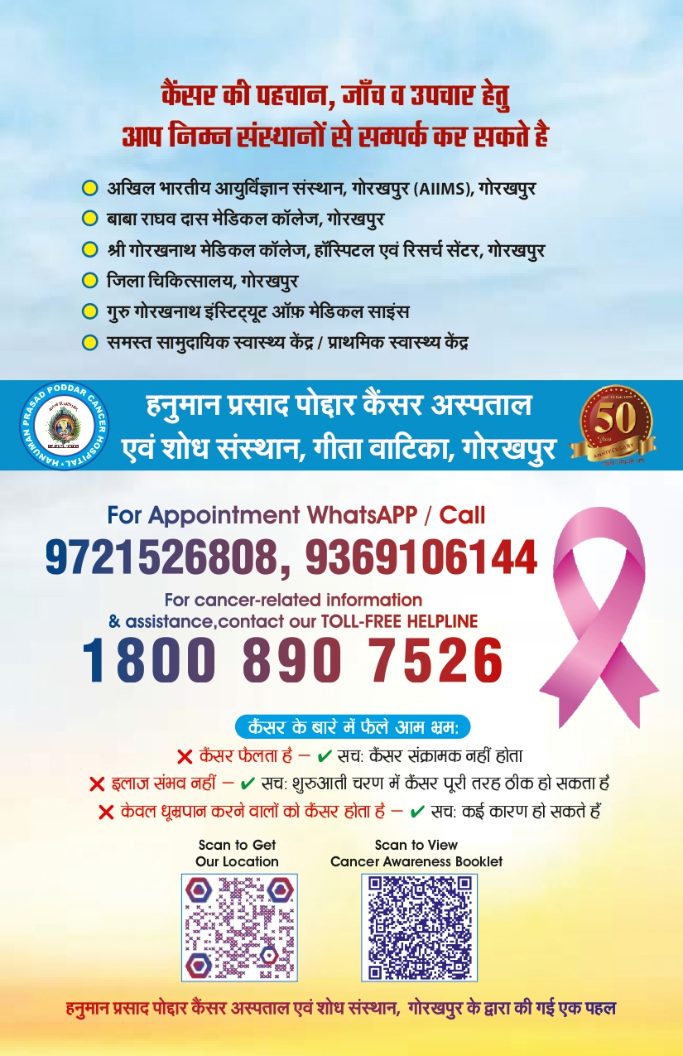
H
HANUMAN PRASAD PODDAR CANCER HOSPITAL & RESEARCH INSTITUTE
ONE VERIFIED CONTENT SOURCE
Yuva Sanchar
“Jago Yuva – Badlo Zindagi”
The campaign content will be based on the Yuva Sanchar booklet, developed
with contributions from medical and institutional experts.
Content Principle
Accuracy Before Virality.
Cancer-Related Information & Assistance — Toll-Free: 1800 890 7526

Slide 19
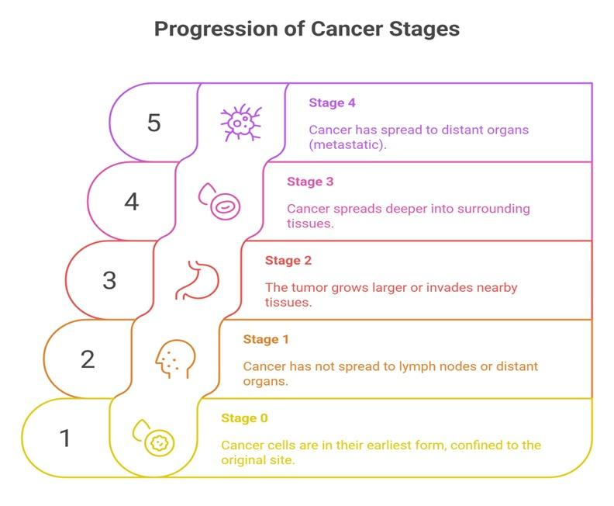
H
HANUMAN PRASAD PODDAR CANCER HOSPITAL & RESEARCH INSTITUTE
CAMPAIGN RATIONALE
Why Early Detection Matters
Progression of Cancer Stages
✓ Say: “Early detection can improve treatment options and outcomes.”
✗ Avoid: “Early cancer never causes death.”
Early detection can improve treatment options and outcomes. Delayed diagnosis can make treatment more difficult.
Earlier detection → Earlier evaluation → Earlier treatment
Cancer-Related Information & Assistance — Toll-Free: 1800 890 7526

Slide 20
H
HANUMAN PRASAD PODDAR CANCER HOSPITAL & RESEARCH INSTITUTE
GENERAL AWARENESS
7 Warning Signs of Cancer
1
2
3
4
Unexplained weight loss
New or unusual lump / swelling
Unexplained bleeding
Persistent cough or hoarseness
5
6
7
Changes in bowel or bladder habits
Sore or ulcer that does not heal
Persistent difficulty swallowing / indigestion
A symptom does NOT automatically mean cancer. Persistent or unexplained changes should be medically evaluated by a qualified healthcare professional.
Cancer-Related Information & Assistance — Toll-Free: 1800 890 7526

Slide 21
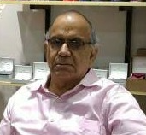
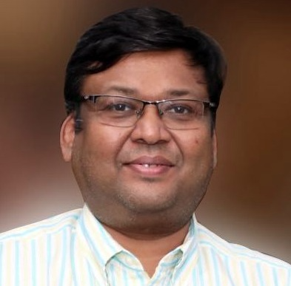
H
HANUMAN PRASAD PODDAR CANCER HOSPITAL & RESEARCH INSTITUTE
ACKNOWLEDGEMENTS
Organizers of the Campaign
With sincere thanks to our campaign leadership for their continued support of this initiative.
UK
Umesh Kr. Singhania
RF
Rasendu Fogla
Secretary
Joint Secretary
Mob.: 9415332498
Mob.: 9415331192
For campaign coordination or administrative queries, please reach out to the Organizers above.
Cancer-Related Information & Assistance — Toll-Free: 1800 890 7526

Slide 22




H
Thank You
Know. Check. Act. Don't Delay.
CONTACT US
Cancer-Related Information & Assistance — Toll-Free Helpline
WhatsApp
YouTube
Instagram
Facebook
1800 890 7526
Hanuman Prasad Poddar Cancer Hospital & Research Institute, Gorakhpur

