Slide 1
PRESENTATION ON ePHARMA
Group Members:
Chetana Bhandari(740312)
Dipendra Shakya(740314)
Gaurav Kumar Shrestha(740316)
Sushan Prajapati(740347)

Slide 2
INTRODUCTION
Web-based project developed for medical store.
Records are kept in database rather than manual.
Track of sales and profit are presented by graphs and report.
Description of medicine is provided.
Web designing tools like PHP, HTML, CSS, JavaScript and SQL.

Slide 3
OBJECTIVE
To design useful, interactive and effective website for pharmacy.

Slide 4
SCOPE
Due to increase shifting of trading getting online nowdays this type of platform get the huge scope.

Slide 5
LIMITATIONS
Emergency delivery of medicine is not possible
Minors orders cannot be executed
Not every product is available in every location

Slide 6
STATEMENT OF PROBLEM
Medicine dosage are not checked.
Valid users are not checked.

Slide 7
LITERATURE REVIEW
Many websites were used as reference :
24seven:
24seven is an online pharmacy or online medicine delivery site for buys medicines, baby products, beauty products and medical equipment.
Onlineaushadhi:
onlineaushadhi is also an online site where the users can order medicine online.

Slide 8
Netmeds:
netmeds is one of the biggest and popular Indian websites for selling medicine, cosmetics, perfumes, face care, medical accessories and many more products.

Slide 9
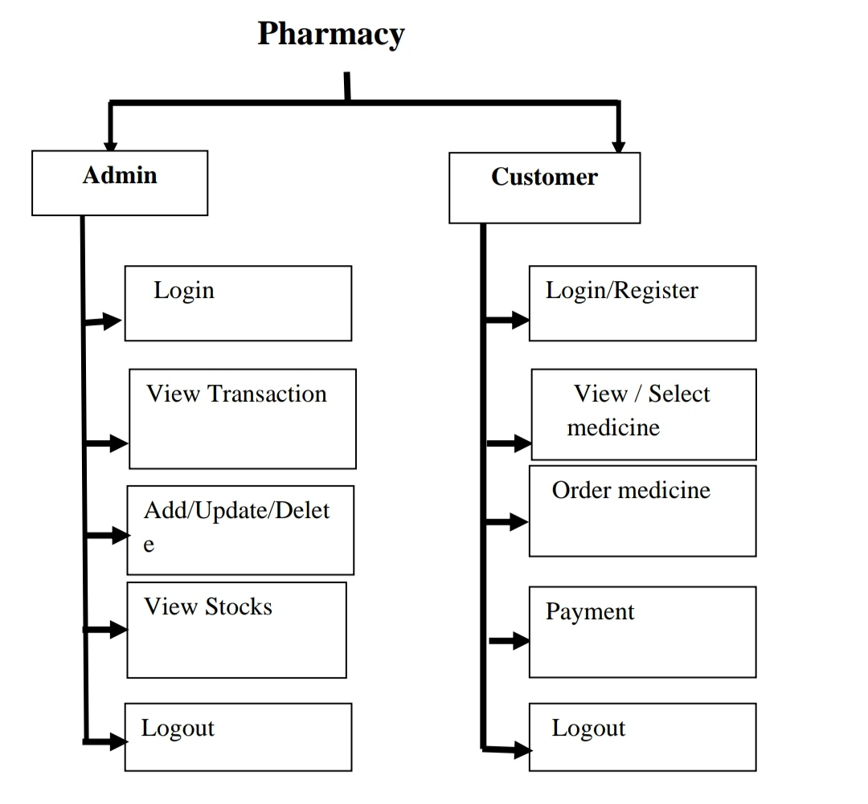
Generic Model

Slide 10
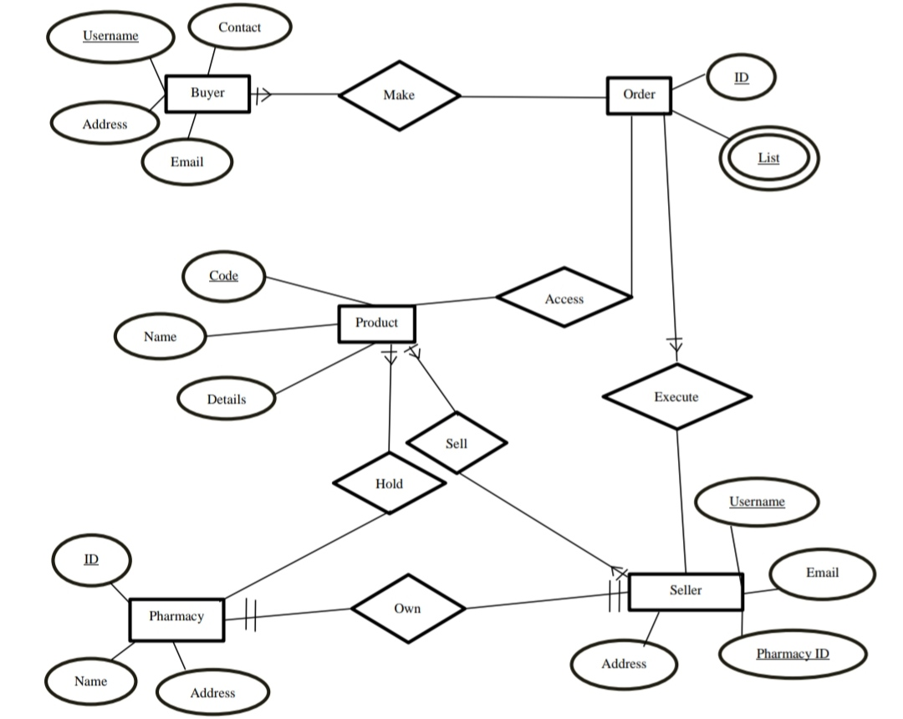
ER Diagram

Slide 11
TOOLS AND PLATFORMS
Windows OS
HTML, CSS, Argon(Bootstrap based CSS)
JavaScript
PHP
MYSQL

Slide 12
RESULT
Develop computerized buying and selling of medical accessories.
Promote e-commerce in the field of pharmacy
Keep the track of buyers and their records.

Slide 13
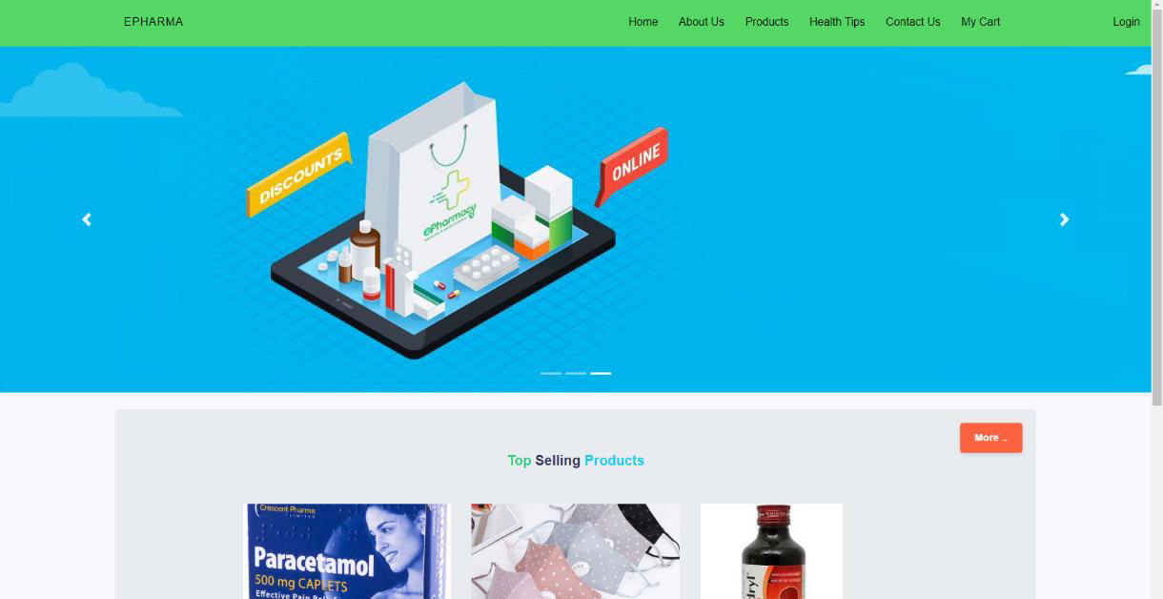
SCREENSHOTS
Fig: Homepage

Slide 14
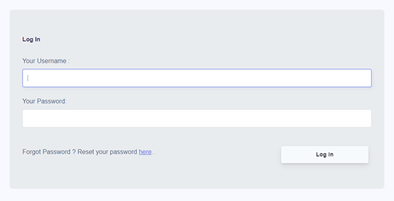
Fig: Login Section

Slide 15
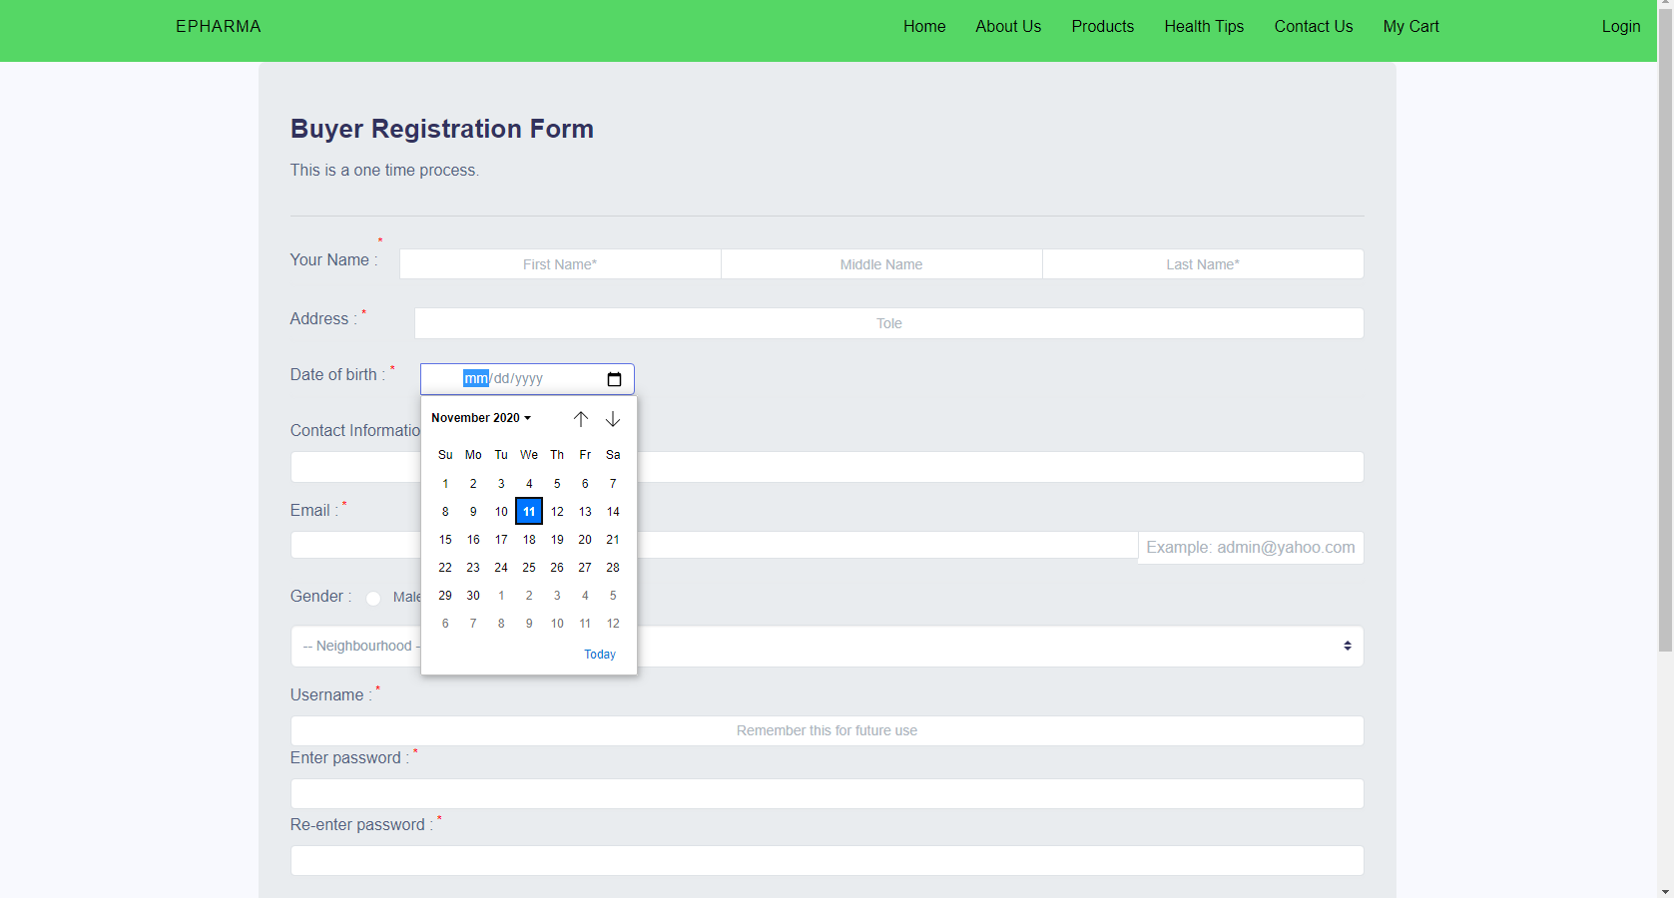
Fig: Buyer Registration Form

Slide 16
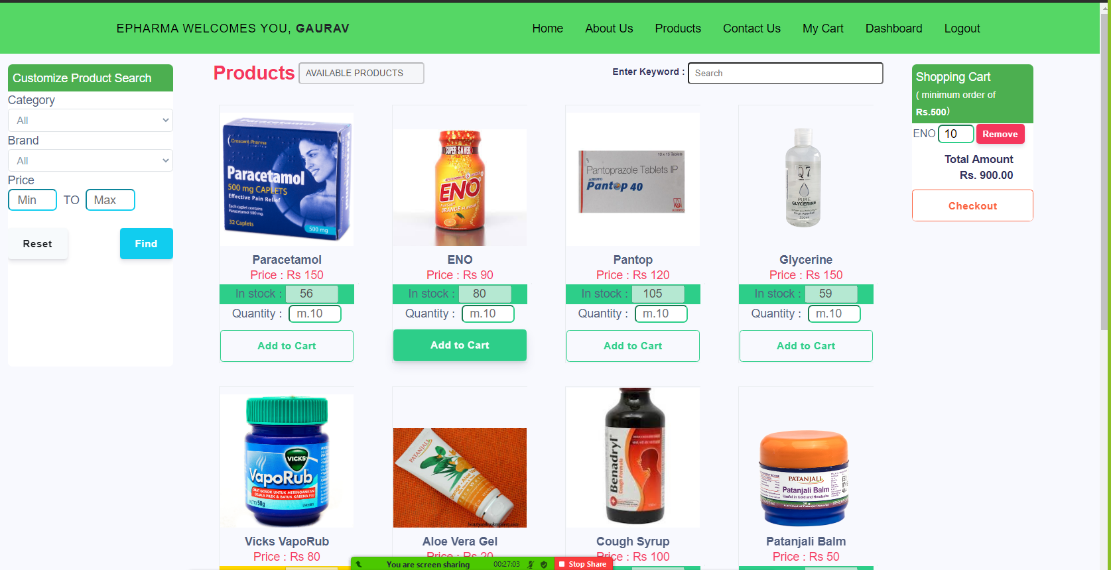
Fig: Product listing

Slide 17
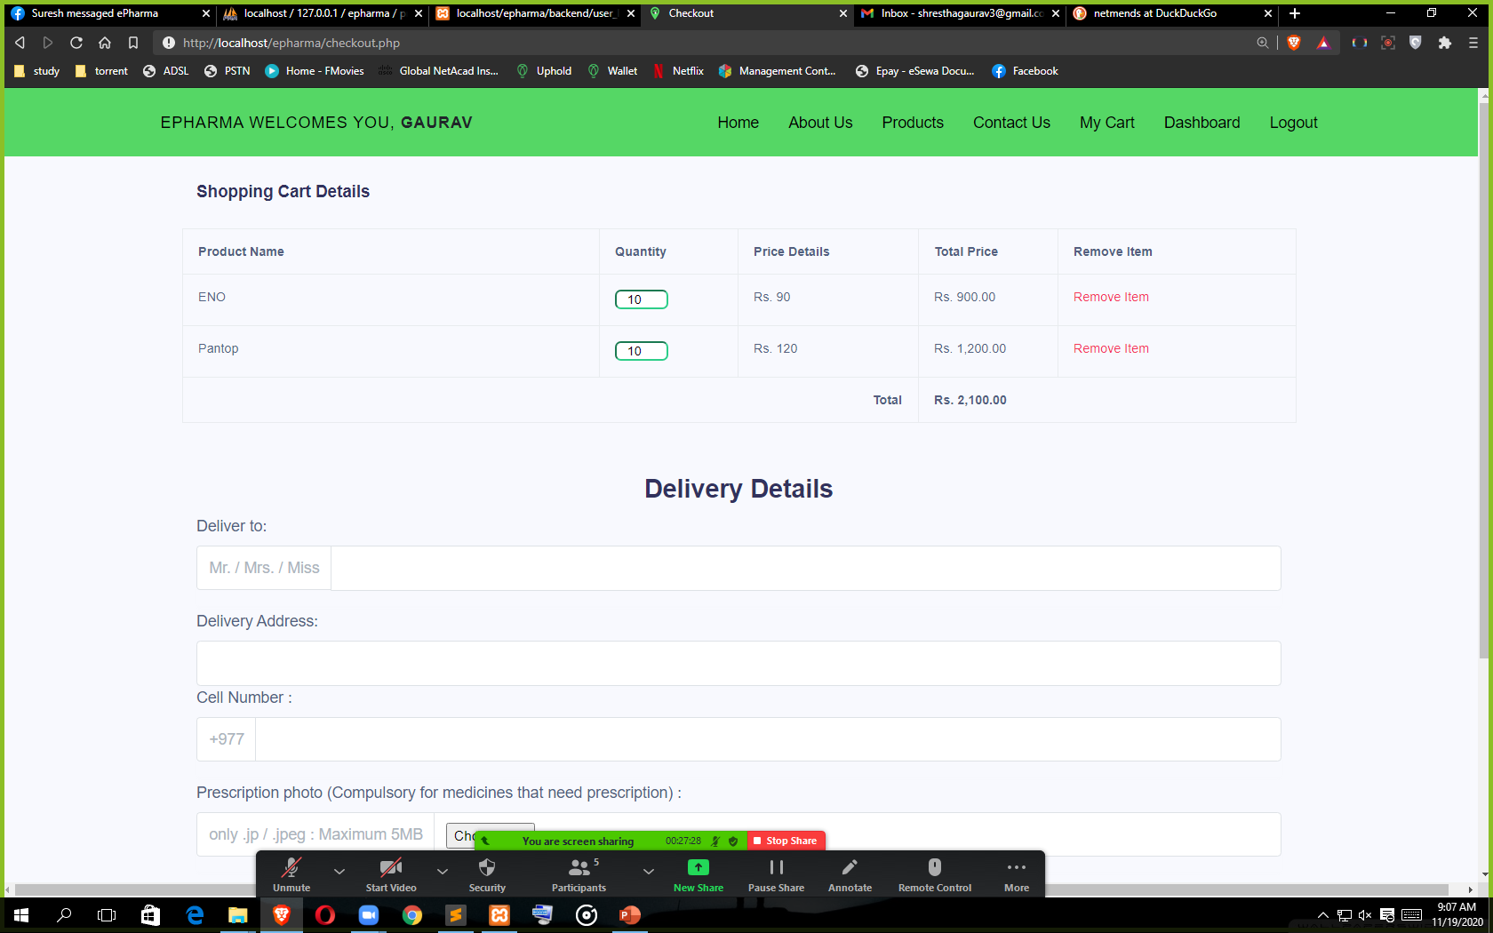
Fig: checkout Page

Slide 18
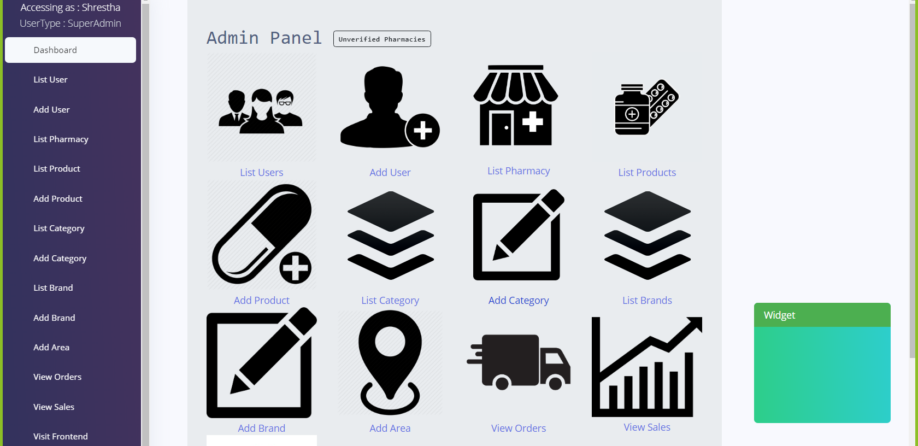
Fig: superAdmin Dashboard

Slide 19
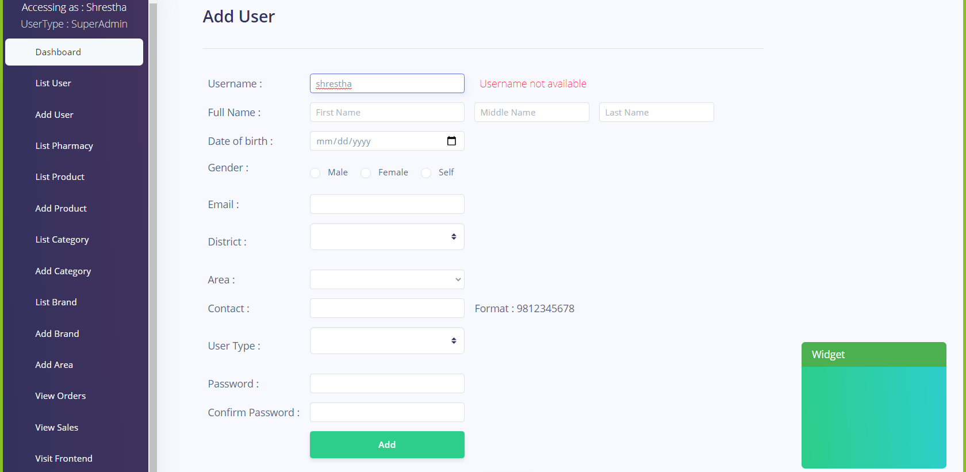
Fig: Add product page

Slide 20
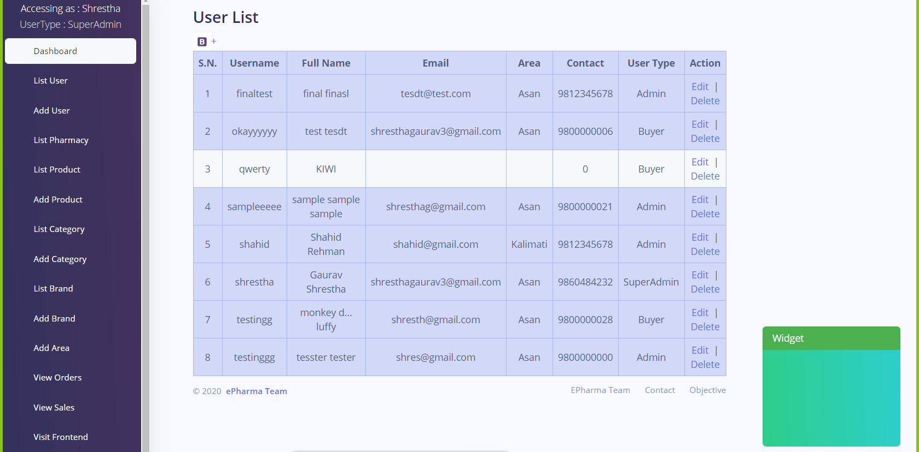
Fig: User list

Slide 21
FUTURE ENHANCEMENT
The security of page could be improved.
The layout of the site can be improved with latest features and tools.
There is no comment and rating section where authorized users could discuss. This can be added in the future.
There could be a messaging system to communicate between actual pharmacists and the buyers.

Slide 22
THANK YOU

