Slide 1



AW_Report
View in Power BI
Last data refresh:
2/19/2021 8:44:44 PM Central Standard Time
Downloaded at:
2/20/2021 6:55:18 PM Central Standard Time

Slide 2
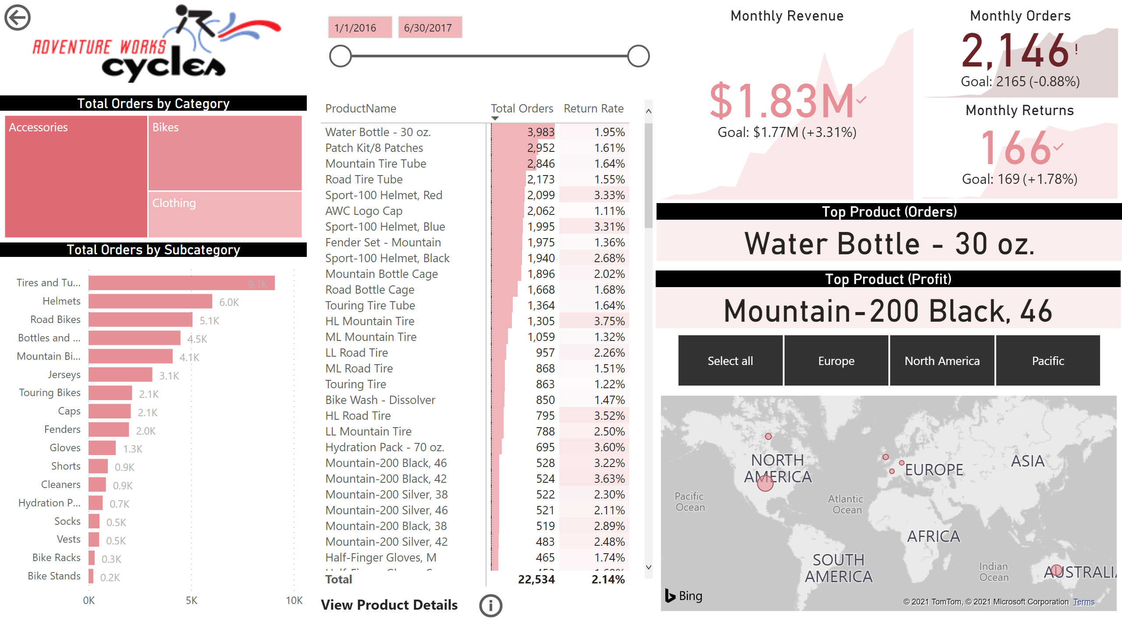
Executive Sumary
Notes:
image
No alt text provided.
Total Orders by Subcategory
No alt text provided.
Total Orders by Category
No alt text provided.
pivotTable
No alt text provided.
slicer
No alt text provided.
Monthly Revenue
No alt text provided.
Monthly Orders
No alt text provided.
Monthly Returns
No alt text provided.
Top Product (Orders)
No alt text provided.
actionButton
No alt text provided.
Top Product (Profit)
No alt text provided.
map
No alt text provided.
slicer
No alt text provided.
textbox
No alt text provided.
actionButton
No alt text provided.

Slide 3
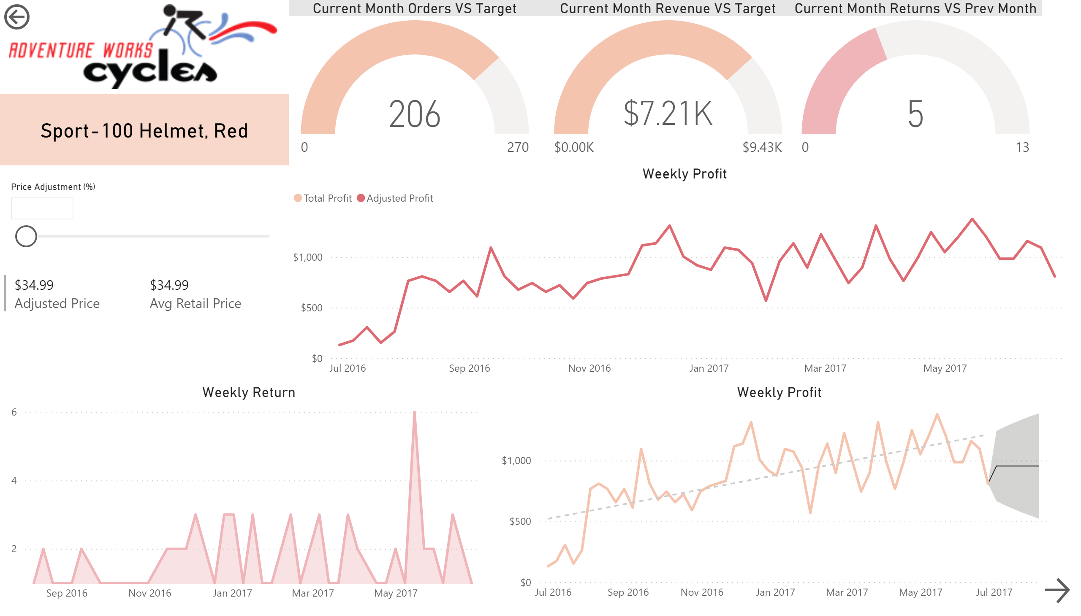
Product Details
Notes:
actionButton
No alt text provided.
Weekly Profit
No alt text provided.
multiRowCard
No alt text provided.
slicer
No alt text provided.
actionButton
No alt text provided.
Current Month Returns VS Prev Month
No alt text provided.
Current Month Revenue VS Target
No alt text provided.
Current Month Orders VS Target
No alt text provided.
Weekly Return
No alt text provided.
Weekly Profit
No alt text provided.
image
No alt text provided.
card
No alt text provided.

Slide 4
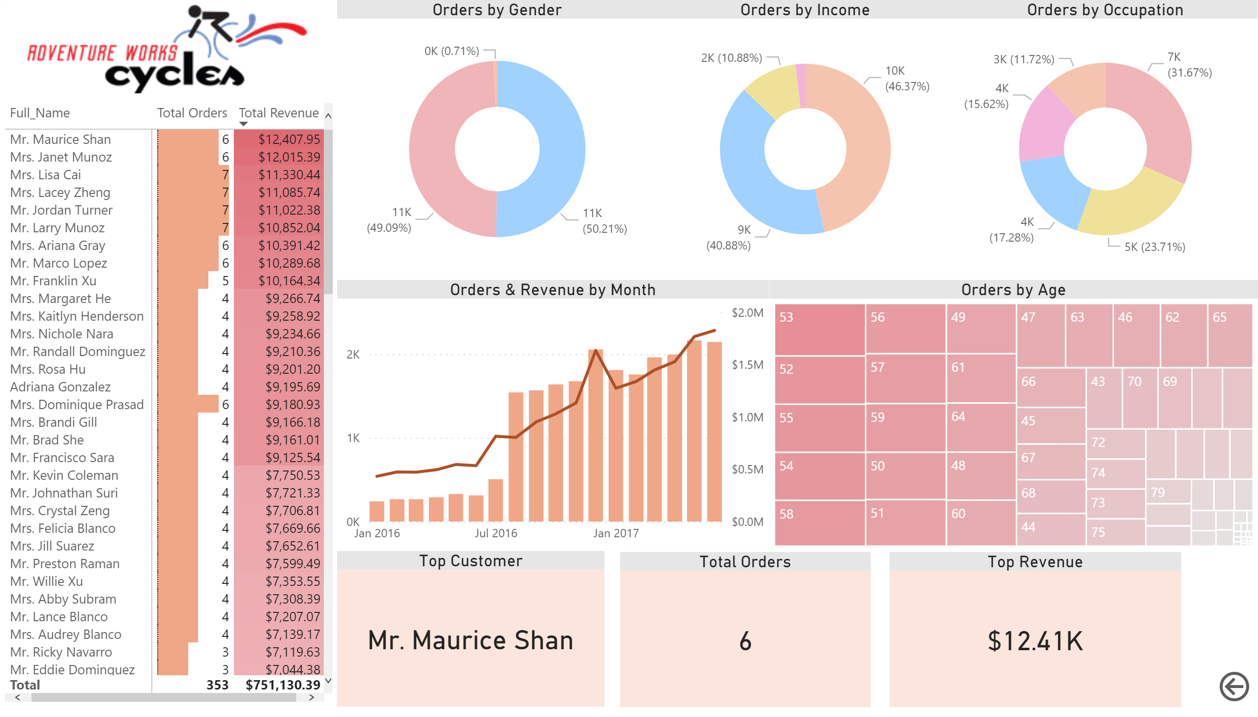
Customer Details
Notes:
pivotTable
No alt text provided.
Orders by Gender
No alt text provided.
Orders by Income
No alt text provided.
Orders by Occupation
No alt text provided.
Orders & Revenue by Month
No alt text provided.
Orders by Age
No alt text provided.
Top Customer
No alt text provided.
Total Orders
No alt text provided.
Top Revenue
No alt text provided.
actionButton
No alt text provided.
image
No alt text provided.

