Slide 1
Cyber Security (CS)
Unit 3: Asymmetric Ciphers
Lecture -3: Principles of Public Key Cryptography
By Ms Prranjali Jadhav
AIDS Dept

Slide 2
Contents
Number Theory, Prime Numbers,
Fermat’s and Euler’s Theorems, Testing for Primality,
The Chinese Remainder Theorem, Discrete Logarithms,
Public-Key Cryptography, Principles of Public-Key Cryptosystems,
The RSA Algorithm,
Diffie-Hellman Key Exchange,
ElGamal Cryptosystem,
Elliptic Curve Cryptography

Slide 3
PRINCIPLES OF PUBLIC KEY CRYPTOGRAPHY
The concept of public key cryptography evolved from an attempt to attack two of the most difficult problems associated with symmetric encryption.
Key distribution under symmetric key encryption requires either (1) that two communicants already share a key, which someone has been distributed to them or (2) the use of a key distribution center.
Digital signatures.

Slide 4
1. Public key cryptosystems
Public key algorithms rely on one key for encryption and a different but related key for decryption.
These algorithms have the following important characteristics:
It is computationally infeasible to determine the decryption key given only the knowledge of the cryptographic algorithm and the encryption key.
In addition, some algorithms, such as RSA, also exhibit the following characteristic:
Either of the two related keys can be used for encryption, with the other used for decryption.

Slide 5
The essential steps are the following:
Each user generates a pair of keys to be used for encryption and decryption of messages.
Each user places one of the two keys in a public register or other accessible file. This is the public key. The companion key is kept private.
If A wishes to send a confidential message to B, A encrypts the message using B’s public key.
When B receives the message, it decrypts using its private key. No other recipient can decrypt the message because only B knows B’s private key.
With this approach, all participants have access to public keys and private keys are generated locally by each participant and therefore, need not be distributed. As long as a system controls its private key, its incoming communication is secure.

Slide 6
Let the plaintext be X=[X1, X2, X3, …,Xm] where m is the number of letters in some finite alphabets. Suppose A wishes to send a message to B. B generates a pair of keys: a public key KUb and a private key KRb. KRb is known only to B, whereas KUb is publicly available and therefore accessible by A.
With the message X and encryption key KUb as input, A forms the cipher text : Y=[Y1, Y2, Y3, … Yn]., i.e., Y=E(KUb(X))
The receiver can decrypt it using the private key KRb. i.e., X=D(KRb()). The encrypted message serves as a digital signature.

Slide 7
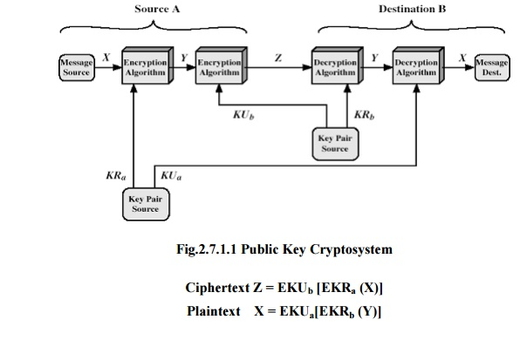
It is important to emphasize that the encryption process just described does not provide confidentiality. There is no protection of confidentiality.
It is however, possible to provide both the authentication and confidentiality by a double use of the public scheme.
Initially, the message is encrypted using the sender’s private key. This provides the digital signature.
Next, we encrypt again, using the receiver’s public key.
The final ciphertext can be decrypted only by the intended receiver, who alone has the matching private key KRb and sender’s public key KUa. Thus confidentiality is provided.
Cipher Text
2
3
1
4

Slide 8
2. Requirements for public key cryptography
It is computationally easy for a party B to generate a pair [KU_{b} , KR_{b}].
It is computationally easy for a sender A, knowing the public key and the message to be encrypted M, to generate the corresponding ciphertext:
C= Z = E[KU_{b}(E[KR_{a}(X)]].
It is computationally easy for the receiver B to decrypt the resulting ciphertext using the private key to recover the original message:
M = X = D[KU_{a} [E(KU_{b} (Y))]]
It is computationally infeasible for an opponent, knowing the public key KU_{b}, to determine the private key KR_{b}.
It is computationally infeasible for an opponent, knowing the public key KU_{b}, and a ciphertext C, to recover the original message M.
The encryption and decryption functions can be applied in either order: M = EKU_{b} [DKR_{b} (M) = DKU_{b} [EKR_{b} (M)]

Slide 9
Public key cryptanalysis
Public key encryption scheme is vulnerable to a brute force attack. The counter measure is to use large keys.
Next----> Public Key Cryptography Algorithms

Slide 10
1. RSA Algorithm
Ron Rivest, Adi Shamir &Len Aldeman Developed this Algorithm in 1978.
It is public key encryption algorithm and block cipher which converts plain text into cipher text and vice versa.

Slide 11
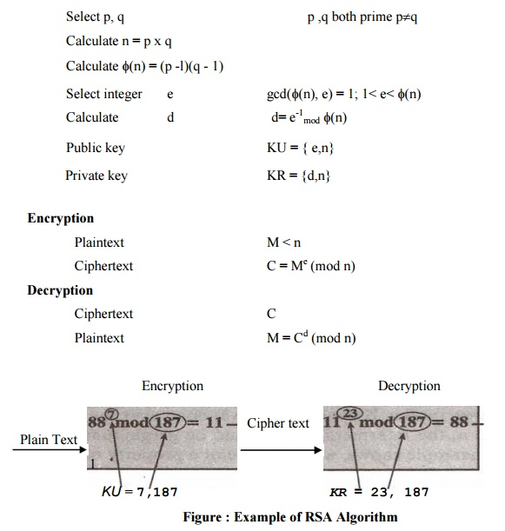
1. The RSA algorithm:
Key Generation

Slide 12
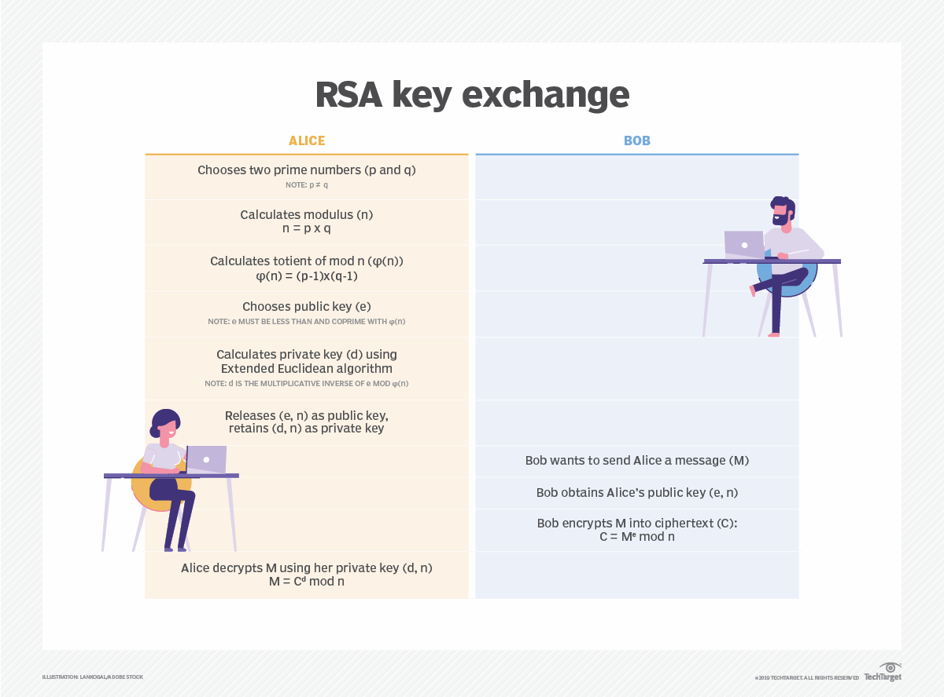

Slide 13
Home work
p=3,q=11,e=3, message M=00111011, find d and cipher text C.
Ans- C=20, d=7
2. p=13,q=17 & M=12 and public key e=19. Find cipher text C.
Ans- C=181

Slide 14
2. Security of RSA
There are 4 approaches to attack the RSA:
brute force key search (infeasible given size of numbers)
mathematical attacks (based on difficulty of computing ø(N), by factoring modulus N)
timing attacks (on running time of decryption)
Chosen Cipher Attack: Hacker tries to attack on the properties of RSA Algorithm

Slide 15
Factoring Problem
Mathematical approach takes 3 forms:
• Factor n = p*q, hence find Ф(n) and then d.
• Determine Ф(n)directly without determining p and q and find d.
• Find d directly, without first determination Ф(n).

Slide 16
Timing attacks
Although the timing attack is a serious threat, there are simple countermeasures that can be used:
Constant exponentiation time – ensures that all exponentiations take the same amount of time before returning a result.
Random delay – better performance could be achieved by adding a random delay to the exponentiation algorithm to confuse the timing attack.
Blinding – multiply the ciphertext by a random number before performing exponentiation.

