Slide 1
Cyber Security Course
Unit 3: Asymmetric Ciphers
Lecture 4- Diffie-Hellman Key Exchange Algorithm
Ms Prranjali Jadhav
AIDS Dept

Slide 2
Introduction to Diffie-Hellman Key Exchange Algorithm
Whitefield Diffie and Martin Hellman develop Diffie-Hellman key exchange Algorithms in 1976 to overcome the problem of key agreement and exchange.
It enables the two parties who want to communicate with each other to agree on a symmetric key, a key that can be used for encrypting and decryption;
Note that Diffie Hellman key exchange algorithm can be used for only key exchange, not for encryption and decryption process.
The algorithm is based on mathematical principles.

Slide 3
Diffie-Hellman Key Exchange Algorithm for Key Generation
The algorithm is based on Elliptic Curve Cryptography, a method of doing public-key cryptography based on the algebra structure of elliptic curves over finite fields.
The DH also uses the trapdoor function, just like many other ways to do public-key cryptography.

Slide 4
DH Algorithm
1. The first party picks ONE prime numbers ’p’ and primitive root of p as ‘g’ and tells them to the second party.
2. The second party then picks a secret number (let’s call it a), and then it computes gª mod p and sends the result back to the first party; let’s call the result A. Keep in mind that the secret number is not sent to anyone, only the result is.
3. Then the first party does the same; it selects a secret number b and calculates the result B similar to the step 2. Then, this result is sent to the second party.
4. The second party takes the received number B and calculates Bª mod p
5. The first party takes the received number A and calculates A^{b} mod p

Slide 5
Diffie Hellman Algorithm
1. key =(Y_{A})^{XB}mod q -> this is the same as calculated by B
2. Global Public Elements
q: q is a prime number
a: a < q and α is the primitive root of q
3. Key generation for user A
Select a Private key X_{A} Here, X_{A} <q
Now, Calculation of Public key Y_{A}
Y_{A} = a^{XA} mod q

Slide 6
Diffie Hellman Algorithm
4. Key generation for user B
Select a Private key X_{B} Here, X_{B} <q
Now, Calculation of Public key Y_{B} Y_{B} = a^{Xb} mod q
5. Calculation of Secret Key by A
key =(Y_{B})^{XA} mod q
6. Calculation of Secret Key by B
key =(Y_{A})^{XB} mod q

Slide 7
Example 1
1. Alice and Bob both use public numbers p = 23, g = 5
2. Alice selected private key a = 4, and Bob selected b = 3 as the private key
3. Both Alice and bob now calculate the value of A and B as follows:
Alice: A = gª mod p=(5⁴ mod 23) = 4
Bob: B = g^{b} mod p=(5³ mod 23) = 10

Slide 8
Example
4. Now, both Alice and Bob exchange public numbers with each other. A = 4 and B = 10
5. Alice and Bob now calculate the symmetric keys
Alice: k_{a} = Bª mod p = 10⁴ mod 23 = 18
Bob: k_{b} = A^{b} mod p = 4³ mod 23 = 18
6. 18 is the shared secret key.

Slide 9
Example 2:
Find the Secret key, if Alice and Bob get public numbers P = 23, G = 9. Alice selected a private key a = 4 and Bob selected a private key b = 3.

Slide 10
Solution 2
Step 1: Alice and Bob compute public values
Alice: A = (9^4 mod 23) = (6561 mod 23) = 6
Bob: B = (9^3 mod 23) = (729 mod 23) = 16
Step 2: Alice and Bob exchange public numbers
Step 3: Alice receives public key B =16 and
Bob receives public key A = 6
Step 4: Alice and Bob compute symmetric keys
Alice: k_{a} = Bª mod p = 16⁴ mod 23 = 9
Bob: k_{b} = A^{b} mod p = 6³ mod 23 = 9
Step 5: 9 is the shared secret.

Slide 11
Uses of Diffie Hellman Algorithm
Encryption: The Diffie-Hellman key exchange algorithm can be used to encrypt; one of the first schemes to do is ElGamal encryption. One modern example of it is called Integrated Encryption Scheme, which provides security against chosen plain text and chosen clipboard attacks.
Password Authenticated Agreement: When two parties share a password, a password-authenticated key agreement can be used to prevent the Man in the middle attack. This key Agreement can be in the form of Diffie-Hellman. Secure Remote Password Protocol is a good example that is based on this technique.
Forward Secrecy: Forward secrecy-based protocols can generate new key pairs for each new session, and they can automatically discard them when the session is finished. In these forward Secrecy protocols, more often than not, the Diffie Hellman key exchange is used.

Slide 12
Advantages of the Diffie Hellman Algorithm
The sender and receiver don’t need any prior knowledge of each other.
Once the keys are exchanged, the communication of data can be done through an insecure channel.
The sharing of the secret key is safe.

Slide 13
Disadvantages of the Diffie Hellman Algorithm
The algorithm can not be used for any asymmetric key exchange.
Similarly, it can not be used for signing digital signatures.
Since it doesn’t authenticate any party in the transmission, the Diffie Hellman key exchange is susceptible to a man-in-the-middle attack.

Slide 14
ElGamal Encryption Algorithm
ElGamal encryption is a public-key cryptosystem. It uses asymmetric key encryption for communicating between two parties and encrypting the message. This cryptosystem is based on the difficulty of finding discrete logarithm in a cyclic group that is even if we know gª and g^{k}, it is extremely difficult to compute g^{ak}.

Slide 15
ElGamal Encryption Algorithm
The ElGamal cryptographic algorithm is an asymmetric key encryption scheme based on the Diffie-Hellman key exchange. It was invented by Taher ElGamal in 1985. The algorithm is widely used for secure data transmission and has applications in digital signatures and encryption.

Slide 16
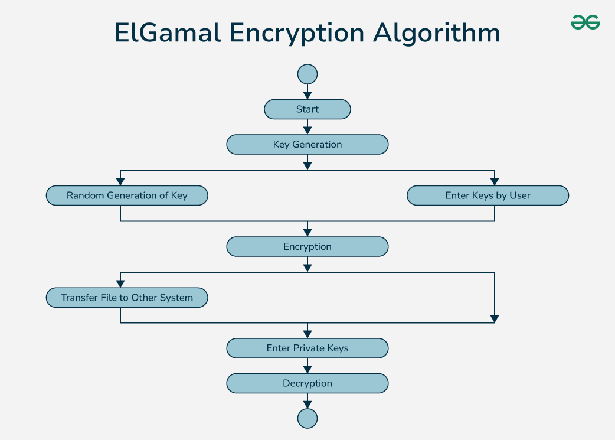

Slide 17
Components of the ElGamal Algorithm
1. Key Generation:
Public Parameters: Select a large prime number p and a generator g of the multiplicative group (Id,In,Asso) Z*_{p}.
Private Key: Select a private key x such that 1 ≤ x ≤p −2.
Public Key: Compute h=g^{x} mod p. The public key is (p,g,h) and the private key is x.

Slide 18
Components of the ElGamal Algorithm
2. Encryption:
To encrypt a message M:
Choose a random integer k such that 1 ≤ k ≤ p−2.
Compute C1 = g^{k} mod p.
Compute C2 =M⋅h^{k} mod p.
The ciphertext is (c1,c2).

Slide 19
Components of the ElGamal Algorithm
3. Decryption:
To decrypt the ciphertext (c1,c2) using the private key x:
Compute the shared secret s= C^{x}₁ mod p.
Compute s⁻¹ mod p (the modular inverse of s).
Compute the original message M = C₂⋅s⁻¹ mod p.

Slide 20
Idea of ElGamal cryptosystem:
Suppose Alice wants to communicate with Bob.
1. Bob generates public and private keys:
Bob chooses a very large number q and a cyclic group F_{q}.
From the cyclic group F_{q}, he choose any element g and
an element a such that gcd(a, q) = 1.
Then he computes h = gª.
Bob publishes F, h = gª, q, and g as his public key and retains a as private key.

Slide 21
Idea of ElGamal cryptosystem:
2. Alice encrypts data using Bob’s public key ‘g’:
Alice selects an element k from cyclic group F
such that gcd(k, q) = 1.
Then she computes p = g^{k} and s = h^{k} = g^{ak}.
She multiples s with M.
Then she sends (p, M*s) = (g^{k}, M*s).
3. Bob decrypts the message :
Bob calculates s′ = pª = g^{ak}.
He divides M*s by s′ to obtain M as s = s′.

Slide 22
Applications of ElGamal Encryption Algorithm
Encryption: ElGamal is used for encrypting messages where public key cryptography is required.
Digital Signatures: A variant of ElGamal is used for creating digital signatures, ensuring message authenticity and integrity.

Slide 23
Advantages
Security: ElGamal is based on the discrete logarithm problem, which is considered to be a hard problem to solve. This makes it secure against attacks from hackers.
Key distribution: The encryption and decryption keys are different, making it easier to distribute keys securely. This allows for secure communication between multiple parties.
Digital signatures: ElGamal can also be used for digital signatures, which allows for secure authentication of messages.

Slide 24
Disadvantages
Slow processing: ElGamal is slower compared to other encryption algorithms, especially when used with long keys. This can make it impractical for certain applications that require fast processing speeds.
Key size: ElGamal requires larger key sizes to achieve the same level of security as other algorithms. This can make it more difficult to use in some applications.
Vulnerability to certain attacks: ElGamal is vulnerable to attacks based on the discrete logarithm problem, such as the index calculus algorithm. This can reduce the security of the algorithm in certain situations.

Slide 25
Elliptic Curve Cryptography
ECC, as the name implies, is an asymmetric encryption algorithm that employs the algebraic architecture of elliptic curves with finite fields.
Elliptic Curve Cryptography (ECC) is an encryption technology comparable to RSA that enables public-key encryption.
While RSA’s security is dependent on huge prime numbers, ECC leverages the mathematical theory of elliptic curves to achieve the same level of security with considerably smaller keys.

Slide 26
History of Elliptic Curve Cryptography
Neal Koblitz and Victor S. Miller independently proposed the use of elliptic curves in encryption in 1985.
Elliptic curve cryptography algorithms entered wide use from 2004 to 2005.
In the mid-1980s, researchers found that examining elliptic curves could lead to the discovery of new sources of difficult problems. Elliptic Curve Cryptography (ECC) introduced a new degree of security to public key cryptosystems, that provide combined encryption and digital signature services.
The security of elliptic curve cryptosystems, like that of all public-key cryptosystems, is based on tough mathematical issues at the core. Given two elliptic curve points G and Y, where Y = kG.
The term "elliptic curve" is derived from the ellipse. Elliptic curves were discovered in the form of the Diophantine equation for c, after the 17th century. Furthermore, while calculating the surface of the ellipse is simple, calculating the circumference of the ellipse is difficult.

Slide 27
ECC, an alternative technique to RSA, is a powerful cryptography approach. It generates security between key pairs for public key encryption by using the mathematics of elliptic curves.
RSA does something similar with prime numbers instead of elliptic curves, but ECC has gradually been growing in popularity recently due to its smaller key size and ability to maintain security. This trend will probably continue as the demand on devices to remain secure increases due to the size of keys growing, drawing on scarce mobile resources. This is why it is so important to understand elliptic curve cryptography in context.
An elliptic curve is not an ellipse, or oval shape, but it is represented as a looping line intersecting two axes, which are lines on a graph used to indicate the position of a point. The curve is completely symmetric, or mirrored, along the x-axis of the graph.

Slide 28
Public key cryptography systems, like ECC, use a mathematical process to merge two distinct keys and then use the output to encrypt and decrypt data. One is a public key that is known to anyone, and the other is a private key that is only known by the sender and receiver of the data.

Slide 29
What are the benefits of ECC?
ECC requires smaller keys than other methods to achieve the same level of security. This can be important in constrained environments where limited storage is available.
Because ECC offers equivalent security with lower computing power and battery resource usage, it is becoming more widely used in cryptocurrency platforms, including Bitcoin and Ethereum, mobile applications, and low-power devices that have limited computational power.
Finally, ECC can be used for digital signatures, key exchange, and other purposes; this makes it a versatile tool for many different applications.

Slide 30
How does ECC work?
From a cryptographic perspective, the points along the graph can be formulated using the following equation: y²=x³ + ax + b, where a and b are constants, and x and y are variables.
Elliptic curves have many interesting mathematical properties that make them well-suited for cryptography. For example, given two points P and Q on an elliptic curve, there is a third point R such that P + Q = R. This property is called “point addition” and is illustrated below.
Another valuable property of cryptography is “point doubling.” This is when we take a point P on an elliptic curve and find another point 2P such that P + P = 2P. This is illustrated below.
We can keep doubling points until we get to the point that we call “the infinity point,” which we denote as O. You can think of this as the limit case where the distance between P and 2P gets arbitrarily close to zero.
Thus, we can add and double points on an elliptic curve to our heart’s content and never get the exact moment twice (except for O).
Given any point P on an elliptic curve, an infinite number of points can be obtained by adding and doubling P (including O). Consequently, an endless number of possible keys can be generated using elliptic curves.

Slide 31
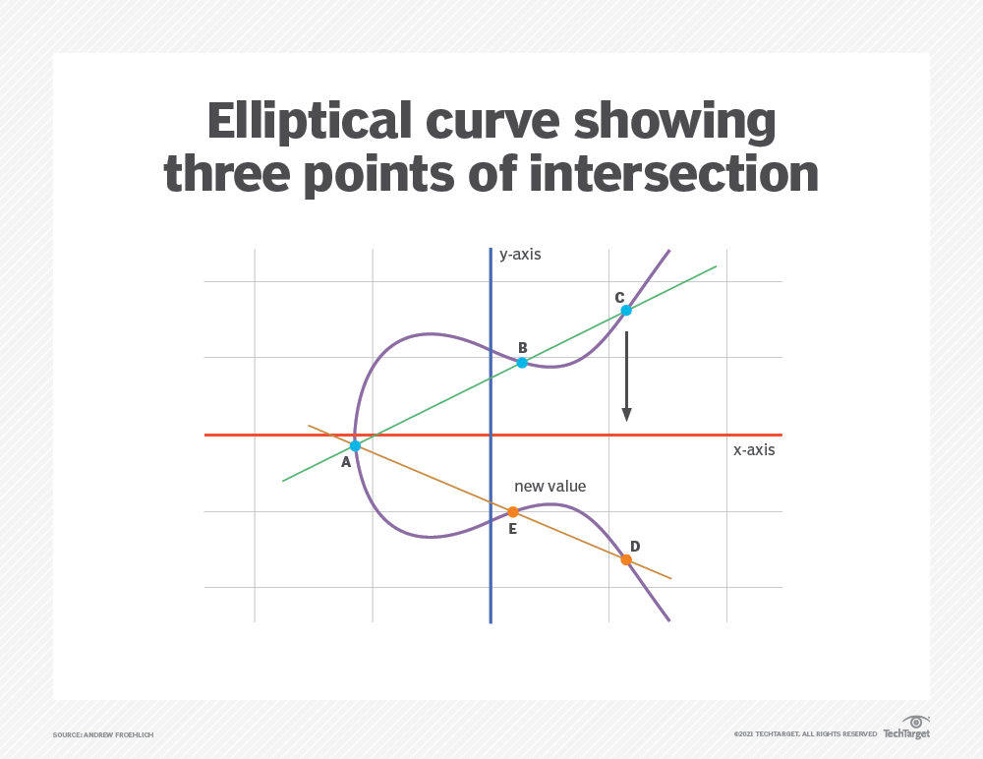
ECC is based on the properties of a set of values for which operations can be performed on any two members of the group to produce a third member, which is derived from points where the line intersects the axes as shown with the green line and three blue dots in the below diagram labeled A, B and C.

Slide 32
Multiplying a point on the curve by a number produces another point on the curve(point C).
Taking point C and bringing it to the mirrored point on the opposite side of the x-axis produces point D. From here, a line is drawn back to our original point A, creating an intersection at point E.
This process can be completed n number of times within a defined max value. The n is the private key value, which indicates how many times the equation should be run, ending on the final value that is used to encrypt and decrypt data. The maximum defined value of the equation relates to the key size used.

Slide 33
Elliptic Curve Cryptography
ECC is like most other public key encryption methods, such as the RSA algorithm and Diffie-Hellman. Each of these cryptography mechanisms uses the concept of a one-way, or trapdoor, function.
This means that a mathematical equation with a public and private key can be used to easily get from point A to point B.
But, without knowing the private key and depending on the key size used, getting from B to A is difficult, if not impossible, to achieve.

Slide 34
Below is the difference between ECC and RSA:
Parameters | ECC | RSA
Working algorithm | ECC is a cryptography technique that works just on a mathematical model of elliptic curves. | RSA cryptography algorithm is primarily based on the prime factorization approach.
Bandwidth savings | ECC gives significant bandwidth savings over RSA. | RSA provides much lesser bandwidth saving than ECC.
Encryption process | The encryption process takes less time in ECC. | The encryption process takes more time in RSA.
Decryption process | The decryption process takes more time. | Decryption is faster than ECC.
Security | ECC is much safer than RSA and is currently in the process of adapting. | RSA is heading toward the end of its tenure.

Slide 35
ECC offers several benefits compared to RSA:
It operates on devices with low CPU and memory resources.
It encrypts and decrypts faster.
Larger key sizes can be used without significantly increasing the key size or CPU and memory requirements.

Slide 36
Elliptic Curve Cryptography Applications
Elliptic Curve Digital Signature Algorithm (ECDSA): ECC is one of the most widely utilized digital signature implementation approaches in cryptocurrencies. In order to sign transactions, both Bitcoin and Ethereum use the field inverse multiplication, but also arithmetic multiplication, inverse function, and modular operation.
Online application: Moreover, ECC is not limited to cryptocurrencies. It is an encryption standard that will be utilized by most online apps in the future due to its reduced key size and efficiency. Most commonly used in cryptocurrencies such as Bitcoin and Ethereum, along with single-way encryption of emails, data, and software.
Blockchain application: The cryptocurrency Bitcoin employs elliptic curve cryptography. Ethereum 2.0 makes heavy use of elliptic curve pairs with BLS signatures, as stated in the IETF proposed BLS specification, to cryptographically ensure that a specific Eth2 validator has really verified a specific transaction.

Slide 37
Elliptic Curve Cryptography (ECC) used for
ECC is frequently discussed in the context of the Rivest–Shamir–Adleman (RSA) cryptographic algorithm. RSA achieves one-way encryption of things like emails, data, and software using prime factorization.
One example is online banking and payments. When you make an online purchase with your debit or credit card, your information is often encrypted using ECC before it’s sent over the internet.
Pretty Good Privacy (PGP) is a popular email encryption software that can leverage ECC to protect your emails from being read by anyone other than the intended recipient.

Slide 38
THANK YOU

