Slide 1
Cyber Security (CS)
Unit 3: Asymmetric Ciphers
Lecture -1: Number Theory, Prime Numbers, Fermat’s and Euler’s Theorems, Testing for Primality, The Chinese Remainder Theorem
By Ms Prranjali Jadhav
AIDS Dept

Slide 2
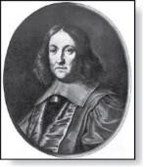
Fermat’s Little Theorem
Theorem 3: (Fermat’s Little Theorem) If p is prime and a is an integer not divisible by p, then
a^{p-1} ≡ 1 (mod p)
Furthermore, for every integer a we have
a^{p} ≡ a (mod p)
(proof outlined in Exercise 19)
Pierre de Fermat (1601-1665)
Fermat’s little theorem is useful in computing the remainders modulo
p of large powers of integers.
Example: Find 7²²² mod 11.
By Fermat’s little theorem, we know that 7¹⁰ ≡ 1 (mod 11), and so
(7¹⁰ )^{k} ≡ 1 (mod 11), for every positive integer k. Therefore,
7²²² = 7^{22∙10 + 2} = (7¹⁰)²²7² ≡ (1)²² ∙49 ≡ 5 (mod 11).
Hence, 7²²² mod 11 = 5.
© 2019 McGraw-Hill Education

Slide 3
Pseudoprimes1*
By Fermat’s little theorem n > 2 is prime, where
2^{n-1} ≡ 1 (mod n).
But if this congruence holds, n may not be prime. Composite integers n such that 2^{n-1} ≡ 1 (mod n) are called pseudoprimes to the base 2.
Example: The integer 341 is a pseudoprime to the base 2. 341 = 11 ∙ 31
2³⁴⁰ ≡ 1 (mod 341) (see in Exercise 37)
We can replace 2 by any integer b ≥ 2.
Definition: Let b be a positive integer. If n is a composite integer,
and b^{n-1} ≡ 1 (mod n), then n is called a pseudoprime to the base b.

Slide 4
Pseudoprimes2*
Given a positive integer n, such that 2^{n-1} ≡ 1 (mod n):
If n does not satisfy the congruence, it is composite.
If n does satisfy the congruence, it is either prime or a pseudoprime to the base 2.
Doing similar tests with additional bases b, provides more evidence as to whether n is prime.
Among the positive integers not exceeding a positive real number x, compared to primes, there are relatively few pseudoprimes to the base b.
For example, among the positive integers less than 10¹⁰ there are
455,052,512 primes, but only 14,884 pseudoprimes to the base 2.
© 2019 McGraw-Hill Education

Slide 5
Euler’s Theorem
Euler’s Theorem can be thought of as a generalization of Fermat’s little theorem. The modules in the Fermat theorem is a prime, the modulus in Euler’s theorem is an integer.
The first version of Euler’s theorem is similar to the first version of the Fermat’s little theorem. if a and n are coprime,
Then Let a and n be coprime. Then a ^{φ(n)} = 1 (mod n).
The Second version of Euler’s theorem is similar to the second version of Fermat’s little theorem; it removes the condition that a and n should be coprime.
If n= p X q, a<n, and k an integer, then a k × f(n) + 1 ≡ a (mod n)

Slide 6
Euler’s Theorem
Solve using Euler’s Theorem: a=3 and n=10.
Solution: φ(n)= φ(10)={1,3,7,9}=4…relatively prime to 10 ie gcd=1
According to Euler’s Theorem,
3⁴=1(mod 10)
81=1 mod 10
81mod 10 =1 & 1 mod 10 =1
Hence proved.

Slide 7
Euler’s Theorem
Solve using Euler’s Theorem: a=2 and n=11.

Slide 8
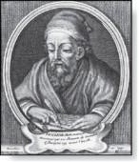

Euclidean Algorithm1
The Euclidian algorithm is an efficient method for computing the greatest common divisor of two integers. It is based on the idea that gcd(a,b) is equal to gcd(a,c) when a > b and
c is the remainder when a is divided by b.
Euclid
(325 B.C.E. – 265 B.C.E.)
Example: Find gcd(91, 287):
287 = 91 ∙ 3 + 14
91 = 14 ∙ 6 + 7
14 = 7 ∙ 2 + 0
Divide 287 by 91
Divide 91 by 14
Divide 14 by 7
Stopping condition
gcd(287, 91) = gcd(91, 14) = gcd(14, 7) = 7

Slide 9
Euclidean Algorithm2
The Euclidean algorithm expressed in pseudocode is:
procedure gcd (a, b: positive integers)
x := a y := b
while y ≠ 0
r := x mod y x := y
y := r
return x {gcd(a,b) is x}
In Section 5.3, we’ll see that the time complexity of the
algorithm is O (log b), where a > b.

Slide 10
Correctness of Euclidean Algorithm1 *
Lemma 1: Let a = bq + r, where a, b, q, and r are integers. Then gcd(a,b) = gcd(b,r).
Proof:
Suppose that d divides both a and b. Then d also divides a − bq
= r (by Theorem 1 of Section 4.1). Hence, any common divisor of a and b must also be any common divisor of b and r.
Suppose that d divides both b and r. Then d also divides bq + r
= a. Hence, any common divisor of a and b must also be a
common divisor of b and r.
Therefore, gcd(a,b) = gcd(b,r).

Slide 11
Correctness of Euclidean Algorithm2 *
Suppose that a and b are positive integers with a ≥ b.
Let r₀ = a and r₁ = b.
Successive applications of the division algorithm yields:
r₀ = r₁q₁ + r₂ r₁ = r₂q₂ + r₃
.
.
.
^{r}n−2 ^{= r}n−1^{q}n−1 ^{+ r}2 r_{n−1} = r_{n} q_{n} .
0 ≤ r₂ < r₁ ,
0 ≤ r₃ < r₂ ,
0 ≤ r_{n} < r_{n−1} ,
Eventually, a remainder of zero occurs in the sequence of terms: a = r₀ > r₁ > r₂ > ∙ ∙ ∙ ≥ 0. The sequence can’t contain more than a terms.
By Lemma 1
gcd(a,b) = gcd(r₀,r₁) = ∙ ∙ ∙ = gcd(r_{n-1},r_{n}) = gcd(r_{n} , 0) = r_{n}. Hence the greatest common divisor is the last nonzero remainder in the sequence of divisions.

Slide 12
Testing for Primality
Primality testing is the process of determining whether a given number is prime or composite (not prime).
What is a Prime Number?
A prime number is a number greater than 1 that has no positive divisors other than 1 and itself.

Slide 13
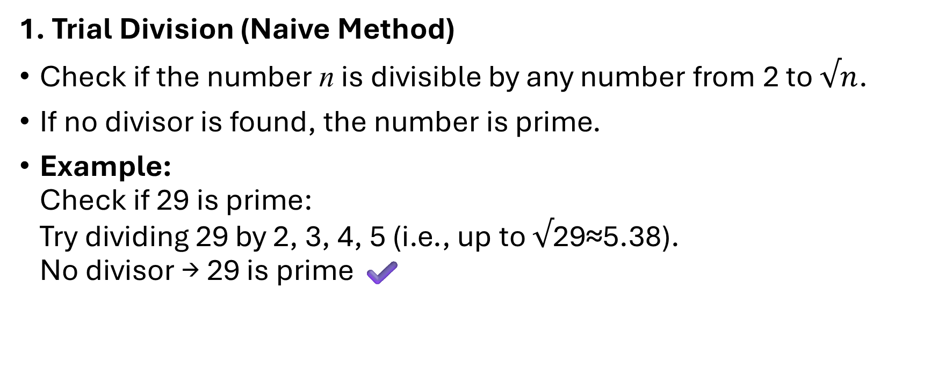
✅ Basic Methods for Primality Testing
1. Trial Division (Naive Method)
Check if the number n is divisible by any number from 2 to $√n$.
If no divisor is found, the number is prime.
Example:
Check if 29 is prime:
Try dividing 29 by 2, 3, 4, 5 (i.e., up to $√$29≈5.38).
No divisor → 29 is prime ✔️

Slide 14
✅ Basic Methods for Primality Testing
2. Sieve of Eratosthenes
Used to find all primes up to a limit N.
Mark multiples of each number starting from 2.
Remaining unmarked numbers are primes.
Useful for generating many primes, not checking a single large one.

Slide 15
✅ Basic Methods for Primality Testing
3. Fermat Primality Test (Probabilistic)
Based on Fermat’s Little Theorem:
If n is prime, then for any integer a,
a ^{n−1}≡1(mod n)
Choose random a, and check the congruence.
If it fails, n is composite.
If it passes for several a, n is probably prime.

Slide 16
✅ Basic Methods for Primality Testing
4. Miller-Rabin Primality Test (Better Probabilistic)
An improved version of Fermat's test with multiple checks.
Repeated testing reduces the probability of error.
✔️ Widely used in cryptography (e.g., RSA key generation).
✔️ Fast and reliable for large numbers.

Slide 17
✅ Basic Methods for Primality Testing
5. AKS Primality Test (Deterministic)
First polynomial-time deterministic primality test.
Always correct — not based on probability.
But:
❌ Slower than Miller-Rabin for practical usage.
✅ Great for theoretical purposes.

Slide 18
The Chinese Remainder Theorem1*
In the first century, the Chinese mathematician Sun-Tsu asked: There are certain things whose number is unknown. When divided
by 3, the remainder is 2; when divided by 5, the remainder is 3; when divided by 7, the remainder is 2. What will be the number of things?
This puzzle can be translated into the solution of the system of congruences:
x ≡ 2 ( mod 3),
x ≡ 3 ( mod 5),
x ≡ 2 ( mod 7)?
We’ll see how the theorem that is known as the Chinese
Remainder Theorem can be used to solve Sun-Tsu’s problem.
© 2019 McGraw-Hill Education

Slide 19
What is the Chinese Remainder Theorem?
CRT solves systems of simultaneous congruences with pairwise coprime moduli.
It guarantees a unique solution modulo the product of the moduli.

Slide 20
The Chinese Remainder Theorem3*
Solve the following system of congruences:
x≡2(mod3)
x≡3(mod4)
x≡2(mod5)
Solution:
Step 1 – Verify Coprime Moduli & Compute M
Check: All moduli (3, 4, 5) are pairwise coprime
Compute M=3×4×5=60

Slide 21
The Chinese Remainder Theorem3*
Step 2 – Compute M_{i}​ and Modular Inverses
M₁=60/3=20, Inverse of 20 mod 3=2…. y₁
M₂=60/4=15, Inverse of 15 mod 4=3…. y₂
M₃=60/5=12, Inverse of 12 mod 5=3…. y₃
Step 3 – Apply CRT Formula
x=(a₁⋅M₁⋅y₁+a₂⋅M₂⋅y₂+a₃⋅M₃⋅y₃) mod M x=(2⋅20⋅2+3⋅15⋅3+2⋅12⋅3) mod 60 x=(80+135+72)mod 60=287 mod 60 = 47 ​

Slide 22
The Chinese Remainder Theorem3*
Final Answer & Verification
Final Answer: x =
Verification:
47mod3=2 ✔️
47mod4=3 ✔️
47mod5=2 ✔️
47 mod 60
[ x ≡ 2 mod 3 ] [ x ≡ 3 mod 4 ] [ x ≡ 2 mod 5 ]
\ | /
----> Apply CRT ---->
[ x ≡ 47 mod 60 ]

Slide 23
The Chinese Remainder Theorem4*
Example 2: Consider the 3 congruences from Sun-Tsu’s problem:
x ≡ 2 ( mod 3), x ≡ 3 ( mod 5), x ≡ 2 ( mod 7).
Let m = 3∙ 5 ∙ 7 = 105, M1
15.
We see that
= m/3 = 35, M2 = m/5 = 21, M3 = m/7 =
2 is an inverse of M1
1 is an inverse of M2
1 is an inverse of M3
= 35 modulo 3 since 35 ∙ 2 ≡ 2 ∙ 2 ≡ 1 (mod 3)
= 21 modulo 5 since 21 ≡ 1 (mod 5)
= 15 modulo 7 since 15 ≡ 1 (mod 7)
Hence,
x = a1M1y1 + a2M2y2 + a3M3y3
= 2 ∙ 35 ∙ 2 + 3 ∙ 21 ∙ 1 + 2 ∙ 15 ∙ 1 = 233 ≡ 23 (mod 105)
We have shown that 23 is the smallest positive integer that is a
simultaneous solution. Check it!
© 2019 McGraw-Hill Education

Slide 24
🧠 Discrete Logarithms
A discrete logarithm is the logarithm in the context of modular arithmetic, commonly used in cryptography (like Diffie-Hellman key exchange, ElGamal encryption).
🧩 Definition
In regular math:
If a^{x}=b, then x=log_{a}b
In modular arithmetic:
If a^{x}≡b (mod n) , then x is called the discrete logarithm of b base a mod n
x= log_{a}b (mod n)

Slide 25
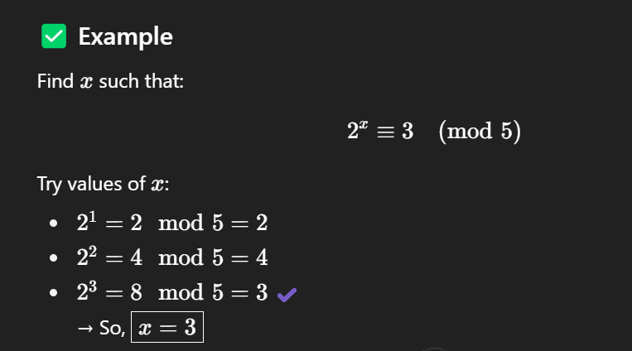
🧠 Discrete Logarithms

Slide 26
🧠 Discrete Logarithms
Use Case | How Discrete Logs Are Used
Diffie-Hellman Key Exchange | Shared secret from gªmod p
ElGamal Encryption | Secure public key crypto
DSA (Digital Signature Algorithm) | Signature verification relies on DL

