Slide 1

Manas Twin
A digital twin that warns of a depressive episode about a week before it begins
For Indian college students and young professionals, and the counsellors who support them
Happiest Health · Reimagining and Reforming Healthcare in India Summit 2026, Bengaluru
Digital Twin Proof-of-Concept Challenge · Team: [Team name] · [Incubator / University]
Notes:
Open with the hook: depression rarely arrives overnight. Introduce Manas Twin: manas means mind.

Slide 2



India's mental-health care starts too late: the treatment gap exceeds 60% for almost every disorder
Why care starts late
~15%
of Indian adults need treatment for one or more mental health conditions
Symptoms build silently for weeks
Sleep, energy, activity and social contact change before anyone names it
Help-seeking is slow
Stigma and few counsellors mean diagnosis often comes well into an episode
>60%
treatment gap for every mental disorder except epilepsy (range 28–83%)
Nobody watches daily signals
Wearables and phones already record the build-up, but no one reads it for the person
Verified fact: NIMHANS, National Mental Health Survey of India 2015–16 (34,802 adults, 12 states). Right panel: problem framing.
Notes:
Cite NMHS 2015-16. The point: care starts after people are already unwell, if at all.

Slide 3
Everyone's 'normal' is different, so one population cut-off flags the wrong person
Person A: above the cut-off, heading into an episode
Sleep fell almost an hour below their own normal. Twin: Early warning, 6.43% risk (7× typical).
Person B: below the cut-off, but stable
A natural short sleeper. Twin risk never above 0.5%.
Synthetic held-out test patients MT0441 (A) and MT0178 (B), 2 Mar – 6 May. The 6 h cut-off is illustrative.
Notes:
Person A still sleeps more than the cut-off but is drifting from their own 7.4 h normal and heads into an episode. Person B always sleeps under 6 h and is fine.

Slide 4



Built for students and young professionals, and the counsellors who support them
Student / employee
Daily 'you vs your normal' mirror, gentle nudges, what-if view. Joins with explicit consent.
Counsellor / EAP / doctor
Risk-ranked caseload with reasons and PHQ-9 trend, so they can reach out before a crisis.
Institution (aggregate)
Anonymised view of stress hotspots like exam weeks, to plan counselling capacity.
How an alert becomes care
1
2
3
4
5
Wearable + phone data arrive daily
Twin sees drift from personal normal
Early warning with plain-language reasons
Counsellor check-in and repeat PHQ-9
Care starts in week zero, not week four
Notes:
Condition: recurrent depressive episodes. Prediction: will an episode start within 7 days?

Slide 5








The twin does four things for each person: mirror, predict, explain, simulate
Mirror
Compares your last 3 and 7 days with your own 45-day normal across 8 signals, plus a single Drift Index
Predict
Probability that a depressive episode begins within the next 7 days, updated every day
Explain
Top reasons in plain language: "steps 18% below usual", "54 min less sleep" (SHAP)
Simulate
What-if: change sleep, bedtime, steps, screen time or social contact and re-run the twin
Signals:
Sleep duration, onset, efficiency
Resting HR, HRV
Daily steps
Late-night screen time, social contacts
+ health record: PHQ-9, prior episodes, family history, medication, comorbidities · exam / work-crunch calendar
Notes:
This is what makes it a twin rather than a classifier: a per-person, continuously updated replica.

Slide 6
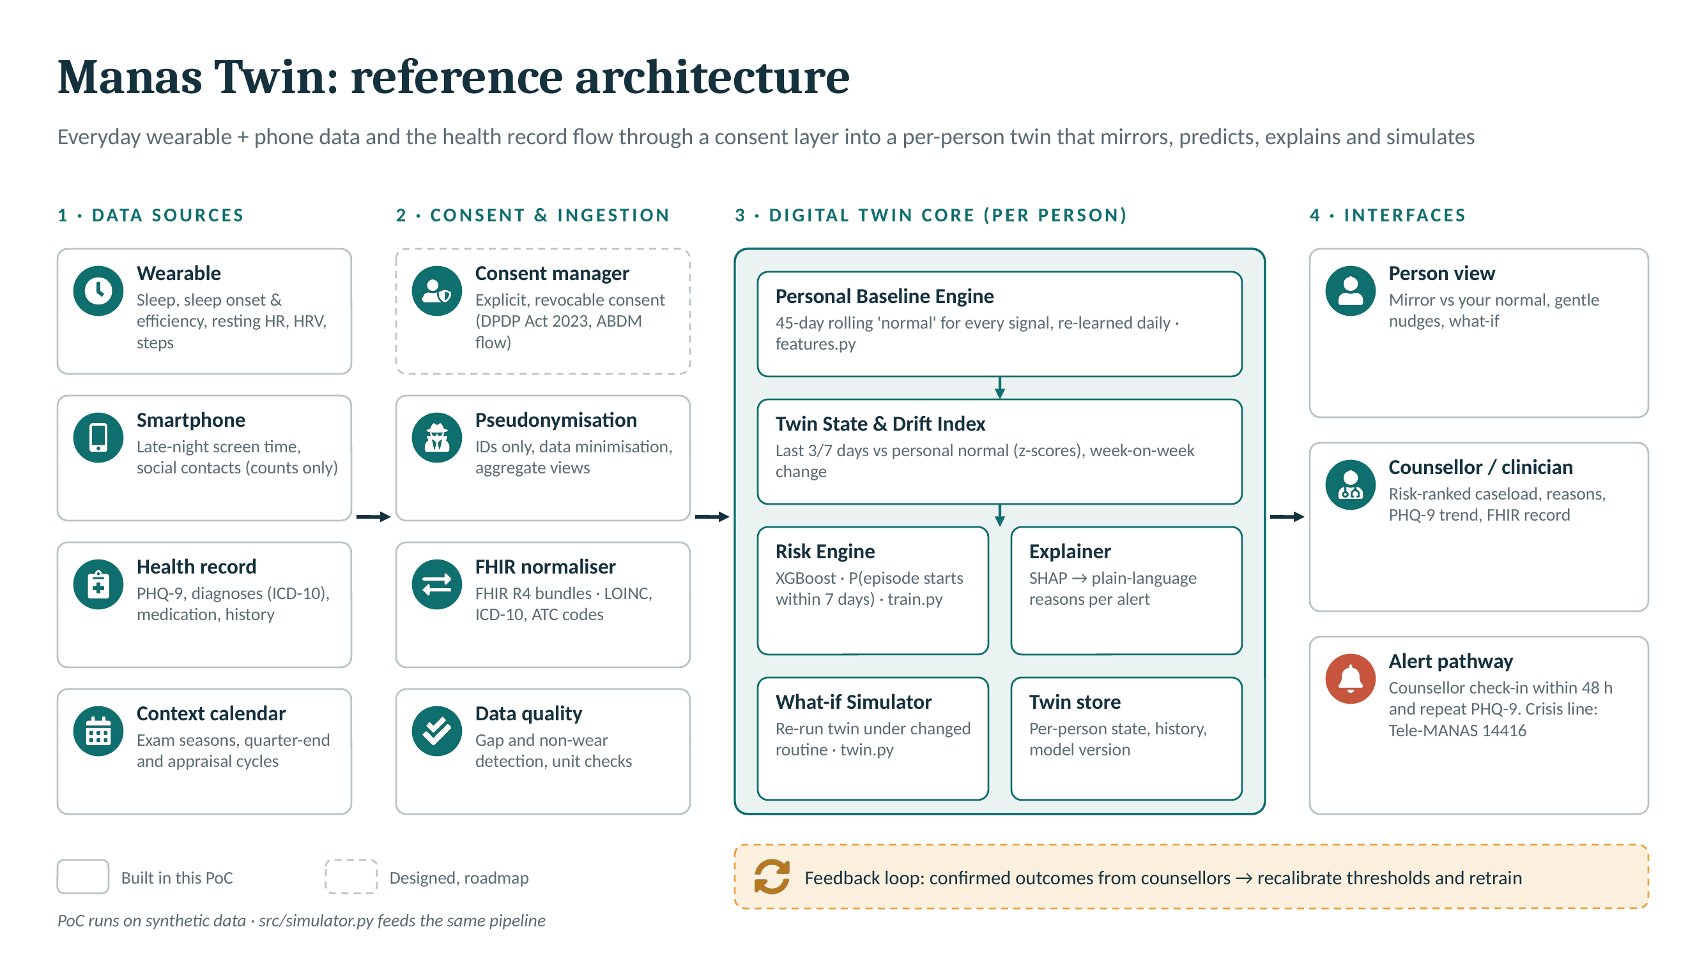
A consent-first pipeline turns everyday data into an explainable 7-day risk
Full-size diagram: docs/Manas_Twin_Architecture.pdf
Notes:
Walk left to right. Solid boxes are built in this PoC, dashed are designed / roadmap.

Slide 7
No public dataset pairs wearables with records, so we simulated 600 people, then checked the features on real actigraphy
How the simulator works
600
144,000
Drivers
Vulnerability, prior episodes, family history, exam / work-crunch calendar, random life events
synthetic people, 12 Indian cities
person-days (240 days each)
Hidden depressive load
Builds up gradually; an episode starts when it crosses a threshold and lasts 14+ days
175
8 + EHR
depressive episodes in 148 people
daily signals plus health record
What the twin sees
Signals drifting from each person's own baseline, plus PHQ-9, diagnoses and medication
Synthetic data generated by src/simulator.py. Signal directions follow digital-phenotyping literature; magnitudes are modelling assumptions.
Notes:
Be upfront that it is synthetic. Ground-truth episodes are used only to create labels and evaluate.

Slide 8



Personal-baseline features + XGBoost + SHAP: accurate enough to screen, transparent enough to trust
50 twin features
Per signal: 7-day mean, deviation from personal normal (3- and 7-day), week-on-week change · Drift Index · non-wear days · EHR context
XGBoost risk engine
350 trees, depth 4 · handles missing days natively · P(episode starts within 7 days)
SHAP + alert bands
Reasons for every score · Early warning at ≥3% risk (≈3× base rate), Watch at half that
Fair test
Split by person: 420 train / 180 unseen test. Threshold fixed on validation people at 95% specificity. Benchmarked against an identical model without personal-baseline features (the 'population model').
Notes:
Validation is by person, so the test set only has people the model never saw.

Slide 9
Personalisation catches more episodes in advance with about 25% fewer false alerts
0.85
AUROC on unseen synthetic people (population model 0.81)
6 days
median warning before the episode begins
0.82
AUROC on REAL wrist-actigraphy, depressed vs control (55 people, 95% CI 0.71–0.92)
Charts: synthetic held-out test set (180 people, 40 evaluable episodes). Real-data check: public DEPRESJON dataset (Garcia-Ceja et al., 2018), leave-one-person-out; it tests the features, not the 7-day early warning.
Notes:
About half of episodes flagged early, median 6 days ahead. Honest framing: a prompt for a human check-in.

Slide 10
For one student, the twin raised the alarm 7 days before onset; usual care diagnosed 19 days after
21 Apr Twin: Early warning
Sleep and steps falling below his own normal during exams
28 Apr Episode begins
Ground truth from the simulator, hidden from the twin
17 May Usual care: diagnosis
PHQ-9 of 16 at clinic, escitalopram started
26 days of possible earlier support
Synthetic test-set patient. Risk values calculated by the trained twin model.
Notes:
MT0441, 18, engineering student in Kochi, end-semester exams.

Slide 11

A healthier week moves the same student from early warning back to stable
Scenario applied to his last 7 days
+1 hour of sleep per night
Bedtime 45 minutes earlier
+3,000 steps a day
45 fewer minutes on the phone after 11 pm
+5 social contacts a day
Model-based sensitivity analysis on the synthetic test patient: shows how the estimate responds, not a guaranteed causal effect.
Notes:
Show this live in the What-if view. Stress that it is associative, not causal.

Slide 12




Safe by design: consent-first, human-in-the-loop, and no suicide-risk prediction
Consent-first
Human in the loop
Explainable
Explicit, revocable consent aligned with DPDP Act 2023 and ABDM consent flows
The twin alerts; a counsellor or clinician decides. It never diagnoses
Every alert ships with its reasons, measured against the person's own normal
Narrow scope
Privacy
Equity
Predicts episode onset only. No suicide or self-harm prediction; crisis line Tele-MANAS 14416 in-app
Pseudonymous IDs, counts not content from phones, aggregate-only views for institutions
Wearables skew urban and affluent: phone-only mode and bias audits on the roadmap
Notes:
Narrow scope is deliberate. Crisis signals go to humans, and Tele-MANAS is shown in-app.

Slide 13
Next: clinician evaluation with 30 psychologists, then a campus pilot
Now
PoC + real-data check
Simulator, twin engine, dashboard, FHIR export; features validated on DEPRESJON (AUROC 0.82)
Next 3 months
Clinician evaluation
Structured feedback from 30 psychologists (protocol built into the app); redesign from findings
3–9 months
Campus pilot
Consented pilot with a university wellness centre; co-design alerts with counsellors
9–18 months
Scale
Health Connect / HealthKit ingestion, ABDM-linked records, multilingual nudges, phone-only mode
Honest limitations
Early-warning accuracy is from synthetic data (features checked on real actigraphy) · about half of episodes flagged early, so it supports rather than replaces human judgement · what-if is associative, not causal · one global model with personalised features, not yet per-person models.
Notes:
Be explicit about limitations: synthetic data, moderate sensitivity, associative what-if.

Slide 14
Proactive, not reactive.
Better mental-health care starts with knowing what normal looks like for each of us, and noticing early when it changes.
Code, data, model and docs: github.com/<your-username>/manas-twin
Run it: pip install -r requirements.txt → streamlit run app/streamlit_app.py
Demo video: link in README
Research prototype on synthetic data, not a diagnostic tool. If you are struggling, call Tele-MANAS 14416 (toll-free, 24×7).

