Slide 1


PLEDGE TO PROGRESS Sustainability Hackathon
Sponsored By
Your Team Name :Inferno
Your team bio :Break Through Miracle
Date :24/04/23

Slide 2
Problem Statement? To train and upskill the automobile workers to operate heavy machinery and execute high risk tasks using virtual reality
Why did you decide to solve this Problem statement?
We decided to solve this problem statement because we noticed that the training that is being provided to the automobile workers is textual and the tasks they have to execute is practical application only so we have identified the gap between textual learning and practical application we wish to close the gap by using virtual reality technology and we also believe that we can raise the standards of the automobile workers by quite a lot

Slide 3
User Segment & Pain Points User Segment-Industry Workers Pain Points 1)Gap between theoretical learning and actual application in real life 2)Traditional learning too tiring 3)Mistakes can damage high cost machinery and also cause to harm workers which may even be fatal

Slide 4
Pre-Requisite Basic Reflexes and movement
What are the alternatives/competitive products for the problem you are solving?
No alternative to our product as of now

Slide 5
Tools or resources Unreal Engine,Blender,AutoCad,Microsoft Azure

Slide 6
Any Supporting Functional Documents
Present your solution, talk about methodology, architecture & scalability
Solution
A vr based environment of an automobile Industry to give the real life ffeling of being an industry and replicating the real life tasks that are performed and task the user with performing those tasks in the environment with accuracy.
Methodology
Creating the required models in Blender
Creating the level design in UnrealEngine accurate to industry
Creating the logic to perform the tasks in the software
Syncing it with Azure cloud to update the data recorded while using the software
Scalablilty
This product is scalable on a b2b scale because not only automobile industry but many more industry will also be willing to deploy such form of training because it has the potential to reduce the mishaps that occur in any factory due to lack of proper equipment usage knowledge

Slide 7
Key Differentiators & Adoption Plan
Key Differentiators
Graphics Quality
Functionalities
Adoption Plan
Pilot testing: Before implementing the training application, conduct pilot testing with a small group of workers to gather feedback and make any necessary improvements.
Implement the training application: Once the training application is finalized, implement it across the organization. This can be done through on-site training sessions or remote access to the application.
Evaluate effectiveness: Regularly evaluate the effectiveness of the training application by assessing the workers' performance on the job. This can help identify any gaps in the training and areas that need improvement.
Continuous improvement: Based on the evaluation, continuously improve the VR-based training application to ensure it remains relevant and effective in upskilling workers.

Slide 8
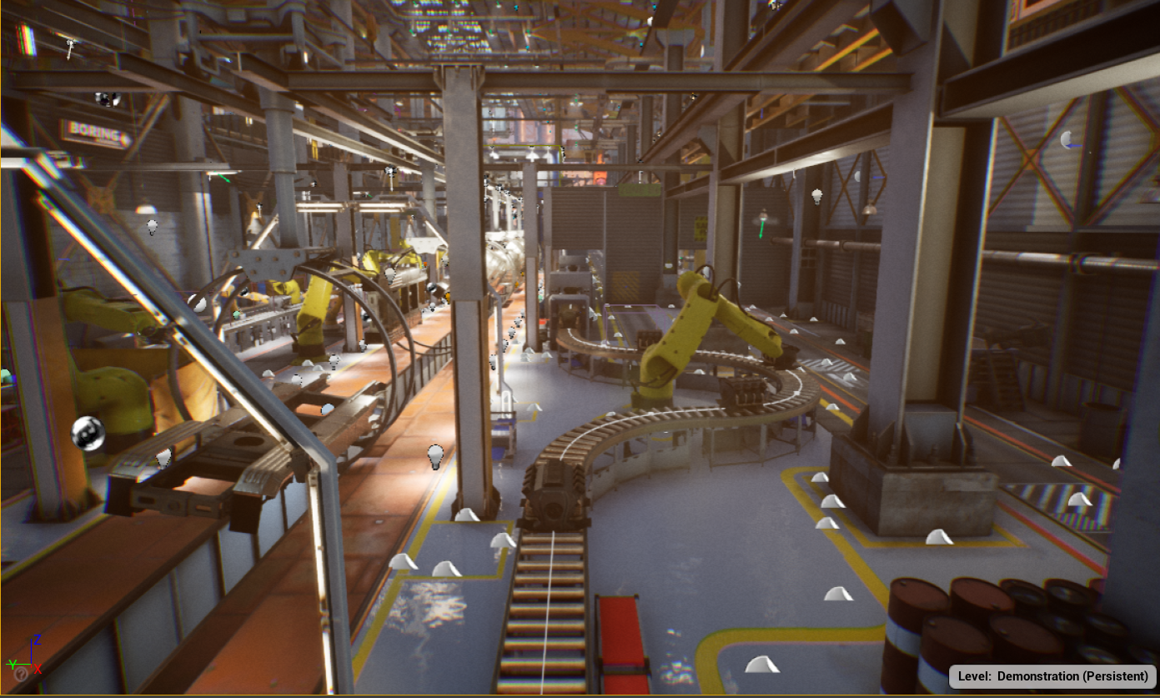
GitHub Repository Link & supporting diagrams, screenshots, if any

Slide 9
Thank You
Team member names
Shreyash Kumar(Leader)
Tanwir Alam
Khushi Raj Das
Janmajay Behera

