Slide 1

NIRMA UNIVERSITY • INSTITUTE OF TECHNOLOGY
Department of Computer Science & Engineering | Master of Computer Applications (MCA)
OPERATING SYSTEMS INNOVATIVE ASSIGNMENT – 1 (6CS102CC25)
Smart CPU Scheduler Simulator
Interactive Gantt Visualization, Multi-Algorithm Benchmark Comparison & Intelligent Workload Recommender
Project Objectives & Key Features
• Complete Algorithmic Suite: Implements FCFS, SJF (Non-Preemptive), SRTF (Preemptive), Priority (Preemptive & Non-Preemptive), and Round Robin.
• Interactive Web Dashboard: Built with Streamlit & Plotly for dynamic process inputs, real-time metrics, and color-coded Gantt timelines.
• Multi-Algorithm Comparison: Side-by-side benchmark bar charts to visually and empirically analyze the Convoy Effect and scheduling trade-offs.
• Smart Heuristic Recommender: Statistical workload analysis (burst variance & priority spread) to dynamically recommend the optimal scheduling algorithm.
Submission & Author Credentials
Student Name : Shrey Patel
Roll Number : 26MCA042
Program & Semester : Master of Computer Applications (MCA - Sem 1)
Subject Name : Operating System (OS)
Subject Code : 6CS102CC25
Faculty Guide : Drashti Patel
Academic Year : 2026 – 2027
Technology Stack : Python 3.11, Streamlit, Plotly, Pandas

Slide 2
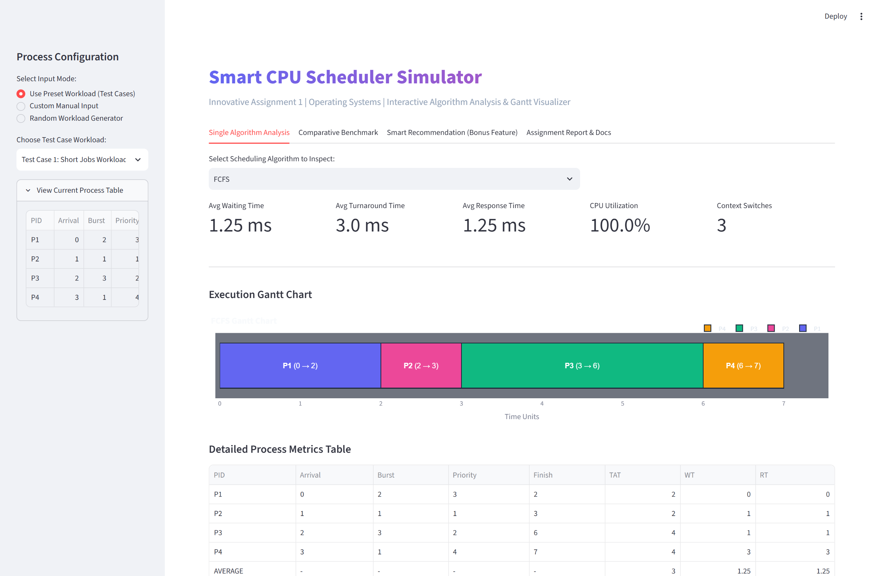
MODULE 1: INTERACTIVE SIMULATION & TIMELINE
Single Algorithm Simulation & Gantt Visualizer
Automated timeline scheduling, real-time KPI metrics, and responsive Plotly Gantt charts
Interactive Capabilities
• Configurable Inputs: Add custom processes or select pre-configured workloads (Short Jobs, Mixed Jobs, Priority Spreads).
• Dynamic Parameters: Fine-tune Round Robin Quantum Q, Preemptive vs Non-Preemptive toggles in real-time.
• Plotly Gantt Chart: Color-coded visual bars showing exact execution time slices, context switches, and CPU idle intervals.
Performance Metrics Computed
✔ Turnaround Time (TAT): Finish Time − Arrival Time (Total system duration).
✔ Waiting Time (WT): Turnaround Time − Burst Time (Delay in Ready Queue).
✔ Response Time (RT): First CPU Execution − Arrival Time (Latency).
✔ CPU Utilization (%): (Busy CPU Time / Total Schedule Length) * 100.
✔ Context Switches: Total process preemptions & state switches logged.
Figure 1: Live Web App — Process Table, KPI Metric Cards, and Plotly Gantt Execution Timeline
Smart CPU Scheduler Simulator • Operating Systems Innovative Assignment 1 • Nirma University
2 / 5

Slide 3
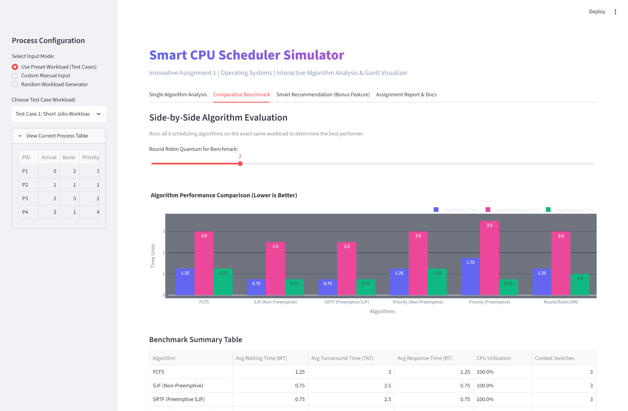
MODULE 2: BENCHMARKING & CONVOY EFFECT ANALYSIS
Multi-Algorithm Comparative Benchmark
Side-by-side empirical performance comparison across all 5 algorithms on identical workloads
Simultaneous Multi-Algorithm Evaluation
• Side-by-Side Execution: Runs FCFS, SJF, SRTF, Priority, and Round Robin simultaneously under identical process arrivals.
• Grouped Bar Charts: Plots Avg Waiting Time, Turnaround Time, and Response Time together for instant visual contrast.
• Empirical Validation: Provides quantitative proof of theoretical scheduling trade-offs directly in the browser.
Convoy Effect Case Study (Test Case 2)
⚡ FCFS Convoy Penalty: P1 (Burst: 8ms) blocks ready short jobs, escalating Avg Waiting Time to 8.80 ms.
⚡ SRTF Preemption Win: Preempts long jobs for shorter tasks, slashing Avg WT to 3.60 ms (59% reduction!).
⚡ Round Robin Balance: Maintains balanced response latency (2.40 ms) across all processes, preventing starvation.
Figure 2: Live Web App — Multi-Algorithm Benchmark Comparison (Grouped Bar Charts & Performance Table)
Smart CPU Scheduler Simulator • Operating Systems Innovative Assignment 1 • Nirma University
3 / 5

Slide 4
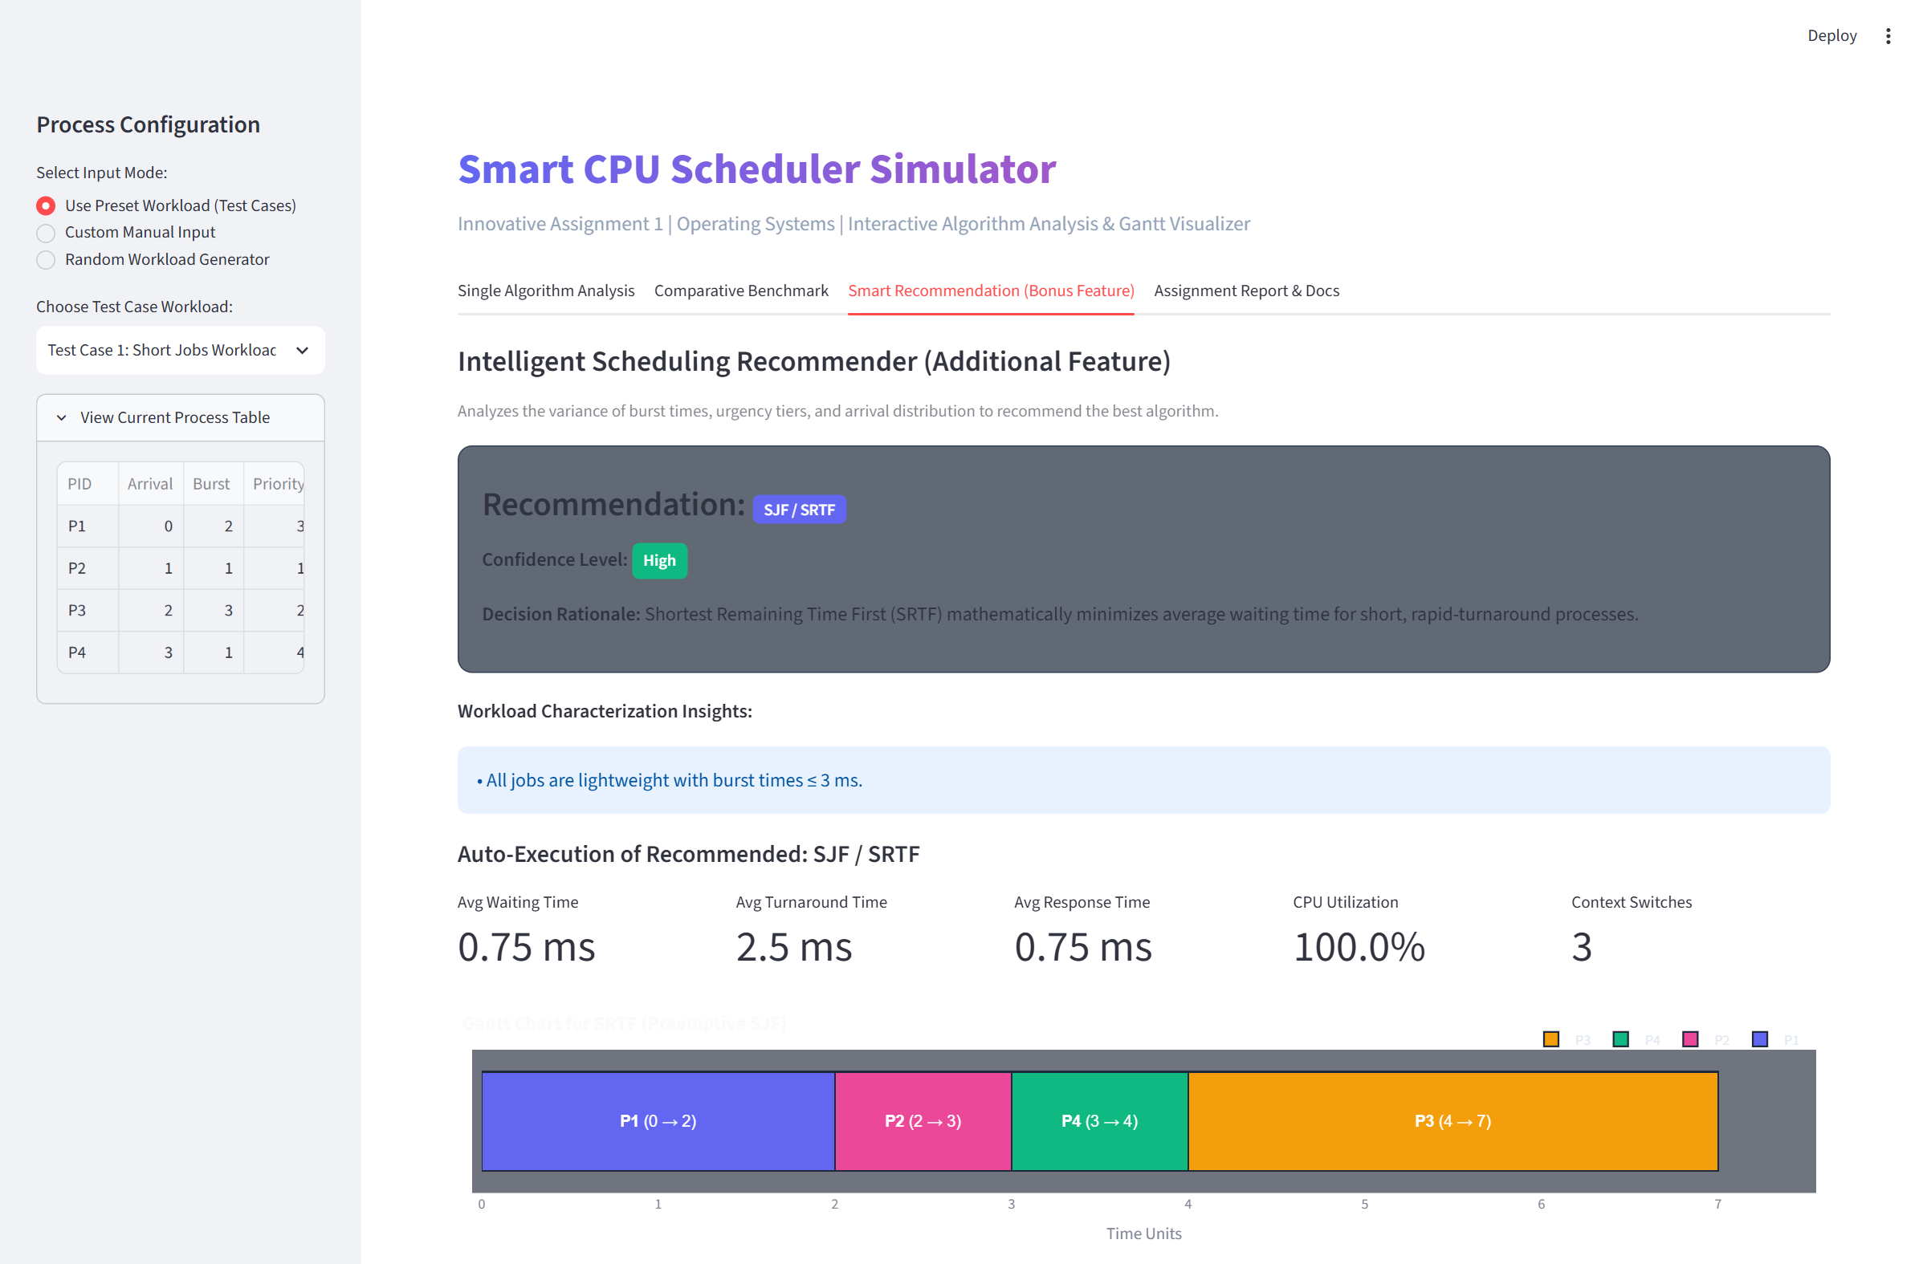
MODULE 3: ADDITIONAL INNOVATION FEATURE
Intelligent Workload-Based Algorithm Recommender
Heuristic AI engine that dynamically analyzes batch characteristics to select the optimal scheduling policy
Heuristic Decision Rules
• High Burst Variance (> 4.0): Detects severe burst heterogeneity. Recommends Round Robin or SRTF to eliminate FCFS convoy delays.
• Homogeneous Short Tasks (≤ 4ms): Detects quick micro-bursts. Recommends SJF / SRTF to mathematically minimize average turnaround time.
• High Priority Spread (≥ 3 Tiers): Detects mission-critical tasks mixed with background jobs. Recommends Preemptive Priority.
• Synchronous Batch Arrivals: Recommends FCFS for uniform sequential pipelines to avoid redundant context switching overhead.
Explainable Intelligence
✔ Clear Rationale: Explains WHY an algorithm is chosen with confidence metrics.
✔ One-Click Run: Instantly runs the recommended policy and generates its Gantt chart.
✔ Pedagogical Value: Helps students connect workload characteristics directly to algorithm behavior.
Figure 3: Live Web App — Smart Workload Recommender (Workload Insights, Algorithm Ranking & Gantt Verification)
Smart CPU Scheduler Simulator • Operating Systems Innovative Assignment 1 • Nirma University
4 / 5

Slide 5
SYNTHESIS: ARCHITECTURE, BENCHMARK MATRIX & TAKEAWAYS
System Architecture, Benchmark Matrix & Key Takeaways
Summary of decoupled modular code, quantitative test workload results, and core conclusions
1. Decoupled Architecture
• scheduler/process.py
Lightweight process structure (PID, Arrival, Burst, Priority, Remaining).
• scheduler/*.py
Transparent algorithm engines (FCFS, SJF, SRTF, Priority, RR) with zero class bloat.
• scheduler/metrics.py
Accurate mathematical computation of WT, TAT, RT, and context switches.
• scheduler/smart_suggest.py
Workload pattern analyzer and heuristic recommendation engine.
• ui/gantt.py
Plotly visualizer rendering interactive execution bars and timeline ranges.
• app.py
Streamlit UI orchestrator with multi-tab navigation and sidebar controls.
2. Empirical Benchmark Matrix
Test Case 2 (Mixed Convoy Workload: 5 Processes):
3. Conclusions & Takeaways
✔ Bridging Theory & Practice: Replaces error-prone manual paper Gantt chart calculations with a verifiable, interactive simulator.
✔ Empirical Rigor: Visually and quantitatively confirms theoretical phenomena like the FCFS Convoy Effect and RR time slice sensitivity.
✔ Intelligent Scheduling: Proves that algorithm selection can be automated through feature extraction and variance analysis.
✔ Clean Engineering: Demonstrates high code maintainability through modular separation between algorithmic logic and presentation layers.
✔ Future Roadmap: Extensible to Multi-Level Feedback Queues (MLFQ), multi-core CPU scheduling, and dynamic real-time priority aging.
Algorithm | Avg WT | Avg TAT | Avg RT
FCFS | 8.80 ms | 13.20 ms | 8.80 ms
SJF (Non-Preempt) | 6.00 ms | 10.40 ms | 6.00 ms
SRTF (Preemptive) | 3.60 ms | 8.00 ms | 1.60 ms
Priority (Preempt) | 4.80 ms | 9.20 ms | 2.60 ms
Round Robin (Q=2) | 7.60 ms | 12.00 ms | 2.40 ms
Quantitative Benchmark Findings:
• SRTF provides provably lowest WT (3.60ms), reducing latency by 59% over FCFS.
• Round Robin ensures uniform responsiveness (RT: 2.40ms) despite higher context switches (11).
Smart CPU Scheduler Simulator • Operating Systems Innovative Assignment 1 • Nirma University
5 / 5

