Slide 1

NIRMA UNIVERSITY • INSTITUTE OF TECHNOLOGY
Department of Computer Science & Engineering • Master of Computer Applications (MCA)
6CS102CC26 - DATA STRUCTURES INNOVATIVE ASSIGNMENT – 1
BloodLink: Real-Time Blood Requisition &
Donor Allocation System
STUDENT CANDIDATE
SHREY PATEL
Roll Number: 26MCA042 • Master of Computer Applications (MCA - Semester I)
ACADEMIC GUIDANCE & EVALUATION
Prof. NIRAV PATEL
Assistant Professor • 6CS102CC26 - Data Structures
Nirma University • 6CS102CC26 - Data Structures • Innovative Assignment 1 • Shrey Patel (26MCA042)
01 / 08

Slide 2
PROBLEM CONTEXT & REGIONAL CHALLENGES
Overcoming Regional Blood Cold-Chain Perishability & Allocation Delays
Resolving life-critical logistical bottlenecks across Gujarat's 34 districts through deterministic data structures.
Critical Cold-Chain Challenges · CHALLENGES
• Strict Biological Shelf Lives: Platelets degrade in 5 days; Whole Blood in 35-42 days; Plasma requires cryogenic sub-zero storage.
• Regional Supply Disparities: Severe supply-demand imbalances between urban hubs (Ahmedabad, Surat) and remote districts (Kutch, Dang).
• Fatal Queue Inversion Risk: Standard FIFO queues force emergency trauma hemorrhages to wait behind non-acute elective surgeries.
• High-Latency Donor Sourcing: Manual donor phone calls and linear database table scanning waste critical resuscitation minutes.
• Cold-Storage Information Silos: Hospitals lack real-time visibility into neighboring blood bank reserves, causing avoidable shortages.
BloodLink Computational Solution · OUR SOLUTION
• In-Memory 3D Static Matrix: Pre-allocated 34x8 array providing O(1) constant-time voluntary donor registration and lookup.
• 3-Tier Multilevel Queue (MLQ): Enforces clinical triage tiers: CRITICAL (<1h), URGENT (<4h), and SCHEDULED (<24h) with strict FIFO.
• Autonomous Event Worker: Single QueueProcessor worker running zero-polling event loop sleeping on empty queues.
• Geodesic Proximity Matching: Haversine spatial ranking pairs emergency requisitions with nearest active blood depots.
• Advanced SQL Push-Down: MySQL 8 JSON aggregations minimize network payloads and eliminate JavaScript CPU serialization.
Nirma University • 6CS102CC26 - Data Structures • Innovative Assignment 1 • Shrey Patel (26MCA042)
02 / 08

Slide 3
SYSTEM DESIGN & MODULARITY
Decoupled Architecture: In-Memory Matrix, MLQ Triage & Event Worker
Clean 3-tier separation: pure data structures, autonomous event-driven worker, and reactive client portals.
Tier 1: In-Memory Core · DATA STRUCTURES
• Donor3DArray Matrix: Encapsulates 34 districts and 8 blood groups in a contiguous reference matrix.
• MultilevelQueue Class: Maintains 3 distinct FIFO Queues with deterministic top-down cascading dequeue.
• O(1) Constant-Time Bounds: Both matrix insertions and MLQ enqueue/dequeue execute in strictly bounded O(1) time.
• Zero-Lock Spatial Cache: 272 static array buckets reside permanently in heap with zero GC fragmentation.
Tier 2: Event Worker · EVENT WORKER
• Autonomous QueueProcessor: Singleton background loop running independently from Socket.IO ingestion.
• Zero-Polling Wakeup: Sleeps on empty queue with events.once('wakeup') yielding 0.00% idle CPU load.
• Haversine Proximity Engine: Ranks depots by geodesic distance and verified component inventory.
• Targeted Result Emission: Dispatches results strictly to request.socketId, preventing broadcast bleed.
Tier 3: Multi-Portal Client · CLIENT PORTALS
• Requester Triage Portal: Clinical priority tier selection with interactive Leaflet GPS geolocation mapping.
• Donor Onboarding Portal: Instant validation of donor weight, age, and 90-day interval with 3D array insertion.
• Gujarat District Directory: District-level catalog covering cold-storage reserves across 34 administrative divisions.
• Interactive Heatmap: Vector SVG district map visualizing real-time statewide blood supply distribution.
Nirma University • 6CS102CC26 - Data Structures • Innovative Assignment 1 • Shrey Patel (26MCA042)
03 / 08

Slide 4
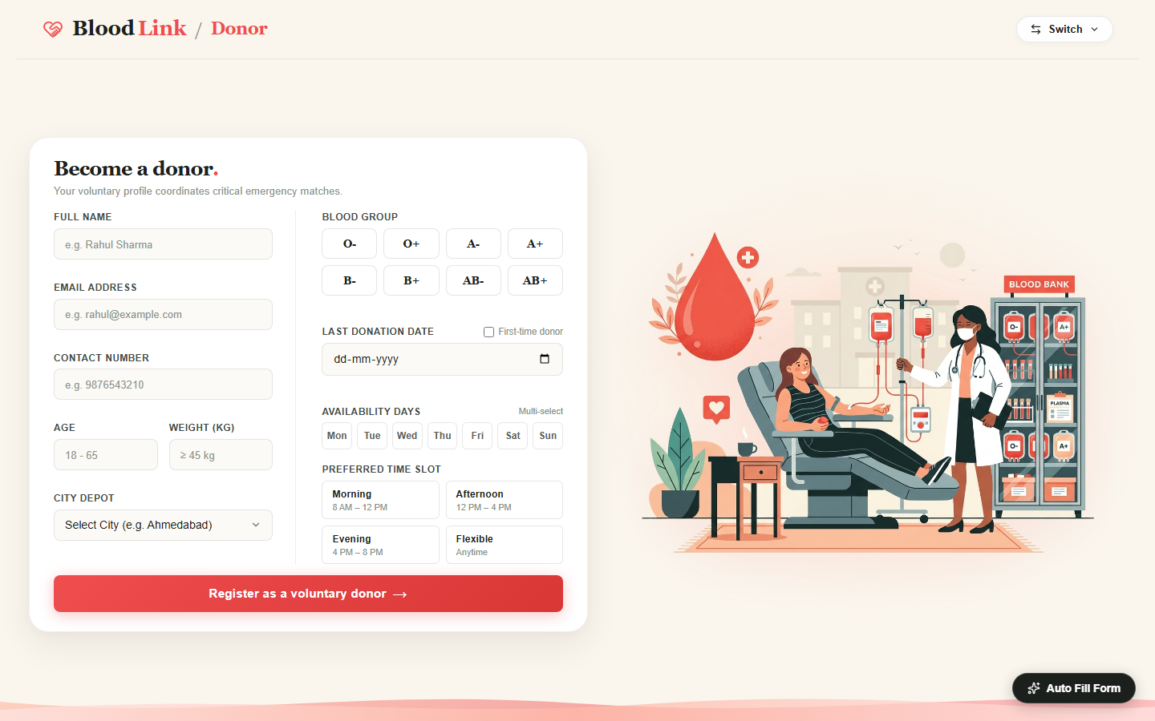
DATA STRUCTURE 1: IN-MEMORY MATRIX
In-Memory 3D Static Matrix Indexing [City][BloodGroup][Donors]
Multidimensional orthogonal indexing enabling O(1) voluntary donor registration and serological compatibility lookup.
Matrix Topology & Mechanical Invariants · 3D MATRIX CORE
• 34 Fixed City Coordinates: Maps Gujarat districts to integer ordinals c in [0, 33] using static lookup tables.
• 8 Blood Group Indices: Serological ABO/Rh phenotypes mapped to indices g in [0, 7] (A+, A-, B+, B-, AB+, AB-, O+, O-).
• Guaranteed O(1) Insertion: matrix[c][g].push(donor) appends records in pure constant time without table scanning.
• Instant Serological Slices: Universal recipient (AB+) and donor (O-) queries project across matrix planes in O(8) time.
• Dense Memory Cache Locality: Pre-allocated 272 bucket pointers require under 2.2 KB of memory with zero pointer chasing.
Figure 1: Voluntary Donor Registration Portal — Capturing donor demographics and serological profile for instant O(1) 3D matrix insertion.
Nirma University • 6CS102CC26 - Data Structures • Innovative Assignment 1 • Shrey Patel (26MCA042)
04 / 08

Slide 5
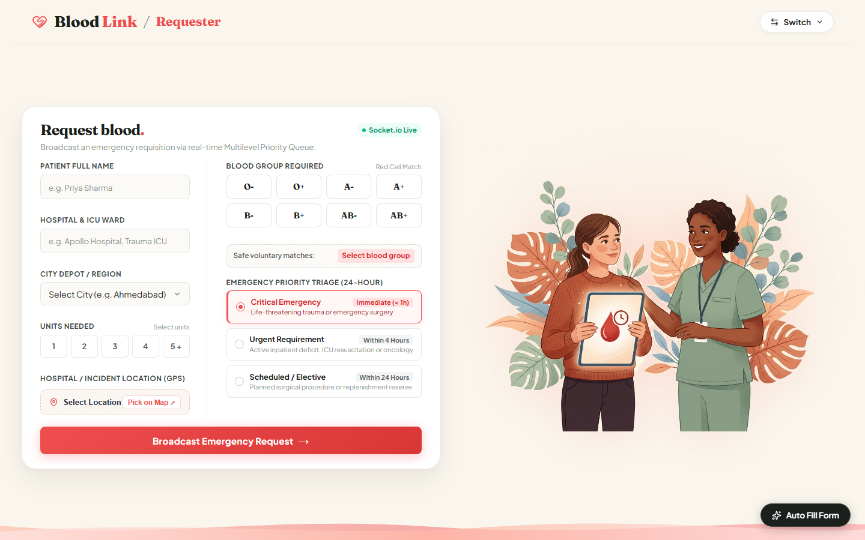
DATA STRUCTURE 2: MULTILEVEL QUEUE
Clinical Triage Prioritization & Deterministic FIFO Discipline
Enforcing strict preemptive clinical triage while guaranteeing zero starvation and intra-tier fairness.
Clinical Triage & Operational Discipline · TRIAGE LOGIC
• Tier 1: CRITICAL (< 1 Hour): Acute polytrauma, massive hemorrhagic shock, ruptured aneurysms. Preemptively dispatched first.
• Tier 2: URGENT (< 4 Hours): Emergency surgery, active ICU transfusions, and severe hemolytic anemia with hemodynamic stability.
• Tier 3: SCHEDULED (< 24 Hours): Planned elective surgeries, thalassemia routine maintenance, and orthopedics.
• Strict Intra-Tier FIFO: Each priority level is governed by an independent FIFO Queue class, ensuring fair arrival sequence.
• Zero-Starvation Cascading: Cascading dequeue strictly inspects Tier 1 -> Tier 2 -> Tier 3 with sub-millisecond dispatch cycles.
Figure 2: Requester Triage Portal — Clinical urgency selection (CRITICAL, URGENT, SCHEDULED) with interactive GPS location mapping.
Nirma University • 6CS102CC26 - Data Structures • Innovative Assignment 1 • Shrey Patel (26MCA042)
05 / 08

Slide 6
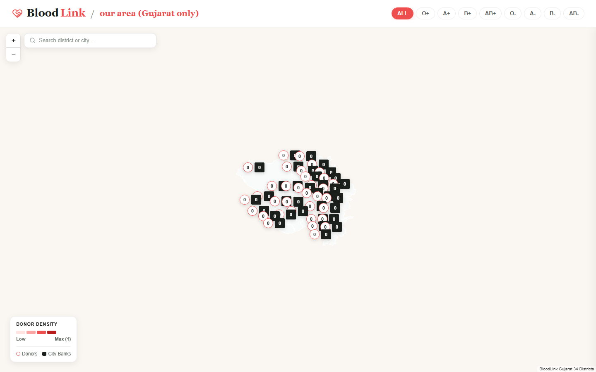
EVENT-DRIVEN WORKER ARCHITECTURE
Autonomous Single-Worker Execution & Zero-Polling Wakeup
Decoupling socket ingestion from queue execution with atomic concurrency locks and targeted event dispatching.
Autonomous Processor & Socket Mechanics · EVENT WORKER
• Singleton Worker Execution: Independent QueueProcessor runs exactly one worker loop protected by isProcessing lock.
• Zero-Polling Event Wakeup: Sleeps on events.once('wakeup') when empty; yields thread to event loop with zero CPU waste.
• Sub-2ms Token Ingestion: Socket handler immediately enqueues, acknowledges client with token, and triggers worker.
• Targeted Client Emission: Dispatches triage results via io.to(request.socketId).emit('send_result') without broadcast leaks.
• Haversine Distance Scoring: Computes exact geodesic distances to rank nearest regional blood banks with matching inventory.
Figure 3: Interactive Gujarat District Spatial Map — Real-time blood supply heatmap coordinating regional logistics.
Nirma University • 6CS102CC26 - Data Structures • Innovative Assignment 1 • Shrey Patel (26MCA042)
06 / 08

Slide 7
COMPLEXITY ANALYSIS & BENCHMARK
Multi-Dimensional Matrix & Multilevel Queue Performance Matrix
Rigorous algorithmic comparisons demonstrating the mathematical superiority of BloodLink's core structures.
Architecture | Donor Insertion | City+Group Lookup | Universal Compatibility | Triage Dequeue | Cache Locality
Flat Array (Unsorted) | O(1) Append | O(N) Full Scan | O(N) Full Scan | O(N) Linear Search | Good (Contiguous)
Singly Linked List | O(1) Head | O(N) Traversal | O(N) Traversal | O(N) Traversal | Poor (Pointer Chase)
Binary Min-Heap | O(log N) | O(N) Unsorted | O(N) Unsorted | O(log N) Sift-Down | Moderate (Tree Heap)
Hash Map (Compound) | O(1) Amortized | O(1) Key Probe | O(K) Probes | O(1) if Separate | Moderate (Sparse)
BloodLink (3D Array + MLQ) | O(1) (Optimal) | O(1) (Optimal) | O(8) Slice (Optimal) | O(1) (Optimal) | Optimal (Dense Grid)
Data Structure Invariant Proofs · KEY FINDINGS
• Guaranteed O(1) Time Bounds: Matrix indexing and queue dispatching operate in strict O(1) time without dynamic re-allocation.
• Zero Memory Waste: Pre-allocating 272 grid pointers requires negligible memory while completely bypassing hash collision overhead.
Clinical Queuing Trade-Offs · ENGINEERING TRADE-OFFS
• MLQ vs Heap Superiority: MLQ achieves O(1) dequeue with strict FIFO fairness, whereas binary heaps incur O(log N) tree sifting.
• Thread Safety Under Concurrency: Single-worker processing eliminates race conditions during multi-client socket ingestion.
Nirma University • 6CS102CC26 - Data Structures • Innovative Assignment 1 • Shrey Patel (26MCA042)
07 / 08

Slide 8
REAL-WORLD SYSTEMS & CONCLUSION
Industrial Healthcare Platforms, Academic Learnings & Verification
Connecting academic data structures to nationwide healthcare logistics and verifying implementation integrity.
Industrial Healthcare Platform Alignment · INDUSTRIAL MAPPING
• eRaktKosh (Govt. of India): National digital blood repository coordinating inventory and voluntary donors across all states.
• American Red Cross Logistics: Employs multi-tier priority dispatch and shelf-life optimization for emergency transfers.
• NHS Blood & Transplant (UK): Utilizes algorithmic cold-chain routing to minimize perishable component wastage.
• Academic Alignment: BloodLink replicates mission-critical production architecture within a clean, auditable implementation.
Academic Conclusions & Student Verification · ACADEMIC SCOPE
• Pedagogical Impact: Demonstrates that classical data structures directly solve life-critical real-world medical logistics.
• Mathematical Correctness: Rigorous automated test suite (test_mlq.js) verifies 100% triage priority and FIFO integrity.
• Zero CPU Waste: Event-driven wakeup pattern provides sub-millisecond responsiveness with 0.00% idle CPU overhead.
• Student Declaration: Original academic work executed for 6CS102CC26 - Data Structures under Prof. Nirav Patel (Oct 2026).
Nirma University • 6CS102CC26 - Data Structures • Innovative Assignment 1 • Shrey Patel (26MCA042)
08 / 08

