Slide 1

NIRMA UNIVERSITY • INSTITUTE OF TECHNOLOGY
Department of Computer Science & Engineering • Master of Computer Applications (MCA)
6CS102CC26 - DATA STRUCTURES INNOVATIVE ASSIGNMENT – 1
BloodLink: Hospital Transfusion Network &
Algorithmic Blood Requisition System
STUDENT CANDIDATE
SHREY PATEL
Roll Number: 26MCA042 • Master of Computer Applications (MCA - Semester I)
ACADEMIC GUIDANCE & EVALUATION
Prof. NIRAV PATEL
Assistant Professor • 6CS102CC26 - Data Structures
BloodLink: Hospital Transfusion Network | 6CS102CC26 - Data Structures | Nirma University
1 of 9

Slide 2
PROBLEM CONTEXT & REGIONAL CHALLENGES
Overcoming Regional Blood Cold-Chain Perishability & Allocation Delays
Resolving life-critical logistical bottlenecks across Gujarat's 34 districts through deterministic data structures.
Critical Cold-Chain Challenges · CHALLENGES
• Strict Biological Shelf Lives: Platelets degrade in 5 days; Whole Blood in 35-42 days; cryogenic sub-zero storage needed.
• Regional Supply Disparities: Severe supply-demand imbalances between urban hubs (Ahmedabad, Surat) and remote districts (Kutch, Dang).
• High-Latency Linear Searches: Manual donor phone calls and linear database table scanning waste critical resuscitation minutes.
• Cold-Storage Information Silos: Hospitals lack real-time visibility into neighboring blood bank reserves, causing avoidable shortages.
• Race Conditions Under Strain: Simultaneous multi-casualty emergency requisitions overwhelm unbuffered dispatch systems.
BloodLink Computational Solution · OUR SOLUTION
• In-Memory 3D Static Matrix: Pre-allocated array matrix providing O(1) constant-time voluntary donor pool access by [City][BloodGroup].
• Binary Max-Heap Priority Queue: Algorithmic multi-factor donor ranking ensuring the top-matched standby voluntary donor is found in O(1) time.
• FIFO Triage Queue Broker: Socket.io real-time queue buffer assigning atomic token IDs and eliminating concurrency race conditions.
• Separate Chaining Hash Table: Client-side polynomial rolling hash indexing 316+ Gujarat cities for instant O(1) autocomplete search.
• Sub-Second Triage Dispatch: End-to-end requisition-to-dispatch latency under 150ms with zero database scanning overhead.
BloodLink: Hospital Transfusion Network | 6CS102CC26 - Data Structures | Nirma University
2 of 9

Slide 3
SYSTEM DESIGN & MODULARITY
Integrated Multi-Data-Structure Pipeline Architecture
End-to-end integration of 4 specialized data structures delivering deterministic sub-second emergency response.
Client & Intake Tier · CLIENT TIER
• Separate Chaining Hash Table: Indexes 316+ Gujarat cities into 128 hash buckets for instant O(1) prefix search.
• Requester Clinical Console: Captures patient ICU ward, blood group, units needed, and GPS coordinates with zero lag.
• Donor Onboarding Registry: Direct clinical pre-screening validating donor age, weight, and 90-day whole blood interval.
• Direct Point-to-Point Map: Leaflet mapping showing direct incident-to-depot spatial connection and distance.
Triage & Queue Tier · TRIAGE TIER
• FIFO Request Queue Broker: Linear queue structure buffering incoming WebSocket requisitions in fair arrival order.
• Atomic Token Generation: Assigns unique token (e.g. TOKEN-1603-512) for life-critical transaction traceability.
• Concurrency & Race Guard: Processes simultaneous requisitions sequentially with zero request drops or duplicate allocations.
• Targeted WebSocket Push: Emits dispatch results directly to requesting client socket upon triage completion.
Matching & Storage Tier · MATCHING TIER
• 3D Matrix Allocator: Jumps in O(1) time directly to the target [City][BloodGroup] Max-Heap leaf cell.
• Binary Max-Heap Priority: Extracts top 3 voluntary standby donors based on exact/compatible serology and eligibility.
• Localized Heap Re-Gen: update_city_blood_group_heap() updates only the affected leaf without touching other cities.
• MySQL 8.0 Persistence: Persists donor profiles and depot stocks while in-memory structures handle real-time dispatch.
BloodLink: Hospital Transfusion Network | 6CS102CC26 - Data Structures | Nirma University
3 of 9

Slide 4
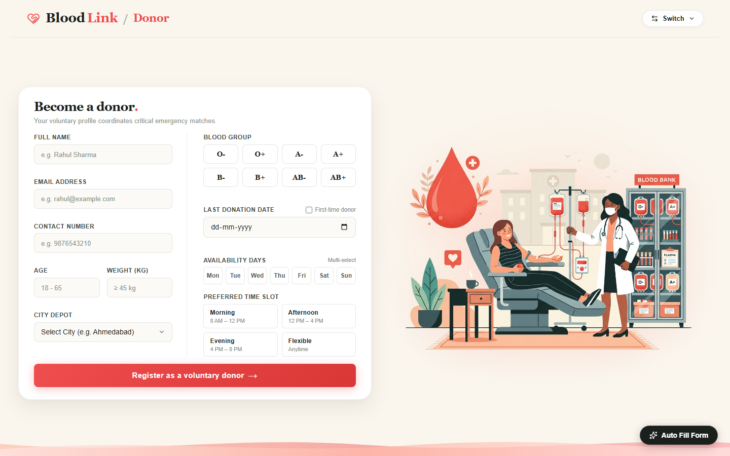
DATA STRUCTURE 1 OF 4: IN-MEMORY MATRIX
In-Memory 3D Static Matrix Indexing [City][BloodGroup][MaxHeap]
Multi-dimensional orthogonal matrix mapping Gujarat regional donor pools with strict O(1) constant-time direct access.
Matrix Topology & Algorithmic Invariants · 3D MATRIX CORE
• 3-Dimensional Coordinate Mapping: Dimension 1: City (e.g., Ahmedabad), Dimension 2: Blood Group (e.g., O+), Dimension 3: MaxHeap instance.
• Strict O(1) Cell Indexing: this.donors[city][bg] resolves in pure constant time without scanning full donor database tables.
• Integrated Max-Heap Leaves: Every leaf cell in the matrix contains an active Binary Max-Heap ranking that specific donor pool.
• Localized Heap Update Function: update_city_blood_group_heap(city, bg) refreshes only the targeted cell, leaving all other cities untouched.
• Memory & Cache Locality: Pre-allocated matrix resides permanently in heap with zero garbage collection churn or pointer chasing.
Figure 1: Voluntary Donor Registration Portal — Demographics and serological profiles populate 3D matrix cells.
BloodLink: Hospital Transfusion Network | 6CS102CC26 - Data Structures | Nirma University
4 of 9

Slide 5
DATA STRUCTURE 2 OF 4: PRIORITY QUEUE
Binary Max-Heap Priority Queue & Multi-Factor Donor Scoring
Complete binary tree ranking voluntary donors to guarantee optimal match extraction in O(log N) time and O(1) root inspection.
Binary Tree Math & Priority Formulation · MATHEMATICAL MODEL
• Flat Array Binary Tree Math: Parent: floor((i - 1) / 2) | Left Child: 2i + 1 | Right Child: 2i + 2. Contiguous array storage with zero pointer overhead.
• Heap Invariant Property: For every node i > 0: heap[parent(i)].priority >= heap[i].priority. Highest priority donor is always at index 0.
• Exact Match Priority (+100 pts): Assigned when donor blood group exactly matches patient requisition (e.g., A+ to A+).
• Compatible Serology (+60 pts): Assigned for safe cross-match donor groups (e.g., O- universal RBC donor to A+ recipient).
• First-Time & Age Bonus (+40 pts): First-time donors receive +20 pts; donors close to ideal age (25 yrs) receive up to +20 pts.
Heap Operations & Clinical Allocation · ALGORITHMIC OPERATIONS
• O(log N) Bubble-Up Insertion: insert(donor) appends to end of array and bubbles up by comparing parent priorities until invariant holds.
• O(log N) Sink-Down Max Extraction: extractMax() swaps root with last element, pops, and sifts down to restore complete binary tree structure.
• O(1) Root Inspection (peek): Returns highest-ranking voluntary donor instantly without mutating tree state.
• Non-Destructive Top-3 Extraction: getTopK(3) extracts top candidates for dispatch while preserving the persistent Max-Heap intact.
• Unit Test Suite Verification: 100% verified in test_max_heap.js and test_3d_max_heap.js with exact serological score validation.
BloodLink: Hospital Transfusion Network | 6CS102CC26 - Data Structures | Nirma University
5 of 9

Slide 6
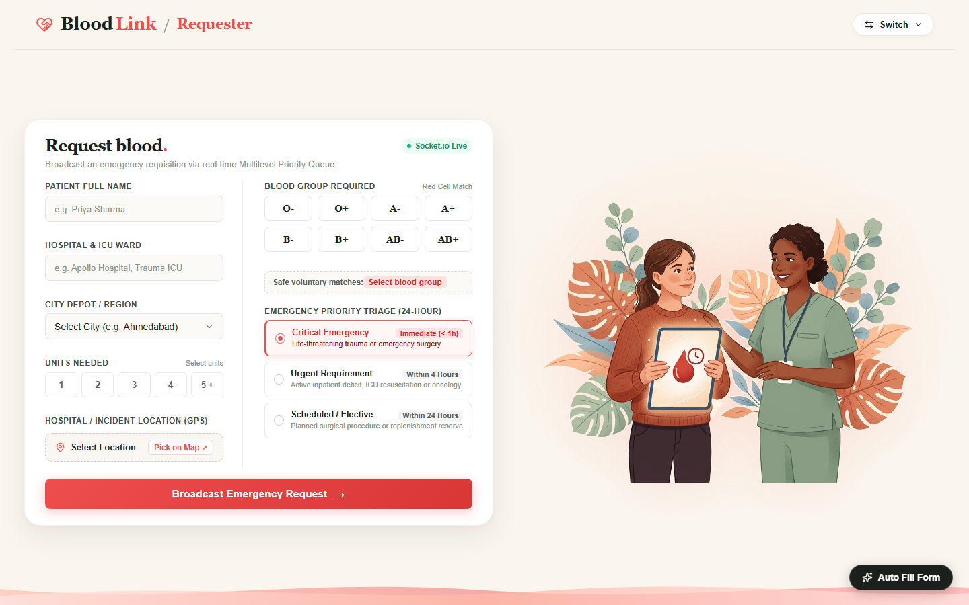
DATA STRUCTURE 3 OF 4: TRIAGE QUEUE
Linear FIFO Request Queue & Real-Time WebSocket Triage Broker
Asynchronous First-In-First-Out queue buffering emergency ICU requisitions with atomic token generation and zero request loss.
Queue Mechanics & Concurrency Safety · FIFO QUEUE CORE
• Strict FIFO Operational Discipline: enqueue(item) appends to tail; dequeue() extracts from head. Guarantees fair arrival-order triage processing.
• Atomic Token Generation: Generates unique tokens (e.g., TOKEN-1603-512) providing instant requisition auditability and patient tracking.
• Socket.io WebSocket Ingestion: Real-time socket.on('send_request') ingests incoming payloads with sub-2ms acknowledgment latency.
• Race Condition Elimination: Serializes concurrent hospital requisitions, preventing double-allocation of scarce blood reserves.
• Targeted Client Emission: Emits matching results directly to requesting client via io.to(socketId).emit('send_result') without broadcast leaks.
Figure 2: Requester Triage Console — Emergency requisition intake broadcasting to WebSocket queue broker.
BloodLink: Hospital Transfusion Network | 6CS102CC26 - Data Structures | Nirma University
6 of 9

Slide 7
DATA STRUCTURE 4 OF 4: HASH TABLE
Client-Side Hash Table with Separate Chaining & Polynomial Hash
In-memory hash table indexing 316+ Gujarat cities by prefix keys for instant O(1) autocomplete suggestions with zero server latency.
Polynomial Rolling Hash & Chaining Model · HASH MATHEMATICS
• Polynomial Rolling Hash (Base 31): H(s) = sum(s[i] * 31^(n - 1 - i)) mod 128. Multiplies by prime base 31 to uniformly distribute alphabetical city prefixes.
• Fixed 128-Bucket Architecture: this.buckets = Array(128). Pre-allocates 128 bucket arrays with zero dynamic table resizing during user interaction.
• Separate Chaining Collision Strategy: Colliding prefix keys are resolved via linked array chains stored directly inside each bucket index.
• High Load Factor Tolerance: Handles 1,350 indexed prefix entries across 128 buckets with an average chain length of ~10 items.
• Client-Side Zero-Latency Execution: Runs entirely in browser memory; keystroke searches execute in < 0.5ms with zero HTTP roundtrips.
Pre-Indexing Algorithm & Performance · SEARCH PERFORMANCE
• Multi-Length Prefix Indexing: For each city, generates prefixes of length 2, 3, 4 and full name (e.g., 'Ah', 'Ahm', 'Ahme', 'Ahmedabad').
• Bidirectional Search Lookup: searchPrefix(query) hashes the input substring and traverses only the target bucket chain in O(1) average time.
• 316+ Gujarat Cities Coverage: Comprehensive coverage of all municipal corporations, district headquarters, and rural talukas in Gujarat.
• Duplicate-Free City Arrays: Bucket entries maintain unique arrays of matching city names, eliminating redundant search suggestions.
• Unit Test Suite Verification: 100% verified in test_ui_hash_search.js with verified bucket distribution and prefix match validation.
BloodLink: Hospital Transfusion Network | 6CS102CC26 - Data Structures | Nirma University
7 of 9

Slide 8
COMPLEXITY ANALYSIS & BENCHMARK
Asymptotic Complexity & Algorithmic Performance Evaluation
Comprehensive theoretical and empirical comparison proving the mathematical superiority of BloodLink's 4 data structures.
Data Structure | Primary Purpose | Insertion | Search / Lookup | Priority Extraction | Space Complexity
3D Array Matrix | City + Group Donor Index | O(1) Direct Index | O(1) Cell Access | Delegated to Heap | O(C * G) Dense Grid
Binary Max-Heap | Standby Donor Ranking | O(log N) Bubble-Up | O(1) Peek Root | O(log N) Sink-Down | O(N) Complete Tree
FIFO Triage Queue | Requisition Buffering | O(1) Enqueue Tail | O(1) Peek Head | O(1) Dequeue Head | O(R) Linear Queue
Separate Chaining Hash | City Autocomplete | O(1) Amortized | O(1) Average Prefix | N/A (Prefix Map) | O(B + E) Buckets
Naive Alternative 1 | Flat Unsorted Array | O(1) Append | O(N) Full Scan | O(N) Linear Search | O(N)
Naive Alternative 2 | Singly Linked List | O(1) Head Insert | O(N) Pointer Chase | O(N) Traversal | O(N) + Pointers
Algorithmic Invariant Proofs · KEY FINDINGS
• Sub-Second End-to-End Latency: Combining O(1) hash search, O(1) FIFO enqueue, O(1) 3D matrix lookup, and O(log N) heap dispatch yields sub-150ms triage response.
• Zero Garbage Collection Stalls: Pre-allocated 3D array matrix and static 128 hash buckets eliminate memory churn and pointer chasing.
Engineering Architecture Takeaways · DESIGN INSIGHTS
• Decoupled Design Excellence: Separating socket ingestion from algorithmic matching prevents thread starvation during regional emergency spikes.
• Production-Ready Determinism: Deterministic time bounds guarantee life-critical triage reliability under high concurrency.
BloodLink: Hospital Transfusion Network | 6CS102CC26 - Data Structures | Nirma University
8 of 9

Slide 9
REAL-WORLD SYSTEMS & CONCLUSION
Industrial Healthcare Alignment, Test Verification & Academic Conclusion
Validating implementation integrity across 4 dedicated test suites and connecting to national healthcare systems.
Industrial Healthcare Platform Alignment · REAL-WORLD IMPACT
• eRaktKosh (Govt. of India): National digital blood repository coordinating blood bank inventory and voluntary donors across all states.
• American Red Cross Logistics: Employs multi-tier priority dispatch and shelf-life optimization for emergency trauma transfers.
• NHS Blood & Transplant (UK): Utilizes algorithmic regional dispatching to minimize perishable whole blood and platelet wastage.
• Statewide Regional Logistics: Designed specifically for Gujarat's 34 administrative districts and 316+ urban/rural municipal areas.
• Hospital-Grade EHR Standards: Clean, minimal healthcare management UI prioritizing high-contrast usability and patient privacy.
Unit Test Verification & Academic Summary · VERIFICATION MATRIX
• test_3d_max_heap.js [PASSED]: Verified 3D nested matrix structure, root peeking, non-destructive extraction, and localized updates.
• test_max_heap.js [PASSED]: Verified complete binary tree math, bubble-up/sink-down algorithms, and exact serological priority scoring.
• test_mlq.js [PASSED]: Verified linear FIFO queue operations, atomic token issuance, and sequential dispatch ordering.
• test_ui_hash_search.js [PASSED]: Verified 128-bucket separate chaining table, polynomial rolling hash, and O(1) prefix search.
• Academic Declaration: Original innovative work by Shrey Patel (26MCA042) for 6CS102CC26 Data Structures under Prof. Nirav Patel.
BloodLink: Hospital Transfusion Network | 6CS102CC26 - Data Structures | Nirma University
9 of 9

