Slide 1

SMART INDIA HACKATHON 2026
TITLE PAGE
SMART INDIA HACKATHON 2026
Problem Statement ID: SIH26101
Problem Statement Title: Karmayogi Statistical Intelligence (KSI) — AI-Powered Competency Modeling for MoSPI
Theme: Smart Governance & Capacity Building (Mission Karmayogi Bharat)
PS Category: Software (Air-Gapped Sovereign AI)
Team Name: CodeVanta

Slide 2
PROPOSED SOLUTION: KARMAYOGI STATISTICAL INTELLIGENCE (KSI)
CodeVanta
Objective: Transitioning MoSPI from 'Rule-based' to 'Role-based' Competency Governance
• Deterministic Vector Gap Analysis: Models officer proficiency across 4 canonical domains against statutory benchmarks using exact L2 Euclidean distance.
• Deficit-Prioritized iGOT Pathways: Dynamic recommendation engine sorting accredited NSSTA/MeitY modules strictly by highest operational deficit.
• Air-Gapped Assessment Synthesizer: Native PyMuPDF parser + local LLM pipeline synthesizing Bloom-tiered MCQs directly from Gazette notifications.
• Sovereign Cadre Governance: 100% on-premise execution guaranteeing DPDP Act 2023 compliance, paired with Directorate capability heatmaps (NAD, FOD, PSD).

Slide 3
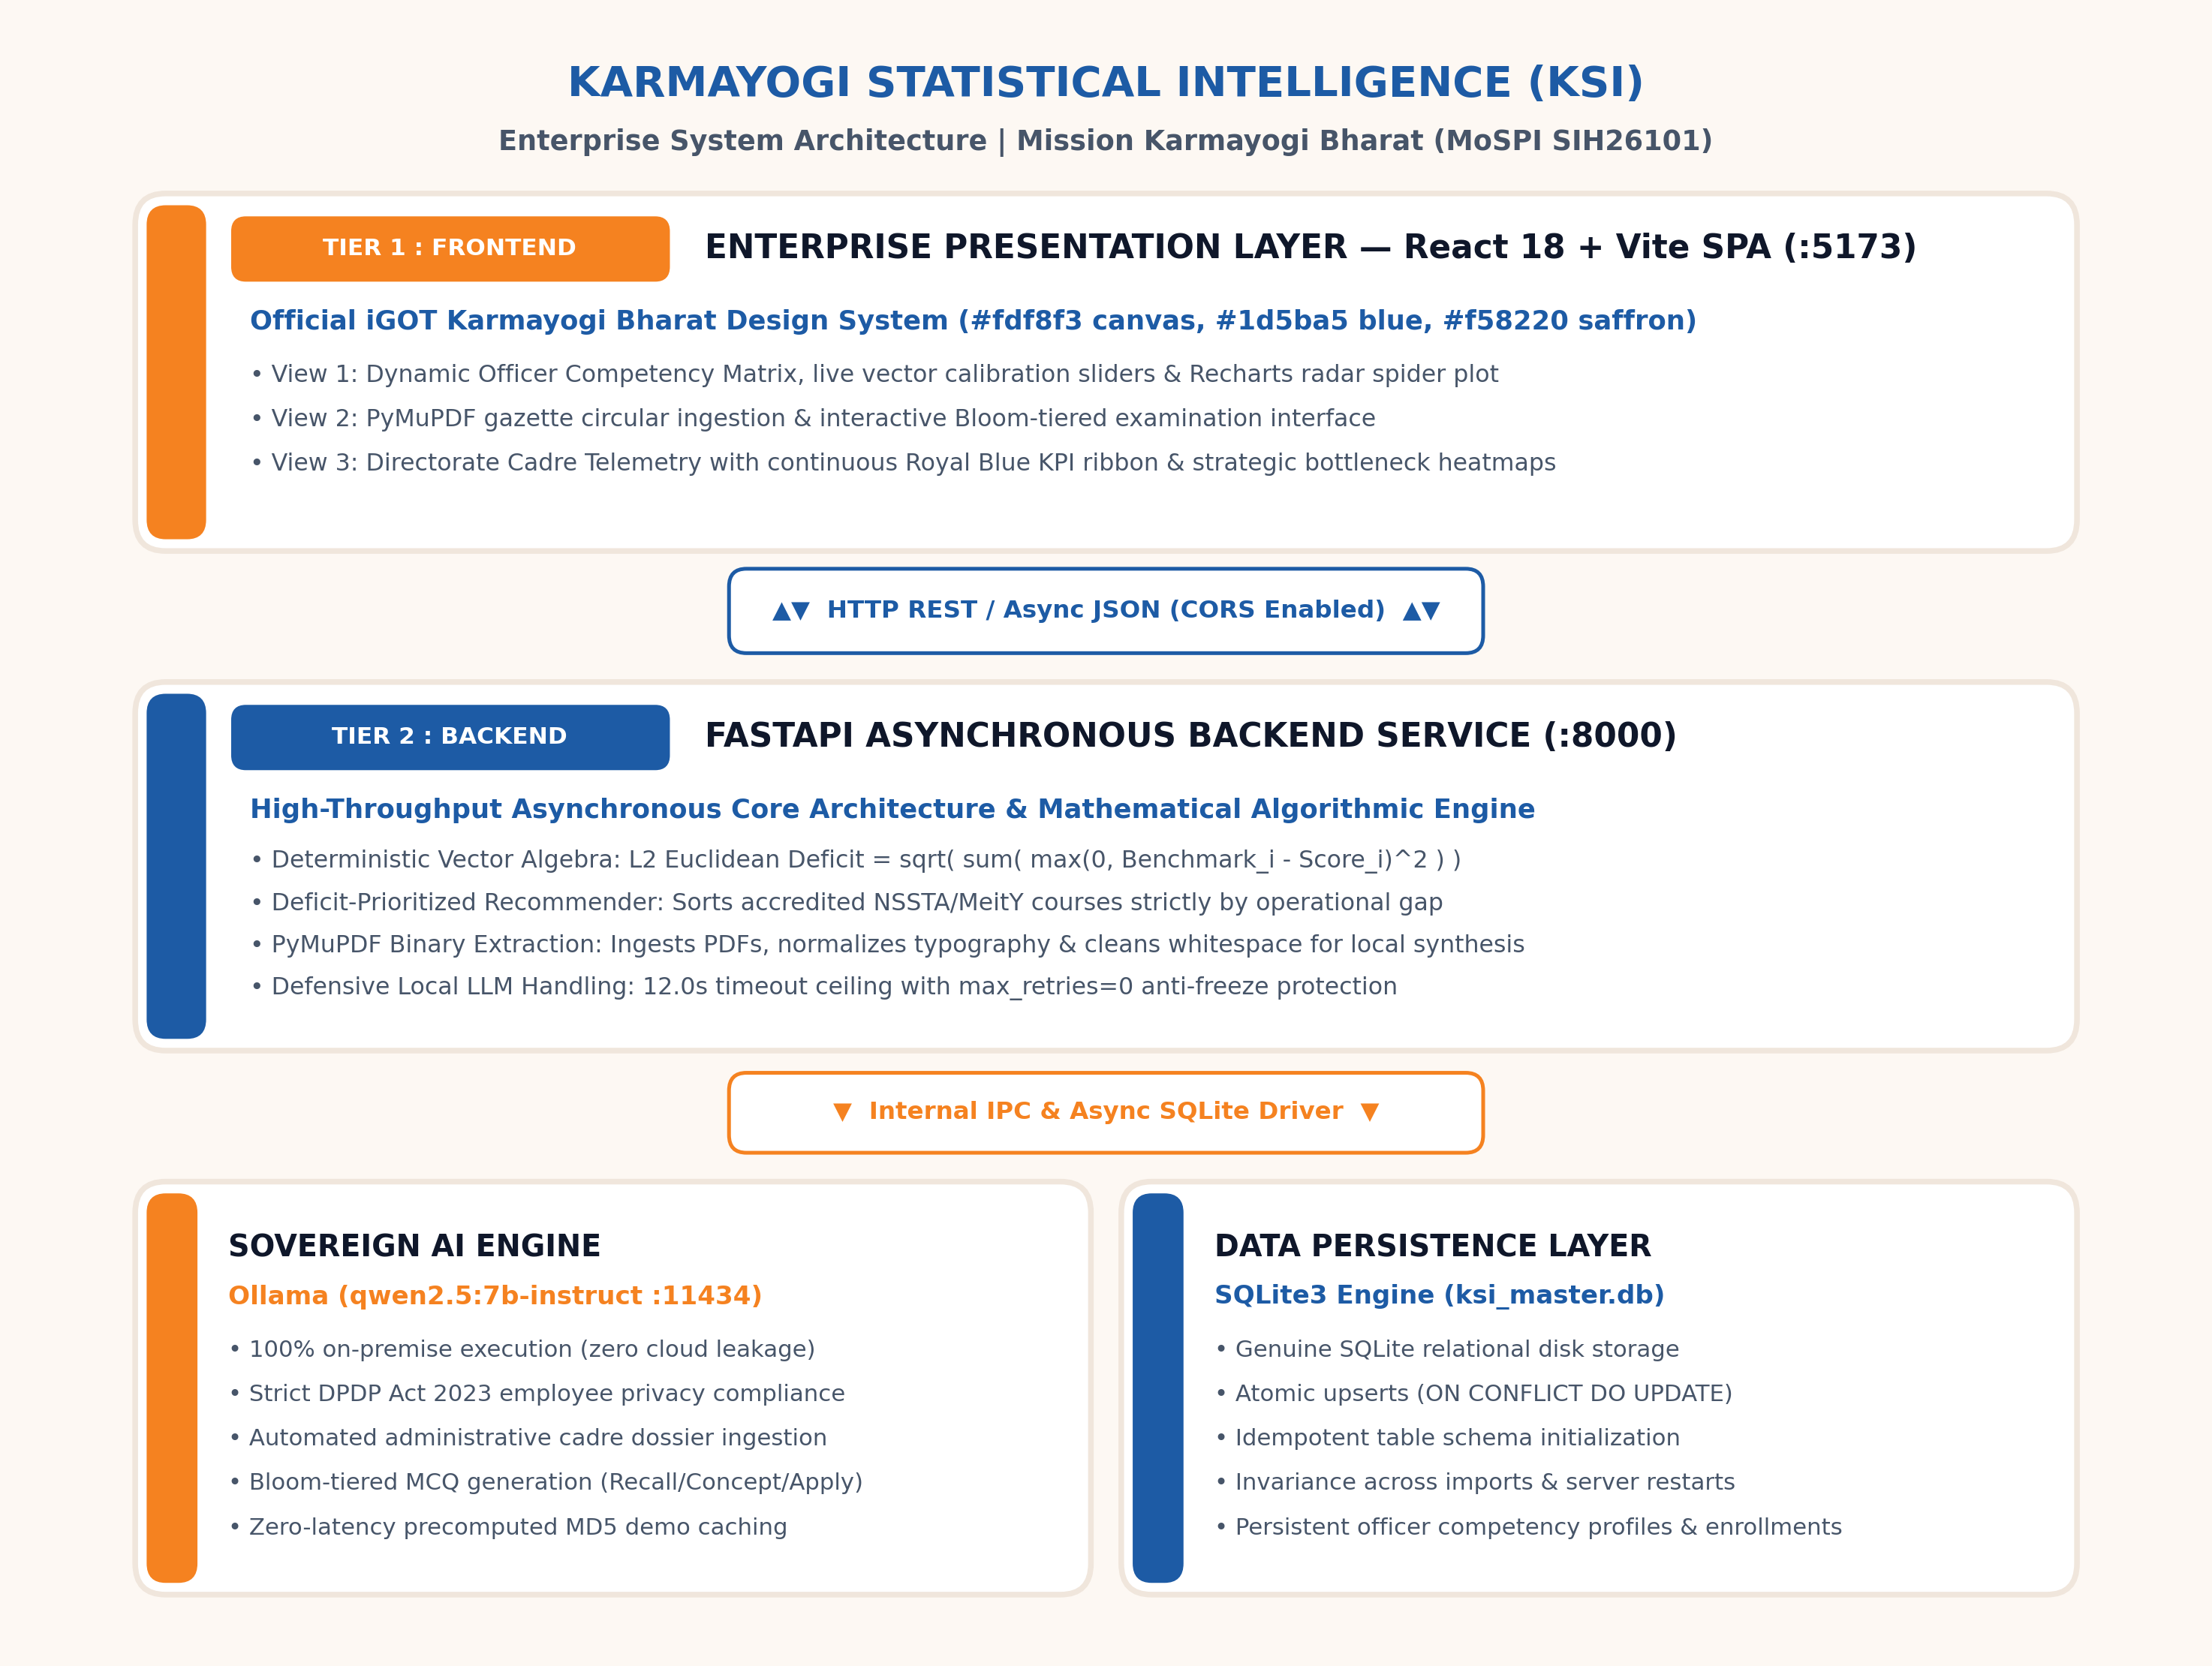
TECHNICAL APPROACH & SYSTEM ARCHITECTURE
CodeVanta
• Core Stack: React 18 + Vite (Official iGOT Bharat Theme) | FastAPI Async REST | SQLite3 disk persistence (ksi_master.db).
• Sovereign AI Engine: Local Ollama (qwen2.5:7b-instruct) pinned with 12s timeout & max_retries=0 anti-freeze guard. Zero external cloud API calls.
• Vector Algebra: Exact Euclidean Deficit L2 = sqrt( sum( max(0, Benchmark_i - Score_i)^2 ) ).
• Operational State: Enterprise web portal verified and live on client port 5173 (React/Vite) backed by async REST endpoints on port 8000 (FastAPI).

Slide 4
FEASIBILITY, RISK ANALYSIS & MITIGATION
Dimension | Potential Risk / Bottleneck | Engineered Mitigation Strategy
Deployment Feasibility | Hardware resource constraints on edge field devices without discrete GPUs. | Engineered for commodity CPUs using quantized 7B model + zero-latency precomputed MD5 hash demo caching.
Inference Stability | Local LLM latency spikes causing HTTP timeouts and interface freezes. | Calibrated 12.0s ceiling with max_retries=0 fail-fast protection and deterministic pedagogical MCQ fallback generator.
Data Sovereignty & Legal | Transmission of MoSPI employee records to third-party cloud APIs violates DPDP 2023. | Zero-leak air-gapped architecture. All vector calculations, scores, and dossier embeddings execute strictly on localhost.

Slide 5
INSTITUTIONAL IMPACT & NATIONAL BENEFITS
CodeVanta
• Direct Beneficiaries: Empowers Subordinate Statistical Service (SSS) and Indian Statistical Service (ISS) officers across FOD, NAD, and PSD divisions.
• Objective Career Pathways: Replaces subjective annual performance appraisals with real-time, empirical competency telemetry and mathematical gap metrics.
• Rapid Curriculum Dissemination: Reduces lag between statutory revisions (e.g., SNA 2008 base revisions, GCF updates) and field readiness from months to seconds via automated circular parsing.
• Strategic Cadre Allocation: Provides Cadre Controlling Authorities with Directorate heatmaps to identify systemic deficits and dispatch targeted capacity-building directives.
• Viksit Bharat Alignment: Directly institutionalizes Mission Karmayogi's mandate for data-driven, role-competent public administration.

Slide 6
STATUTORY REFERENCES & RESEARCH WORK
CodeVanta
• Mission Karmayogi Bharat (DoPT / CBC): Framework of Roles, Activities, and Competencies (FRAC) Dictionary and NPCSCB guidelines.
• MoSPI / NSSTA Curriculum: Training Policy and Assessment Compendium (TPAC) and induction course syllabi for Junior Statistical Officers (JSO).
• United Nations Statistics Division: System of National Accounts (SNA 2008) guidelines on Gross Value Added (GVA), deflators, and input-output tables.
• Digital Personal Data Protection Act (DPDP 2023): Statutory provisions governing sovereign employee data localization, confidentiality, and consent boundaries.
• Pedagogical Grounding: Bloom's Revised Taxonomy (Anderson & Krathwohl, 2001) for automated multi-tier psychometric question generation.

