Slide 1







Search . . .
YOGA
Intelligent Real-Time Yoga Posture Correction Using Computer Vision

Slide 2

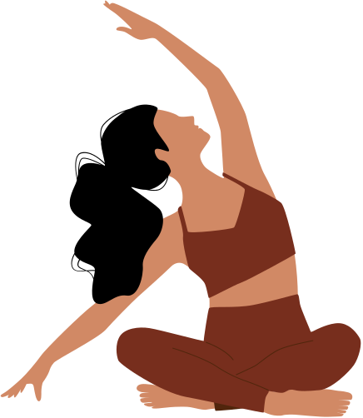

INTRODUCTION
The increasing popularity of yoga has led to a growing number of people practicing it at home.
However, without proper guidance, many individuals are prone to adopting incorrect postures, which can result in injuries or diminish the effectiveness of the practice.
The absence of a physical trainer or instructor to provide real-time feedback and corrections exacerbates this issue
Yoga Wellness
encompasses the physical,mental,&emotional
benefits of practicing yoga

Slide 3

Project purpose
now a days all are busy for their work and no one have to spend a quality time for their family and their health. some people suffering so many disease because they don't follow the daily routine of the yoga
the purpose is to be promote health and wealth improve physical health by increasing flexibility strenght
mental health purpose is to be reducing stress, improving focus and concentration
so we can practice yoga at home it can help improve health condition ,its also help to the balance the body fitness at the home asa safe and secure

Slide 4
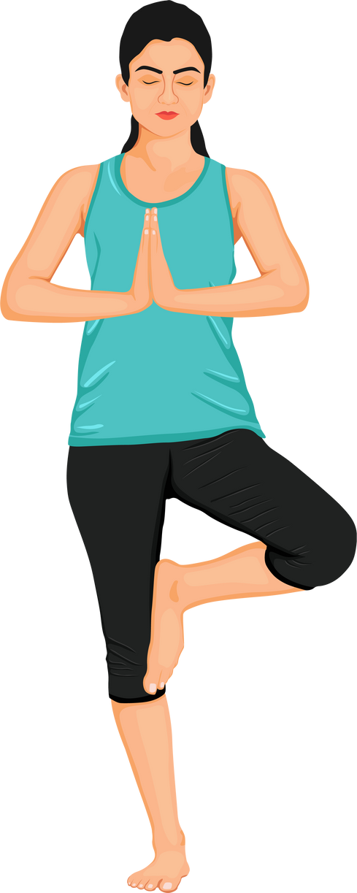
TEAM AND PROBLEM OVERVIEW
problem statement:
In today’s fast-paced world, many people practice yoga at home without proper guidance, leading to incorrect postures that can cause injury or reduce the effectiveness of the practice.
Our app uses computer vision to detect real-time yoga postures and provide instant feedback, ensuring safe and effective yoga practice without the need for a physical trainer.
Team Name : All of us
Team code : HACKV05
Team members:
Sunil : Project lead and backend developer
Shreya&Satish : Research and Documentation
Prajwal : UI/UX & frontend developer
Institution name : Shetty Group of Institutions

Slide 5
In brief about the problem statement
Home Practice Risks :
Practicing yoga at home without guidance often leads to incorrect postures.
Injury Potential:
Incorrect postures can cause
physical strain or injury,
reducing practice effectiveness.
Tech Opportunity:
Advancements in computer vision and AI offer opportunities to develop intelligent systems for posture correction.
Lack of Feedback:
Without immediate correction,
users may continue practicing with flawed techniques

Slide 6
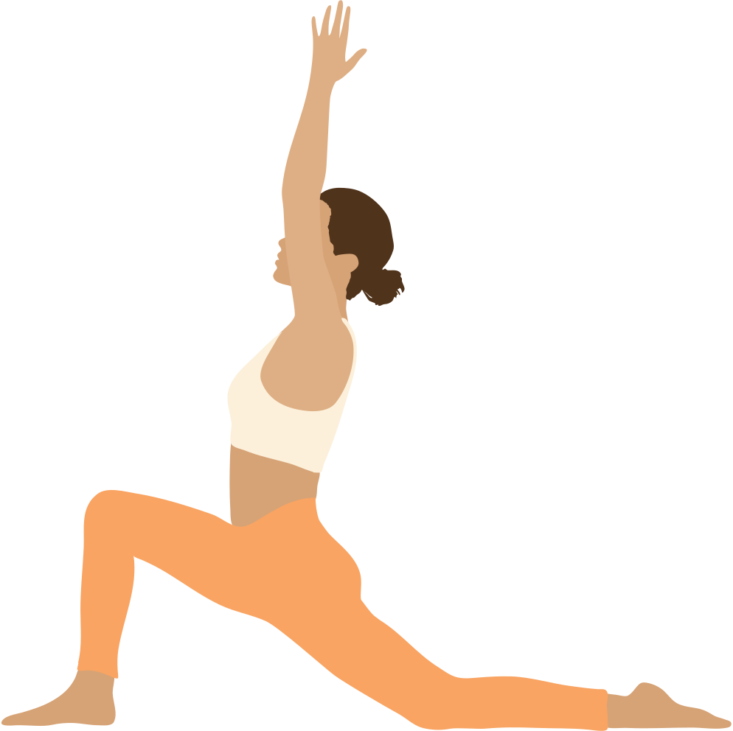
Solution
Digital Yoga
Digital yoga refers to the use of digital technologies to practice, teach, and enhance yoga. This can include:
Online Classes and Tutorials
Pre-recorded classes: Video classes available on-demand.
Live streaming: Real-time classes with instructors.
interactive tutorials: Guided practices with feedback.
:-Yoga Apps and Software:-
1. Pose tracking and correction: Using computer vision and AI to analyze and correct poses.
2. Personalized practice plans: Tailored sequences based on user goals and needs.
3. Progress tracking and analytics: Monitoring user progress and providing insights.

Slide 7
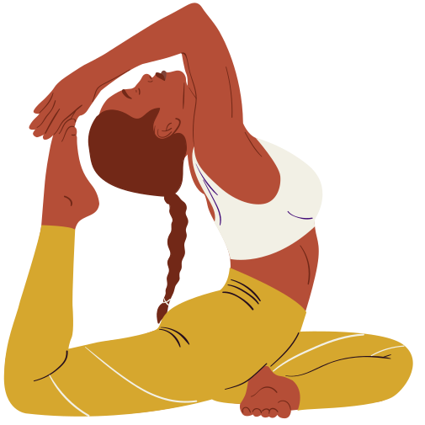
Virtual Reality (VR) and Augmented Reality (AR) Yoga
1. Immersive experiences: Using VR/AR to create engaging and interactive practices.
2. Guided meditations and relaxation: Using VR/AR to enhance mindfulness and relaxation.
benefits of Digital Yoga
1. Convenience: Practice yoga anywhere, anytime.
2. Accessibility: Reach a wider audience, including those with mobility or location constraints.
3. Personalization: Tailor practices to individual needs and goals.
4. Cost-effective: Reduce costs associated with traditional studio-based classes.
Challenges and Limitations
1. Technical issues: Connectivity, hardware, and software limitations.
2. Lack of human interaction: Missing the social and personal aspects of traditional classes.
3. Quality and accuracy: Ensuring the quality and accuracy of digital yoga content.

Slide 8
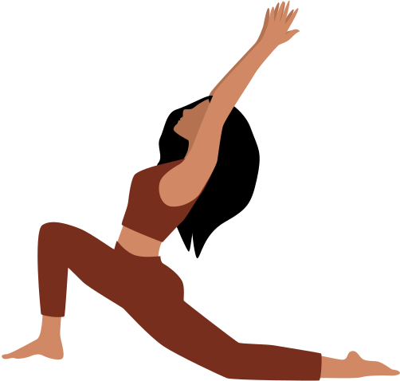

Title: People Involved or Affected Content:
Yoga Instructors:
Might collaborate to feed data
App Developers: Build and maintain the platform
End Users: People practicing yoga at home
Medical Professionals: Provide posture safety standards
Fitness Influencers: Help promote and provide content
Investors/Funding Bodies:
Support development
Order Now

Slide 9


Search . . .
COMPETETIVE ANALYSIS
Asana Rebel
Yoga workouts, video instruction BUT No real-time correction beacuse the technical limitation. like computer vision,ai limitation ,data quality.
Daily Yoga
Guided sessions, community BUT No pose tracking . why beacuse pose tracking not working, classes not loading, audio or video issue
Yoganotch
Sensor-based pose detection BUT Requires extra hardware .require smartphone tablet, smart tv, and wearable devices(pulse rate ,heart rate etc
Mirror
Real-time trainer interaction BUT Expensive setup

Slide 10
Search . . .
IMPACT
1. Increased accessibility: Reach a wider audience, including those with mobility or location constraints.
2. Convenience: Practice yoga anywhere, anytime, at your own pace.
3. Personalization: Tailor practices to individual needs, goals, and preferences.
4. Cost-effectiveness: Reduce costs associated with traditional studio-based classes.

Slide 11
Search . . .
VALUE PROPOSITION
1. Flexibility and autonomy: Practice yoga on your own terms.
2. Improved physical and mental well-being: Enhance flexibility, strength, balance, and reduce stress.
3. Community support: Connect with like-minded individuals and instructors.
4. Continuous learning: Access a wide range of classes, workshops, and tutorials.

Slide 12
Common challenges
Search . . .
Time Management: Finding dedicated time for practice and staying committed to the challenge. To overcome this, set clear goals, prioritize yoga, and schedule dedicated practice time.
Self-Doubt: Overcoming fears of not performing poses perfectly and embracing individual progress. Focus on your journey, celebrate small victories, and practice self-acceptance.
Physical Limitations: Modifying poses to accommodate injuries or physical constraints.
Listen to your body, use props when needed, and prioritize progress over perfection.
Creating a Class Aura: Replicating the immersive experience of a physical yoga class in an online setting. Utilize high-quality video classes, interactive content, and community features to enhance engagement.
Staying Motivated: Maintaining enthusiasm and dedication throughout the challenge. Establish a support network, track progress, and celebrate small victories.

Slide 13
Solution for common challenges
Search . . .
Set Clear Goals: Define objectives and track progress to stay motivated
Establish a Routine: Schedule dedicated practice time and prioritize yoga.
Seek Support: Connect with online communities, friends, or family for encouragement.
Focus on Progress: Emphasize individual growth and celebrate small victories.
Mindful Practice: Cultivate self-awareness and acceptance, focusing on the journey rather th perfection.

Slide 14
Search . . .
Future scope
Global Access: Yoga for everyone, anywhere, anytime through digital platforms.
Personalized Experience: AI-driven sessions tailored to individual needs and progress.
Wearable Integration: Real-time feedback with fitness trackers and smart devices.
VR/AR Immersion: Virtual environments enhancing the yoga experience.
Mental Health Focus: Digital yoga promoting relaxation and stress relief.
Community Engagement: Live sessions and challenges foster online yoga communities.

Slide 15
Skillsgained
Search . . .
Computer Vision & Pose Estimation
Machine Learning for posture classification
UI/UX Design for user interaction
TeamCollaboration Experience
Effective task distribution & communication
Continuous feedback and iterative development
Key Takeawys from the Hackathon
Time management under deadlines
Creative problem-solving and adaptability
Importance of diverse skills in team success

Slide 16


BRAINSTROMING AND AFFILITY MAPPING
Idea generation technique
MIND MAPPING :VISUALIZE IDEAS &CONNECTION
USING YOGA APP FOR DAILY ROUTINE AND MAINTAIN DAILY ,COMPLET TASKES
PLANING: MAKING PLANS FOR YOGA WHAT YOU NEED TO DO
EX: STREES RELIEF OR BODY FITNESS ETC

Slide 17
AFFINITY MAPPING
1.Virtual Yoga Classes: Live or pre-recorded classes with instructors.
2. AI-Powered Yoga Assistant: Personalized yoga plans and real-time feedback.
3. Yoga Pose Detection: Computer vision-based pose detection and correction.
4. Breathing Exercise Guides: Guided breathing exercises for relaxation.
5. Meditation and Mindfulness: Guided meditation and mindfulness exercises.

Slide 18
CONTACT DETAILS
Email : lsunilamani2080@gmail.com
Linkedin :
https://www.linkedin.com/in/sunil-l-2669852b1?utm_source=share&utm_campaign=share_via&utm_content=profile&utm_medium=android_app
Open for Questions
We’d be happy to answer any questions or feedback!

Slide 19
THANK YOU
A big thank you to the organizers and jury for their time and support.
Your feedback and encouragement mean a lot to us.

