Slide 1
Anemia
Shrey Gupta

Slide 2
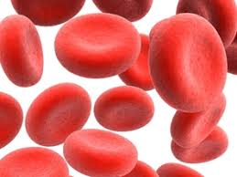
Introduction
Overview of Red Blood Cells (RBCs)
Anemia is a prevalent blood disorder that affects people of all ages and backgrounds.
Anemia occurs when the body lacks sufficient healthy red blood cells or hemoglobin, leading to reduced oxygen-carrying capacity and potential health issues.
If hemoglobin count of a person is higher than normal, it indicates polycythemia
Red blood cells (RBCs) are crucial for transporting oxygen from the lungs to the body's tissues and carbon dioxide from the tissues back to the lungs.
Hemoglobin, a protein within RBCs, binds to oxygen and facilitates its transport throughout the body.

Slide 3
Types of Anemia
Iron-Deficiency Anemia: Most common type caused by insufficient iron intake or absorption, leading to decreased hemoglobin production.
Vitamin Deficiency Anemia: Due to deficiencies in vitamin B12 or folate, leading to impaired RBC production.
Hemolytic Anemia: Characterized by increased destruction of RBCs, often due to inherited or acquired conditions.
Aplastic Anemia: A rare condition where the bone marrow fails to produce enough blood cells, including RBCs.
Sickle Cell Anemia: A genetic disorder causing abnormal hemoglobin, leading to misshapen RBCs that break down more easily.
Thalassemia: An inherited disorder affecting hemoglobin production, leading to abnormal RBCs and anemia.
Anemia of Chronic Disease: Occurs in individuals with chronic illnesses due to reduced RBC production and increased breakdown.
The most common type of anemia worldwide is iron-deficiency anemia.

Slide 4
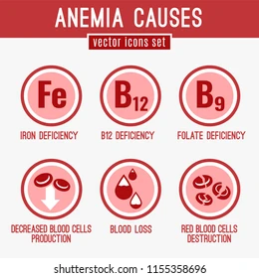
Causes of Anemia
Nutritional Deficiencies: Lack of iron, vitamin B12, or folate in the diet.
Blood Loss: Chronic bleeding (e.g., gastrointestinal disorders, menstrual irregularities) or acute bleeding (e.g., injury, surgery).
Hemolysis: Increased destruction of RBCs due to various factors, such as certain infections or autoimmune diseases.
Genetic Factors: Inherited disorders affecting RBCs' structure or production.
Chronic Diseases: Certain illnesses can interfere with RBC production or survival.

Slide 5
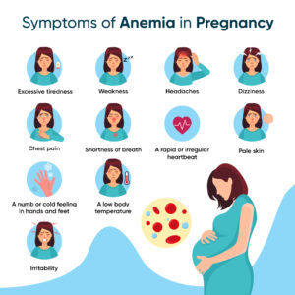
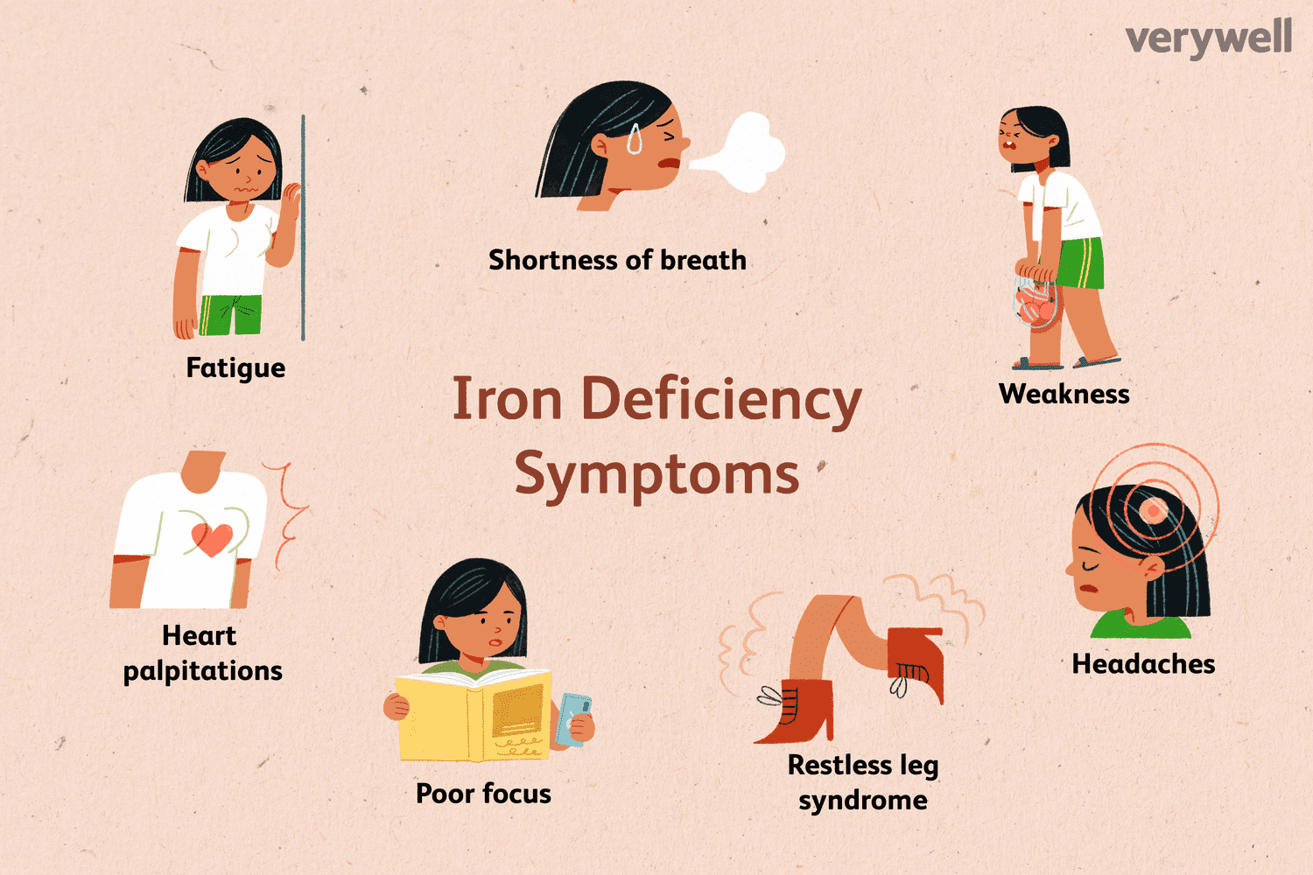
Symptoms of Anemia
Fatigue and weakness
Pale skin and nail beds
Shortness of breath
Dizziness or lightheadedness
Cold hands and feet
Headache
Irregular heartbeat

Slide 6
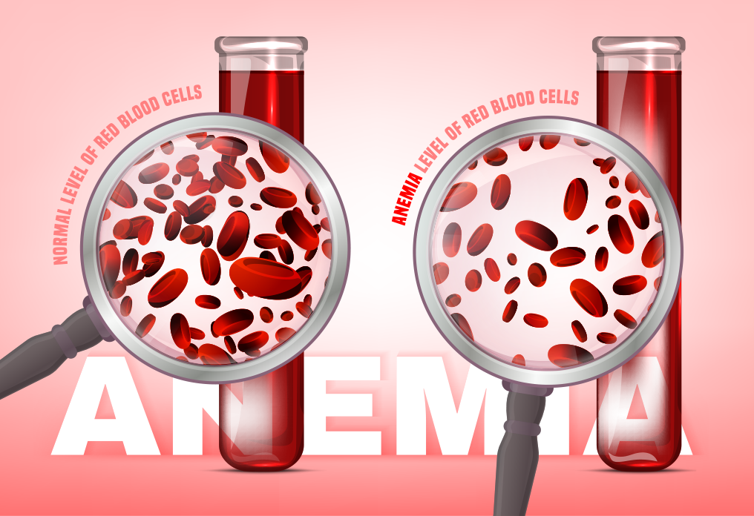
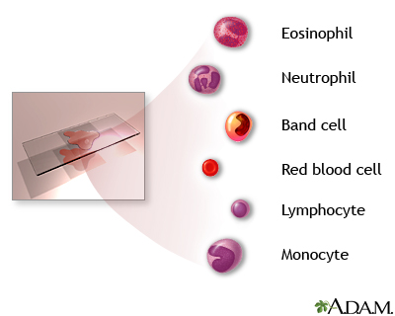
Diagnosis of Anemia
Complete Blood Count (CBC): Measures RBC count, hemoglobin levels, hematocrit, and other blood cell parameters.
Peripheral Blood Smear: Helps identify the shape and size of RBCs, aiding in diagnosing specific types of anemia.
Additional Tests: Iron studies, vitamin B12 and folate levels, hemoglobin electrophoresis, and bone marrow biopsy may be required for a definitive diagnosis.

Slide 7
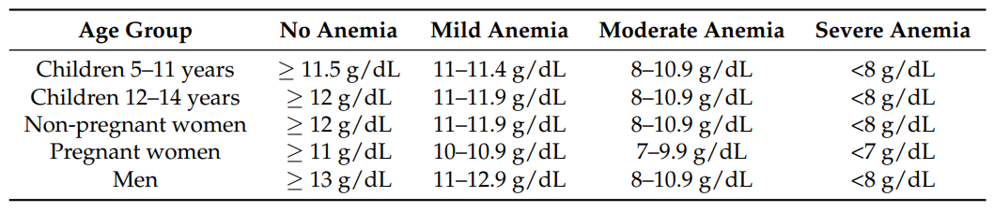
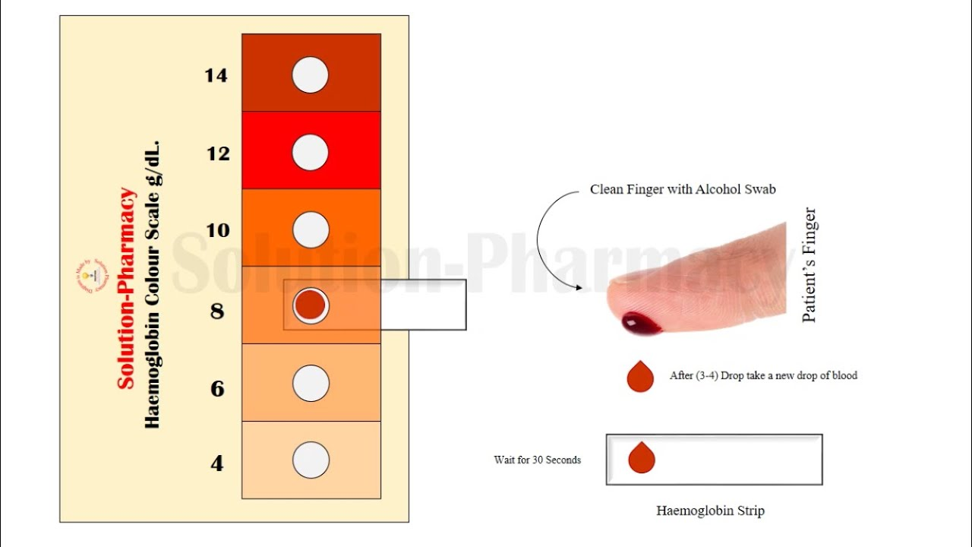
World Health Organization guidelines
WHO Color Scale
Emerging Point-of-Care Technologies for Anemia Detection - PMC

Slide 8
Facts
A study by WHO indicates that 42% of children below the age of 6 and 40% of pregnant women worldwide are anemic. This affects the world's total population by 33%, due to the cause of iron deficiency.
According to the WHO, 29.9% of women of reproductive ages are suffering from anaemia globally. The prevalence is 29.6% in non-pregnant women and 36.5% in pregnant women.
The World Health Organisation (WHO) estimated that 24.8% of the global population was anaemic between 1993 and 2005
Iron deficiency anemia is estimated to be present in 1.6 billion people globally and more than 85% of the populations in Africa and Asia.
Iron deficiency Anemia is the most common nutritional deficiency, and it causes thousands of deaths (allianceanemia.org); it is also responsible for increased morbidity and mortality in pre-school children and pregnant women.
In 2002, iron deficiency Anemia was considered to be among the most important contributing factors to the global burden of disease.
Anemia has a slow evolution: normally, no obvious symptoms appear for Hb>9–10 g/dl, since the human body implements compensatory mechanisms, and when the compensation can no longer guarantee an adequate dose of oxygen, symptoms such as fatigue, paleness, and many others appear.

