Slide 1
NETWORK PROGRAMMING: GAME OF ROCK,PAPER,SCISSORS.
SHRAVANI DESHMUKH 14CE2019
SHREY DHINGRA 14CE1052

Slide 2
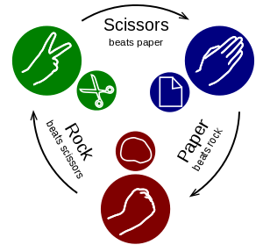
ROCK-PAPER-SCISSORS:
Rock, Paper, Scissors (RPS) is a simple hand game that is played around the world, with many different names and variations.
It is commonly used as a way of coming to decisions, and in some cases is even played for sport.
The rules require that competing players use one hand to form one of three shapes at an agreed-upon time.
The person that plays the strongest “object” is the winner of the game.

Slide 3
RULES OF THE GAME:
The players usually count aloud to 3, or say the name of the game i.e. Rock Paper Scissors each time either raising one hand in a fist and swinging it down on the count or holding it behind. They then "throw" by extending it towards their opponent.
Player has the full range of throws to play, as follows:
1. Rock: wins against scissors, loses to paper and stalemates against itself.
2. Paper wins against Rock, loses to scissors and stalemates against itself.
3. Scissors wins against paper, loses to rock and stalemates against itself.
The player with the most points wins the game.

Slide 4
TECHNOLOGIES USED:
The “RPS Game” project is mainly implemented using JAVA with TCP/IP socket programming and the GUI is built using JFrames.
The javax.swing package provides classes for java swing API such as JButton, JTextField, JFileChooser etc.
Networking is supported through the java.net package.

Slide 5
BASICS OF NETWORK:
SOCKET:
A socket is an interface for an application to connect to a host‘s network stack (part of the OS). After connecting, an application is able to bi-directionally exchange data with other processes on the same or another host.
SOCKET PAIR:
Specified the two end points that uniquely identifies each TCP connection in an internet.

Slide 6
SOCKET PROGRAMMING:
Sockets provide the communication mechanism between two computers using TCP.
A client program creates a socket on its end of the communication and attempts to connect that socket to a server.
When the connection is made, the server creates a socket object on its end of the communication.

Slide 7
CLIENT-SERVER COMMUNICATION:
Normally, a server has a socket that is bound to a specific port number.
On the client-side: The client knows the hostname of the machine on which the server is running and the port number on which the server is listening.
To make a connection request, the client tries to connect with the server on the servers machine and port.
If everything goes well, the server accepts the connection.
On the client side, if the connection is accepted, a socket is successfully created and the client can use the socket to communicate with the server.

Slide 8
SOCKET FOR CLIENT AND SERVER:
Server:
Welcoming socket:
Welcomes some initial contact from a client.
Connection socket:
Is created at initial contact of client.
New socket that is dedicated to the particular client.
Client:
Client socket:
Initiate a TCP connection to the server by creating a socket object. (Three-way handshake).
Specify the address of the server process, namely, the IP address of the server and the port number of the process.

Slide 9
VISUAL WALKTHROUGH

Slide 10
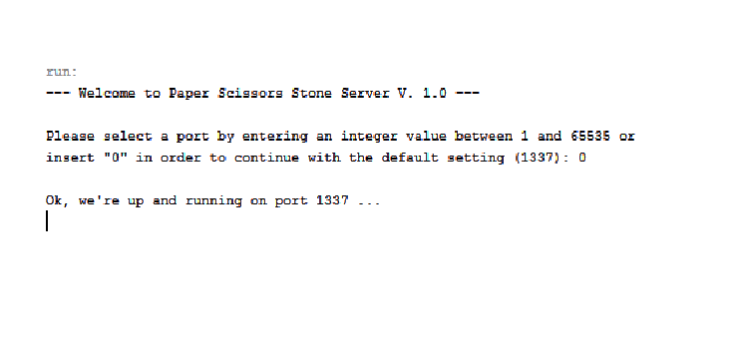
SERVER SIDE (BEFORE PLAYING)

Slide 11
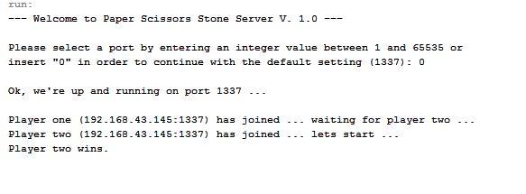
SERVER SIDE (AFTER PLAYING)

Slide 12
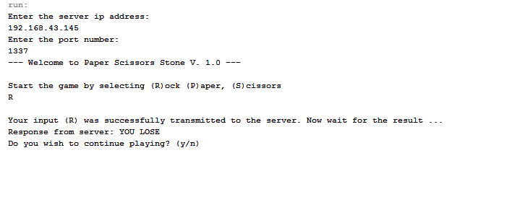
CLIENT #1 SIDE

Slide 13
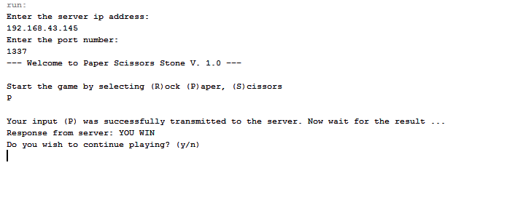
CLIENT #2 SIDE

Slide 14
THANK YOU

