Slide 1
TEAM - 7 Sberbank Russian Housing Market
TEAM MEMBERS
Maitray Shah
Salmaan Pehlari
Shrey Bhatt

Slide 2
PROBLEM STATEMENT
Housing is a major investment for both the general population and the developers. And when it comes to planning a budget the last thing people want is uncertainty.
Complex interactions between housing features such as number of bedrooms and location are enough to make pricing predictions complicated. Adding an unstable economy to the mix means even more uncertainty.
So we try to predict housing market prices of Russia whose volatile economy makes forecasting prices a challenging task.

Slide 3
DATA EXPLORATION
As we started to explore the dataset, the first thing we encountered was many of the features were missing values.
Then we tried plotting how has the price changed over the years to see if it follows a certain pattern.
Showing correlation between other features and price of the houses – and finding which features affects the prices the most.
Explored different features in the dataset that we found the most important with price to see if there’s any pattern involved.
Plotting different feature graphs from the macro economic factors and trying to relate them with the prices of the houses and attempting to uncover a pattern.

Slide 4
DATA PREPROCESSING
In some cases addressing Missing values with Imputer() and StandardScaler().
In some case removing Columns having more than 33% missing values as they won’t give much information.
Selected the logarithm of the “price” values from the train data to remove skewness and to have a uniform distribution.
Using LabelEncoder() to process columns with Object type.
Using limited features from both the training data and macro economic data based on their relevance.

Slide 5
ALGORITHMS USED
Linear Regression - Linear regression is a linear model, e.g. a model that assumes a linear relationship between the input variables (x) and the single output variable (y).
Random Forest Regression - Random Forest is an extension of bagging that in addition to building trees based on multiple samples of your training data
XGBoost - XGBoost is an implementation of gradient boosted decision trees designed for speed and performance. XGBoost is an algorithm that has recently been dominating applied machine learning and Kaggle competitions for structured or tabular data.

Slide 6

EVALUATION METRIC
Root Mean Squared Logarithmic Error
ϵ is the RMSLE value (score)
n is the total number of observations in the (public/private) data set,
pi is your prediction,
ai is the actual response for i.
log(x)is the natural logarithm of x

Slide 7
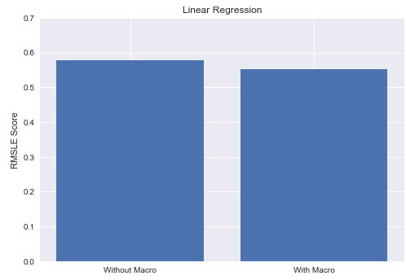
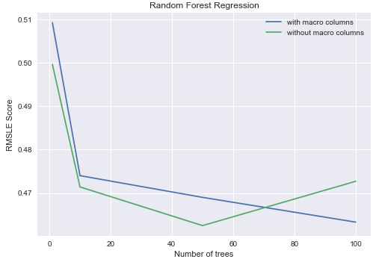
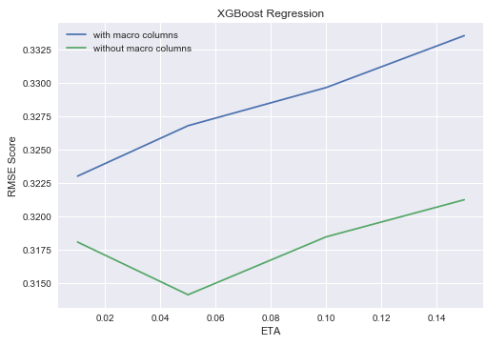
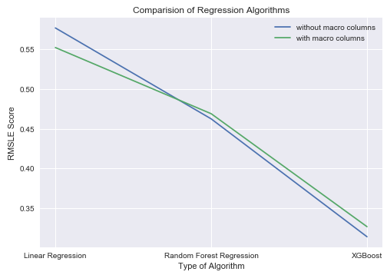
RESULTS

