Slide 1


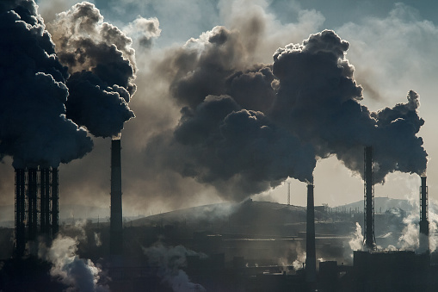
Analysis of US Daily AIR Quality Index 1980-2021
Shrey BISHNOI
015945501
DePARTMENT OF APPLIED DATA SCIENCE
SAN JOSE STATE UNIVERSITY
MAJOR PROFESSOR: ANDREW H. BOND

Slide 2

OVERVIEW
The Air The US Environmental Protection Agency (EPA) devised the Air Quality Index (AQI) to provide a simple and uniform way to report daily air quality conditions.
The AQI is a measurement of daily air quality. It indicates how clean or dirty the air is, as well as any potential health risks, particularly for ground-level ozone and particle pollution.
Ground-level ozone, particle pollution, carbon monoxide, and sulfur dioxide are the four principal air pollutants controlled by the Clean Air Act.
The higher the AQI number, the more polluted the air is and the greater the health risk.
The AQI is used by the EPA and local governments to convey straightforward information about air quality in your area, how dirty air might impact you, and how you can protect your health. From 1980 through 2021
This dataset contains daily reports of air quality index from several US metro regions, as well as geographic data for the collecting locations. There are over 10 million records in this collection.

Slide 3
AQI CATEGORIES
AQI Quality Values | AQI Category | Actions to Protect your Health
(<50) | Good | AQI value in this category is between 0-50 and air quality is considered satisfactory and poses little or no health risk.
(50-100) | Moderate | Air quality is acceptable ;however individuals who are very sensitive to air pollution may experience adverse health effects. People who are unusually sensitive to ozone or particle pollution may experience respiratory symptoms
(100-150) | Unhealthy for Sensitive Groups | People with lung or heart disease, older adults, children, and people participating in activities that require heavy or extended exertion may experience adverse health effects.
(150-200) | Unhealthy | Everyone may begin to experience adverse health effects and members of sensitive groups may experience more serious health effects.
(200-300) | Very Unhealthy | This would trigger a health alert signifying that everyone may experience more serious health effects.
(>300) | Hazardous | This would trigger health warnings of emergency conditions. The entire population is more likely to be affected.

Slide 4
DATASET
This Dataset contains the following attributes:
State Name: The name of the state where the monitoring site is located.
County Name: The name of the county where the monitoring site is located.
Defining Parameters: The name or description assigned in AQS to the parameter measured by the monitor. Parameters may be pollutants or non-pollutants.
Date: The calendar date with which the AQI values are associated.
AQI: The Air Quality Index for the day for the pollutant, if applicable.
Category: AQI is divided into 6 category levels( Good, Moderate, Unhealthy for Sensitive Groups, Unhealthy, Very Unhealthy, Hazardous) describes the air quality which corresponds to various health issues.
Longitude: The monitoring site’s angular distance east of the prime meridian measured in decimal degrees.
Latitude: The monitoring site’s angular distance north of the equator measured in decimal degrees.

Slide 5
DATA PREPARATION
Data preparation has been performed on Tableau Prep Builder
Changed data role abbreviation to State/province
Changed data role to city
Performed cleaning operation on the dataset.
Created some calculated fields for analysis on the dataset
Created bins on the AQI data to map the values to AQI Category.
Removed outliers and noisy data
Handled inconsistent values by grouping them
Changed the date time format from string to date

Slide 6
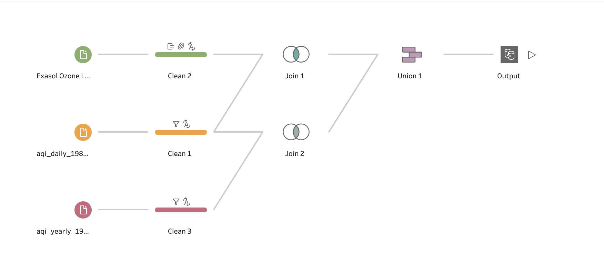
DATA PREPARATION

Slide 7
VISUALIZATIONS
Some of the visualization which I have created on Tableau Desktop are:
﻿Air Quality Index by States in 2020
Geospatial Map to show Air Quality Index
Estimating AQI in following years
Average Air Quality Index for All states
Every States has seen an improvement in the air quality
Top 10 Counties with Highest AQI

Slide 8
VISUALISATIONS
Defining Parameter Impact
Seasonal Changes in Defining Parameters
Report of SO2 as a defining Parameter
Annual changes in defining parameters
Air Quality Categories
Air Quality in Different States
Average Air Quality Index by Month

Slide 9
SUMMARY
The Air Quality Index is:
Used to protect public health
Used to determine appropriate activities for people, industry, and commerce
Calculated from monitored values of 5 major pollutants
An effective tool to determine how well Clean Air Act standards are being met by our communities

Slide 10
REFERENCES
https://www.epa.gov/outdoor-air-quality-data/air-data-basic-information
https://aqs.epa.gov/aqsweb/airdata/FileFormats.html
https://www.epa.gov/outdoor-air-quality-data
https://www.epa.gov/outdoor-air-quality-data/air-quality-index-daily-values-report
https://www.epa.gov/air-research/air-quality-and-climate-change-research

Slide 11
THANK YOU

