Slide 1
DEEP PORTFOLIO MANAGEMENT
Team p: Candice Li, jenny liu, Shrey goel, Muktesh waghmare

Slide 2
RECAP PREVIOUS DISCUSSION
Data Sourcing
Run original implementation and verify results.
Implement EIIE topology with CNN, RNN, and LSTM, as well as PVM, OSBL, and a fully exploiting and explicit reward function.
Incorporating better transaction cost models.
Replicate the paper as is before looking to extend the algorithm to other asset classes beyond cryptocurrency.

Slide 3
PROGRESS
Resolved Data Issue: Publicly available data from Poloniex.
Ran back test for CNN for different time periods.
Studied back test results for tuned and raw hyperparameters.

Slide 4
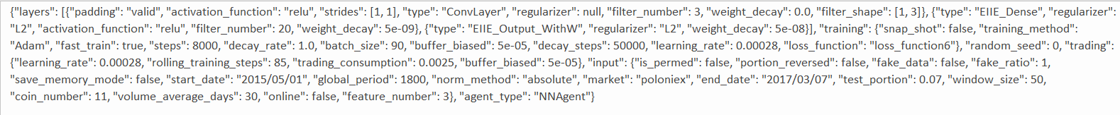
PRELIMINARY RESULTS: UNTUNED HYPERPARAMETERS

Slide 5
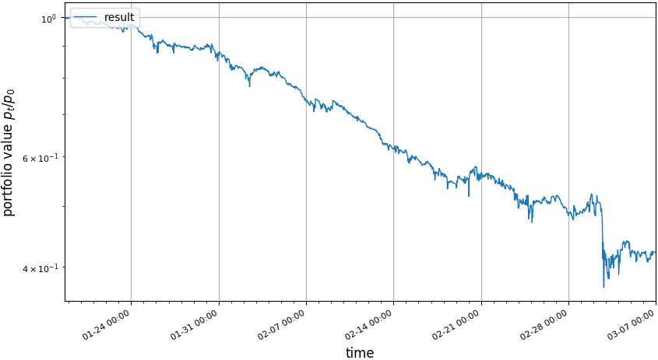
PRELIMINARY RESULTS: UNTUNED HYPERPARAMETERS

Slide 6
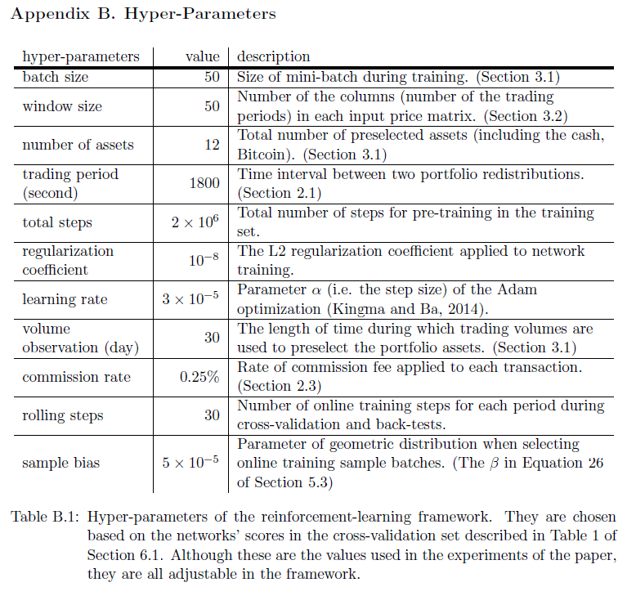
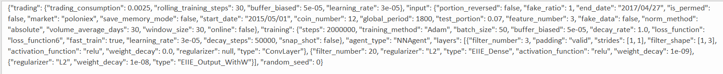
PRELIMINARY RESULTS: TUNED HYPERPARAMETERS

Slide 7
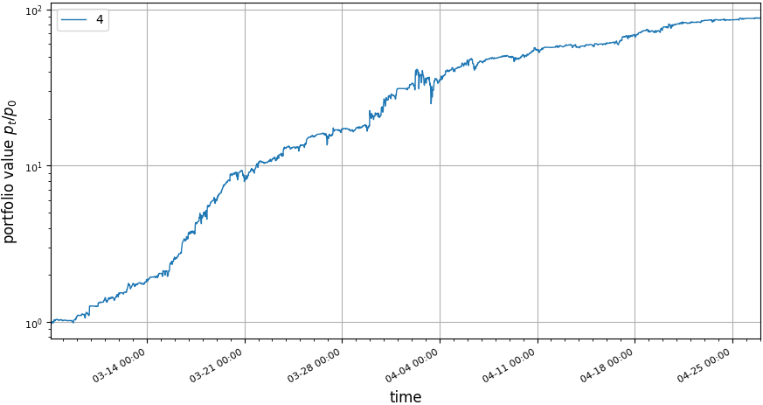
PRELIMINARY RESULTS: TUNED HYPERPARAMETERS

Slide 8
PRELIMINARY RESULTS

