Slide 1

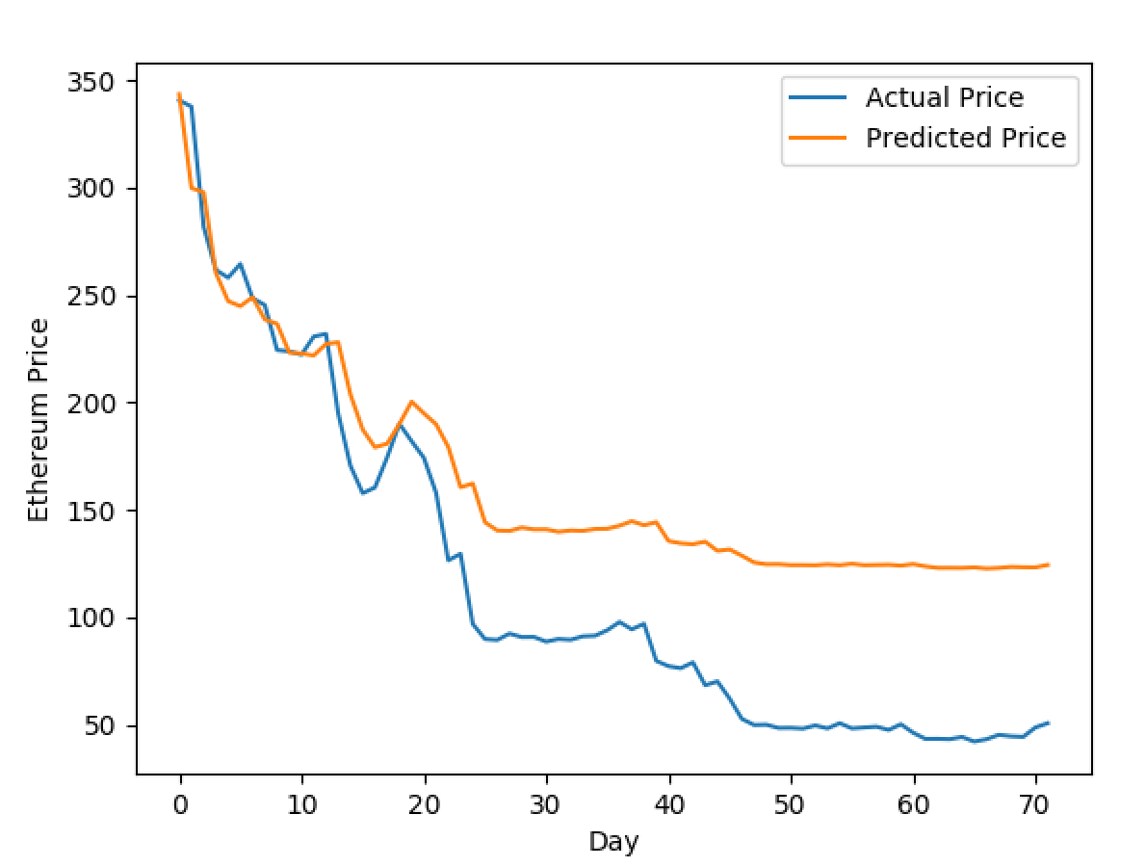
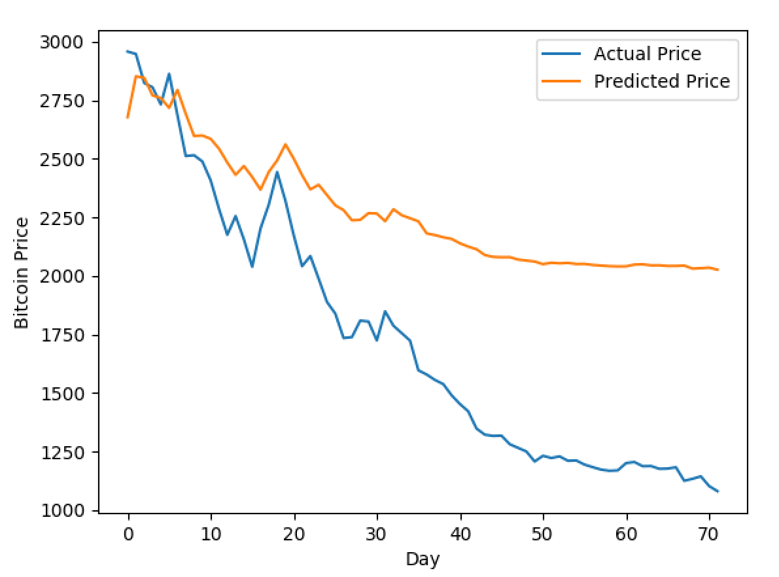
Winter 2018 – ECE457B Computational Intelligence
ECE Dept, University of Waterloo
Instructor: Fakhri Karray
Cryptocurrency Financial Market Predictor
Cluster #2: Xiaozhuo Yu, Shrey Khosla, Shashank Sabhlok, Shruti Appiah
Abstract and Overview:
This project’s aim is to predict the behavior of cryptocurrencies which have very volatile markets. To achieve this goal we used current state of the art algorithms and frameworks to be to be able to get a good prediction. We used free and open historical trading data that is available for cryptocurrencies as well as Google Trends to elicit popularity/interest in specific cryptocurrencies in developing our solution. Our project is meant to be an additional source of input for traders to help them with making more informative decisions.
Text Size: 32
Experiments, Analysis:
Problem Formulation:
Tools, Algorithms:
…
Python
Tensorflow
Keras
ScikitLearn
MatPlotLib
PandaS
Google Trends
We created a solution using both FeedForward Neural Networks (using Tensorflow) and Recurrent Neural Networks, specifically LSTM (using Keras) to be able to compare and contrast between multiple solutions and their accuracy.
Each solution used the same dataset for two popular cryptocurrencies, Bitcoin and Ethereum. Using the previous day to predict the next day’s price, we trained our models using 80% of the data and tested it on the rest of the 20%.
After building a model and having a prediction made, we used data from Google Trends on each specific cryptocurrencies to be able to elicit correlations between the popularity and the rise and fall of the specific Stock Markets.
Experiment Setup
Evaluation Metrics
Graphs
FeedForward(20% only)
LSTM (full dataset)
Text Size: 32
Proposed Solution:
…
Conclusion:
…

