Slide 1
Hyer
Location Based Job Listing and Job Search with Payments

Slide 2

The Problem
A multitude of job posting apps exist, such as jobs.ca, Workopolis, craigslist, etc. Out of those many job posting apps, a small portion of them are for short-term jobs, or a simple task that one person wishes to pay another person for. And even furthur, out of those apps, none seem to be able to filter jobs relative to your current location, and list jobs that can be on the other edge of the city. This results in constant clicking into job postings, finding they are too far and going back. Additionally none of these apps seem have a sort of payment system incorporated, which also for many people who live using their card, or do not like carrying coins, can be a nuisance.

Slide 3


Hyer
Our application, is the solution to those problems. Our app is divided into two mobile applications, one for the employer, and one for the employee.
Employers:
Load in app credits to their account - used to pay others.
Post jobs, look at applications, hire applicants, and pay the employee.
Employee:
Search for jobs (including distance and location filters)
Apply for jobs, and get paid for their work.

Slide 4



Learning Goals
Two team members had no experience in web development
Wanted to learn how to design a RESTful API
Database integration in the back end
Wanted to learn how to use premade APIs to ease redundant development (e.g. Firebase)
Deployment of application for non-local use
No members had experience in React Native
Wanted to try a new framework for building an application
No members had experience with continuous integration
Wanted to learn how to use Travis CI limiting pushes to the repo that resulted in something not working

Slide 5

Intended Deliverables

Slide 6
Deliverable 1
For deliverable 1, we intended to have the minimum viable product finished for our applications. This included:
Ability for employer/employee to login
Ability for employer/employee to register
Ability for employer to add jobs
Ability for employee to search jobs
Ability for employer/employee to edit account details

Slide 7
Deliverable 2
For deliverable 2, we intended to get our main features that differentiate our app up and running. This included:
Ability for employee to search jobs listed in order of nearest job
Ability for employee to limit search to jobs under a given radius from them
Ability for employee to apply to a job
Ability for employer to hire an applicant for given job
Ability for employer to pay employee credits for given job

Slide 8

Project Strategy

Slide 9

Project Strategy
We split our group into two separate groups: Backend and Frontend.
We were aiming to allow each member to be focused into the areas where their respective goals lied.
Backend: Ryan Raymond Patrick
Frontend: Tim Shreyash

Slide 10



Project Strategy
Frontend wanted to:
Implement login, register, and edit profile pages
For both employers and the employees.
Implement posting jobs, hire applicants and pay employees.
For the employers.
Implement viewing the jobs, apply for the jobs and receive pay from employers.
For the employees

Slide 11
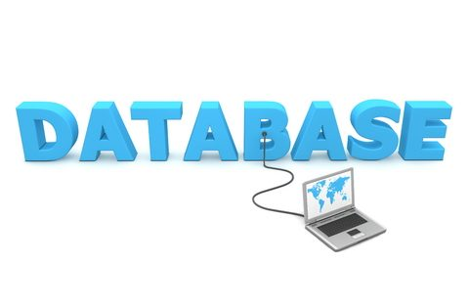

Project Strategy
Backend wanted:
RESTful API
to create, remove, update, and delete users/jobs from the database.
Implement all necessary searching and filters
Lower the workload for the frontend.

Slide 12
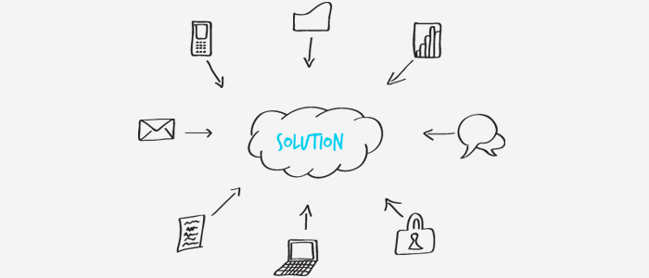
Architecture

Slide 13

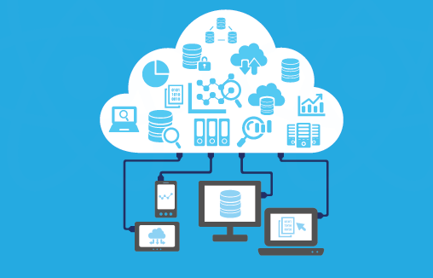
Backend Architecture
Firebase:
Supported by Google
Database for Users & Jobs
NoSQL real-time cloud database
Possibility of multiple users accessing the database at once.
Firebase authentication
Token turns into userID in backend

Slide 14
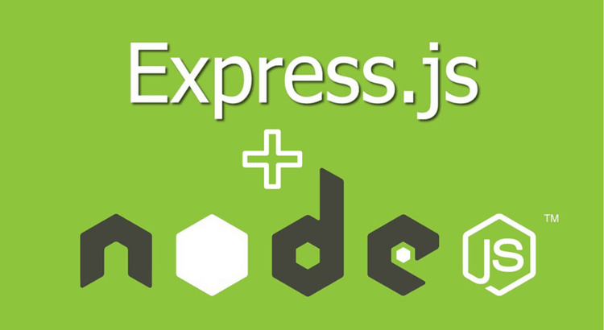
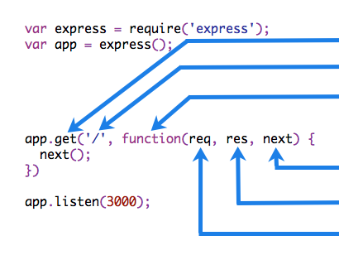
Backend Architecture
More backend:
Node.js
Express.js
Node.js framework
Simplified HTTP requests
Firebase functions
Plethora of functions made backend programming much easier

Slide 15

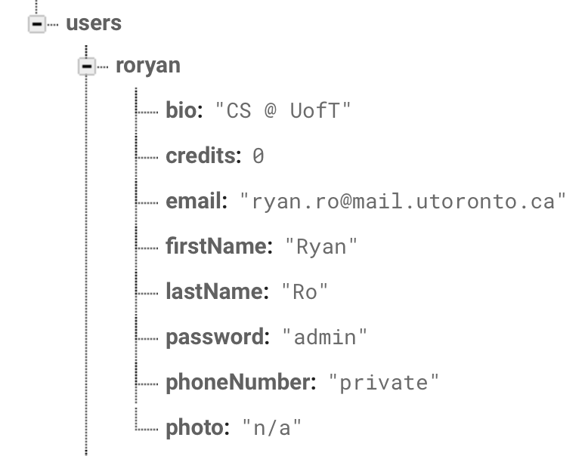
Backend Architecture
Our two endpoints in the backend were users and jobs.
User object example:

Slide 16

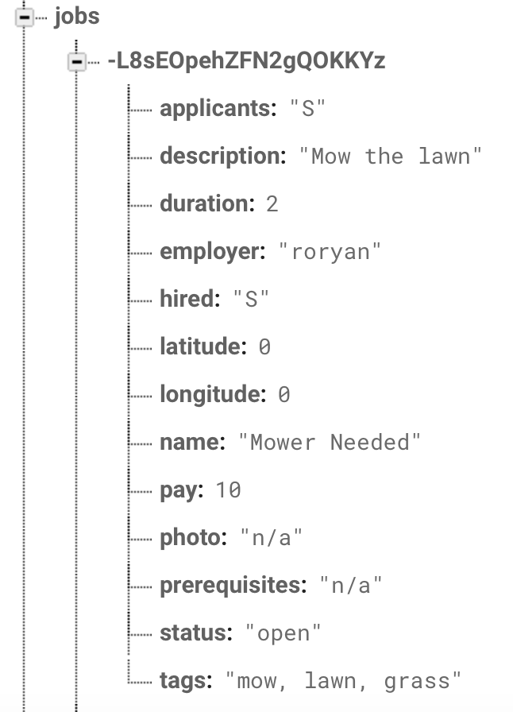
Backend Architecture
Job object example:

Slide 17
Backend Architecture
The API calls had the following parameters
GET /users : Gets all users
username : If specified gets user with given username
GET /jobs : Gets all jobs that are not closed
jobID : If specified gets job with given jobID
search : If specified gets jobs with given search string in its name or tags
employer : If specified gets jobs by a given employer
order : If specified orders the jobs gotten by given order (supports location, and pay)
latitude, longitude, km : If specified filters only the jobs gotten that are in the given km radius

Slide 18

Backend Architecture
Other calls (POST, PUT, DELETE):
Relatively generic
Taking in data to post/update/delete
Multitude of checks
Does the user or job exist?
Was this username already taken?
Etc…
Return the respective codes (2xx, 4xx)

Slide 19


Frontend Architecture
We wanted a mobile Application for both iOS and Android. A member for each platform would spread us too thin
Solution? React Native.
Compiles mobile web applications
We can specify choose between both iOS and Android
With React Native, our applications called our detailed backend API, and rendered the response or status from those calls.
Notes:
We wanted our application to be a mobile application, however we would rather it be available for both iOS and Android, and splitting the frontend members into two different platforms would have spread us too thin. Our solution was to code in React Native, which compiles a mobile web application for both iOS and Android, by specifying which platform they would like the app be compiled for. Our applications call our detailed backend API, and render objects using the response, or status from those calls.

Slide 20

Collaboration

Slide 21
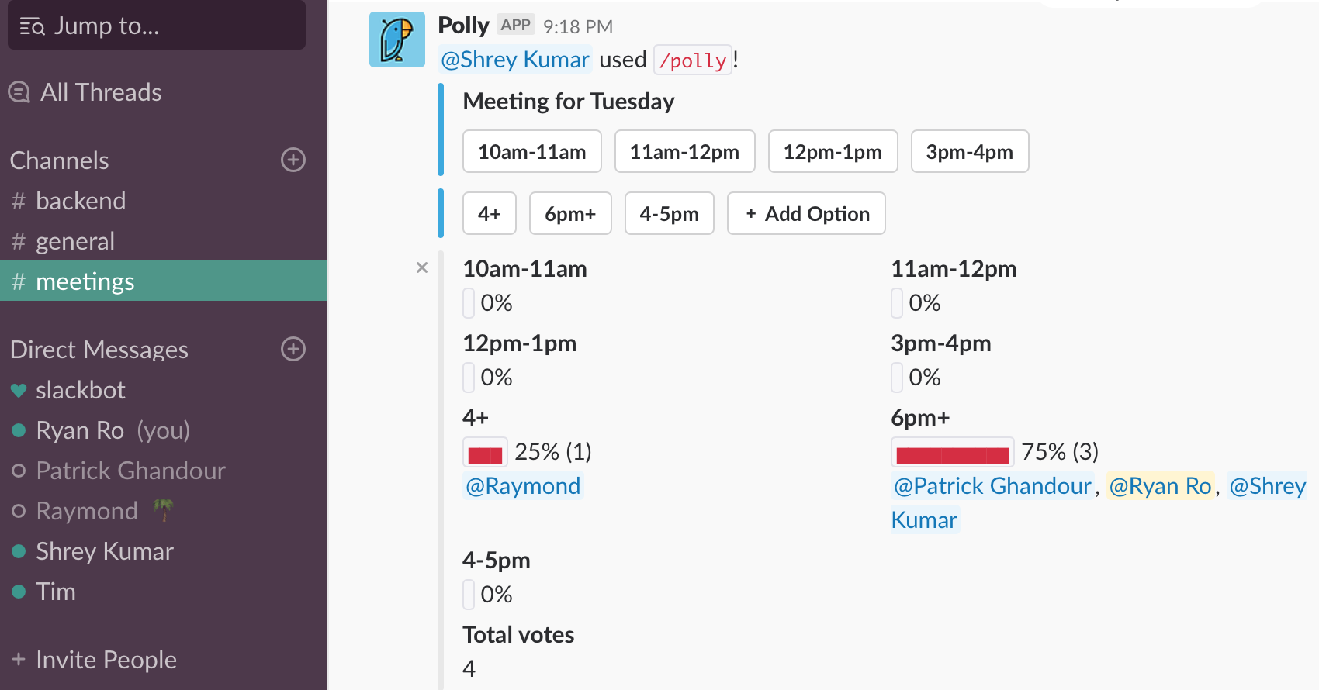
Meetings
For our meetings, we polled our members, to see which time worked out for us all, and then met at the respective time in BA3200, to discuss our project.

Slide 22
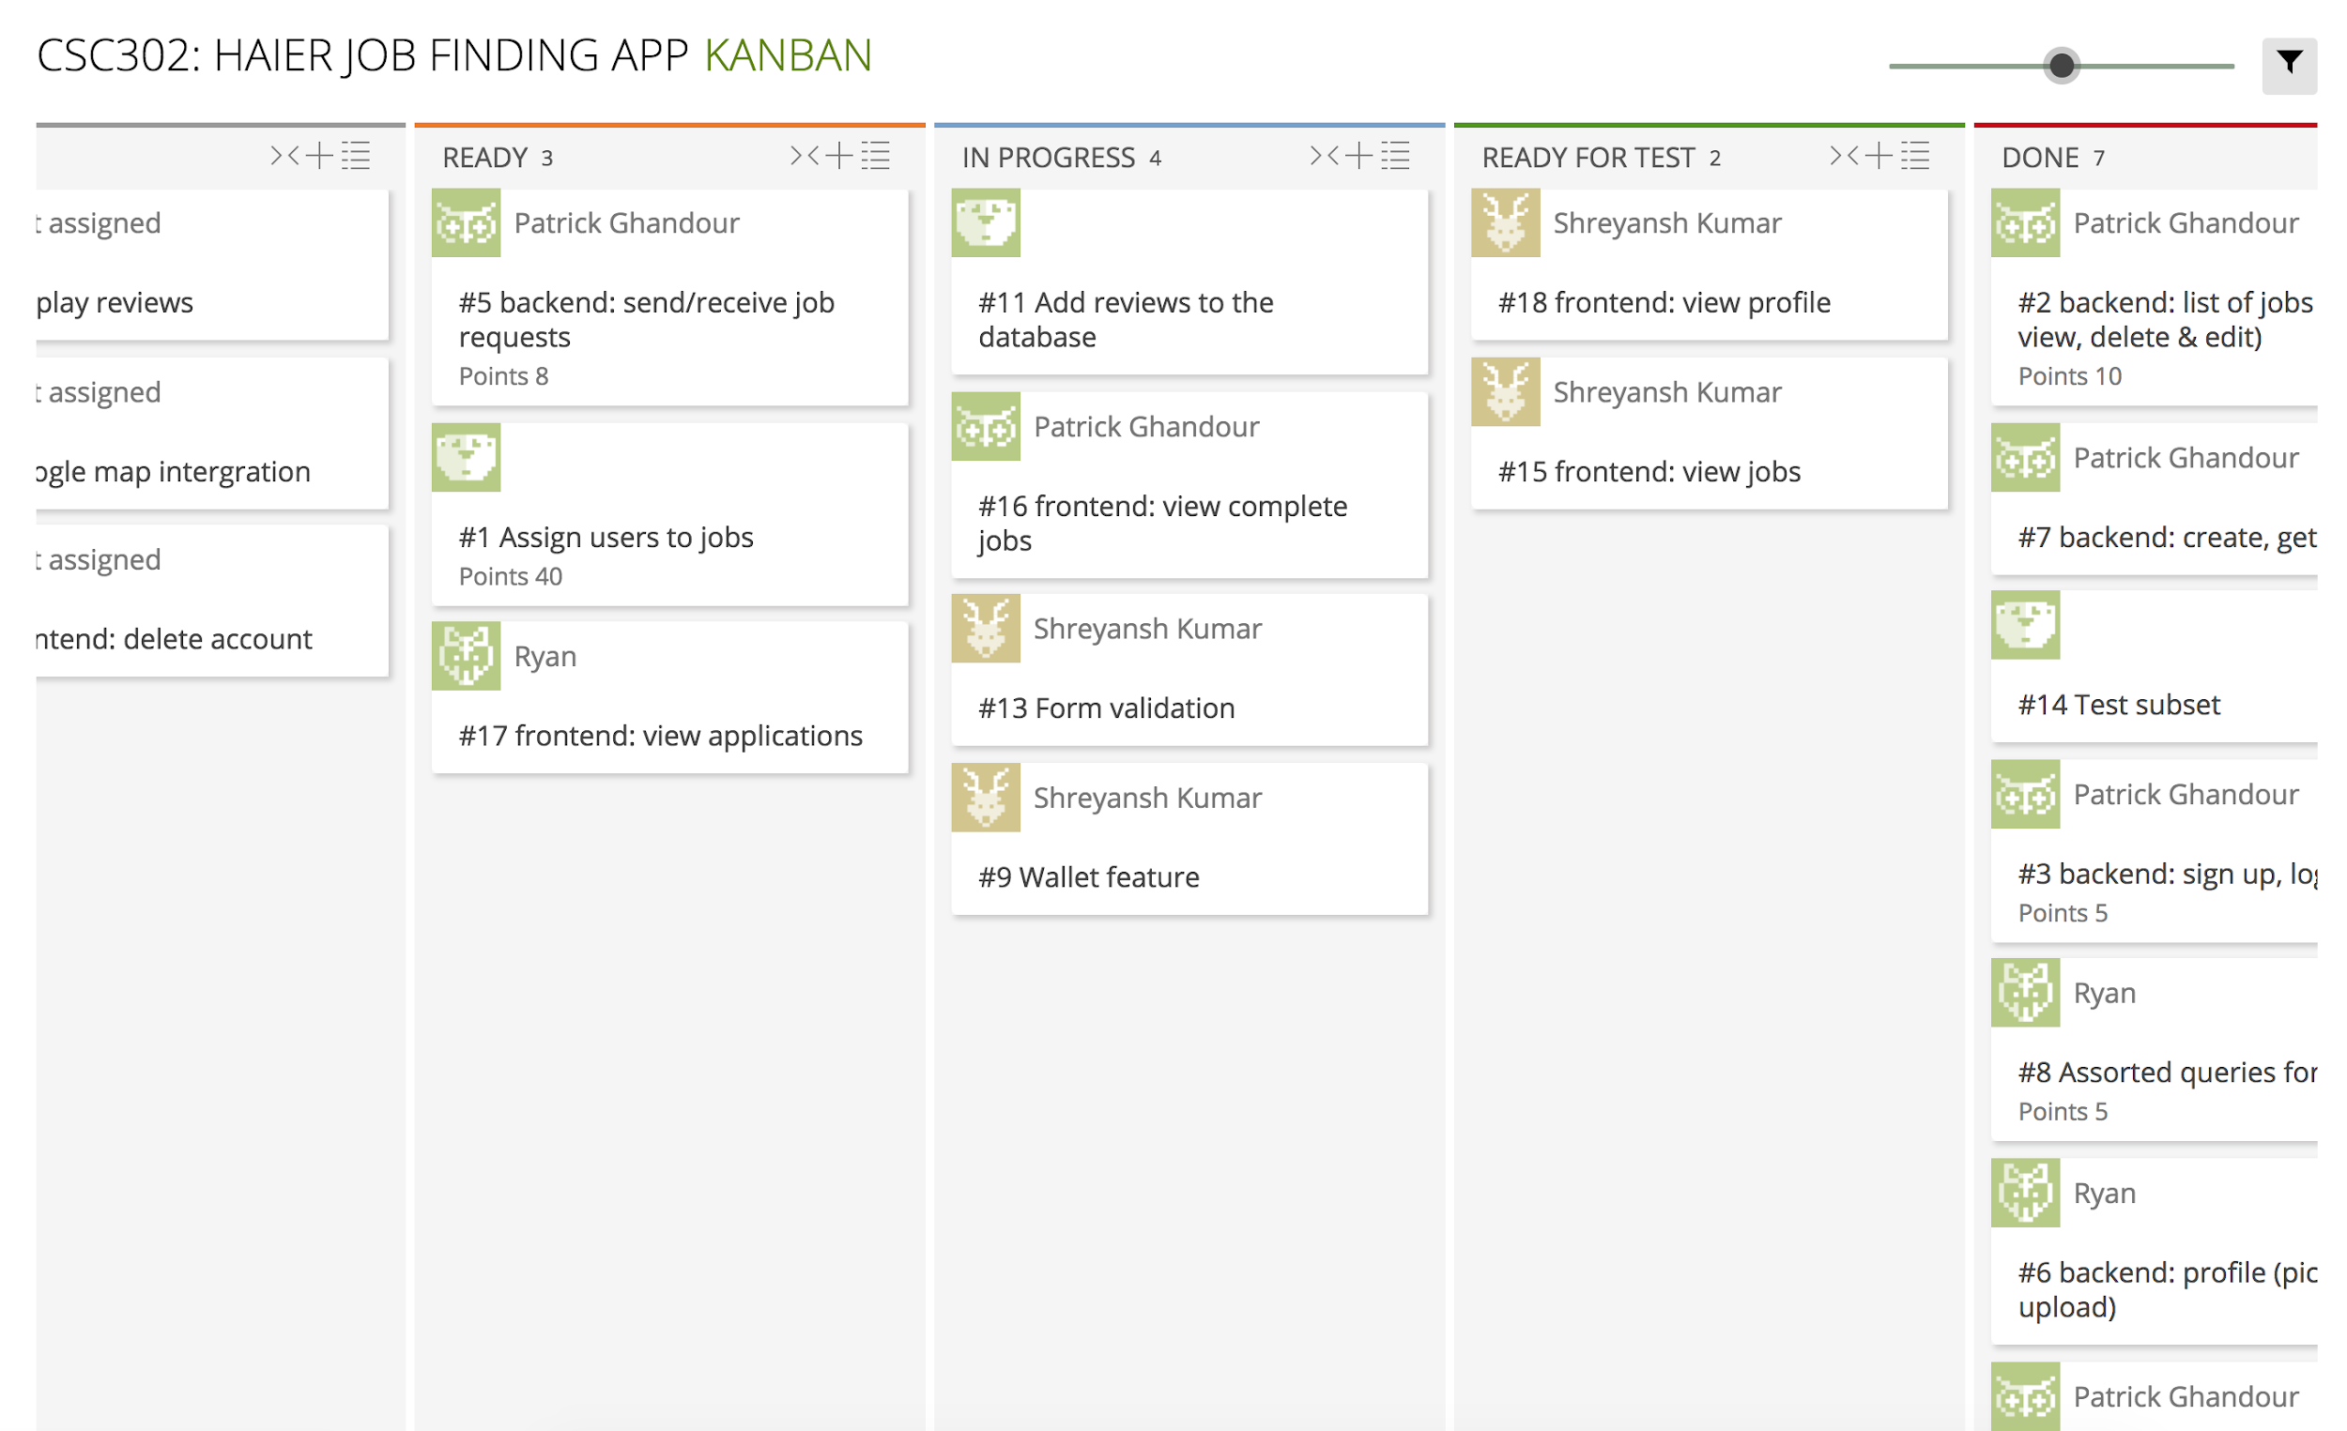
Meetings
In the meetings we discussed what needed to be done, and who was going to approach which task and how they were going to approach it. This was in sync with our Kanban board on taiga.io.

Slide 23
Kanban
The Kanban process is efficient for our group
Each member, can at their own time of preference, add, take, and accept tasks that either they have come up with on their own, or have come up during a meeting
Since we are still students, we would like some exposure to the other areas of software development,
With Kanban, members can take tasks they are interested in
If a member could not make a meeting, with a Kanban board it is easy to visualize and see, what they have missed, and what needs to be done
The tasks were sized so each task should not take too long, and each member who gets assigned or takes the task, knows exactly what to do

Slide 24

Testing

Slide 25
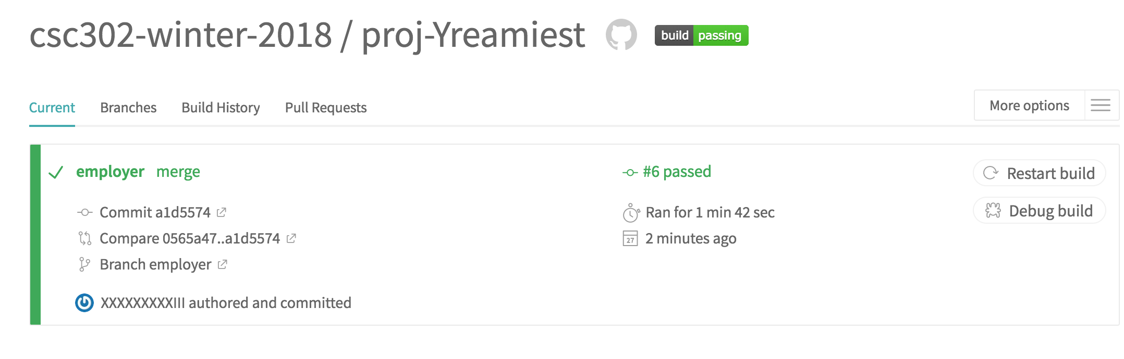
Testing: Backend
Created a set of tests using Mocha covering every possible API call
Used Travis for continuous integration
Made sure every pull request passed the tests
Before merging another member who is familiar with the code reviewed the changes

Slide 26
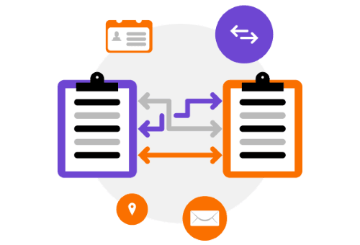
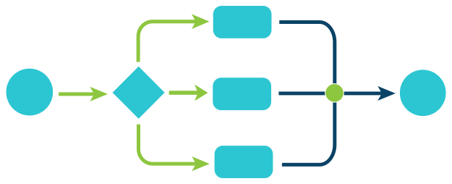
Testing: Frontend
Tested specific workflows, e.g.
Adding a job
Accepting a request for a job
Tested for data concurrency
Made sure frontend and backend data were consistent

Slide 27

Features

Slide 28

Features: Employee App
Request jobs after viewing jobs from job list
Filter jobs by location, search, employer
Order jobs by pay and distance
View jobs applied for, accepted, in progress, and completed
When accepted for a job, view location, employer contact information, and location
Set job to in progress

Slide 29

Features: Employer App
Add/Modify/Delete jobs
Includes description, pay, time, location, etc.
View profile of user who applied to the job
May accept or decline application
View all previously listed jobs
Also all accepted job application
Mark job request as complete
Pays the employee

Slide 30
Demo

Slide 31
Goals

Slide 32
Goals: Learning
Learned how to use react native to create Android and iPhone apps (With no prior experience)
Two group members who had no experience in web development
Learned how to create a RESTful API
Learned how to use a noSQL database
Develop an app through Kanban
Continuous integration
Secure authentication

Slide 33

What went well and what didn’t
What went well:
Project Management
Kept separate branches on GitHub
Communicated about changes & kept in contact through Slack
Product Design
Backend and Frontend were able to communicate easily
Everything we initially planned was finished in time for today’s demo
What didn’t:
Did not allocate enough manpower to the frontend.
Entire group meetings
The group rarely got everyone together because of conflicting schedules
Not a big issue since we were split into 2 smaller teams and can meet separately
But, the teams were isolated and didn’t know what the other team was up to.

Slide 34
Finsigh

