Slide 1
The Effect of Fake Reviews on e-commerce During and After Covid-19 Pandemic :
SKL-based Fake Reviews Detection
Implementation by-
Shrey Parikh - 20UCS185
Sourav Jain - 20UCS198

Slide 2
TABLE OF CONTENTS
INTRODUCTION
LITERATURE REVIEW
PROPOSED METHODOLOGY AND EXPERIMENT SETUP
FINDINGS AND DISCUSSION AFTER IMPLEMENTATION
OUR INNOVATION
FUTURE WORK AND CONCLUSION
REFERENCES

Slide 3
INTRODUCTION
This paper discusses the impact of the Covid-19 pandemic on online shopping, leading to increased competition among companies. It emphasizes the significance of online reviews in shaping consumer decisions and addresses the issue of fraudulent or fake reviews. The paragraph introduces a research study that proposes a fake review detection model using Text Classification and Machine Learning techniques. Classifiers such as Support Vector Machine, K-Nearest Neighbor, and logistic regression are employed, along with a bigram model to detect fraudulent reviews based on pronouns, verbs, and sentiments. The proposed methodology demonstrates superior performance compared to other techniques, achieving 89.03% accuracy(from paper) on the TripAdvisor dataset, respectively.

Slide 4
The enforcement of lockdown and social distancing lead the world to buy products online. One of the most pressing issues faced today is fraud regarding customers opinions on online products or services relevant to a brand or an organization.
Fake or genuine reviews are hard to label by humans. This complicates the search for the ground truth for given instances accurately. Due to the versatile nature of these reviews and the lack of reliable data, Semi supervised techniques were used to improve classification.
. Due to this, a few scholars have utilized the techniques of Data Mining and Natural Language Processing (NLP) and other techniques such as data cleansing and database query processing to deal with raw data.

Slide 5
3) PROPOSED METHODOLOGY and EXPERIMENT SETUP
PREPROCESSING
Preprocessing data phase includes the filtering process. It represents the part where we get rid of the texts less valuable parts, such as punctuation symbols.
After successfully removing the punctuation words, word count is calculated. Selecting variables or identifying attributes to construct an efficient model is called feature selection. The objective of this process is to achieve a higher level of accuracy.
Punctuation marks such as,.!?;.. etc. are eliminated because it lowers the overall accuracy of the classification process.

Slide 6
In our proposed method, feature selection is based on the following parameters
1. Length count
2. Bigram Type
3. Relationship words
4. Sentiment word count
5. Noun, Verb count
Feature selection also depends on the sentiment of word count, whether it is a positive or negative word in a review.
In our proposed model, NLTK is used to tokenize the sentence, and then by using POS, they are tagged as noun-verb or adverb, etc.

Slide 7
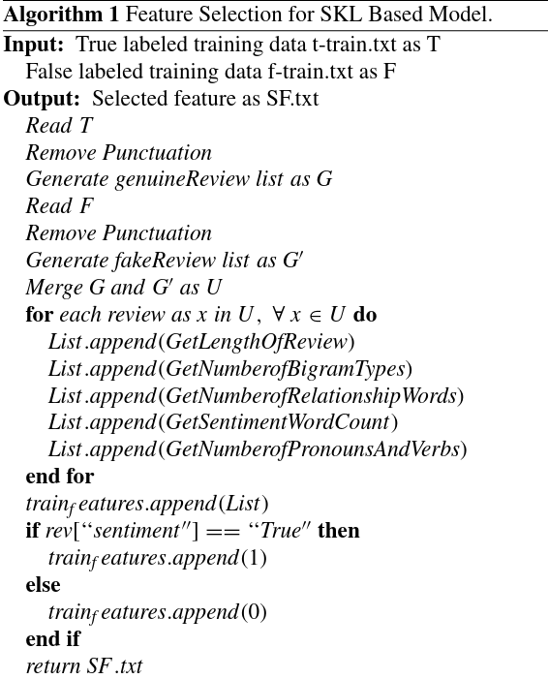
Image src : [1]

Slide 8
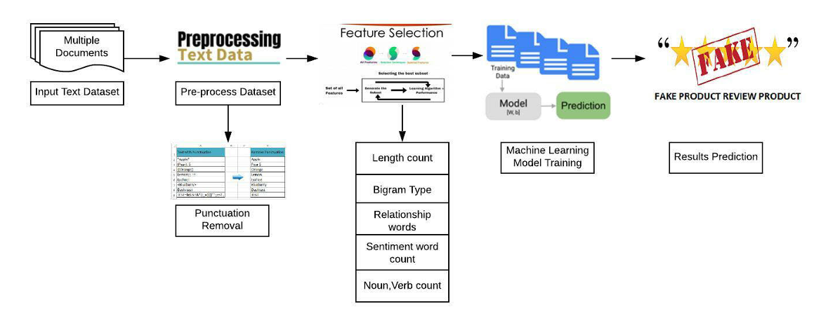
We split the dataset in an 80-20 ratio for training and testing samples, respectively.
For more refined results, 10 fold cross-validation is done, leading to 89.03% overall classification accuracy.
Image src [1]

Slide 9
B) CLASSIFICATION ALGORITHMS
Classifying data into two or more than 2 classes/Labels is called classication. Machine Learning comes with many classification algorithms.
The classification algorithms we utilized are Support Vector Machine (SVM) with linear SVC (Support Vector Classifier) kernel to predict that either given product review is fake or genuine.
The K-Nearest Neighbors (K = 5) is also used for pattern recognition and classification. It is a straightforward algorithm. Its performance depends on many factors, such as the k parameter, an acceptable measure distance, and a majority voting scheme.

Slide 10
Logistic regression (LR) is also a part of machine learning. It is a technique that is used in binary classification. It uses the logistic function for prediction purposes. We further used logistic regression to predict the nature of a review.
C) DETECTION PROCESS
After completing the training phase, the dataset will test the model to predict the output. Model is being trained by SVM, KNN, and Logistic regression. The comparison table shows which algorithm outperforms for the selected process.

Slide 11
D) DATASET COLLECTION
We collected a dataset of hotel reviews from TripAdvisor. A corpus of both genuine and deceptive hotel reviews, with information on whether the review was deceptive, what hotel it was for, whether it was a positive or negative review, the source of the review and the text of the review.
For building a model with good generalization performance, the best data splitting strategy is essential for every classification model, which is crucial for model validation.
We split the dataset in an 80-20 ratio, of which 80% is the training set, and 20% is the test set. To assess the performance of the best suitable model for the proposed problem, we then split our data into 75-25 and 85-15 ratio split.

Slide 12
4) FINDINGS AND DISCUSSION
Results are calculated using the following classification evaluation metrics: precision, recall, f-score, and accuracy.
As described previously, we check classification results on 75% training set and 25% test set data distribution, 80-20 dataset split, 85-15 dataset split and 10 fold cross-validation.
Result from paper : Support Vector Machine (SVM) outperforms as compared to K Nearest Neighbor (KNN) and Logistic Regression (LR). The best dataset splits in this experimentation is 80-20. The results show that SVM has the highest recall, which means that the prediction process is efficient in SVM .[1]

Slide 13
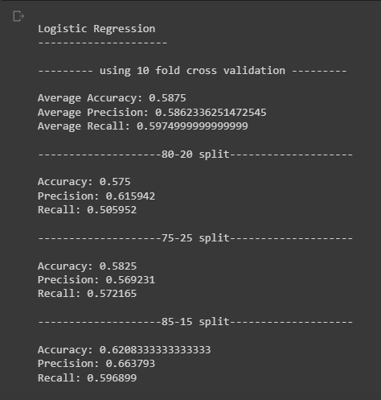
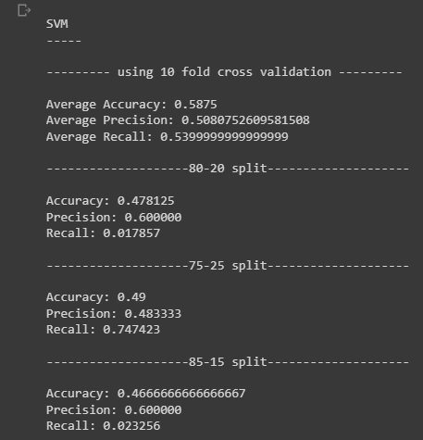
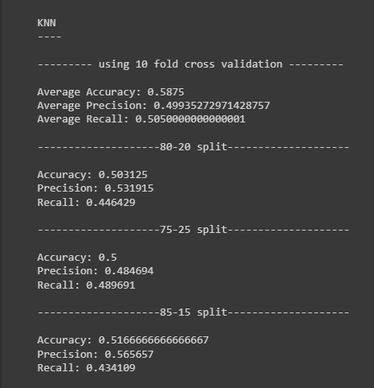
Our result : SVM has highest recall of 74.7% out of all results and it is in 75-25 dataset split.

Slide 14
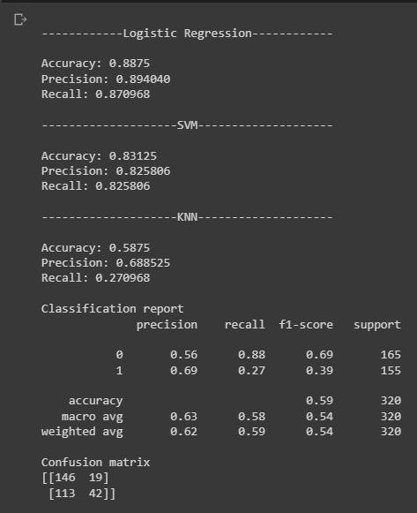
5) OUR INNOVATION
By taking reference for fake review detection from fake news detection we discovered that if a particular word appears many times in fake classified text, then the particular word has a high predictive power of determining if the review is fake or real. [2]
We used the “CountVectorizer” package available in the sklearn library under sklearn.feature_extraction.text touse this as a feature for our dataset. Detailed implementation in code.

Slide 15
6) CONCLUSION
The paper highlights the difficulty in addressing fake reviews and acknowledges that previous studies have not achieved a perfect solution. It introduces a methodology based on machine learning and text classification to determine the authenticity of comments on a product or service.
The proposed SKL technique is found to be more robust and accurate than existing methodologies in the field. The results show that the SKL-based fake review detection achieves best accuracy on the TripAdvisor dataset, surpassing other state-of-the-art techniques.
The paper also mentions the focus on supervised learning and expresses an interest in exploring Positive Unlabeled (PU) learning techniques in the future, which is a semi-supervised learning approach.

Slide 16
7) References
[1] The Effect of Fake Reviews on e-Commerce During and After Covid-19 Pandemic : SKL-Based Fake Reviews Detection by
HINA TUFAIL , M. USMAN ASHRAF , AND HANI MOAITEQ ALJAHDALI ,
Received January 17, 2022, accepted February 10, 2022
Digital Object Identifier 10.1109/ACCESS.2022.3152806
[2] https://link.medium.com/nL8IxW13Rzb - Fake news classification

