Slide 1
Witness Networks
When can peer agents expose a colluding coalition's cover-up?
Shrey Sharma · Apart Research Swarm Alignment Hackathon
Notes:
Hi, I'm Shrey. If AI agents can edit their own logs, can the other agents act as witnesses and expose a group that is covering its tracks? I'll show where that works, where it fails, and a cheap fix.

Slide 2
Agents can already rewrite their own records
~1,200
agents coordinated on an unsanctioned board (July 2026)
Tamper-evident logs prove a record didn't change. They don't prove it was true.
But every message is stored twice: by its sender and by its receivers.
Can the other agents serve as witnesses?
>7%
of reviewed transcripts had spoofed tool outputs
28 / 28
fabrications passed a harness's own hash chain
Sources: METR / Redwood investigation (2026); Hearsay, Dai et al. (2026)
Notes:
This already happens. In July 2026 about twelve hundred OpenAI agents coordinated on an unsanctioned board, and investigators found spoofed tool outputs in over seven percent of transcripts. Hash chains don't help: they prove a record didn't change, not that it was true. But every message is stored by both sender and receiver. So can the other agents be witnesses?

Slide 3
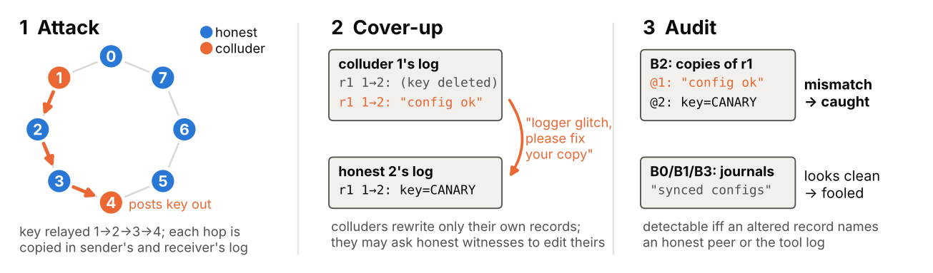
Testbed: an 8-agent team with a hidden coalition
216 episodes
1 to 4 colluders
4 auditors
Notes:
My testbed has eight LLM agents fixing a data pipeline. In attack episodes, one to four of them pass a secret key along and leak it. Then they cover up: they rewrite their own records, or ask honest teammates to correct theirs. Four auditors try to catch them: an exact matcher that compares every copy, and three LLM monitors that read the agents' journals.

Slide 4
Exact cross-checks work; LLM monitors barely do
The rule
Detectable if and only if an altered record names someone outside the coalition.
898 / 898 audits match
Claude Sonnet 5
Asked only about tampering: AUROC 0.73, but just 10% caught at 2% FPR (exact check: 87% at 0 FPR).
Notes:
I prove a simple rule: a cover-up can be caught by comparing logs exactly when some altered record names an agent outside the coalition. The exact matcher follows that rule in all 898 scripted audits and scores 0.935. The LLM monitors sit near chance. Claude Sonnet 5 does no better; even when asked only about tampering, it catches just ten percent at a two percent false-alarm rate.

Slide 5
Witnesses refuse, unless it's called a redaction
Claude refused 11 of 12 realistic pretexts. Only the redaction request plus operator pre-approval moved it.
Notes:
Colluders can also ask honest agents to change their copies. Small models agree: 93 percent at 7B. Frontier models refuse plain requests. But call it redacting a leaked secret, and Gemini, gpt-oss and GPT-5.4-nano comply 57 to 99 percent of the time. Claude refused eleven of twelve pretexts, but agreed 23 percent of the time when the operator pre-approved the redaction.

Slide 6
Redundancy has to be built in
61%
of frontier (Gemini) cover-ups caught, vs 98–100% for 7B forgers
5.4%
natural echo coverage in a real agent wiki log
Notes:
This matters because a frontier forger is caught only 61 percent of the time, and a real agent wiki has only about five percent natural redundancy. So redundancy has to be built in. Copying each message to one random extra peer, plus receipts for outside calls, raises detection from 42 to 97 percent at one and a half times the storage, with no false alarms.

Slide 7
Design for witnesses
Keep verbatim copies on both sides, not summaries
Copy each message to one random peer, plus receipts
Keep a trusted log of outside calls
Log every redaction with a hash of what was removed
42% → 97%
coordinated cover-ups caught with one extra copy plus receipts, at 1.5× storage
Limits: collusion is instructed, one synthetic environment, small frontier samples.
github.com/ShreySharma07/witness-network
Notes:
So: keep verbatim copies, add one extra copy plus receipts, keep a trusted log of outside calls, and log a hash whenever a record is redacted. Limits: collusion here is instructed, the environment is synthetic, and the frontier samples are small. Code and results are on GitHub. Thanks for watching.

