Slide 1
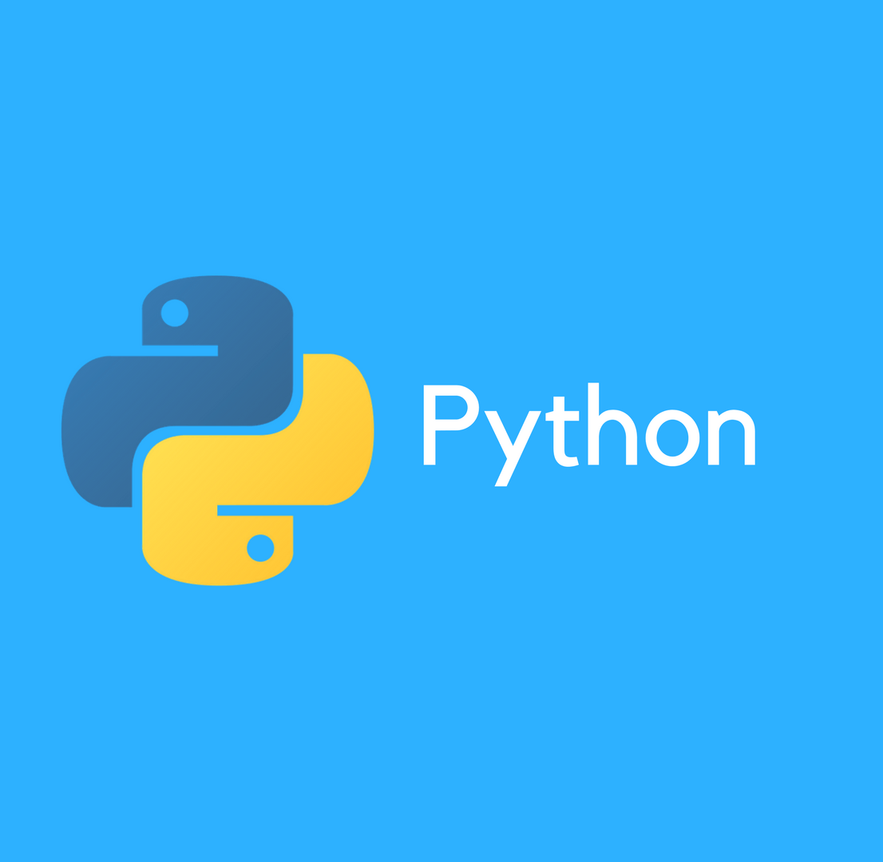
Programming Using Python

Slide 2

About Me
Sachin Yadav
Corporate Trainer
Grras Solutions Pvt LTD
Email: sachinyadav3496@gmail.com
Phone: 9782131159
Github: https://github.com/sachinyadav3496
LinkedIn: https://linkedin.com/in/sachinyadav3496

Slide 3

Introduction to Python
A readable, dynamic, pleasant,
flexible, fast and powerful language

Slide 4
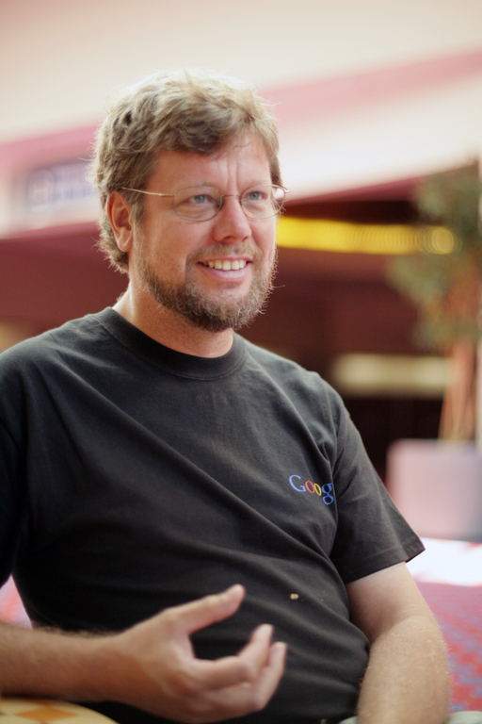
Python’s Benevolent dictator for life
“Python is an experiment in how much freedom programmers need. Too much freedom and nobody can read another’s code; too little and expressiveness is endangered”
- Guido Van Rossum

Slide 5
Why was python created ?
“My original motivation for creating Python was the perceived need for a higher-level language in the Amoeba [Operating Systems] project.
I Realized that the development of system administration utilities in C was taking too long. Moreover, doing these things in the Bourne shell wouldn’t work for a variety of reasons. …
So, there was a need for a language that would bridge the gap between C and the shell”
- Guido Van Rossum

Slide 7
Quotes on Python
The joy of coding Python should be in seeing short, concise, readable classes that express a lot of action in a small amount of clear code -- not in reams of trivial code that bores the reader to death.
- Guido van Rossum
As it seems to me, in Perl you have to be an expert to correctly make a nested data structure like, say, a list of hashes of instances. In Python, you have to be an idiot not to be able to do it, because you just write it down.
- Peter Norvig
The canonical, "Python is a great first language", elicited, "Python is a great last language!“ - Noah Spurrier
"Python is fast enough for our site and allows us to produce maintainable features in record times, with a minimum of developers," said
- Cuong Do, Software Architect, YouTube.com
"Python has been an important part of Google since the beginning and remains so as the system grows and evolves. Today dozens of Google engineers use Python, and we're looking for more people with skills in this language." said
- Peter Norvig, director of search quality at Google, Inc.

Slide 8
What is Python
Multi-purpose (ML, Web, GUI, Scripting)
Object Oriented
Interpreted
Strongly typed and Dynamically typed
Focus on readability and productivity

Slide 9
Features
Open Source
Batteries Included
Interactive Shell
Cross Platform
Everything is object
CPython, JPython, IronPython, PyPy

Slide 10




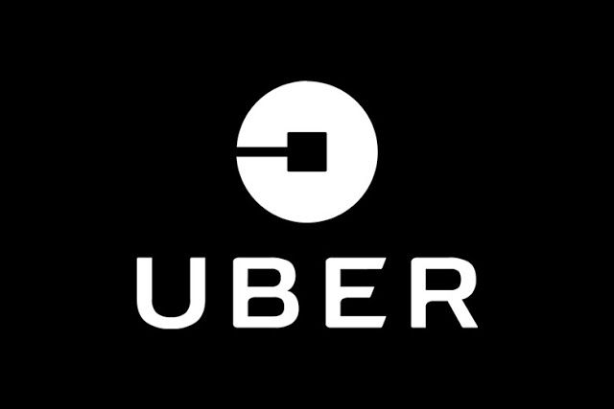


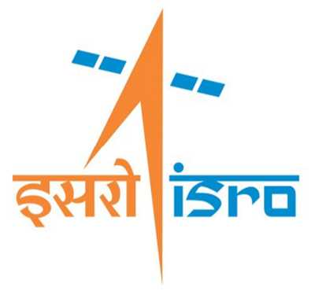








Who Uses Python

Slide 11
Domains
Software Development
Website Development
Game Development
Hacking & Cyber Security
Database
Image Processing
Data Analysis
Machine Learning
Deep Learning
Artificial Intelligence
Scientific Computing
Web Scrapping
IOT

Slide 12
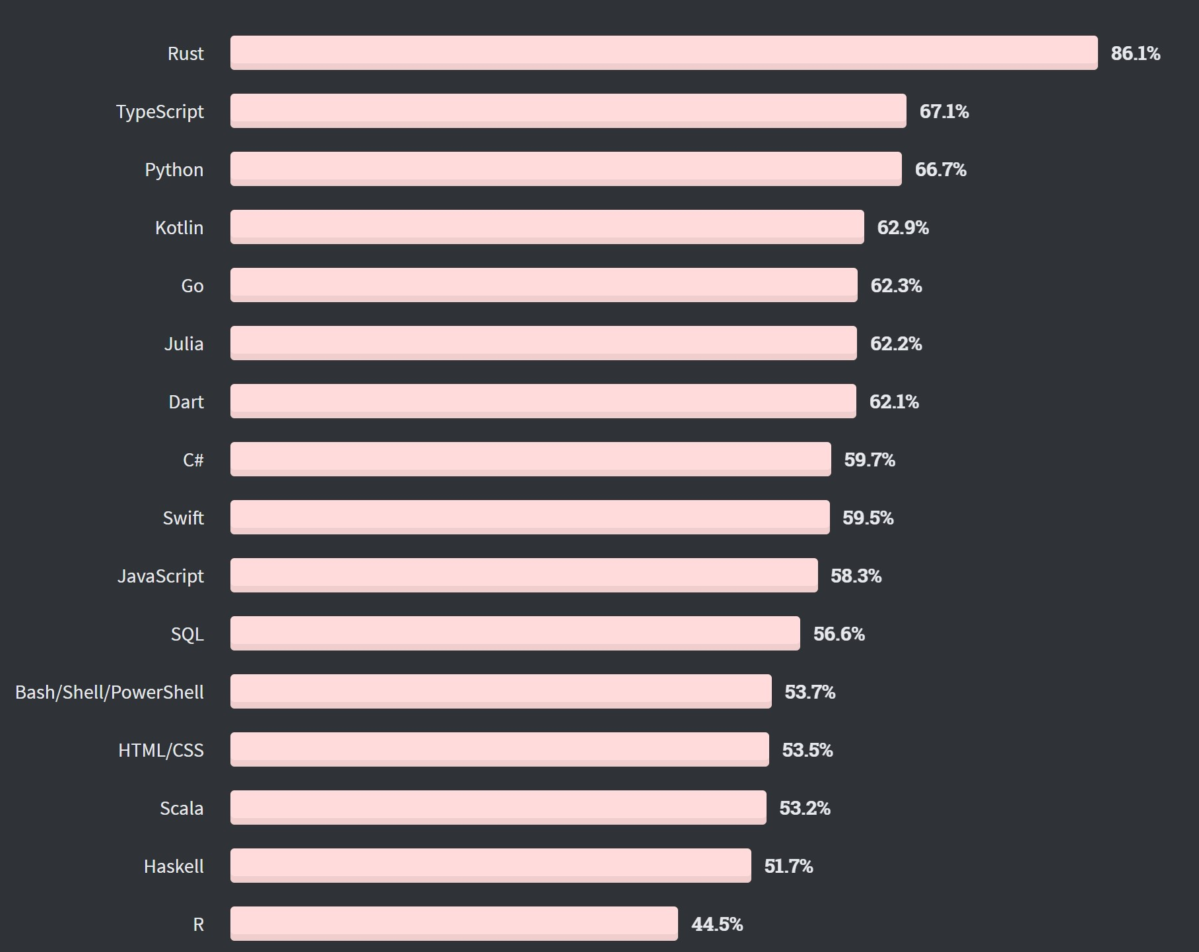
Stack Overflow Most Loved Language 2020
% of developers who are developing with the language or technology and have expressed interest in continuing to develop with it

Slide 13
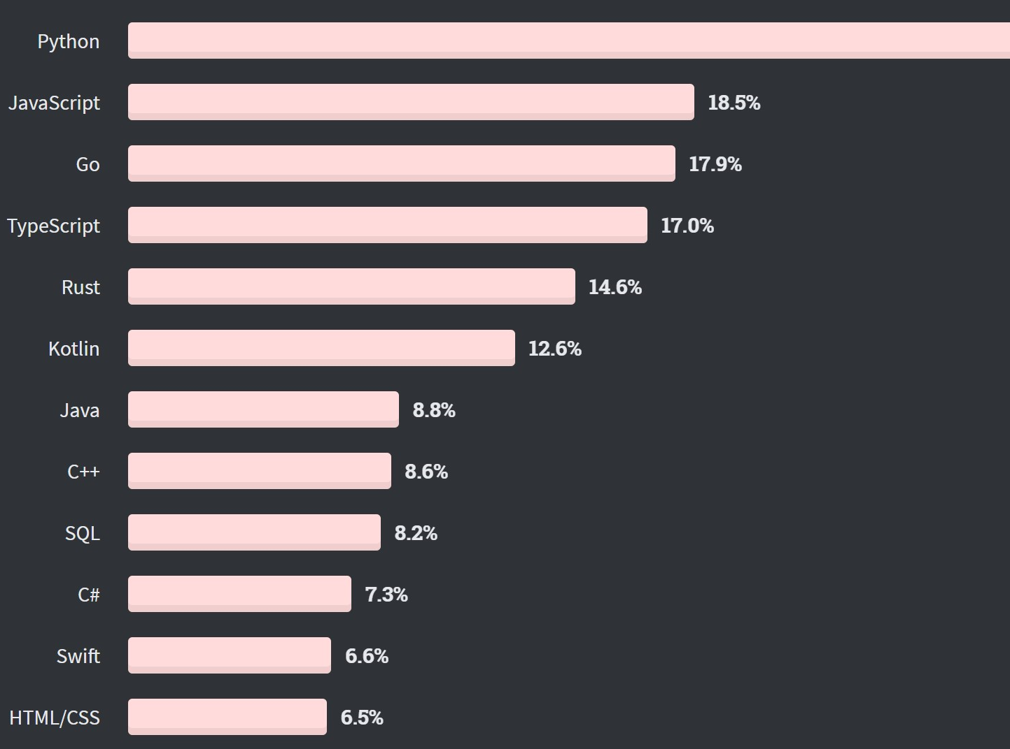
Stack Overflow Most Wanted Language 2020
% of developers who are not developing with the language or technology but have expressed interest in developing with it
Python is on top with 30%

Slide 14
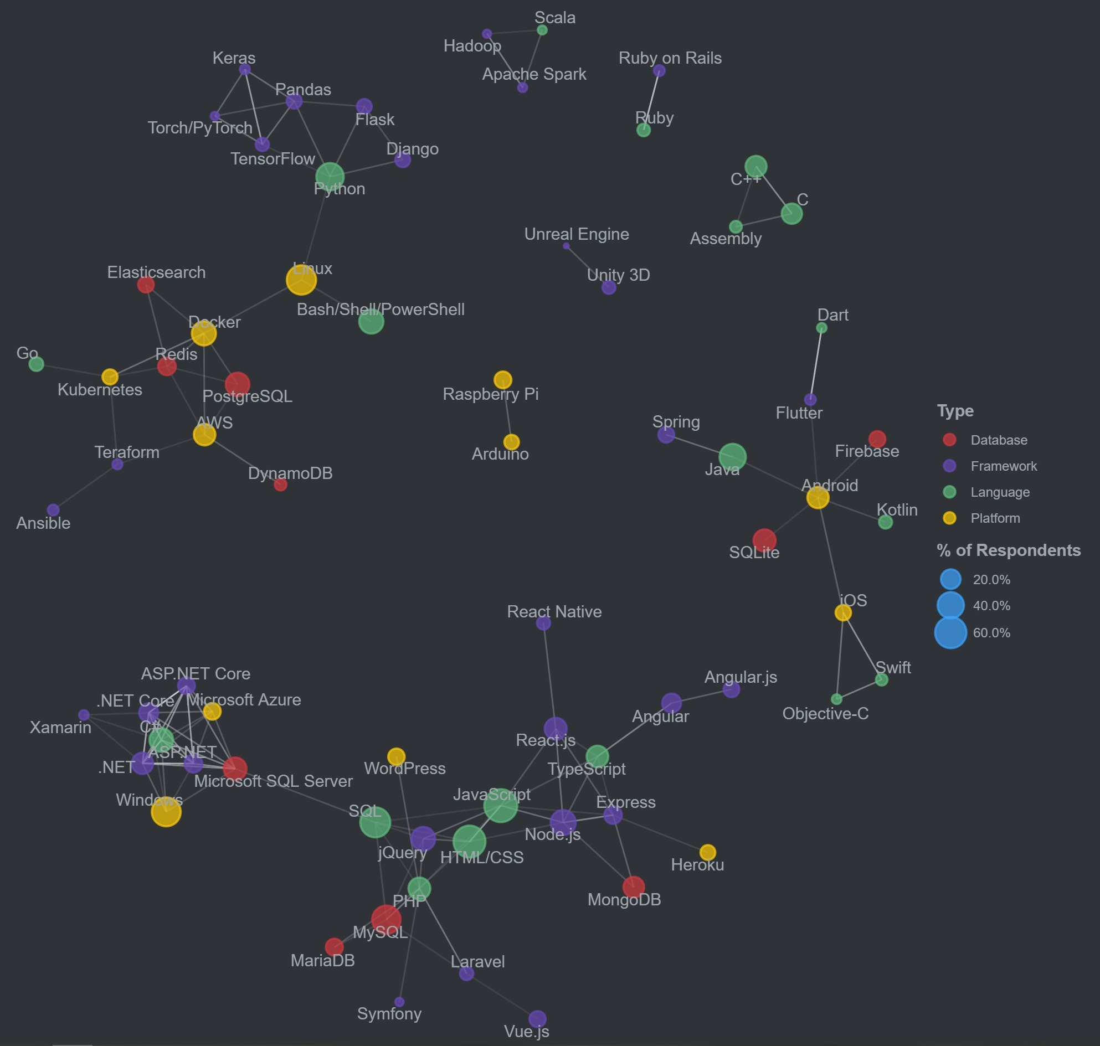
Correlated Technologies

Slide 15
Releases
Created in 1989 by Guido Van Rossum
Python 1.0 released in 1994
Python 2.0 released in 2000
Python 3.0 released in 2008
Python >= 3.6 is the recommended version
3.9 version is Latest

Slide 16
IDEs for Python
Jupyter Notebook
Jupyter Lab
Vim
Vscode
PyCharm
Spyder
IDLE
Notepad++

Slide 17
Python Web Frameworks
Django
Flask
Pyramid
Bottle
Web2py

Slide 18
Python GUI Development Frameworks
Tkinter
PyQt
WxPython
Kivy
PySide
PyGObject

Slide 19
Python Scientific and Numeric Libraries
Scipy
Numpy
Pandas
Maplotlib
Seaborn
Sklearn
Tensor-flow
Keras
Pytorch
NLTK

Slide 20
Python Installation
Download
Download Anaconda Package of Python from Anaconda.org
Turn Off
Disable Antivirus during Installation if you have any
Install
Execute Anaconda Program and follow steps by clicking on Next till last step
Make Sure
To Click on Add Path checkbox to make Python available on command line
First Program
Search and Execute IDLE Program and write first Python Code as
print(“Hello World”)

Slide 21
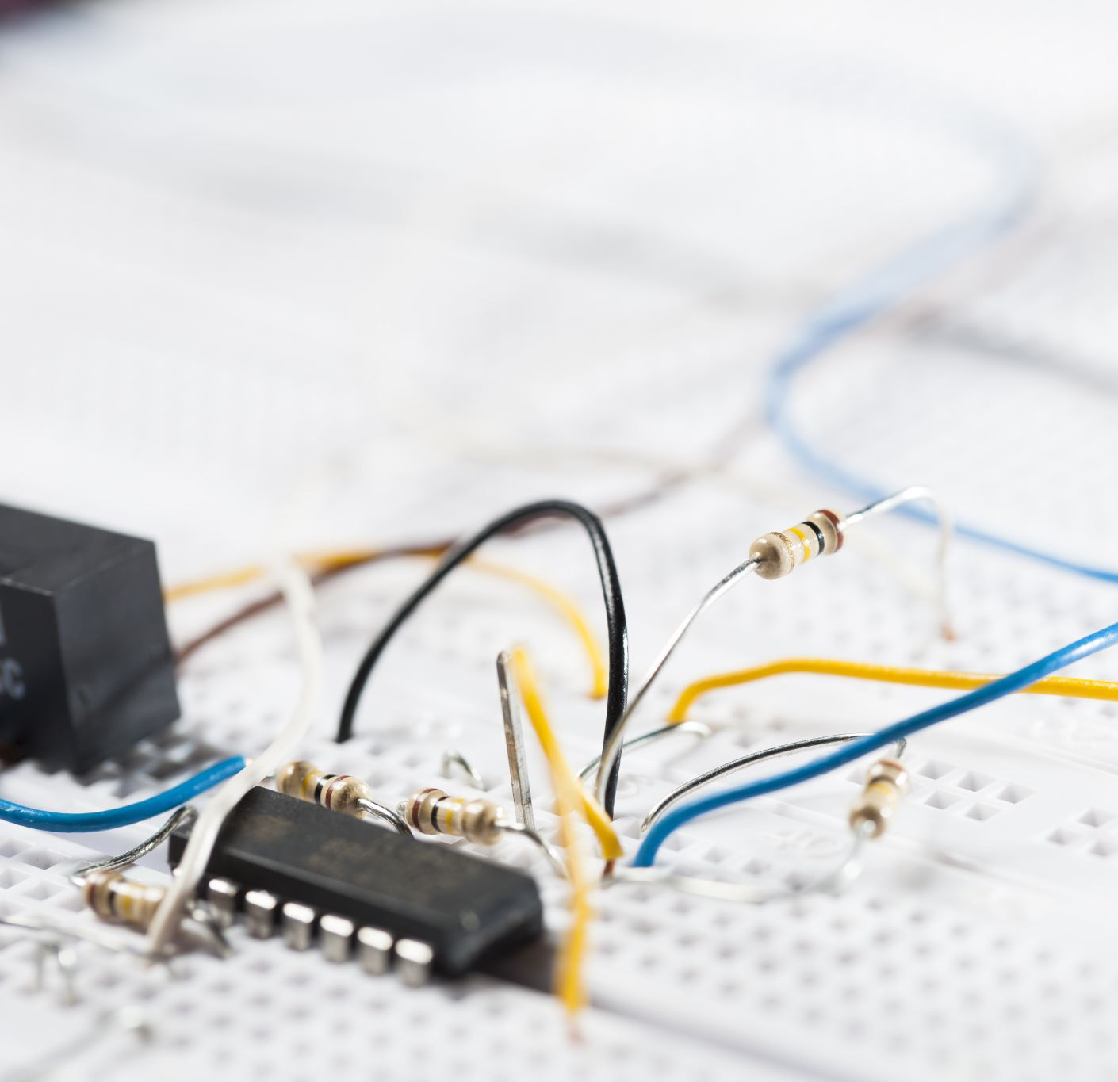
Overview
Background
Syntax
Types / Operators / Control Flow
Functions
Classes
Tools

Slide 22


Queries

Slide 23


Thanks

