Slide 1

CS648 Project
Aayush Gupta (210020) Ridin Datta (210840) Shrey Wadhawan (200948)

Slide 2
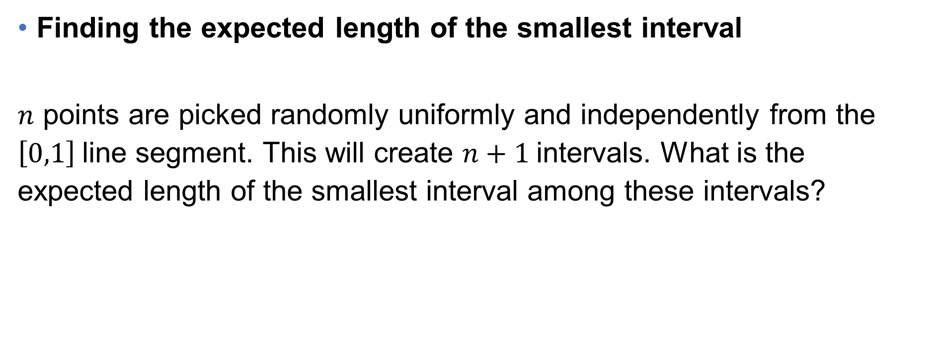
Problem Statement
Finding the expected length of the smallest interval
$n$ points are picked randomly uniformly and independently from the $\left[0,1\right]$line segment. This will create $n+1$intervals. What is the expected length of the smallest interval among these intervals?

Slide 3

Claim
The expected length of the smallest interval is $O(n^{−2})$

Slide 4

Proofs
By Randomized Incremental Construction
we will be proving that the expected length of smallest interval is$θ(n^{−2})$.
By a novel method

Slide 5

Proof 1: Randomized Incremental Construction
As all points are picked uniformly and independently, so we can analyze the problem as gradually picking the points one by one.
We will be analysing the case when we are picking the ${(i+1)}^{th}$ point.

Slide 6
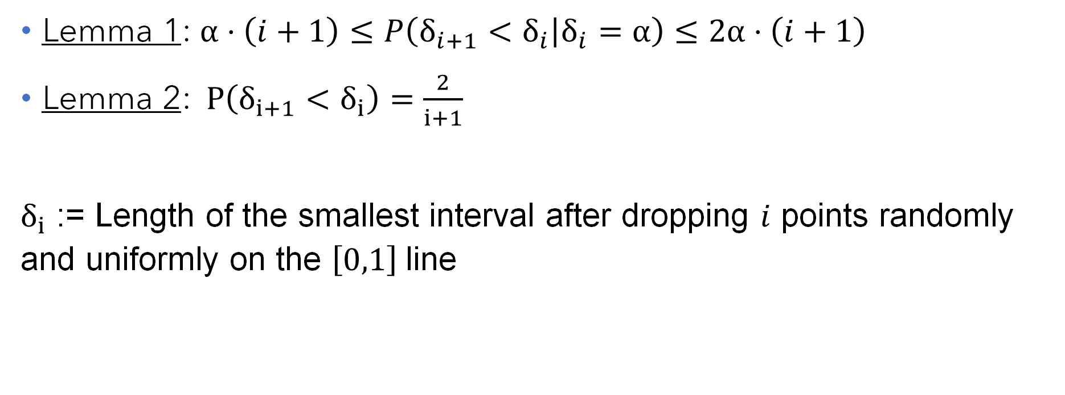
Proof 1: Randomized Incremental Construction
Lemma 1: $α⋅\left(i+1\right)≤P\left(δ_{i+1}<δ_{i} | δ_{i}=α\right)≤2α⋅\left(i+1\right)$
Lemma 2:$P\left(δ_{i+1}<δ_{i}\right)=\frac{2}{i+1}$
$δ_{i}$ := Length of the smallest interval after dropping $i$ points randomly and uniformly on the $\left[0,1\right]$line

Slide 7

Proof 1: Randomized Incremental Construction
Using Lemma 1:
$α⋅\left(i+1\right)≤P\left(δ_{i+1}<δ_{i} | δ_{i}=α\right)≤2α⋅\left(i+1\right)$
$⇒α⋅\left(i+1\right)⋅P\left(δ_{i}=α\right)≤P\left(δ_{i+1}<δ_{i} | δ_{i}=α\right)⋅P\left(δ_{i}=α\right)≤2α⋅\left(i+1\right)⋅P\left(δ_{i}=α\right)$
$⇒\int{α}⋅\left(i+1\right)⋅P\left(δ_{i}=α\right)dα≤\int{P\left(δ_{i+1}<δ_{i} | δ_{i}=α\right)}⋅P\left(δ_{i}=α\right)dα≤\int{2α}⋅\left(i+1\right)⋅P\left(δ_{i}=α\right)dα$
$⇒\left(i+1\right)E\left[δ_{i}\right]≤P\left(δ_{i+1}<δ_{i}\right)≤2\left(i+1\right)E\left[δ_{i}\right]$
$⇒\frac{P\left(δ_{i+1}<δ_{i}\right)}{2\left(i+1\right)}≤E\left[δ_{i}\right]≤\frac{P\left(δ_{i+1}<δ_{i}\right)}{i+1}$

Slide 8

Proof 1: Randomized Incremental Construction
Using Lemma 2:
$\frac{1}{{\left(i+1\right)}^{2}}≤E\left[δ_{i}\right]≤\frac{2}{{\left(i+1\right)}^{2}}$
Thus, $E\left[δ_{i}\right]=θ\left(i^{−2}\right)$
$⇒E\left[δ_{n}\right]=θ\left(n^{−2}\right)$

Slide 9
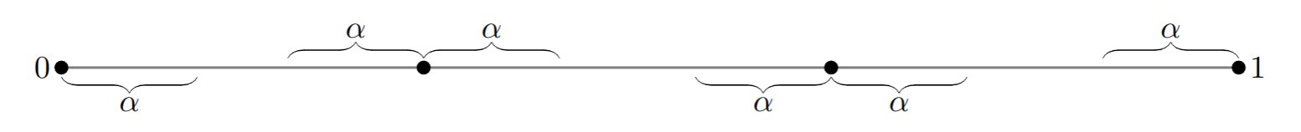
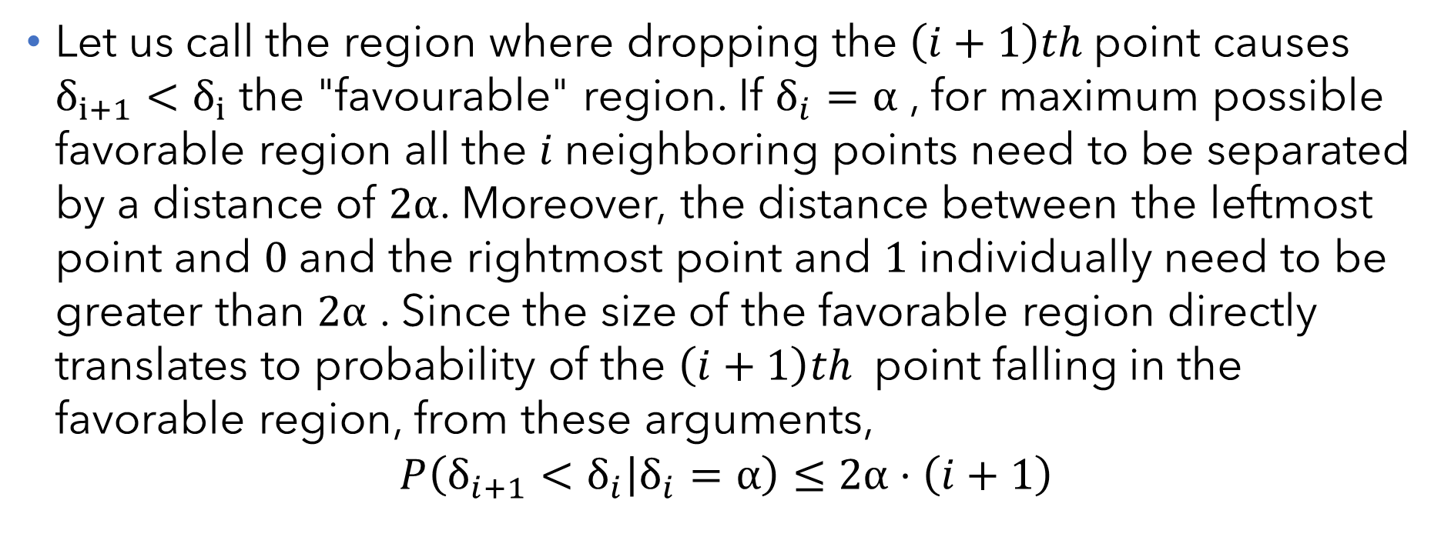
Proof of Lemma 1
Let us call the region where dropping the $\left(i+1\right)th$point causes $δ_{i+1}<δ_{i}$the "favourable" region. If $δ_{i}=α$ , for maximum possible favorable region all the $i$neighboring points need to be separated by a distance of $2α$. Moreover, the distance between the leftmost point and $0$and the rightmost point and $1$individually need to be greater than $2α$ . Since the size of the favorable region directly translates to probability of the $\left(i+1\right)th$ point falling in the favorable region, from these arguments,
$$P\left(δ_{i+1}<δ_{i} | δ_{i}=α\right)≤2α⋅\left(i+1\right)$$

Slide 10
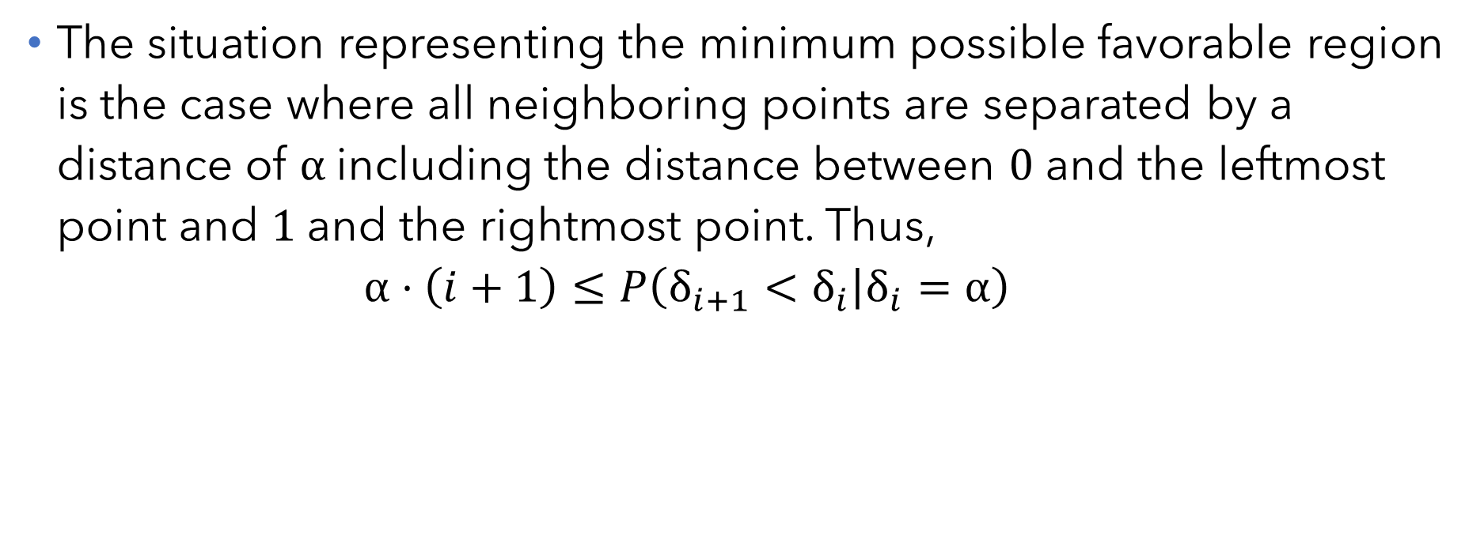
Proof of Lemma 1
The situation representing the minimum possible favorable region is the case where all neighboring points are separated by a distance of $α$including the distance between $0$ and the leftmost point and $1$and the rightmost point. Thus,
$$α⋅\left(i+1\right)≤P\left(δ_{i+1}<δ_{i} | δ_{i}=α\right)$$

Slide 11

Proof of Lemma 2
In the randomized incremental construction framework let us consider that $i$points have been dropped. The smallest interval is defined by 2 points. Let us call them $p$ and $q.$If either $p$or $q$are chosen as the $\left(i+1\right)th$point they would define the smallest interval. Otherwise, the smallest interval remains the same as $δ_{i}$Since the points have been chosen random uniformly, every point has the same probability of being the last dropped point. Hence,
$$P\left(δ_{i+1}<δ_{i}\right)=\frac{2}{i+1}$$

Slide 12
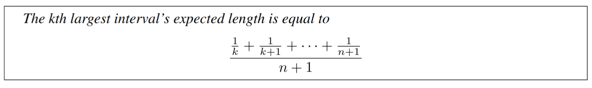
Proof 2: By Geometry
We will prove the following claim in a novel geometric fashion

Slide 13
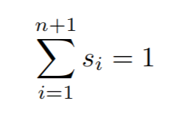
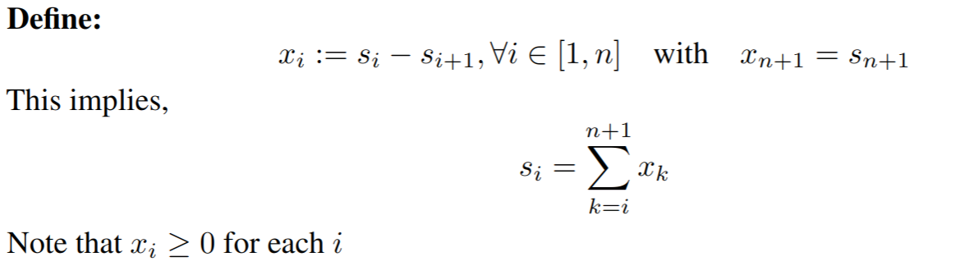
Proof 2: By Geometry
Without loss of generality, assume the [0, 1] segment is broken into segments of length s1 ≥ s2 ≥ · · · ≥ sn ≥ sn+1, in that order

Slide 14
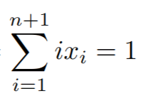



Proof 2: By Geometry

Slide 15
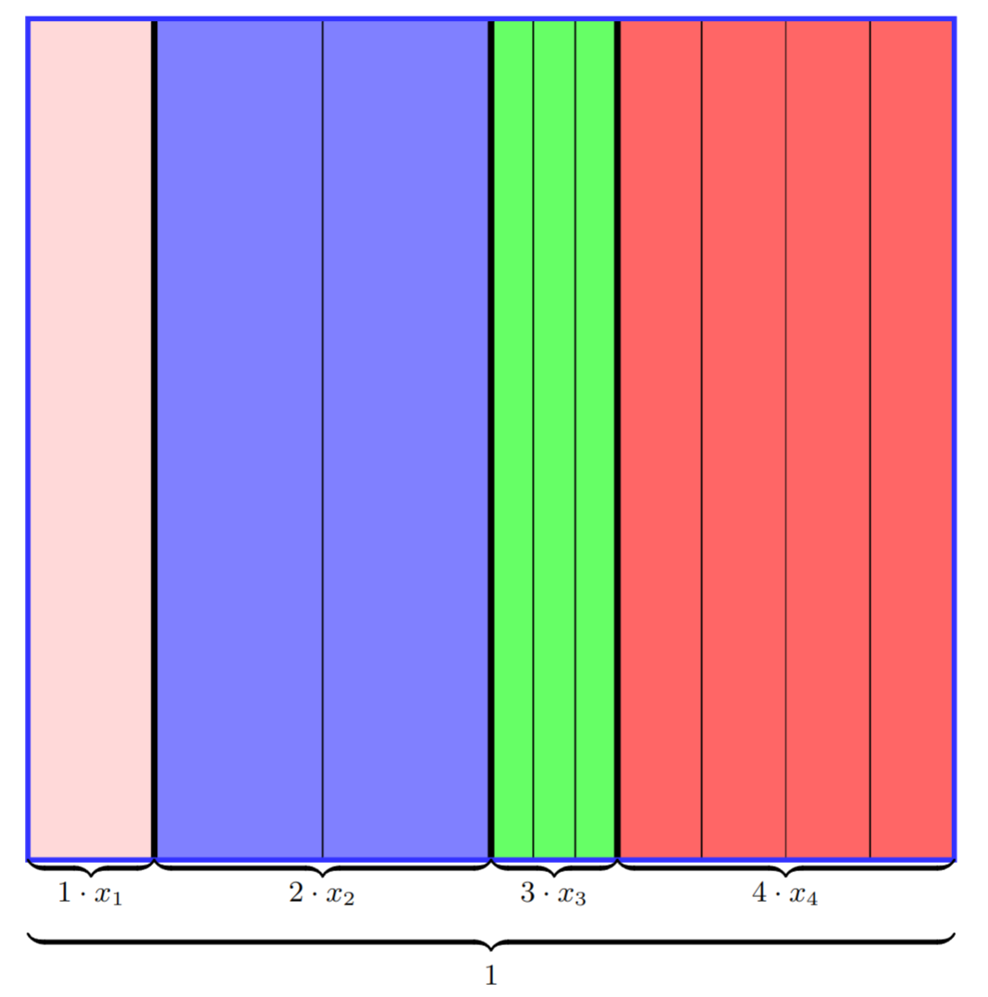
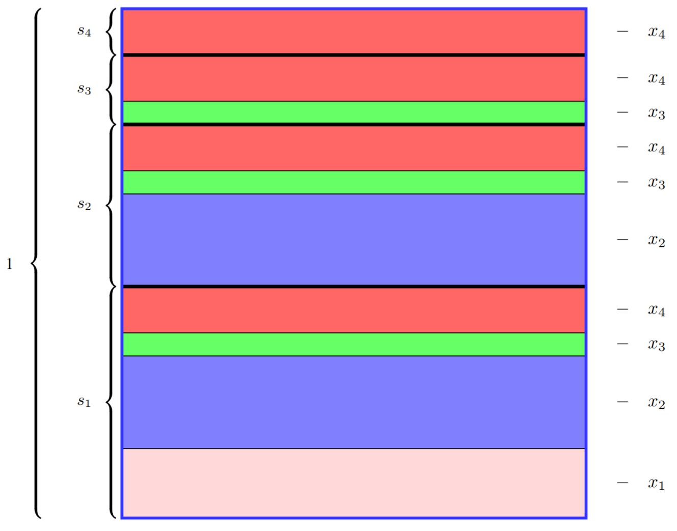


Proof 2: By Geometry

Slide 16
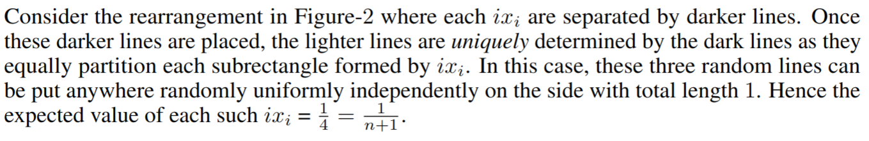
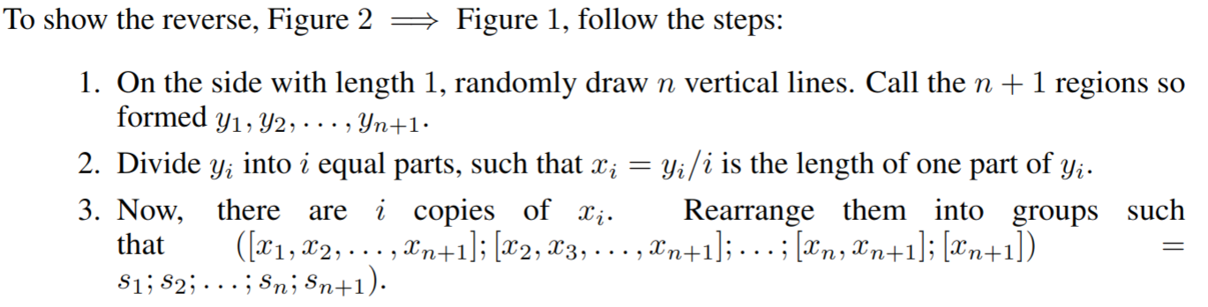
Proof 2: By Geometry

Slide 17

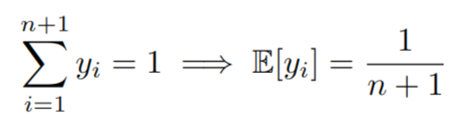
Proof 2 By Geometry

Slide 18
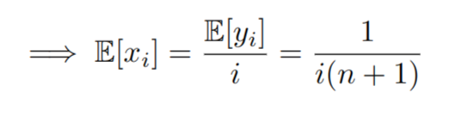
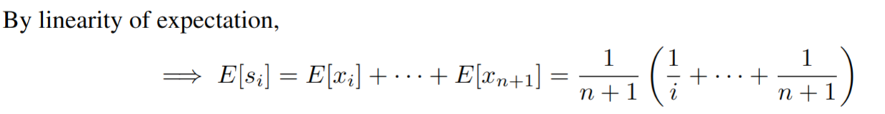

Proof 2: By Geometry

