Slide 1

Graph-Based RAG for Indian Criminal Law Using IPC–BNS Mapping and Answer Verification
Guide: Ms. Pavitra
Designation:
Department of Computer Science & Engineering
B.M.S. College of Engineering
Siddhanth Narendra Kuthnikar 1WN24CS277 Shreya Sharma 1WN24CS270 | Reva Kumari 1WN24CS227 Sanika Raj 1WN24CS245
Notes:
Arpana

Slide 2
OUTLINE
Introduction
Problem Statement and Objectives
Literature Survey
Comparison of Existing Methods
High Level Design
Detailed Design
Software and Hardware Requirements
Functionalities of the Modules
Proposed Implementation Plan
Evaluation Plan and Expected Outcomes
Applications
References
Notes:
ap

Slide 3
Introduction
The Societal Problem: Navigating the legal system is complex and inaccessible for the average citizen due to dense legal language and the sheer volume of statutes. Since 1 July 2024 the Bharatiya Nyaya Sanhita (BNS) has replaced the Indian Penal Code (IPC), so citizens, police and lawyers must now translate between old and new section numbers.
Why it Matters: Wrong or outdated section numbers can lead to incorrect charges, filings and legal advice. General-purpose AI tools can cite sections that do not exist or confuse IPC with BNS, so answers must be traceable to the law itself.
SDG Mapping: This project aligns with UN Sustainable Development Goal (SDG) 16: Peace, Justice, and Strong Institutions, by promoting the rule of law and equal access to justice for all.
Notes:
Niha

Slide 4
Problem Statement
Existing legal RAG systems rely mainly on vector similarity, which retrieves text that sounds similar but cannot follow how an IPC section maps to a BNS section (merged, split, modified or removed). They also lack a reliable check that an answer is supported by the retrieved law, so they can hallucinate section numbers or answer without citations.
Proposed Objective: To build a graph-based RAG system for Indian criminal law that links IPC and BNS sections in a Neo4j knowledge graph, combines vector and graph retrieval, and verifies every answer against the retrieved evidence, giving cited answers or declining when evidence is insufficient.
Notes:
Anusree

Slide 5
Objectives
1. Knowledge graph: Build a Neo4j graph connecting IPC and BNS sections using official sources, including sections with no direct replacement.
2. Graph-based RAG: Answer criminal-law questions by combining vector search with graph traversal; manage the workflow with LangGraph and connect tools through MCP where practical.
3. Answer verification: Check answers against the retrieved documents; search again or decline when evidence is weak; always cite the relevant sections.
4. Testing and comparison: Evaluate on 75–100 expert-verified questions: vector vs graph RAG, with vs without verification, and text vs scanned documents and tables (smaller set).

Slide 6
Literature Survey
Sl.NO | Title | Year | Article type | Abstract | Contribution | Laccuna | Findings
1 | Redefining legal access: a RAG-based AI system for Indian law (LegalEase) | 2025 | Journal (Springer) | Navigating the Indian judicial system poses steep challenges due to dense legal vernacular and a backlog of disputes. This paper presents LegalEase, a bilingual Retrieval-Augmented Generation (RAG) framework developed to democratize access to statutory legal knowledge. The architecture utilizes FAISS and ChromaDB for vector retrieval over statutory legal frameworks, comparing performance across Gemini-2.5-flash, Llama-3.1, and GPT-3.5 models. | Implementation of an open-access bilingual RAG framework customized for Indian statutory frameworks (BNS and IPC), featuring semantic retrieval and localized query-answering modules. | Lacks multi-hop reasoning capabilities required for establishing inter-case precedent links and interpreting contradictory historical judicial rulings. | Gemini-2.5-flash attained the highest ROUGE scores for comprehensive summarization, while GPT-3.5 exhibited the highest semantic similarity (MPNet score) in statutory clause matching.
2 | Legal Query RAG (LQ-RAG) | 2025 | Journal (IEEE Access, vol. 13) | Hallucinations and factual errors remain prominent vulnerabilities when generative large language models process domain-specific legal queries. This study introduces LQ-RAG, a decoupled hybrid retrieval-augmented generation framework that isolates embedding fine-tuning from generative instruction-tuning. The framework deploys a recursive LLM-based evaluation agent to assess answer fidelity against verified statutory provisions. | Designed a decoupled fine-tuning paradigm for legal embeddings and generative models, augmented by an automated recursive evaluation agent for real-time hallucination detection and re-generation. | Imposes substantial computational overhead during recursive validation and relies primarily on proprietary models for evaluation rather than ground-truth feedback from human legal practitioners. | Consistently outperformed standard baseline RAG architectures in retrieval precision, achieving significant gains in Hit Rate and Mean Reciprocal Rank (MRR) across complex statutory queries.
Notes:
Pooja

Slide 7
Literature Survey
3 | Enhancing legal document building with retrieval-augmented generation | 2025 | Journal (Computer Law & Security Review, Elsevier) | The drafting and validation of enterprise legal documentation demands precision and adherence to strict regulatory statutes. This research explores semantic context retrieval paired with LLM generative capabilities to automate contractual clause synthesis and compliance document assembly from institutional repositories. | Developed an automated drafting and context-aware synthesis pipeline for corporate agreements and regulatory filings using hierarchical document chunking and targeted statutory retrieval. | Demonstrates fragility when encountering multi-jurisdictional constraints, conflicting statutory amendments, or non-standard bespoke contractual negotiations. | Drastically curtailed turnaround time for routine compliance drafting while maintaining high structural consistency, though mandatory human-in-the-loop validation remains essential for nuanced dispute clauses.
4 | A Survey on Legal Judgment Prediction: Datasets, Metrics, Models and Challenges | 2023 | Journal (IEEE Access, vol. 11) | Automated Legal Judgment Prediction (LJP) aims to forecast legal outcomes (charges, law articles, and penalty terms) from textual fact descriptions. This comprehensive survey systematically reviews 43 LJP datasets spanning 9 languages across civil-law and common-law systems. It establishes a taxonomy of 16 evaluation metrics across 4 categories and benchmarks 8 legal-domain pre-trained language models, dissecting open challenges including interpretability, data bias, complex statutory logic reasoning, and human-machine performance gaps. | Formulated an exhaustive, standardized survey of LJP corpora across 9 languages, categorizing 16 quantitative evaluation metrics and comparing legal pre-trained transformer models and topological multi-task reasoning frameworks. | Conducts a broad meta-analytical taxonomy across historical civil and common law datasets; does not propose an empirical end-to-end conversational RAG pipeline. | Revealed that standard classification metrics fail to capture legal nuance, establishing that multi-task hierarchical modeling (mapping facts to statutes to charges) significantly outperforms disjoint prediction baselines.
Notes:
Pooja

Slide 8
Literature Survey
5 | Enhancing legal assistance with AI: intent classification and domain-specific model tuning | 2025 | Journal (Artificial Intelligence and Law, Springer) | User legal inquiries frequently present conversational ambiguities that cause generic language models to retrieve inapplicable legal references. This paper presents an intent-guided legal assistance architecture that performs fine-grained classification of legal intent across varied domains prior to activating specialized semantic retrieval. | Formulated a dual-stage legal processing workflow combining domain-specific intent classification with tailored transformer model tuning to prevent cross-domain hallucination. | Multi-layer intent classification introduces additional inference latency and demands ongoing supervised retraining as statutory boundaries and novel civil causes of action emerge. | Boosted relevant context retrieval by 22% compared to direct single-stage RAG baselines by filtering irrelevant statutory domains before document fetching.
6 | A Circumstance-Aware Neural Framework for Explainable Legal Judgment Prediction | 2024 | Journal (IEEE Transactions on Knowledge and Data Engineering, vol. 36) | Traditional Legal Judgment Prediction models typically treat entire factual descriptions uniformly, neglecting how judicial reasoning evaluates specific crime circumstances. This paper presents NeurJudge, a circumstance-aware neural framework that dynamically partitions factual narratives into distinct legal circumstances using intermediate subtask signals. It further introduces an explainable extension (E-NeurJudge) leveraging a cooperative teacher-student architecture to generate transparent, grounded legal rationales alongside predicted statutory articles and penalties. | Designed a circumstance-aware neural framework and a cooperative teacher-student rationalization model (E-NeurJudge) that dynamically disentangles case facts to deliver verifiable, explainable judicial predictions. | Requires high computational resources for training multi-stage teacher-student networks; circumstance splitting becomes difficult on informal, non-standard user-submitted legal queries. | Achieved state-of-the-art predictive accuracy across multiple legal benchmarks while drastically improving transparency, producing factual rationale sentences that closely match human judicial reasoning.
Notes:
Pooja

Slide 9
Literature Survey
7 | LegalAI Research in LLM Era: Data, Modeling and Evaluation | 2026 | Journal (Artificial Intelligence Review, Springer) | The transition from extractive natural language processing to generative foundation models has revolutionized LegalAI research. This comprehensive survey systematically reviews recent paradigms in legal training corpus construction, domain-adapted parameter architectures, and evaluation protocols across diverse judicial jurisdictions. | Formulated an exhaustive taxonomy categorizing modern generative legal architectures, knowledge-injection methods, and critical limitations of conventional lexical evaluation metrics in judicial contexts. | Conducts purely qualitative and meta-analytic synthesis; does not propose an empirical model architecture or introduce a standalone experimental dataset. | Demonstrated that standard NLP metrics (such as BLEU and ROUGE) correlate poorly with judicial legal soundness, necessitating domain-grounded factuality and hallucination verification benchmarks.
8 | Large Language Models in Legal Systems: A Survey | 2025 | Journal (Humanities & Social Sciences Communications, Springer Nature) | The integration of generative artificial intelligence into courtroom workflows, institutional arbitration, and commercial law firms introduces profound operational efficiencies alongside ethical and systemic challenges. This paper investigates practical deployments of leading commercial legal tech platforms, analyzing practitioner adoption patterns and socio-technical hurdles. | Provided an empirical socio-technical assessment of commercial legal AI systems in active judicial and corporate workflows, detailing risks related to evidentiary bias and client confidentiality. | Emphasizes policy, sociology, and workflow implications, lacking granular technical architectural breakdowns or vector retrieval algorithmic optimizations. | Concluded that while LLMs generate 35-50% gains in initial document discovery and research workflows, proprietary black-box decision models severely hinder institutional judicial accountability.
Notes:
Pooja

Slide 10
Literature Survey
9 | Legal knowledge infusion for large language models: A survey | 2025 | Journal (Information Fusion, Elsevier) | Equipping foundational large language models with accurate statutory knowledge without catastrophic forgetting represents a central research problem in domain adaptation. This survey examines knowledge infusion mechanisms, including continual pre-training, parameter-efficient fine-tuning (PEFT), knowledge graph integration, and contextual retrieval. | Systematically evaluated knowledge integration strategies for legal LLMs, benchmarking computational costs against memory retention and statutory reasoning fidelity. | Severe knowledge injection via continual pre-training often degrades general conversational reasoning capabilities; fails to resolve runtime statutory drift without persistent external indexing. | Determined that LoRA/PEFT parameter adaptation paired with hybrid statutory knowledge graphs achieves an optimal trade-off between computational overhead, reasoning accuracy, and catastrophic forgetting prevention.
10 | Large language models in law: A survey | 2024 | Journal (AI Open, ScienceDirect / Elsevier) | Natural language understanding within legal AI has transitioned rapidly from supervised token classification models toward zero-shot and few-shot generative reasoning. This paper reviews the empirical capabilities and boundary conditions of foundational models on standardized legal evaluation suites such as LexGLUE. | Established comprehensive baselines comparing off-the-shelf closed and open LLMs across statutory classification, clause extraction, and judicial outcome prediction tasks. | Highlights that un-tuned zero-shot generative LLMs remain excessively unpredictable for production legal advisory deployments due to unconstrained hallucinated legal citations. | Identified that while general LLMs achieve fair performance on surface-level semantic extraction, robust legal reasoning necessitates dedicated domain fine-tuning and retrieval grounding.
Notes:
Pooja

Slide 11
Literature Survey
11 | Exploring LLMs applications in law: a literature review on current legal NLP approaches | 2025 | Journal (IEEE Access) | This literature review synthesizes the contemporary state of artificial intelligence in legal proceedings across four pivotal functional domains: automated judgment prediction, statutory retrieval, contractual compliance analysis, and multilingual legal translation. | Mapped existing legal NLP research onto a maturity spectrum, categorizing applications into technically established versus unresolved open challenge domains. | Focuses on literature published prior to early 2024, leaving recent advances in multi-agent orchestration, agentic tool-use RAG, and self-reflective evaluation frameworks unaddressed. | Concluded that statutory information retrieval is functionally mature, whereas autonomous judicial judgment forecasting and complex multi-hop statutory synthesis remain prone to critical logic gaps.
12 | LegalReasoner | 2024 | Journal (IEEE Access, vol. 12) | Legal outcome prediction necessitates intricate multi-hop logical deductions linking factual evidence, procedural records, and statutory provisions. This work proposes LegalReasoner, a multi-stage reasoning framework integrating contrastive learning, Graph Attention Networks (GAT), and hierarchical attention mechanisms. | Architected a structured multi-stage reasoning framework incorporating Graph Attention Networks to explicitly trace precedents and statutory dependencies during judicial decision synthesis. | Complex multi-tier graph architecture creates heavy inference latency and memory footprints, limiting its deployment for low-latency interactive consumer legal chatbots. | Significantly outperformed single-stage LLM baselines in outcome prediction accuracy and logical explainability by explicitly separating precedent graph retrieval from judgment formulation.
Notes:
Pooja

Slide 12
Literature Survey
13 | Transformer-Based Abstractive Summarization of Legal Texts in Low-Resource Languages | 2025 | Journal (Electronics, MDPI) | Court judgments and statutory documents in non-English jurisdictions are often exceedingly verbose, creating substantial cognitive burdens for legal researchers. This research investigates the application of sequence-to-sequence transformer architectures (mT5 and BART) for generating abstractive summaries of judicial decisions in low-resource regional dialects. | Developed domain-adapted sequence-to-sequence abstractive summarization pipelines capable of compressing voluminous regional court judgments into structured legal headnotes. | Generative abstractive models occasionally introduce factual distortions or subtle statutory semantic drift, inadvertently altering the legal consequence of judicial holdings. | Achieved notable text compression ratios (exceeding 80%) while retaining salient judicial findings, though expert review uncovered minor factual inconsistencies in approximately 12% of generated summaries.
14 | A RAG Method for Question Answering on Airworthiness Regulations | 2025 | Journal (Electronics, MDPI) | Regulatory compliance monitoring requires strict adherence to granular technical thresholds and statutory safety mandates. This paper presents an industry-specific RAG system built to parse complex aviation regulatory codes, deploying dense vector retrieval to supply exact compliance answers. | Designed a high-precision, rule-grounded RAG architecture optimized for statutory question answering across densely nested technical regulatory documentation. | Heavily constrained to rigid, deterministic rule retrieval; completely unsuited for handling subjective common-law interpretations, discretionary rulings, or ambiguous user scenarios. | Attained a 94% retrieval accuracy on deterministic compliance queries, confirming the efficacy of RAG pipelines for strictly bounded regulatory query environments.
Notes:
Pooja

Slide 13
Literature Survey
15 | Hallucinations in generative AI and LLMs: tests, datasets, detection and correction | 2026 | Journal (Language Resources and Evaluation, Springer) | Hallucinatory outputs in Large Language Models undermine public trust and institutional adoption, especially in high-stakes fields like medicine and jurisprudence. This work presents specialized perturbation test suites and benchmark datasets engineered to provoke, quantify, and rectify factual hallucinations in generative models. | Formulated a quantifiable evaluation framework and synthetic perturbation benchmark to systematically measure hallucination rates and evaluate automated post-generation correction modules. | Detection algorithms occasionally exhibit false positives by flagging novel valid analogical legal reasoning as factual hallucination. | Demonstrated that coupling external grounded knowledge bases (via RAG pipelines) with recursive verification loops reduces factual hallucination rates by upwards of 60% relative to unassisted LLM generation.
16 | Evaluation of open and closed-source LLMs for a low-resource language | 2024 | Journal (ScienceDirect, Elsevier) | Developing nations face high financial and infrastructural barriers when adopting proprietary cloud-based LLM APIs for public legal assistance. This empirical study conducts a systematic benchmarking of open-source architectures (Llama, Mistral) against closed-source alternatives (GPT-4) on regional legal statutory parsing. | Conducted comprehensive comparative benchmarks demonstrating how fine-tuned open-source LLMs can serve as accessible, cost-effective computational backbones for regional legal NLP tasks. | Open-source models exhibit severe sub-word tokenization fragmentation when handling non-Latin regional scripts, leading to inflated latency and memory overhead. | Established that while proprietary models retain superiority in conversational eloquence, domain fine-tuned open-weight models achieve competitive statutory accuracy at a fraction of operational hosting costs.
Notes:
Pooja

Slide 14
Literature Survey
17 | LLM based QA chatbot builder | 2024 | Journal (SoftwareX, Elsevier) | Legal practitioners and judicial institutions handle confidential case materials that cannot be transmitted to external third-party cloud APIs due to legal privilege and statutory privacy regulations. This software paper presents an open-source, on-premise modular QA framework enabling secure document indexing and local conversational querying. | Built an open-source, privacy-preserving modular software architecture for local deployment of RAG-based document question-answering systems bypassing external cloud APIs. | System robustness is acutely vulnerable to upstream Optical Character Recognition (OCR) errors; degraded scanned legal filings cause severe context retrieval collapse. | Successfully validated an end-to-end local document ingestion, vectorization, and conversational retrieval pipeline offering real-time low-latency response generation on consumer hardware.
18 | Enhancing the Precision and Interpretability of RAG in Legal Technology: A Survey | 2025 | Journal (IEEE Access, vol. 13) | The adoption of automated legal reasoning tools by courts and legal counsel is contingent upon interpretability, verifiable evidence grounding, and traceable citation chains. This survey reviews methodological approaches for enhancing transparency and precision in legal Retrieval-Augmented Generation architectures. | Synthesized architectural paradigms for verifiable citation generation, paragraph-level source attribution, and interpretability guardrails in legal retrieval pipelines. | Imposing strict factual attribution and verbatim citation constraints frequently renders model generation stiff, excessively repetitive, and less conversational. | Documented that legal technology systems providing granular, inline paragraph citations during generation achieved significantly higher trust and verification scores among legal practitioners.
Notes:
Pooja

Slide 15
Literature Survey
19 | Multifaceted structural classification of Indian legal judgments | 2026 | Journal (Discover Artificial Intelligence, Springer) | Unstructured judicial rulings from Indian courts present massive text lengths and tangled prose containing disparate rhetorical functions. This research introduces a structural NLP framework to segment and classify Indian Supreme Court judgments into distinct facets: factual background, legal arguments, statutory references, and operative verdicts. | Designed a multifaceted structural parsing framework tailored for Indian judicial texts to automatically categorize document segments into standardized rhetorical roles. | Classification accuracy deteriorates substantially when processing older, digitized archival judgments with non-standard typographic structures and inconsistent legal abbreviations. | Attained high F1-scores across modern Supreme Court judgment segmentation, establishing that rhetorical pre-filtering significantly boosts downstream vector retrieval precision in RAG systems.
20 | Enhancing Indian legal judgment classification with embeddings, feature selection, and ensemble strategies | 2025 | Journal (Artificial Intelligence and Law, Springer) | Automatic categorization of court rulings into specialized statutory domains is crucial for efficient case docket management and legal retrieval. This study combines dense legal domain embeddings (InLegalBERT) with statistical feature selection and ensemble classifiers to predict judgment categories across Indian court records. | Formulated a hybrid classification pipeline combining domain-specific InLegalBERT representations with ensemble learning to handle class imbalance in Indian criminal, civil, and constitutional litigation. | Operates strictly as a discriminative classification pipeline; lacks generative explanation synthesis or conversational question-answering capabilities. | Demonstrated that ensemble configurations leveraging domain embeddings significantly outperformed baseline general BERT models, achieving heightened precision on historically underrepresented statutory classes.
Notes:
Pooja

Slide 16
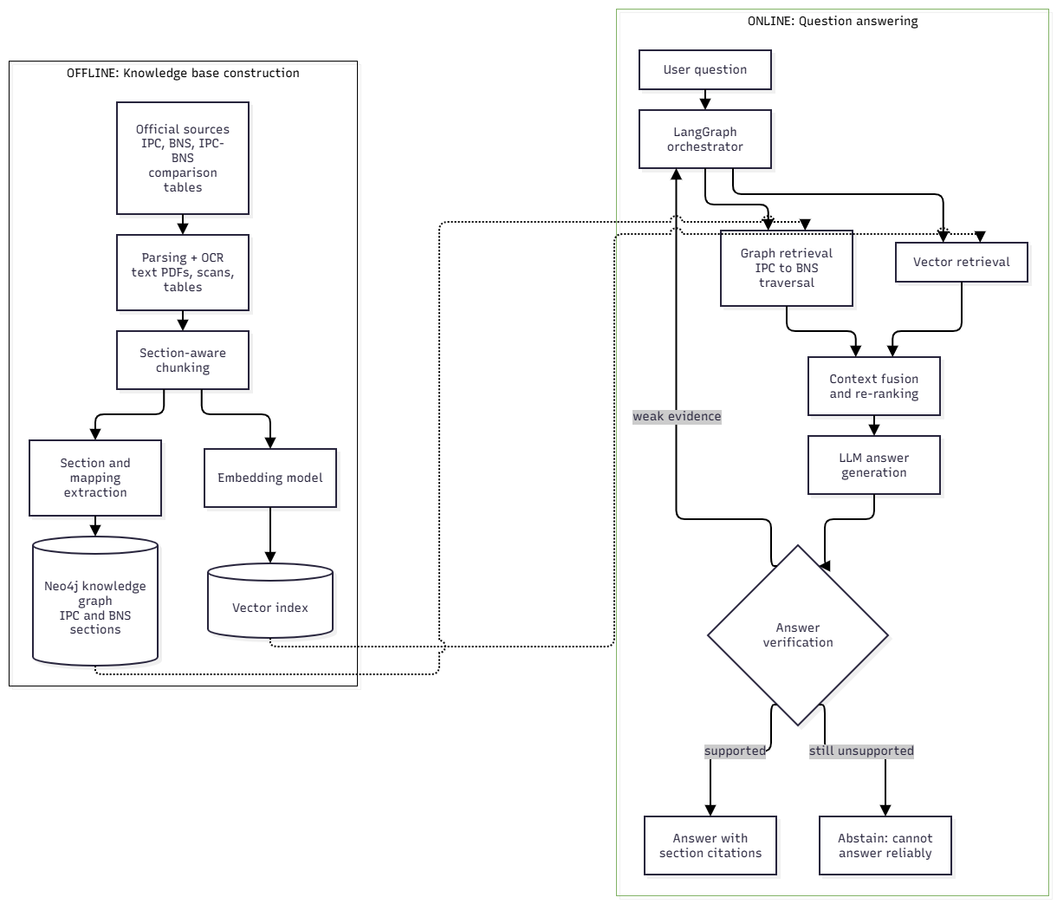
High Level Design

Slide 17
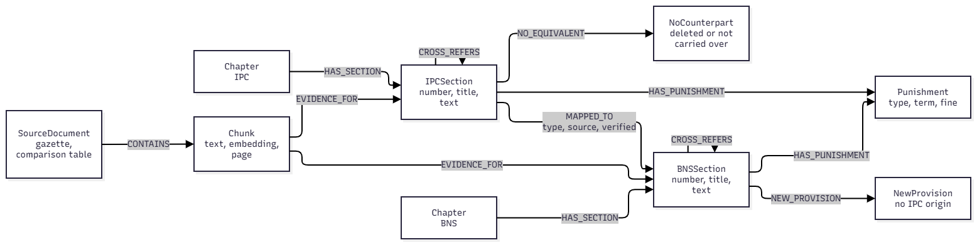
Detailed Design: Knowledge Graph Schema

Slide 18
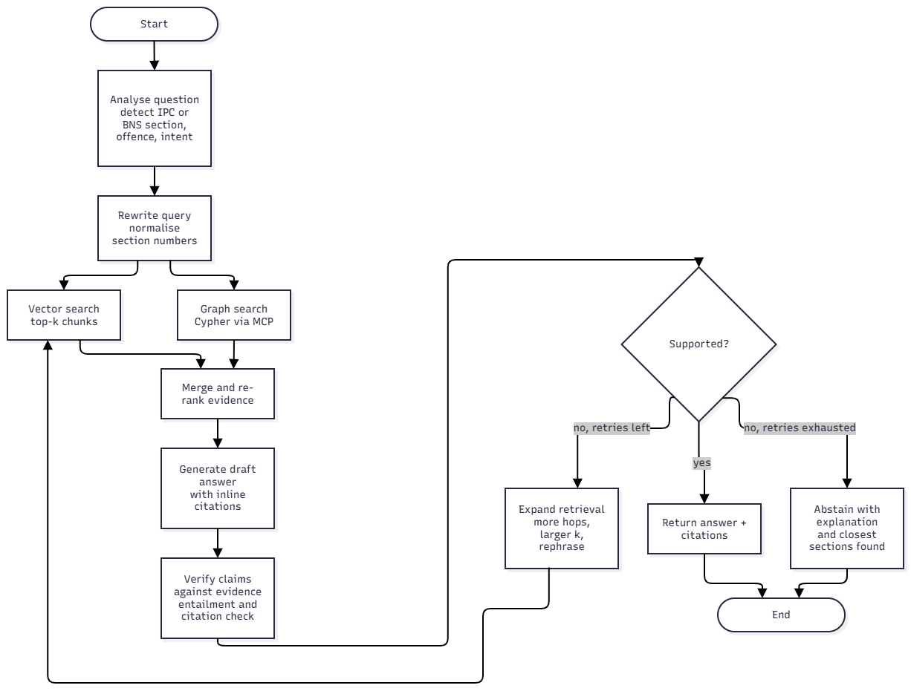
Detailed Design: LangGraph Workflow

Slide 19
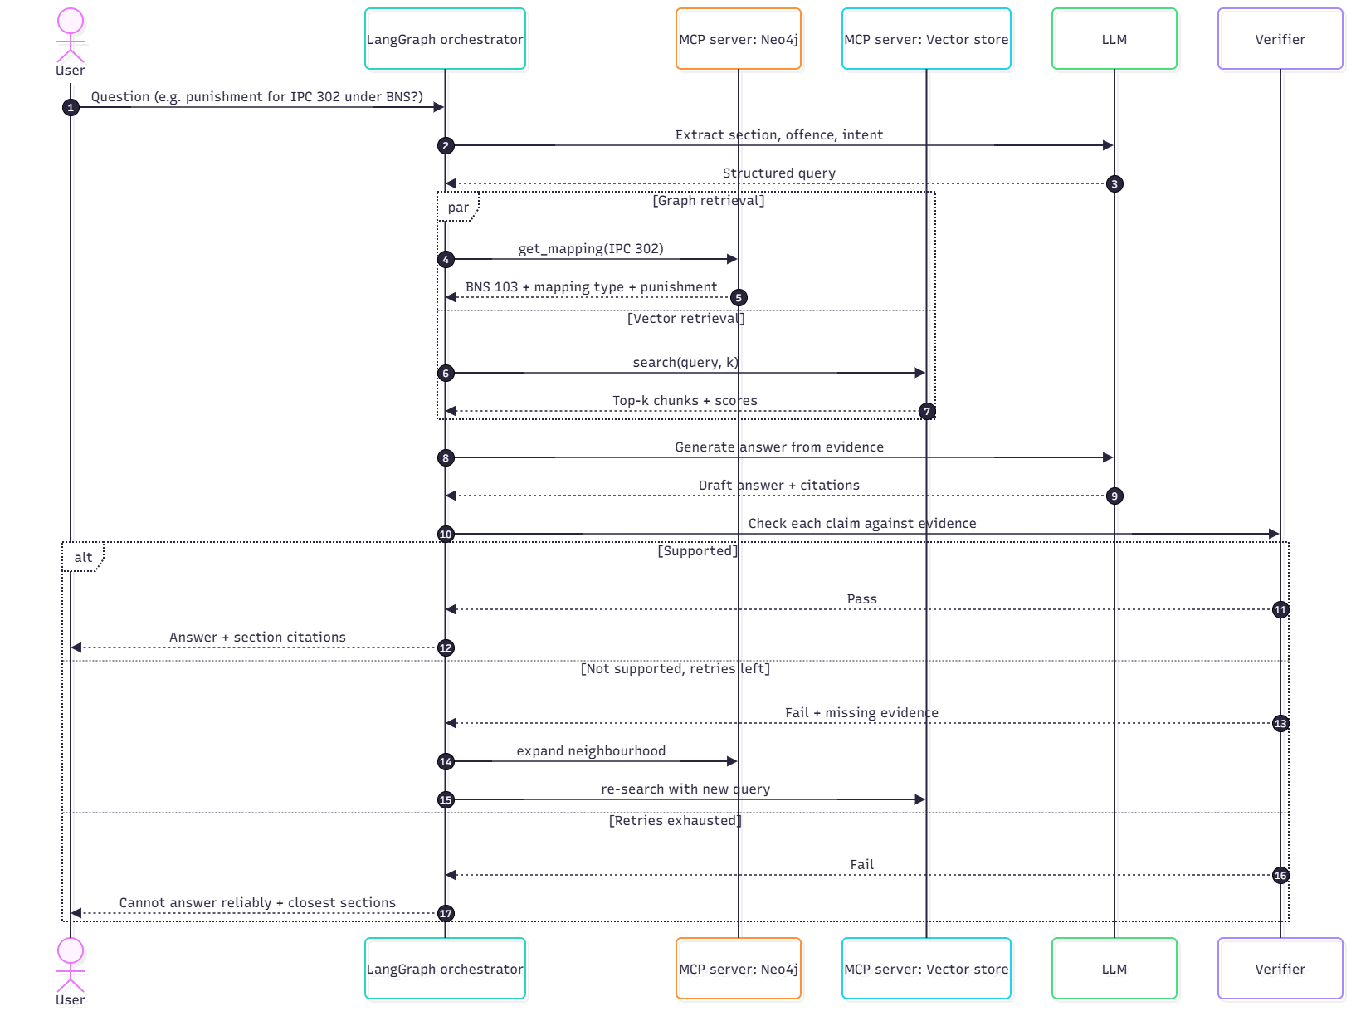
Detailed Design: MCP Tool Interaction

Slide 20
Software and Hardware Requirements
Category | Proposed requirement
Language | Python 3.10+
Graph database | Neo4j (Cypher queries)
Workflow and tools | LangGraph for orchestration; MCP for tool connections
Vector search | Vector store such as FAISS or ChromaDB, with a sentence-embedding model (to be finalised)
LLM | Open-source or API-based LLM for generation and verification (to be finalised)
Document processing | PDF parsing, OCR and table extraction tools (to be finalised)
Hardware | Laptop/PC with multi-core CPU and 16 GB RAM; GPU or cloud notebook if needed

Slide 21
Functionalities of the Modules
Module | Functionality
Document Processing | Parses IPC, BNS and comparison-table PDFs; applies OCR to scanned pages; extracts tables; splits text section by section.
Knowledge Graph Builder | Creates IPC and BNS section nodes and MAPPED_TO links (exact, merged, split, modified); marks sections with no replacement.
Vector Index | Embeds section chunks and stores them for semantic search.
Retrieval | Fetches semantically similar text and follows IPC–BNS links in the graph; merges and ranks the evidence.
Answer Generation | LangGraph workflow that analyses the question, calls retrieval tools via MCP and drafts an answer with citations.
Answer Verifier | Checks each claim against the evidence; triggers re-search or declines to answer if unsupported.
Evaluation | Runs the test questions on every configuration and computes the comparison metrics.

Slide 22
Proposed Implementation Plan
Phase | What we will do | Output
1. Data collection | Collect official IPC and BNS texts and the IPC–BNS comparison table; run OCR on scanned pages and extract tables. | Cleaned, section-wise corpus
2. Knowledge graph | Create IPC and BNS section nodes and MAPPED_TO links with mapping types; add links for sections with no direct counterpart; get mappings checked by a law student. | Verified IPC–BNS graph in Neo4j
3. Graph-RAG pipeline | Build the vector index; build the LangGraph workflow (analyse, retrieve from vector and graph, merge, generate); expose Neo4j and the vector store as MCP tools. | Working QA system
4. Verification and evaluation | Add the verifier (check, retry or decline, cite); build the 75–100 question test set; run all configurations. | Results and comparisons

Slide 23
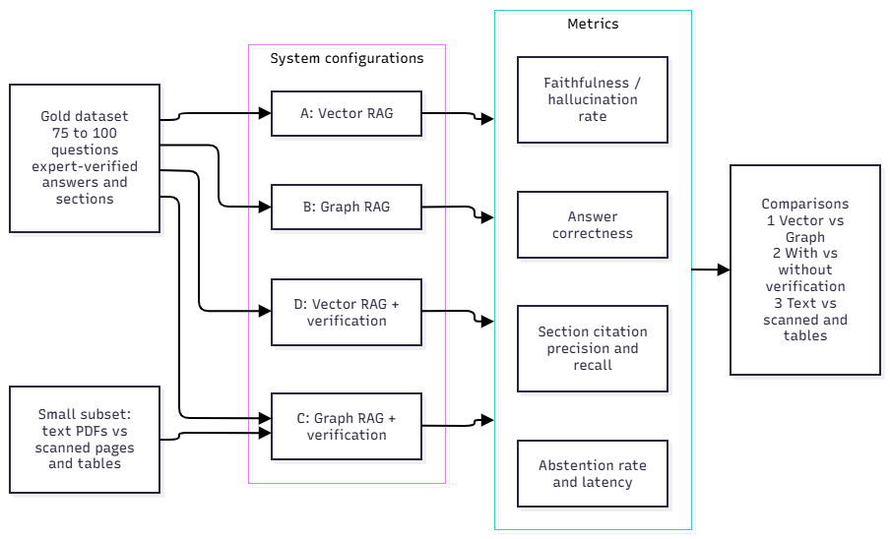
Evaluation Plan

Slide 24
Evaluation Plan
Planned comparisons: (1) vector-based RAG vs graph-based RAG; (2) system with vs without answer verification; (3) text-based retrieval vs retrieval involving scanned documents and tables, on a smaller test set.
Test dataset: 75–100 Indian criminal-law questions; correct answers and relevant sections verified by a law student or legal practitioner.
Metrics: answer correctness, citation precision and recall, hallucination rate, abstention rate and response time.
Expected outcome (hypothesis): graph retrieval improves IPC–BNS mapping questions, and verification reduces unsupported answers. To be tested.

Slide 25
Applications
Citizen legal awareness: check what an old IPC section is now called in the BNS and what it says, with cited sources.
Police and legal practitioners: quick IPC-to-BNS conversion for case files and documents that still cite the IPC.
Law students and teaching: a study aid that links old and new provisions with verifiable citations.
Other legal domains: the graph-RAG-with-verification design can be reused for other statutes and for fields where wrong answers are costly.

Slide 26
References
[1] Mubeen, F., Mehdi, A., Haque, M.A., Nomani, M.Z.M. and Uddin, N.S., “Redefining legal access: a RAG-based AI system for Indian law”, Human-Intelligent Systems Integration, Volume 7, Page no. 87–98, 2025. DOI: https://doi.org/10.1007/s42454-025-00086-8
[2] Wahidur, R.S.M., Kim, S., Choi, H., Bhatti, D.S. and Lee, H.-N., “Legal Query RAG”, IEEE Access, Volume 13, Page no. 36978–36994, 2025. DOI: https://doi.org/10.1109/ACCESS.2025.3542125
[3] Buffa, M., Ferrara, A., Picascia, S., Riva, D. and Castano, S., “Enhancing legal document building with Retrieval-Augmented Generation”, Computer Law & Security Review, Volume 59, Article no. 106229, 2025. DOI: https://doi.org/10.1016/j.clsr.2025.106229
[4] Cui, J., Shen, X. and Wen, S., “A Survey on Legal Judgment Prediction: Datasets, Metrics, Models and Challenges”, IEEE Access, Volume 11, Page no. 102050–102071, 2023. DOI: https://doi.org/10.1109/ACCESS.2023.3317083
[5] Bhatnagar, M. and Huchhanavar, S.S., “Enhancing legal assistance with AI: a comprehensive approach to intent classification and domain specific model tuning”, Artificial Intelligence and Law, Springer Nature, 2025. DOI: https://doi.org/10.1007/s10506-025-09441-1
[6] Yue, L., Liu, Q., Jin, B., Wu, H. and An, Y., “A Circumstance-Aware Neural Framework for Explainable Legal Judgment Prediction”, IEEE Transactions on Knowledge and Data Engineering, Volume 36, Issue 11, Page no. 5453–5467, 2024. DOI: https://doi.org/10.1109/TKDE.2024.3387580
[7] Chi, X., Wang, W., Zhang, Z., Li, A., Huang, Y., Wu, Y., Kuang, K., Sun, C., Liu, X., Wu, F. and Xiong, M., “LegalAI Research in LLM Era: Data, Modeling and Evaluation”, Artificial Intelligence Review, Volume 59, Article no. 118, 2026. DOI: https://doi.org/10.1007/s10462-026-11514-9
[8] Dehghani, F., Dehghani, R., Naderzadeh Ardebili, Y. et al., “Large Language Models in Legal Systems: A Survey”, Humanities and Social Sciences Communications, Volume 12, Article no. 1977, 2025. DOI: https://doi.org/10.1057/s41599-025-05924-3
[9] Liu, Q., Yu, H., Wang, Q., Xu, Q., Li, J., Zou, Z., Mao, R. and Cambria, E., “Legal knowledge infusion for large language models: A survey”, Information Fusion, Volume 125, Article no. 103426, 2026. DOI: https://doi.org/10.1016/j.inffus.2025.103426
[10] Lai, J., Gan, W., Wu, J., Qi, Z. and Yu, P.S., “Large language models in law: A survey”, AI Open, Volume 5, Page no. 181–196, 2024. DOI: https://doi.org/10.1016/j.aiopen.2024.09.002
[11] Siino, M., Falco, M., Croce, D. and Rosso, P., “Exploring LLMs Applications in Law: A Literature Review on Current Legal NLP Approaches”, IEEE Access, Volume 13, Page no. 18253–18276, 2025. DOI: https://doi.org/10.1109/ACCESS.2025.3533217
[12] Wang, X., Zhang, X., Hoo, V., Shao, Z. and Zhang, X., “LegalReasoner: A Multi-Stage Framework for Legal Judgment Prediction via Large Language Models and Knowledge Integration”, IEEE Access, Volume 12, Page no. 166843–166854, 2024. DOI: https://doi.org/10.1109/ACCESS.2024.3496666
[13] Masih, S., Hassan, M., Fahad, L.G. and Hassan, B., “Transformer-Based Abstractive Summarization of Legal Texts in Low-Resource Languages”, Electronics, Volume 14, Issue 12, Article no. 2320, 2025. DOI: https://doi.org/10.3390/electronics14122320
[14] Zheng, T., Shen, S. and Zeng, C., “A Retrieval-Augmented Generation Method for Question Answering on Airworthiness Regulations”, Electronics, Volume 14, Issue 16, Article no. 3314, 2025. DOI: https://doi.org/10.3390/electronics14163314
[15] Naser, M.Z., “Hallucinations in generative artificial intelligence and large language models: tests, datasets, detection and correction methods”, Language Resources and Evaluation, Volume 60, Article no. 64, 2026. DOI: https://doi.org/10.1007/s10579-026-09938-4
[16] The exact title “Evaluation of open and closed-source LLMs for a low-resource language” could not be verified against a matching publisher record. Confirm the original article or DOI before including it.
[17] Salim, M.S., Hossain, S.I., Jalal, T., Bose, D.K. and Basher, M.J.I., “LLM based QA chatbot builder: A generative AI-based chatbot builder for question answering”, SoftwareX, Volume 29, Article no. 102029, 2025. DOI: https://doi.org/10.1016/j.softx.2024.102029
[18] Hindi, M., Mohammed, L., Maaz, O. and Alwarafy, A., “Enhancing the Precision and Interpretability of Retrieval-Augmented Generation (RAG) in Legal Technology: A Survey”, IEEE Access, Volume 13, Page no. 46171–46189, 2025. DOI: https://doi.org/10.1109/ACCESS.2025.3550145
[19] Garg, S., Bysani, H., Chandana, S.S. et al., “Multifaceted structural classification of Indian legal judgments”, Discover Artificial Intelligence, Volume 6, Article no. 282, 2026. DOI: https://doi.org/10.1007/s44163-026-01035-3
[20] Prabhakar, P. and Pati, P.B., “Enhancing Indian legal judgment classification with embeddings, feature selection, and ensemble strategies”, Artificial Intelligence and Law, Volume 34, Issue 2, Page no. 523–564, 2026. DOI: https://doi.org/10.1007/s10506-025-09438-w

Slide 27
THANK YOU
Notes:
ap

