Slide 1

ADS Presentation
Presented By:
1) Poonam S. Katale 2018BTECS00209
2) Vaishnavi C. Bharambe 2018BTECS00214
3) Shreya A. Kulkarni 2018BTECS00217
Guided By: Prof. H. V. Gandhi

Slide 2
Problem Statement
Implement Total Correspondence method for Double ended heap. Analyze your results by varying different parameters over sequence of operations.

Slide 3
Operations on Total Correspondance Method
Insert elements
Build Min/Max Heap
Get Min/Max element
Delete Min/Max element

Slide 4
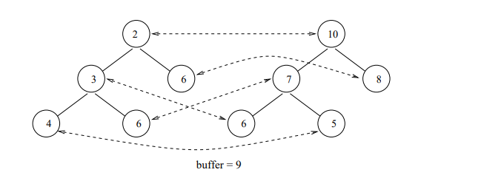
1) Insert elements and Build Heaps
Elements 3 6 4 5 6 8 6 7 2 10

Slide 5
2) Get Min/Max element
1) Minimum element returned will be 2
2) Maximum element returned will be 10

Slide 6
4)Delete Min/Max element
1) Minimum element deleted will be 2 and its corresponding element
10 will be deleted and heap will be rebuild again 10 will now go into
buffer
2) Maximum element deleted will be 10 as it in buffer and it is maximum

Slide 7
Thank You!!!!

