Slide 1

LOW-CODE PROJECT | ZOHO CREATOR
Company Leave Management System
Automating leave requests, approvals and balances with Deluge, Blueprint and CRM integration
Shreya Amudhu N R
Roll No. 240701505 | CB23F35 Low-Code Application Development
Rajalakshmi Engineering College | November 2026
Notes:
Introduce the project: a centralised HR leave application built entirely on Zoho Creator, as the individual project for CB23F35.

Slide 2




Leave Tracking Is Fragmented and Error-Prone
THE MANUAL PROCESS TODAY
WHAT GOES WRONG
1
Employee asks via WhatsApp, phone or email
2
Manager replies informally or forwards to HR
Duplicate records
Calculation errors
Employee, leave-type and balance data repeated across files
Manual used and remaining days lead to disputes
3
HR records it in Excel or a paper register
4
HR calculates used and remaining days by hand
No over-booking control
No visibility or security
5
Year-end consolidation for admin and payroll
Requests beyond the available balance are not blocked
Shared files expose personal data; no live dashboard
Notes:
Walk through the manual process on the left, then the four consequences on the right. These come from the system study in Chapter 2.

Slide 3
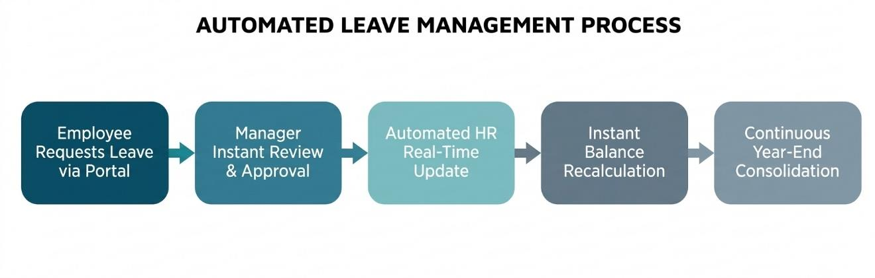
The Solution: One Automated Source of Truth
01
Normalised data model across 7 forms
02
Deluge validation, balance updates and reminders
03
Blueprint approval plus a separate extra-leave process
7
10
04
Role-based reports, calendar, kanban and dashboard
Forms
Reports
05
Zoho CRM sync and e-mail notifications
12
4
06
Secure access through roles and field-level rules
Deluge scripts
User roles
Notes:
The proposed system replaces every manual step with a structured, automated one. Mention the headline numbers: 7 forms, 10 reports, 12 scripts, 4 roles.

Slide 4

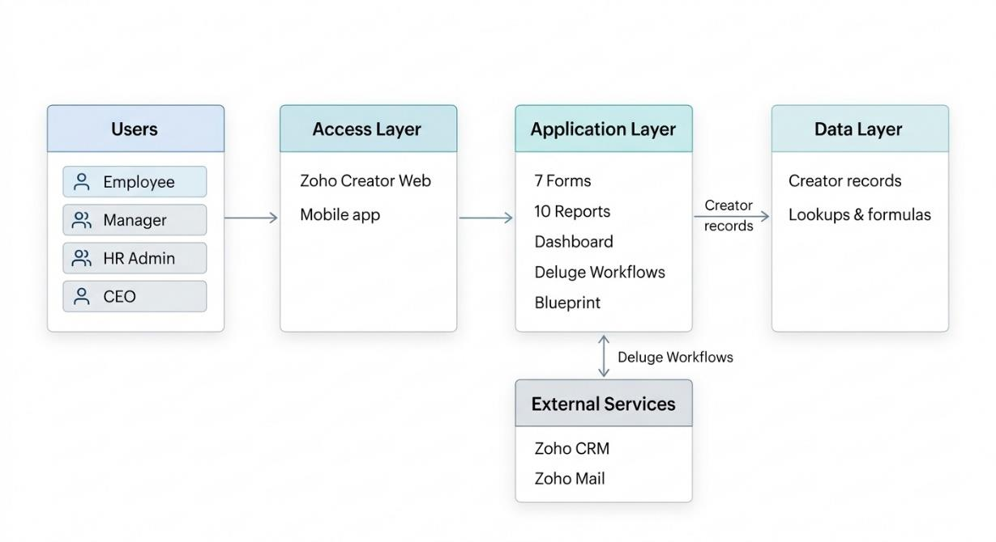




System Architecture
Users
Employee, Manager, HR Admin, CEO
Access
Zoho Creator web and mobile app
Application
7 forms, 10 reports, dashboard, workflows, Blueprint
Data
Creator records with lookups and formulas
External
Zoho CRM and Zoho Mail via Deluge
Notes:
Four layers: users, access, application and data, with CRM and Mail as external services reached through Deluge.

Slide 5
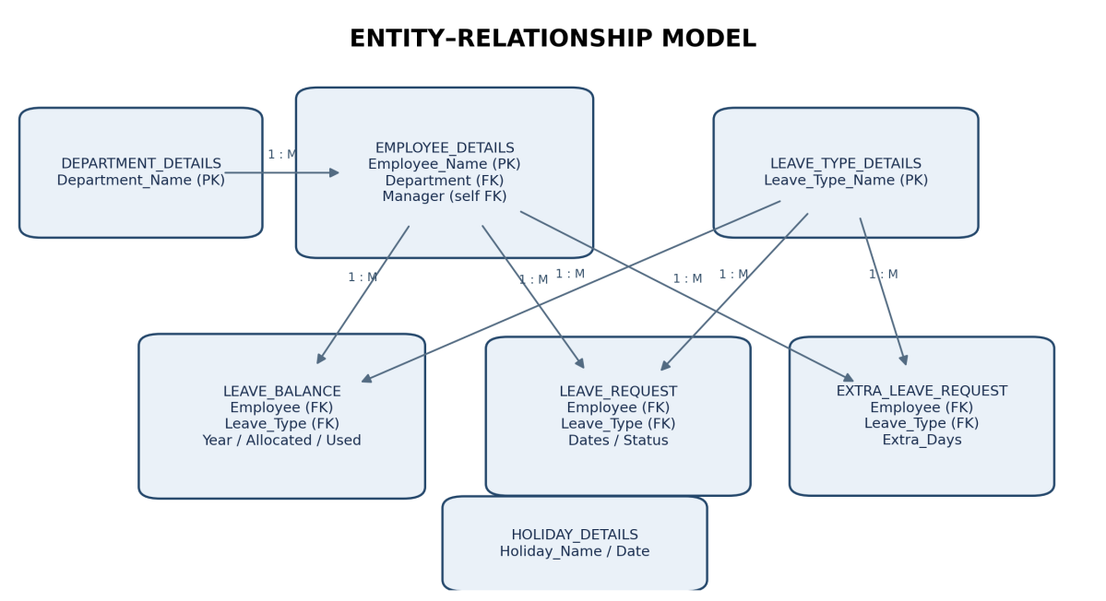
Data Model and Relationships
Department → Employee
One-to-many through a Department lookup
Employee → Manager
Self-referencing lookup; manager email auto-fills
Employee + Leave Type
Feed Balance, Request and Extra Leave forms
Balance ↔ Request
Matched in Deluge on employee, type and year
Sample dataset loaded in the application
Remaining Days
8 Depts
10 Employees
8 Leave types
10 Balances
10 Requests
6 Extra
8 Holidays
Formula field: Allocated minus Used
Notes:
Department is one-to-many with Employee; Employee has a self lookup for the manager. Leave Type and Employee both feed the three transaction forms. Holiday is standalone.

Slide 6
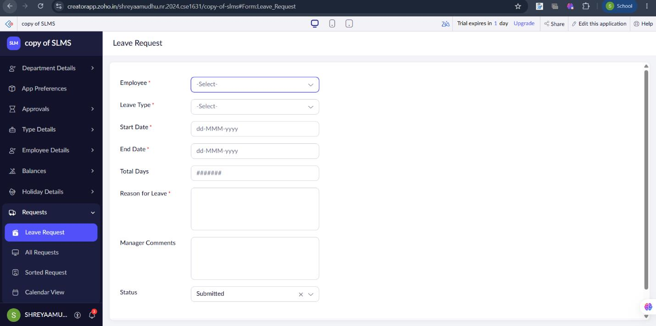
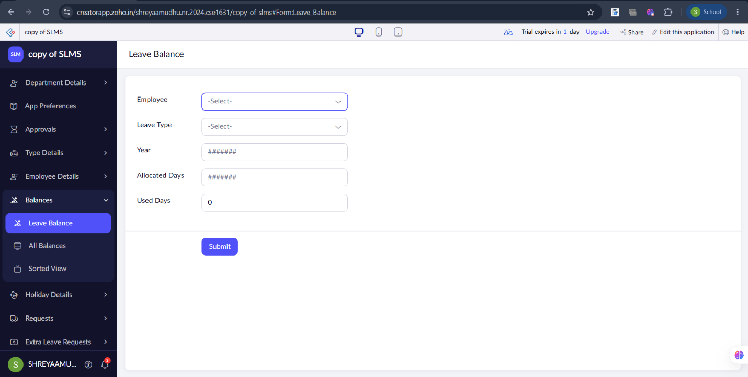



Forms and Data Capture
Leave Request: employee, type, dates, days, reason, status
Leave Balance: yearly allocated, used and remaining days
Lookups
Defaults and formulas
Validations
Employee, type, department and manager link forms
Status = Submitted, Used Days = 0, Remaining Days calculated
Mandatory fields and duplicate balance protection
Notes:
Show the two key forms. Leave Request defaults to Submitted; Leave Balance holds the yearly allocation that validation reads.

Slide 7
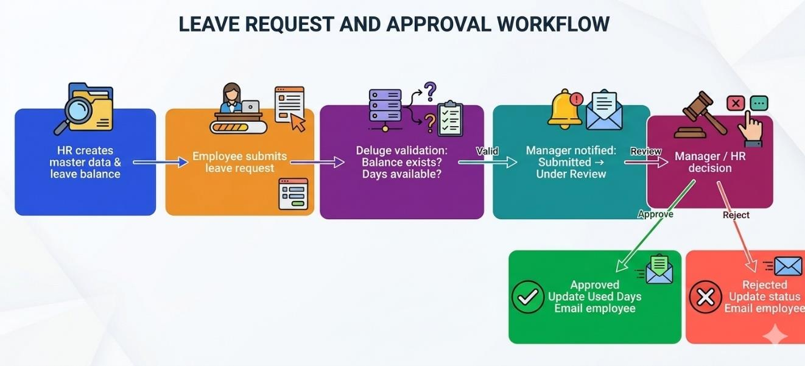



Leave Request and Approval Workflow
BLUEPRINT STAGES
Submitted
Under Review
Approved
Rejected
Pre-checks
Instant alert
Daily reminder
Balance must exist and cover the days
Manager is e-mailed on submission
Scheduled mail for pending requests
Notes:
Trace a request from HR setup to a manager decision. Approval updates used days and e-mails the employee; rejection updates status and e-mails the employee.

Slide 8
Deluge Automation: Business Rules in Code
DS-02 Leave Request validation
DS-02
DS-03
bal = Leave_Balance[Employee == input.Employee
&& Leave_Type == input.Leave_Type
&& Year_field == input.Start_Date.getYear()];
if(bal.count() == 0)
{
alert "No leave balance is set up.";
cancel submit;
}
else if(input.Total_Days > bal.Remaining_Days)
{
alert "Only " + bal.Remaining_Days
+ " day(s) remaining.";
cancel submit;
}
Validate balance and remaining days
E-mail manager on submission
DS-05
DS-06
Auto-fill allocation, sum approved days
Search and upsert Zoho CRM contact
DS-07
DS-11
Daily pending-request reminder
Approval: update Used Days, notify
Notes:
Twelve Deluge scripts power validation, notifications, balance updates, CRM sync and approval actions. The snippet is the real balance validation from the application.

Slide 9
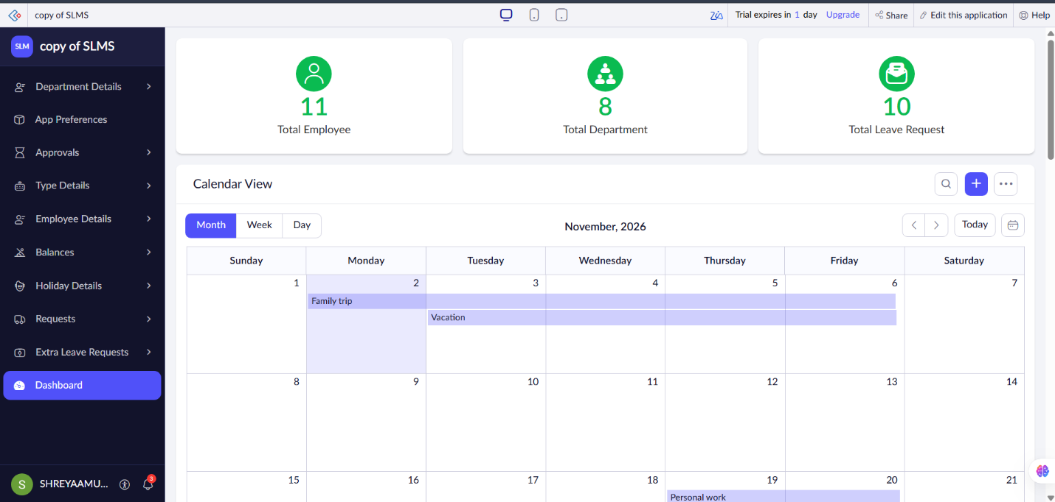
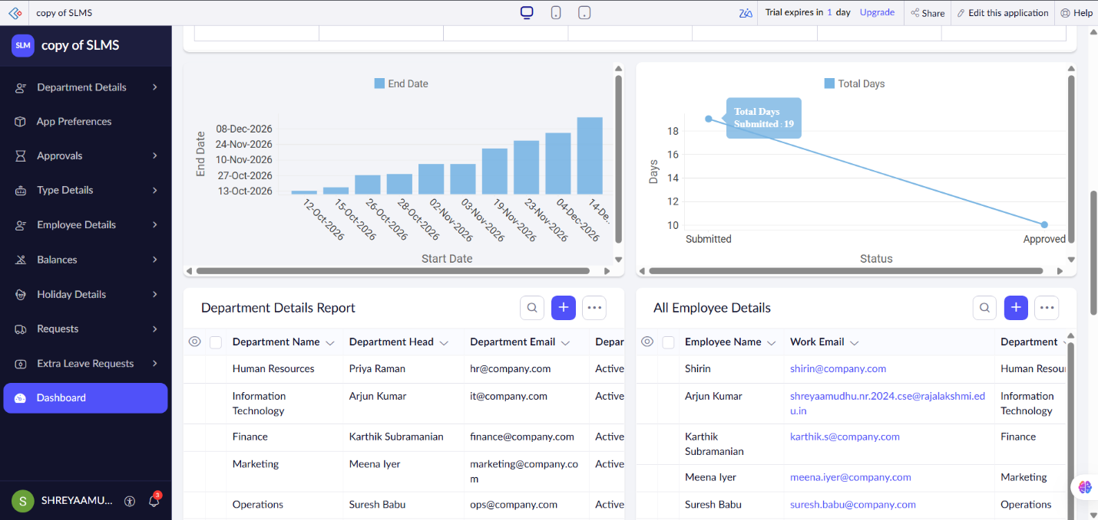
Reports and Management Dashboard
7
2
1
3
List reports
Kanban reports
Calendar
KPI panels
Quick and detail views
Grouped by leave type
Requests by date range
Employees, departments, requests
Notes:
Dashboard shows total employees, departments and leave requests, a calendar, charts and embedded reports. Ten reports: seven list, two kanban, one calendar.

Slide 10
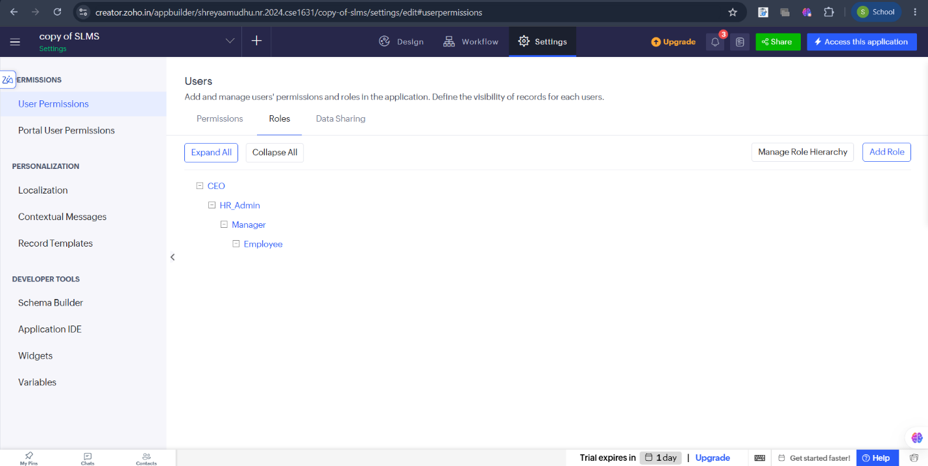


Integrations and Role-Based Security
Zoho CRM
Employee save searches contacts by e-mail, then updates or creates the contact.
Zoho Mail
Manager alerts, decision e-mails and daily pending reminders via sendmail.
CEO
›
HR Admin
›
Manager
›
Employee
Access control
Role hierarchy: profiles control access to forms, reports and fields
Employees get read-only identity fields and cannot run approval transitions.
Notes:
Role hierarchy CEO to HR Admin to Manager to Employee. Employee profiles make identity fields read-only and block approval transitions. CRM sync uses a Creator connection.

Slide 11
Testing and Results
18 / 18
test cases passed
as recorded in the report
Validation scenario
Earned Leave balance: 15 allocated, 10 used, 5 remaining
5-day request: accepted
6-day request: blocked with "Only 5 day(s) remaining"
29 days across 10 requests: Casual 4 requests, Earned 4 requests, Sick 2 requests.
All requests start as Submitted until moved through the Blueprint.
Notes:
18 documented test cases covering validation, workflow, permissions, reminders and the dashboard. Leave data: Casual 6 days over 4 requests, Earned 19 over 4, Sick 4 over 2. Rahul Menon scenario: 5 days remaining, so a 6-day request is blocked.

Slide 12


Known Limitations and Future Roadmap
Current limitations
Future enhancements
Total Days is entered manually, not calculated
Maximum Consecutive Days is stored, not enforced
No overlap, weekend or holiday checks
Possible double update of Used Days by duplicate scripts
Half-day leave and carry-forward out of scope
Auto-calculate working days minus holidays
Enforce consecutive-day limits and overlap checks
Half-day leave, year-end rollover, auto balances
Multi-level approval with escalation
Zoho Analytics, payroll and Zoho People links
Mobile push, Slack, WhatsApp or Cliq alerts
Notes:
Be upfront about the limits: Total Days is manual, maximum consecutive days is stored but not enforced, and overlaps/weekends/holidays are not checked. The roadmap addresses each of these.

Slide 13



Conclusion
One source of truth
Automation that enforces rules
Controlled and visible
Seven linked forms replace scattered spreadsheets and chat threads.
Deluge, Blueprint, schedules and CRM sync cut manual follow-up.
Roles, field rules, ten reports and a live dashboard.
Thank you
Shreya Amudhu N R | Roll No. 240701505 | Questions welcome
Notes:
Close with the three takeaways, then invite questions.

