Slide 1
Virtual Campus Tour
Disha Nayak 4MW22AD016
Izma Ilyas 4MW22AD018
Shravani 4MW22AD049
Shreya S Kharvi 4MW22AD054
Guide:- Ms. Megha Rani
Department of Artificial Intelligence and Data Science Engineering
Date: 04-12-2024

Slide 2
Summary of previous presentation
The presentation focuses on the development of a Virtual Campus Tour aimed at providing an immersive and accessible way for prospective students and stakeholders to explore campus locations remotely. Using technologies like panoramic imaging, virtual reality , and image stitching, the project seeks to create a realistic and interactive experience. It highlights the relevance of such tours in enhancing accessibility, safety, convenience, and informed decision-making.
However, challenges such as high development costs, technical issues, limited user interaction, and the need for frequent content updates are acknowledged. Existing gaps include ensuring accessibility for users with disabilities, maintaining scalability, and achieving high-quality panoramic images. The primary objectives are to make campus information widely accessible, create an immersive virtual experience, and incorporate interactive features while addressing the challenges of user comfort and content maintenance. This innovative approach leverages modern technology to showcase campuses effectively to a global audience.

Slide 3
Objectives
Accessibility: Make campus information accessible to a wider audience, ensure the virtual tour is accessible to users with disabilities.
Immersion: Create a realistic and immersive virtual experience that simulates an on-campus visit.
Personalization: Allow users to customize their tour based on their interests and academic goals.
Interactivity: Provide interactive elements, such as clickable points of interest and virtual reality experiences, to enhance engagement. Ensure the virtual tour is accessible to users with disabilities.

Slide 4
Problem Statement for the Virtual Tour Project
The aim of this project is to create an interactive and immersive virtual tour website that allows users to explore various rooms or environments through panoramic images. The key challenge is to automate the stitching of multiple images into seamless panoramas, ensuring the images are properly resized for optimal performance and fast loading times. The website must be responsive and user-friendly, providing smooth navigation between different panoramas across different devices. Additionally, the project aims to deliver a secure and accessible online experience that enables users to explore the virtual tour seamlessly.

Slide 5
Literature Review
RESEARCH PAPER | AUTHOR | KEY FINDINGS
A Progressive Web App for Virtual Campus Tour." In 2021 International Conference on Computing, Communication and Green Engineering (CCGE). IEEE, 2021. | Harsh Shah, Vinayak Tupe, Amit Rathod, Sohel Shaikh and Nilesh Uke. | The project uses Unity3D to create an interactive virtual campus tour with 3D models, maps, quizzes, and tutorials, offering a cost-effective remote exploration solution. Future plans include AR/VR, personalization, and better accessibility.
"Web-based Campus Virtual Tour Application using ORB Image Stitching.“ (EECSI). IEEE, 2018 | Triyanna Widiyaningtyas, Didik Dwi Prasetya and Aji P Wibawa. | The study presents a web-based 360° virtual tour for the State University of Malang, using ORB image stitching for immersive campus panoramas, ensuring accessibility and effective asset promotion
Examining the Virtual Campus :Managing College Tours in Future.2014. | Nitin Narang,Yash Mankar,Parth Prabhu etc. | The integration of advanced technologies such as 360-degree cameras, virtual reality (VR), and augmented reality (AR) creates immersive experiences. Features like hotspots, audio guides, and widgets enrich user interaction by providing detailed insights into campus facilities and culture.
Virtual Reality 360 UTM Campus Tour with Voice Commands | Adlin Shaflina binti Azizo, Farhan bin Mohamed, Chan Vei Siang, Muhammad Ismail Mat Isham | The VR 360 UTM Campus Tour uses Unity3D and voice commands for immersive, low-cost campus navigation via VR headsets. It offers interactive exploration but relies on strong internet and quiet environments.

Slide 6
Methodology
Flowchart:
Image Collection
Image Stitching and Panaroma Motion
Web Deployment

Slide 7
Image Collection:
The image collection process is the foundational step of this virtual tour project. High-quality images of each room or space are captured to ensure a realistic and immersive virtual tour experience. For this, either a standard camera or a 360° camera can be used. If using a regular camera, multiple overlapping photos of each room are taken, ensuring around 30-50% overlap between consecutive images. This overlap is critical for effective image stitching later. This systematic approach ensures that the images are ready for processing and contribute to the seamless creation of panoramas.

Slide 8
2. Image Stitching and Panaroma Motion:
Image stitching is an activity in image processing by combining a set of images into a larger panorama image with a wider field of view of the scene .The goal of this process is to generate natural-looking mosaics free of artifacts that may occur due to some effects, such as relative camera motion, optical aberrations, and illumination changes . To generate stitched image we use image stitching algorithm
After a series of stitched images generate an image panorama, the next step is to apply motion techniques to rotate the panoramic image display, so it looks immersive like the original. To implement this module we use the HTML script combined with the jQuery library. The working of this module is to rotate the image left or right to display the entire picture. This approach provides visualization as if the image is moving and the user is like being in its original location.

Slide 9
3. Web Deployment:
The deployment of the virtual tour project involves hosting the website on a platform accessible to users, ensuring scalability, responsiveness, and ease of access. The deployment process includes setting up the necessary files, selecting a hosting platform, and ensuring proper configuration. For this virtual tour project, it involves uploading all the necessary files to a hosting platform.
To deploy the virtual tour website, the project files (HTML, CSS, JavaScript, and images) are uploaded to a hosting platforms. After uploading, the website is made live with a URL. The site is then tested for performance and compatibility on different devices and browsers. Optionally, HTTPS can be enabled for security, and a custom domain can be set for a personalized URL.

Slide 10
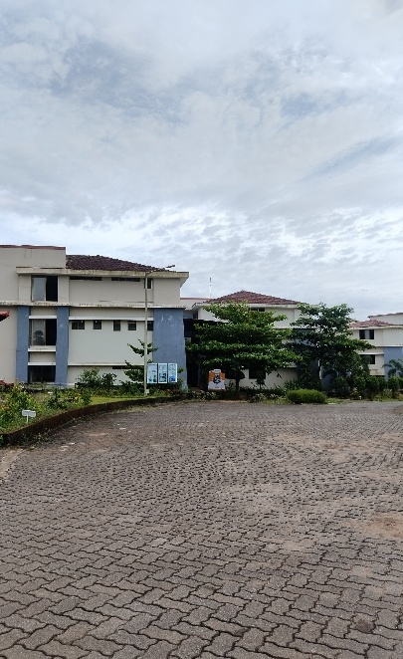
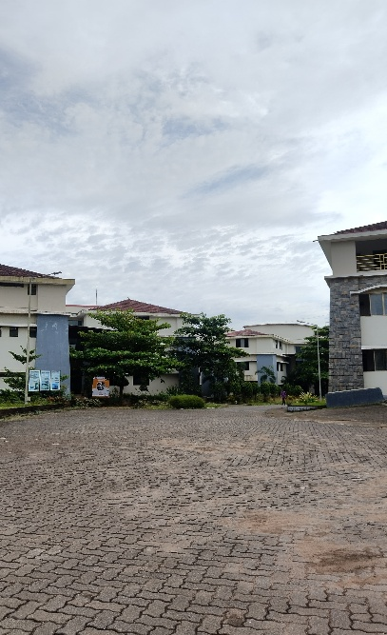
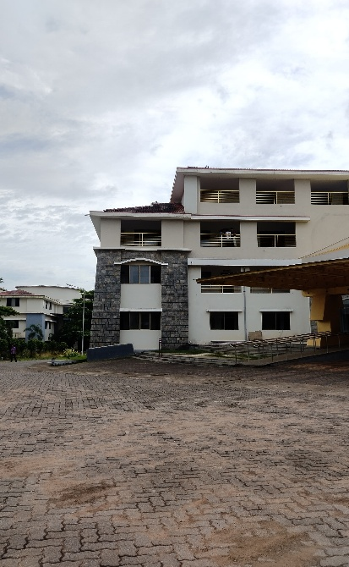
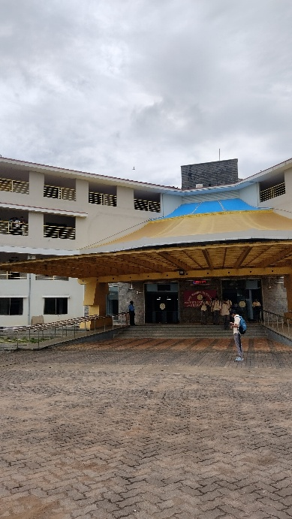
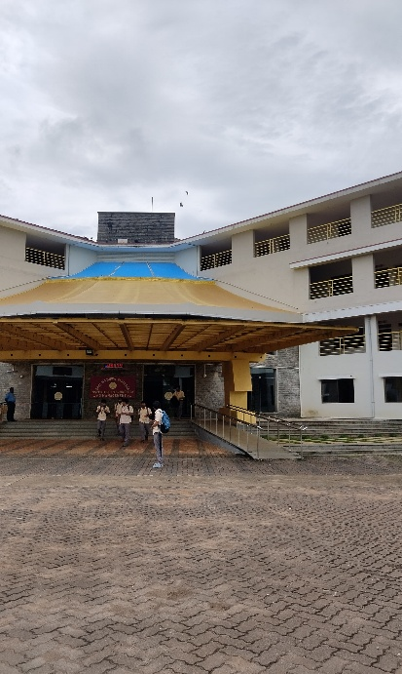
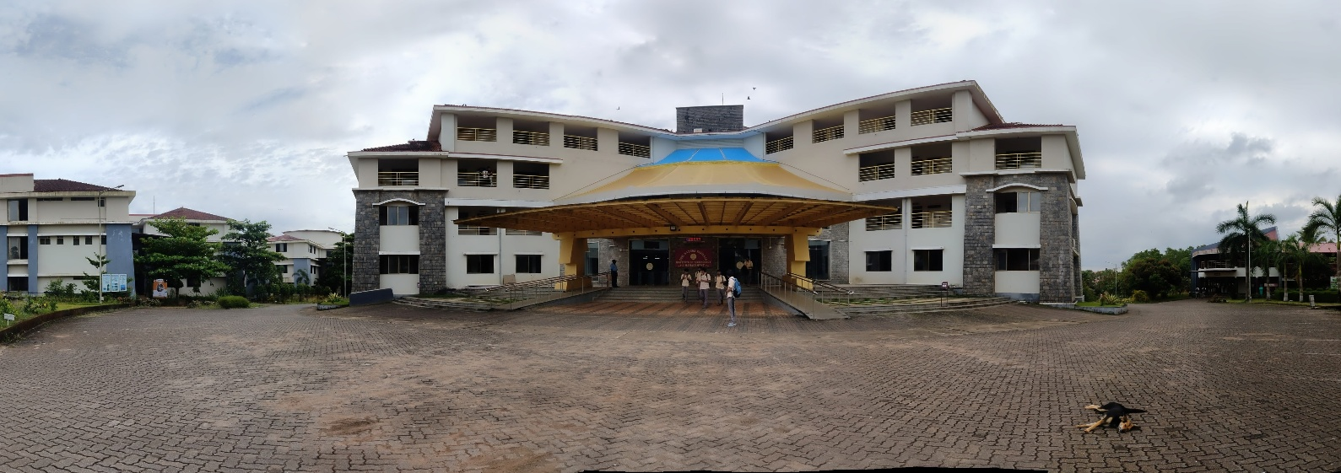
Data Samples

Slide 11
Model Selection
1. OpenCV ( cv2) :
OpenCV, the core module used in this project, is a powerful computer vision library that provides various functions for image and video processing. In this project, OpenCV is used for two main tasks: resizing images and stitching them into panoramas. The cv2.resize() function allows resizing images to an optimal size, ensuring faster processing without compromising quality. The cv2.createStitcher() method stitches multiple images together, seamlessly creating panoramic views of rooms for the virtual tour. OpenCV’s integration with numpy makes it efficient for handling image data.
2. HTML/CSS/JavaScript :
These three web technologies are used to build the front-end interface of the virtual tour. HTML structures the content, CSS styles the layout and ensures responsiveness across different devices, and JavaScript adds interactivity by enabling actions like navigating through different rooms and interacting with the panoramas. Together, they create an engaging and user-friendly experience for navigating the virtual tour.

Slide 12
Contents
A
Introduction
Relevance of the Work
Issues and Challenges
Literature Review
i. Existing Gaps
ii. Problem Statement
iii. Objectives
Methodology
References

Slide 13
Abstract
A College virtual tour provides a concise overview of the visual elements showcased in campus tour. It highlights key locations , facilities, and overall ambiance of the campus. 360 view of the different paths that leads to college infrastructure. This comprehensive approach to developing a college virtual tour website using virtual reality, modern web technologies.
The virtual tour leverages to display 360 degree images, allowing prospective students to explore campus locations interactively. The tool will examine the challenges and limitations of VR technology in this context, including technical issues, accessibility and cost considerations.

Slide 14
Introduction
In this era of rapid technological innovation, the idea presents an innovative approach to creating a virtual tour of a campus using photography, we capture panoramic images of campus landmarks or locations to create an immersive and iterative virtual experience.
Using this low-cost, readily replicable method, academic institutions may showcase their campuses globally, giving stakeholders and prospective students a feeling of accessibility and community.
The process entails using the power of contemporary photography to take high-resolution pictures, guaranteeing an exquisite portrayal of the campus landscape.
The resulting virtual tour improves the user experience overall with information overlays and straightforward navigation, in addition to being a useful marketing tool for colleges.
The innovative method for virtual campus tours is presented as a tool to encourage academic institutions to utilize technology for creating an engaging and welcoming environment for all participants.

Slide 15
Introduction
Relevance of the Work
Accessibility
Showcasing Facilities
Safety and convenience
Immersive experience
Informed Decision-Making

Slide 16
Introduction
ii. Issues and Challenges
Cost of Development: Creating high-quality VR content can be expensive. Colleges may need to invest in specialized equipment and software, as well as hire skilled professionals to produce the tours.
Technical Issues: VR experiences can be prone to technical glitches, such as lag or crashes, which can lead to frustration for users. Ensuring a smooth experience requires ongoing maintenance and updates.
User Experience: Some users may find VR disorienting or uncomfortable, particularly if they are not familiar with the technology. This can detract from the overall experience and may discourage them from using it.
Limited Interaction: While VR can provide a visual experience, it may lack the personal interaction that an in-person visit offers. Prospective students may miss out on engaging with current students or faculty during a VR tour.
Content Updates: Campuses change over time, and keeping VR content up to date can be a challenge. Colleges need to regularly update their tours to reflect new buildings, facilities, or changes in campus life.

Slide 17
Literature Review
Existing Gaps
User-Friendliness : The virtual tour should be accessible to users with disabilities . A user-friendly interface with clear navigation and information is essential for a positive user experience.
Scalability and Maintenance : As the campus grows and changes, the virtual tour needs to be easily updated and maintained . A scalable system is required to accommodate future expansions and technological advancements.
Accuracy and Quality : Stitching images from smartphones can lead to distortions or alignment issues, which may detract from the visual quality of the tour.
Manual and Time-Consuming Process : Even with mobile photography, the process of capturing high-quality panoramic images and stitching them together can be manual the time required for capturing and processing images may hinder the scalability of this method across larger campuses or in situations requiring frequent updates.

Slide 18
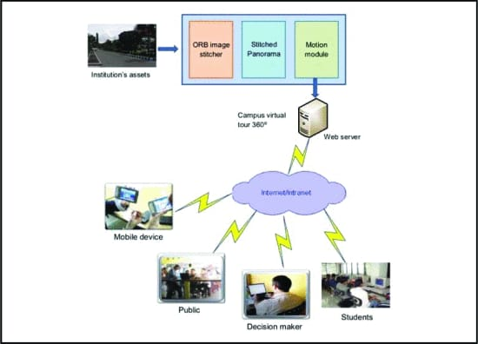
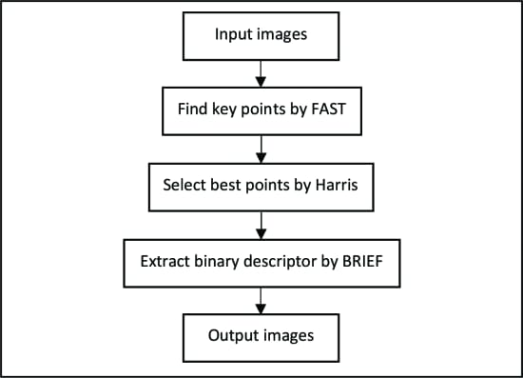
Methodology
Fig: ORB Image Stitching Stages
Fig: System Architecture

Slide 19
Methodology
System design:
This explains how to create a web-based virtual tour. It involves stitching multiple images together and enabling users to explore the resulting panorama.
Motion panorama:
To make the virtual tour immersive, the stitched panoramic image is rotated using HTML and jQuery. This creates the illusion of movement, as if the user is physically exploring the location.
ORB Image Stitching:
Image stitching is the basic construction process of a series of overlapping images into a single panoramic image with a high resolution. This activity is widely implemented in real-time applications and is an interesting topic in the field of computer vision and computer graphics experts.

Slide 20
References
Harsh Shah, Vinayak Tupe, Amit Rathod, Sohel Shaikh and Nilesh Uke. "A Progressive Web App for Virtual Campus Tour." In 2021 International Conference on Computing, Communication and Green Engineering (CCGE). IEEE, 2021.
Triyanna Widiyaningtyas, Didik Dwi Prasetya and Aji P Wibawa. "Web-based Campus Virtual Tour Application using ORB Image Stitching." 2018 5th International Conference on Electrical Engineering, Computer Science and Informatics (EECSI). IEEE, 2018

Slide 21
THANK YOU

