Slide 1

PROTOTHON 2025
Team: Vector

Slide 2
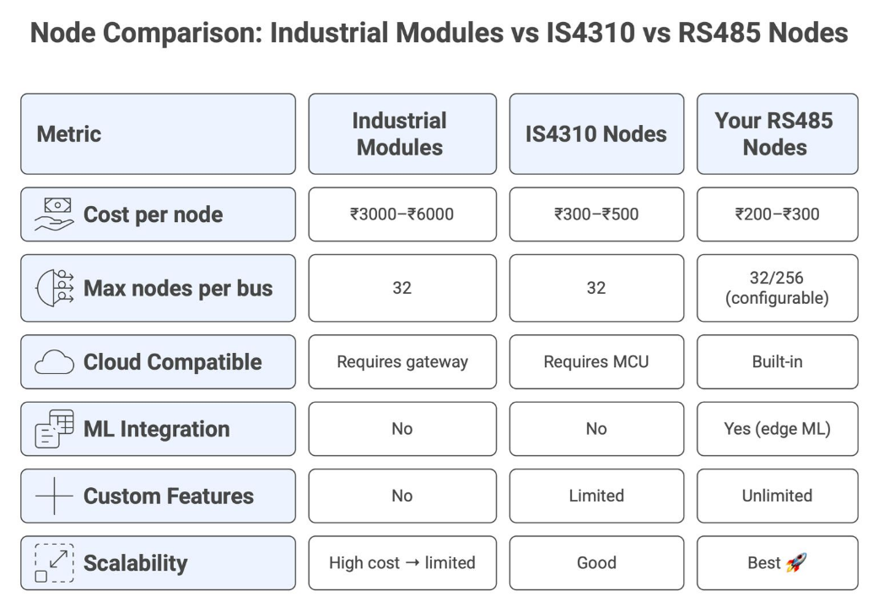
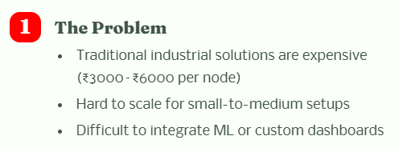
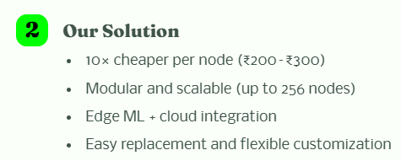
THE PROBLEM & OUR SOLUTION

Slide 3
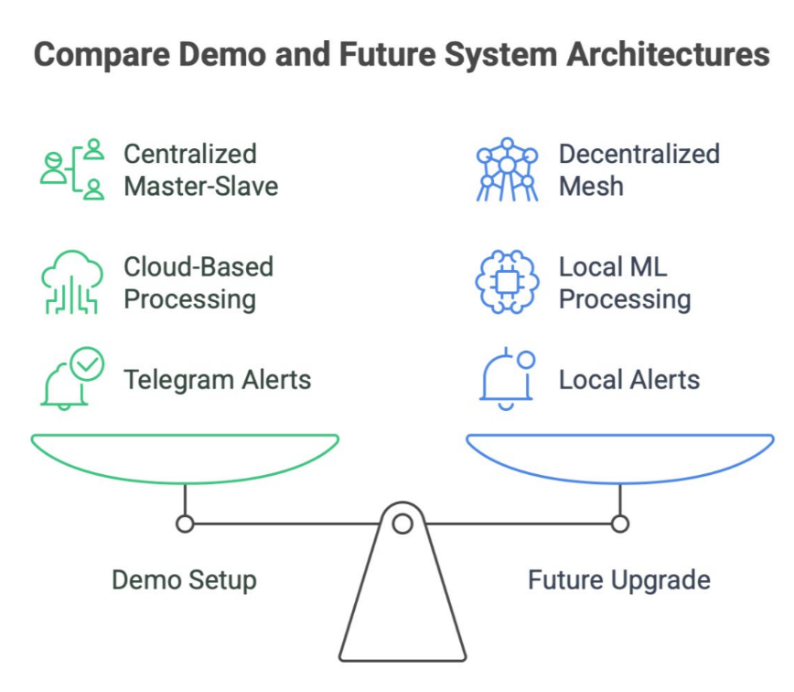
DEMO AND FUTURE UPGRADES
Demo Setup (What we are showing now):
1. Arduino/ESP32 nodes connected via RS485 Master-Slave bus
2. Real-time monitoring with Firebase cloud dashboard
3. Telegram alerts for anomaly detection
4. Works over long distances, reliable and industrial-grade
5. Simple, low-cost deployment (~₹200–₹300 per node)
Proposed Future Upgrade (ESP32 Mesh):
1. Decentralized ESP32 mesh network along with RS485→ no master node required
2. Local edge ML on each node for anomaly detection
3. Local dashboard served by mesh → works without internet
4. Fully scalable → additional nodes can join dynamically
5. Maintains all features of demo (alerts, dashboard) but more flexible & offline-ready

Slide 4
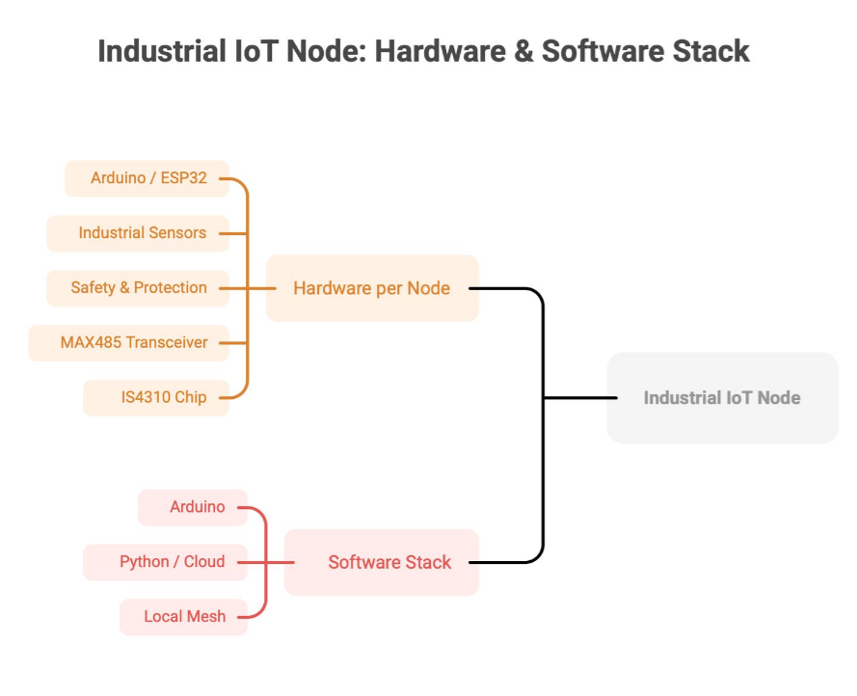
TECH STACK

Slide 5
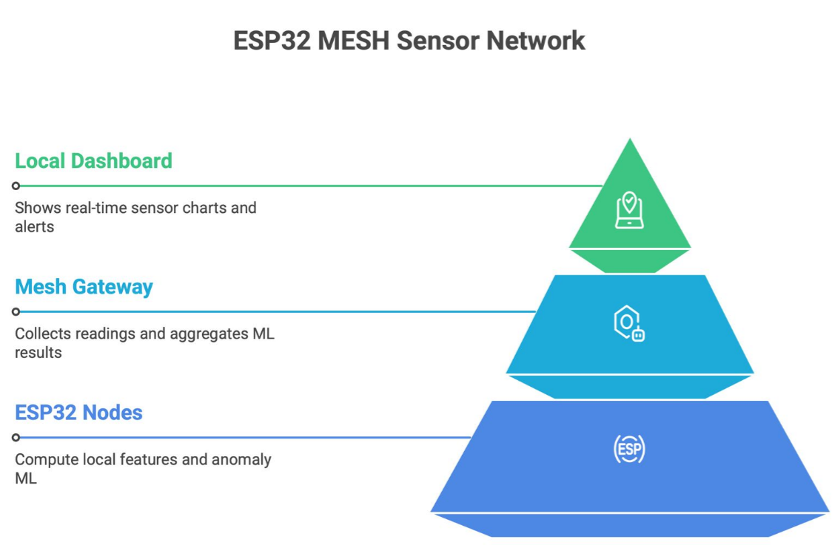
DOUBLE ADVANTAGE
Wired + Wireless
To prevent failure!! Not excluding RS485 , instead including ESP32

Slide 6
THANK YOU

